Slide 1
Expanding Off of Polaris
Rohit Mittal
Academic Research Presentation - 9/5

Slide 2
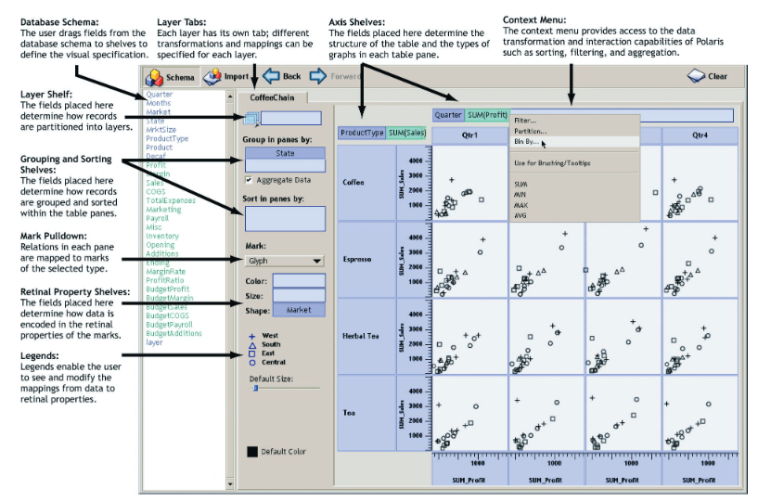

Slide 3
Summary
A visualization system for multidimensional databases
Handles the problem of how to show complex relationships and associations in a dataset
Multiple ways to express data that inform how visualizations are created (simplified to ordinal/quantitative)
Consideration for different tools
Sorting
Undo/redo
Tooltips

Slide 4
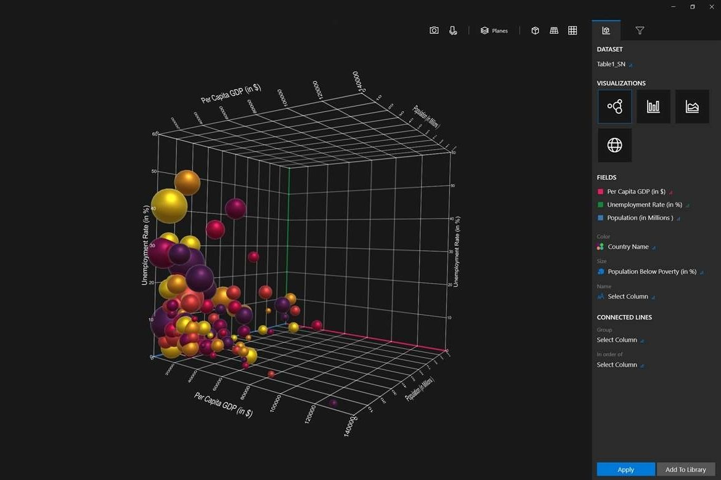
Extension - Why stop at 2d visualizations?
Source - https://datainnovation.org/2018/08/visualizing-data-in-3d/

Slide 5
Proposal
Augment Polaris to generate 3d visualizations of data
Humans can make intuitions about 3d spaces
Could be used to express hierarchy
Challenges
Appropriate interface (monitor and mouse? Keyboard? Holograms?)
Many different new data-type associations to think about
Animations

