Slide 1
Expanding off of Qetch
Rohit Mittal
Academic Research Presentation - 9/8

Slide 2
Summary
A way for humans to draw time series data and match it to existing data without needing to worry about accuracy and scale
Design influenced by how humans exaggerate when drawing visually salient features like peaks and troughs
Uses a system with regular expression to allow quick modification of the sketches (ex: repeating) a well as analysis over the data

Slide 3
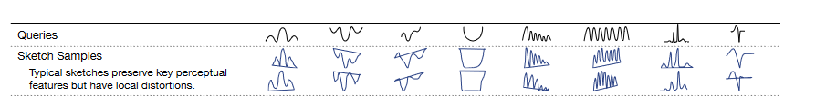
User Specific Qetch Calibration
Users likely have individual quirks when sketching
Measure specific user quirks with calibration and use that to inform matching algorithm

Slide 4
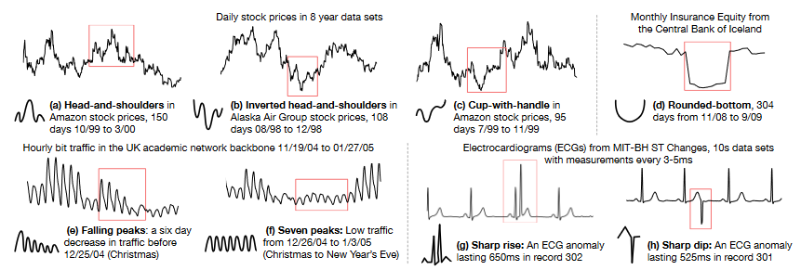
Machine Learning
Research insights when analyzing Qetch could be replicated using machine learning
Create a model which “calibrates” on sample user sketches
Model then takes Qetch inputs and modifies them based on how the user performed on samples

