Slide 1
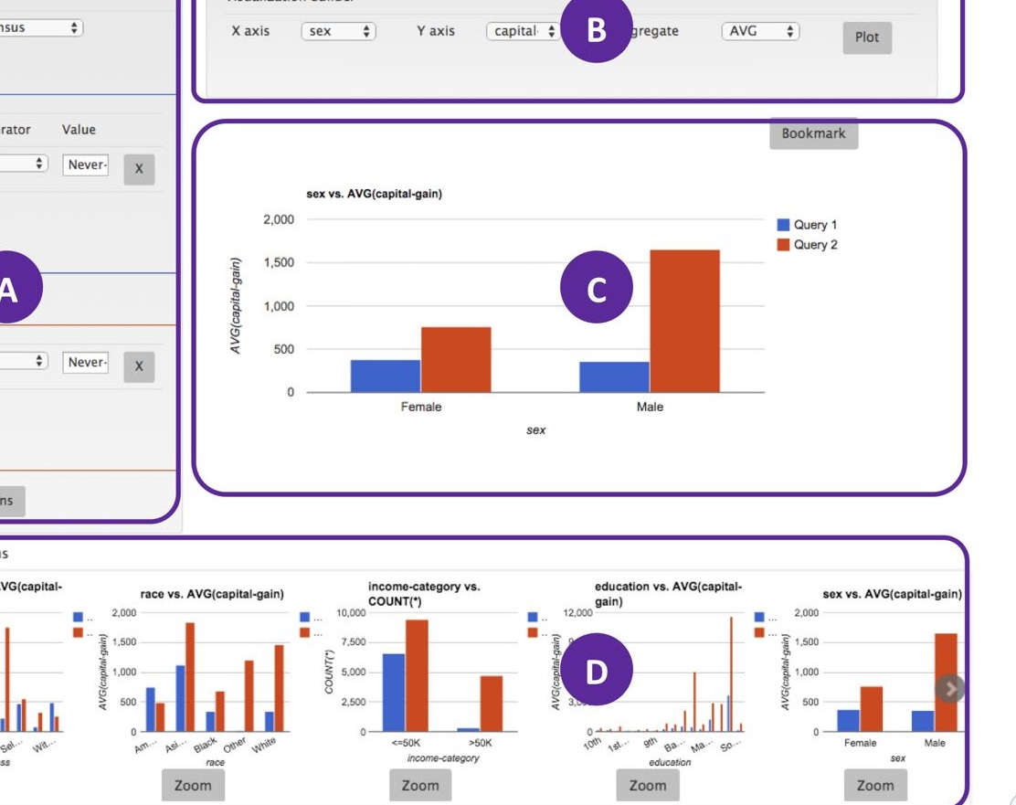
Pros and Cons of Integrating SEEDB
Industry Practitioner:
Yixuan ZHOU

Slide 2
Context:
BuyMall is an e-commerce company with a wealth of data on orders from various customers. They would like to utilize this data to run campaigns aimed at boosting their sales. However, the manager has reviewed the current dashboard and is very dissatisfied.
1
Order Analysis – identify abnormals
Uncover customer purchasing patterns and behavior to optimize the marketing strategies.
Quick Segmentation
2
Use SEEDB's segmentation capabilities to target specific customer groups with personalized offers and campaigns.
3
Referral Program
Leverage SEEDB to track the effectiveness of the referral program and maximize its impact on sales.
Notes:
Deviation
Template

Slide 3
Why & Why not Implement SEEDB in Our Company?
👌
Rapid Visualization Recommendations 🚀
👌
Time-Saving Efficiency ⏰
👌
No Integration Challenges ⚙️
SEEDB provides quick and relevant visualization recommendations, enabling us to uncover interesting insights with ease.
Stop spending valuable hours manually creating visualizations.
Implementing SEEDB is a easy job, as it easily integrates with any relational database.
[a middleware layer on top of any DBMS]
❔
Privacy and Security Considerations 🔒
❔
Explore Other Options 🔄
We cannot make sure that the SEEDB's data handling and recommendation algorithms could be privacy-concerned. [end to end environment]
Consider alternatives such as the "Show Me" feature in Tableau or the "Quick Insights" feature in PowerBI for additional visualization capabilities.

Slide 4
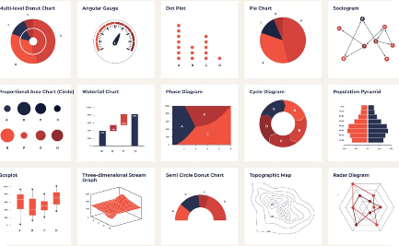

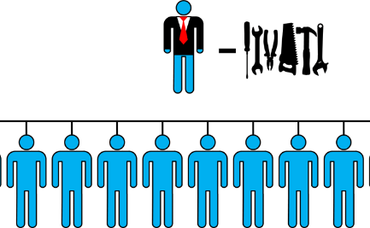
Unlocking the Power of SEEDB
Enhanced Data Exploration 📊
Scalability 📈
Reduced Workload
SEEDB elevates the data exploration capabilities by recommending visualizations based on your queries. Quickly identify trends and uncover valuable insights.
SEEDB has ability to work with large datasets and provides near-interactive performance, it enables that the data exploration process remains efficient even with massive datasets.
Empower data analysts with SEEDB's rapid visualization generation. They can focus on advanced analysis and problem-solving.

