Slide 1
Benchmarking Spreadsheet Systems
Michael Wang
Role: Paper Author
Notes:
Good morning everyone. Today I will be presenting "Benchmarking Spreadsheet Systems" in the role of the Paper Author. To start, I'd like to ask a rhetorical question. We know what spreadsheets are, and we know what benchmarks are, but what do we gain from benchmarking spreadsheets? Why should we do this? To answer this question, I'd like to provide some background information.

Slide 2
Why?
Spreadsheets are everywhere.
Datasets (and spreadsheets) are getting bigger.
How usable are spreadsheet systems on large and complex datasets?
We cannot access the internal source code of proprietary systems.
We can use benchmarks to measure spreadsheet performance.
Notes:
"Recent estimates from Microsoft peg spreadsheet use at about 1/10th of the world’s population."

Slide 3
Benchmarks
Basic Complexity Testing (BCT)
Objective: To measure the latency of basic spreadsheet operations
Data Load (import, open)
Update
Query (simple, select, report, aggregate, lookup)
Interactivity requires the latency to be no more than 500 ms (0.5s).

Slide 4
Benchmarks
Optimization Opportunity Testing (OOT)
Objective: To find design opportunities for optimization techniques
Indexes
Incremental Updates
Workload-Aware Data Layout
Computation Sharing
Notes:
Questions?

Slide 5
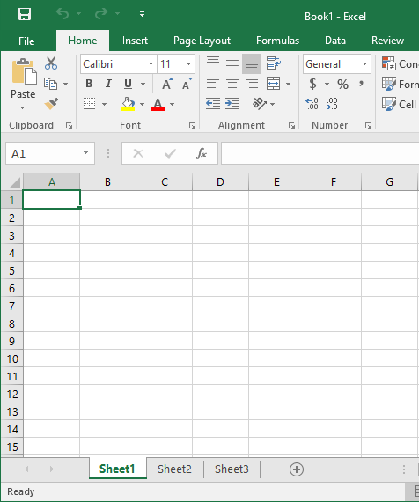
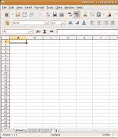
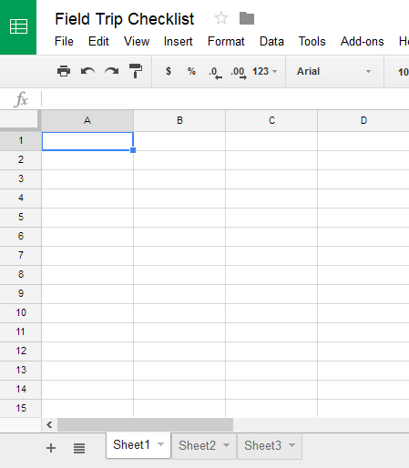
Spreadsheet Systems
Excel (1 million rows) Calc (1 million rows) Google Sheets (5m cells)

Slide 6
Design Obstacles
Manual measurement has low accuracy.
Measurements need to be made through a custom program.
It's impractical to individually measure every spreadsheet operation.
Operations are classified (BCT) and different optimization scenarios were considered (OOT).
Poor Calc documentation, Google Apps Script quotas

Slide 7
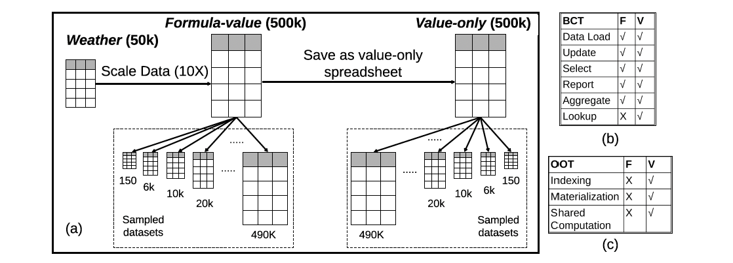
Experimental Design
Notes:
50000 rows and 17 columns
Ten runs for each evaluation, trimmed mean of 8 runs
Questions?

Slide 8
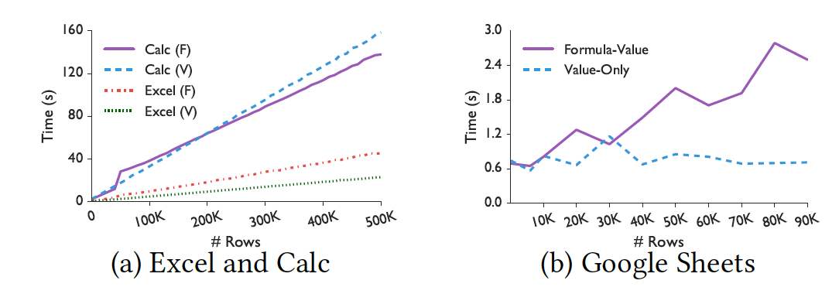
BCT Results: Data Load
Notes:
Open and import are "essentially equivalent", so the authors evaluated only the open operation. O(m) because number of columns is fixed.
All systems violate interactivity, but for different reasons.

Slide 9
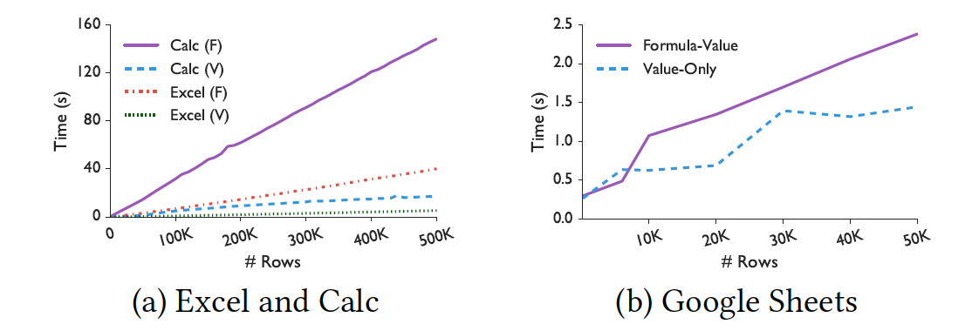
BCT Results: Sort
Notes:
Sort is an update operation
All systems violate interactivity, formula spreadsheets have significantly worse performance due to unnecessary recomputation

Slide 10
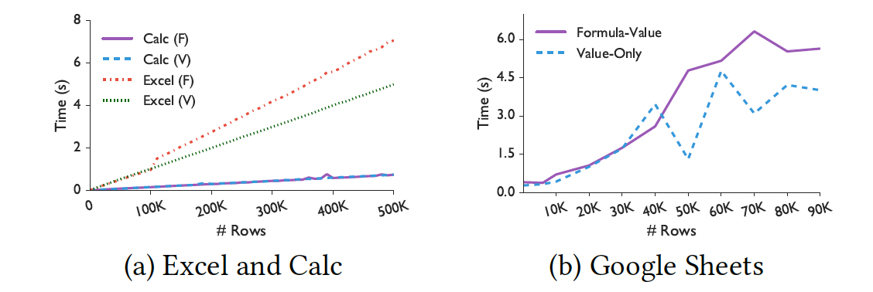
BCT Results: Pivot Table
Notes:
Although all three systems violate interactivity, Calc significantly outperforms by avoiding unnecessary recomputations

Slide 11
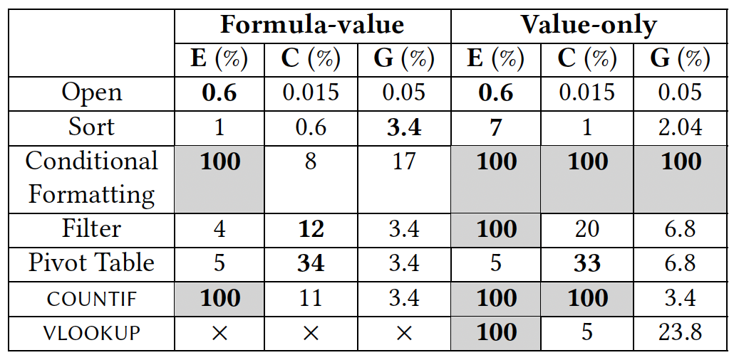
BCT Results Summary
Notes:
Conditional Formatting: Calc value-only for 500k rows is approx 0.3s => possible interactivity violation at 1m rows

Slide 12
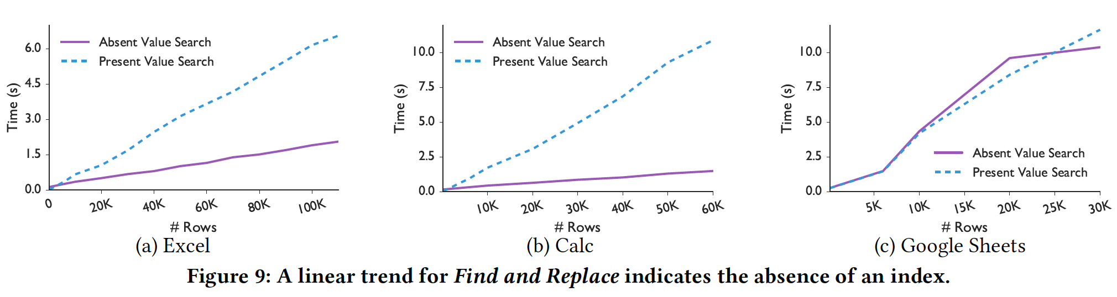
OOT Results: Inverted Index

Slide 13
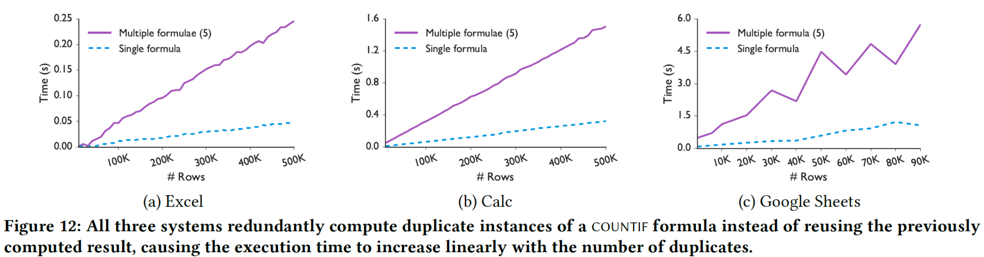
OOT Results: Reusing Computation

Slide 14
Other OOT Results
Lack of columnar data representation
Lack of computation sharing between similar formulae
Lack of incremental updates

Slide 15
Proposed Solutions
Database-style optimizations
Indexing
Columnar data representation
Efficient computation
Incremental updates

Slide 16
Proposed Solutions
Asynchronous computation
Asynchronous open (partially implemented by Google)
Dynamic reordering
Efficient execution
Translating formulae into SQL queries using database backend
Approximation

Slide 17
Takeaways
Spreadsheets are not interactive for users on large datasets.
Spreadsheet systems could benefit from database-style optimizations.
Benchmarking benefits spreadsheet system development.

