Slide 1
Can Foundation Models Wrangle Your Data?
Michael Wang
Role: Peer Reviewer

Slide 2
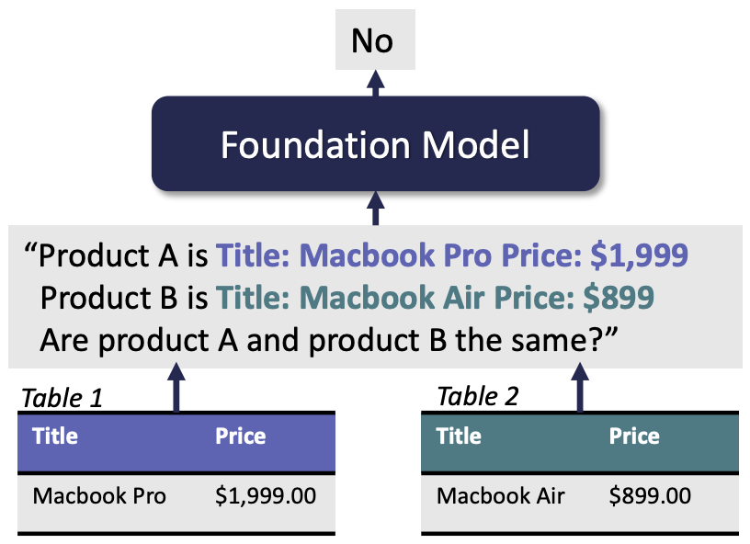
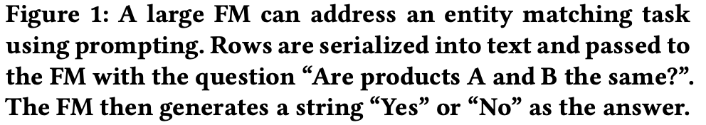
Paper Summary
Foundation Models as a natural language interface for data tasks
cleaning and integration
entity matching, schema matching, data transformation, imputation, error detection
experimental evaluation of FMs compared to SoTA solutions
considerations for future research

Slide 3
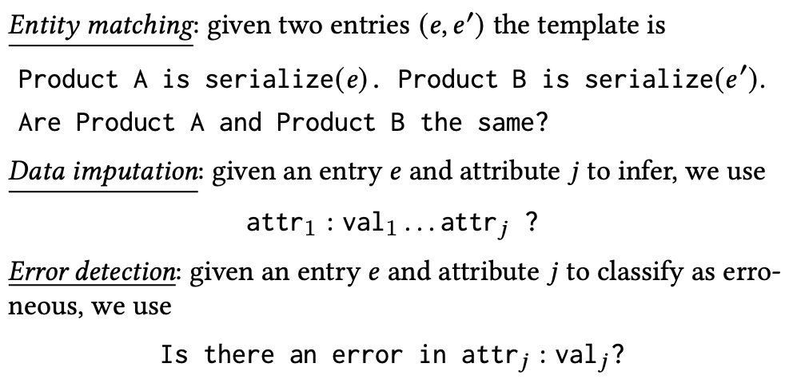
Technical Contribution

Slide 4
Experimental Contributions
Large FMs achieve SoTA performance on data tasks without fine tuning.
Prompt engineering: attribute selection, prompt formatting, task demonstrations

Slide 5
Research Discussion
Opportunities: natural language, prototyping for design, passive learning
Concerns: workflow integration, system interaction, debugging
Technical Challenges: domain specialization, privacy, prompting

Slide 6
Strong Points
S1: Insightful experimental evaluation
S2: Robust discussion
S3: Good writing style

Slide 7
Opportunities for Improvement
O1: Limited technical scope
O2: Ethical implications of using FMs for data tasks

Slide 8
Overall Evaluation
Accept

