Slide 1
Gestural Query Specification
Yixuan ZHOU
Role: Paper Author

Slide 2
Problem
The Increasing use of the Smart Devices
End-user-friendly interaction:
Keyboard/ Mouse-driven interaction
Problems with ad-hoc, open-domain querying of relational databases:
Gestural Input - the space of possible actions is large
State of the database to recognize and articulate queries - if the user is unsure about the query, they system need to guide the users
Notes:
the gesture type, along with metadata parameters such as coordinates and pressure, are sent to the application, which then uses them to infer actions. This mapping of interpreted gestures to a domain-specific action can be considered as a classification problem.
Unlike domain-specific applications, for ad-hoc, open domain querying

Slide 3
Challenges & Opportunities
Users need feedback during the articulation of the gesture
-> Continuous loop of interaction instead of Query - Result
New patterns of interaction will overwhelm the users
-> The system needs to guide the users
The popularization of Direct manipulation Interfaces
Notes:
Query model: we will explain later – each query operation takes 1/more relation as input, and outputs 1 relation
There’ll be a time-series of up to 10 2-dimensional points, at 30 sets per second

Slide 4
Introduction
Data model:
Relational Model – as an example
Query Model:
Read & Write data at Data & schema Level
Gestural Articulation:
A gesture = A set of Time-series of points
e.g. 2-dimensional multi-touch interface that supports 10 fingers at a touch sampling rate of 30-Hz
Outperforms the existing methods in usability
Notes:
Query model: we will explain later – each query operation takes 1/more relation as input, and outputs 1 relation
There’ll be a time-series of up to 10 2-dimensional points, at 30 sets per second, at first, the query intent will be equally spread all the valid Joins

Slide 5
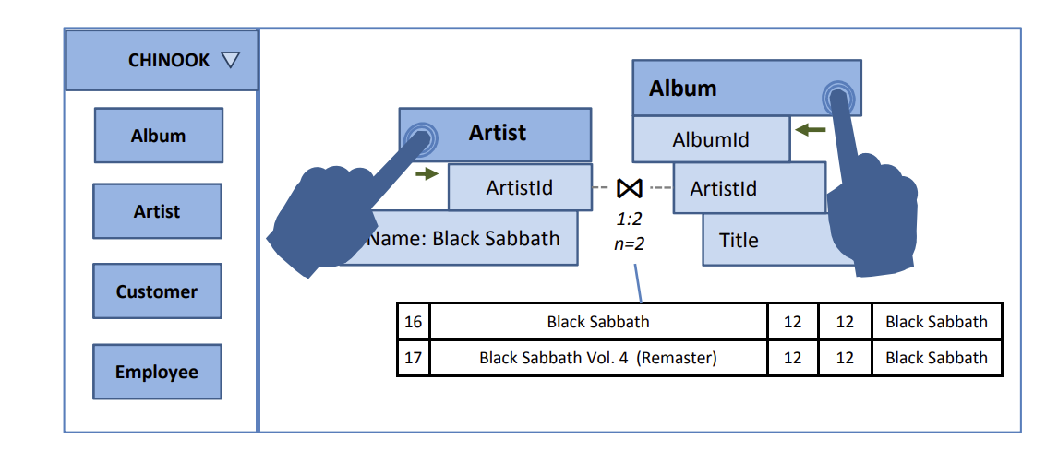
Header
Single Manipulation Action
Workspace
Tray
A view of the table
Notes:
Tray: list of tables available in the dataset
Table in the workspace represents a view of a table

Slide 6
Models and Preliminaries
Query Specification:
A conceptual task -> the correct structured query
Query Intent:
A Probability distribution over a space of valid relational queries Query Intent Transition: Narrow down to an explicit query
Query Context: a collection of information that allows the system to infer and narrow down the space of possible queries
Query Gesture：
The gestures will be codified as a search pattern, with likelihood score. The system will use the likelihood score and query context to build a query template.
Intent Feedback: Preview of the most likely join result & stats; Not the focus of the paper

Slide 7
1. Put “Artist” in the query context
3. Put “Album” in the query context
4. Zoom in - Preview
2. Pinch-out to preview the relation
5. Filter the Name of the Artist
6. Join by bringing the relations close to each other
Query Specification Task:
Representing a Filter [Selection] followed by a JOIN
Query Intent Transition

Slide 8
A gestural query Language - What’s important
Direct Manipulation:
Interact directly with data and interface elements
Closure and Composition:
Input: 1/more relations Output: 1 relation
Feedback:
Could be piece of info that aids users – on the most likely query result
Expressivity
Notes:
All gestures should be available to the users all the time
Make sure the gestural query operators be closed under relational algebra

Slide 9
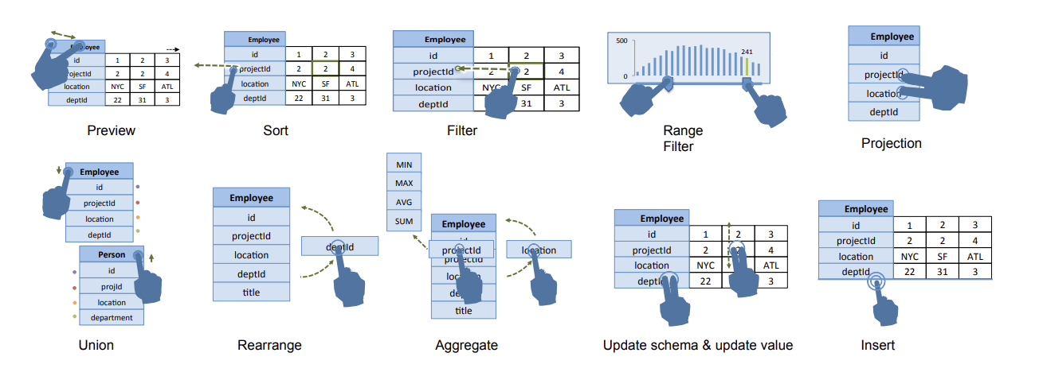
Vocabulary
Tapping and holding a table cell, drag the copy to the header
Drag multiple attributes to make a new table
Pinch-out
Swipe right/left
Drag to the header – desired aggregation
2 fingers – swipe
Doubletap the bottom
On top
Notes:
Rearrange: drag it to another place of the attribute list
Aggregate: Drag the grouping attribute to the table header to access a popup menu of aggregate functions. Then, drag the aggregated attribute through the desired aggregation functions
Update: Numeric: scroll up/down; Categorical: selection of category; Alphanumeric: text input with autocompletion

Slide 10
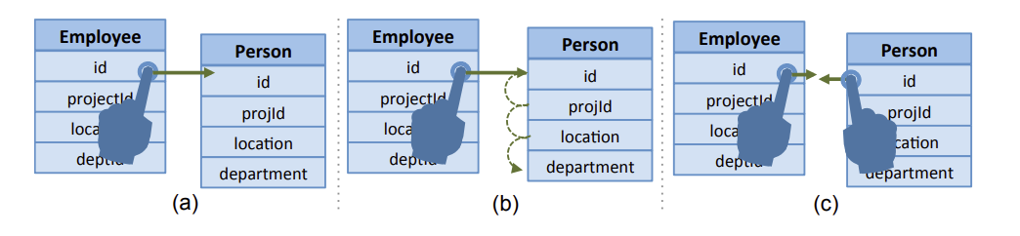
Interactive Join
M*N separate drag gestures - 1 preview per gesture
Continue the drug to different columns
M*N separate drag gestures

Slide 11
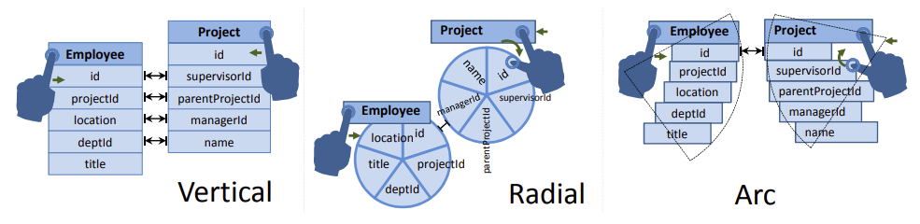
Readable and Pragmatic Layout
Pair of attributes will be at identical distances
Hard-to-read, cannot scale
Notes:
Leaving the Join intent ambiguous

Slide 12

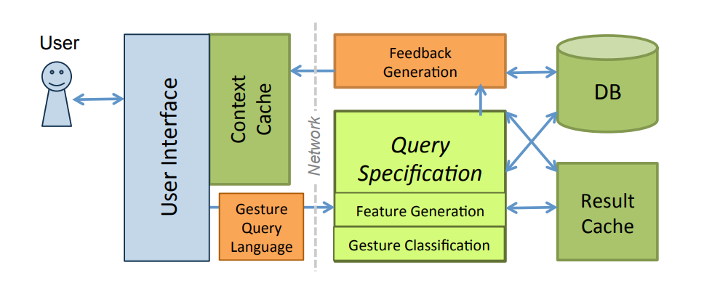
Query Specification System
Gesture recognition as classification:
1) Proximity – spatial info about UI elements
2) Compatibility – schema info like matching types Goodness of a query with feature values fi(q)
Notes:
including proximity and compatibility features conditioned on each type of query, combine them linearly in the argument of an exponential.

Slide 13
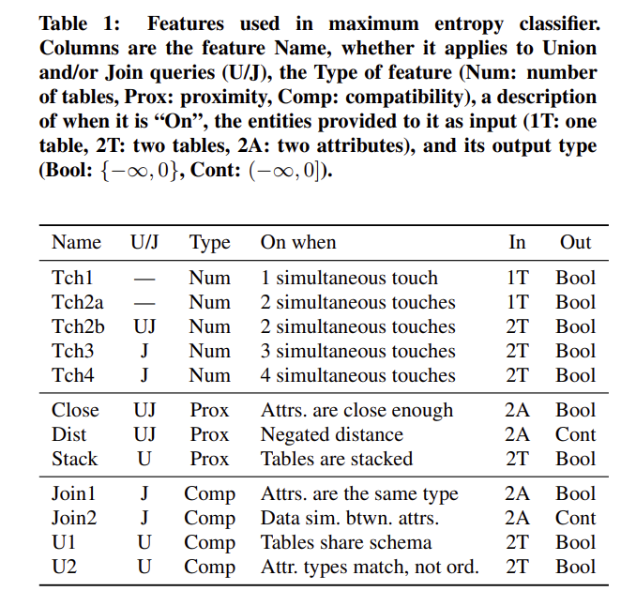
Initialization:
TchX features = -∞. g(q) = 0 for all queries.
Gesture Start:
Tch2b feature -> 0 if two tables touched.
Other TchX functions remain -∞.
Processing Queries:
Evaluates remaining queries.
Distance Calculation:
All attribute pairs initially far apart.
Close = -∞, g(q) = 0 for all queries.
Proximity of Tables:
Close becomes 0 when tables get close.
Computes Dist features.
Compatibility Check:
Stacked = -∞ cuz tables are side by side,
only JOIN queries have non-zero goodness.
Identifying Compatible Pairs:
Uses Join1 and Join2 features to find the best compatible attribute pair for display
Notes:
features are computed in a specific order and earlier features that return a value of −∞ stop the computation of later features, avoiding unnecessary calculations.
whether tables have compatible schemas (the U1 feature) for UNION queries, and the degree to which two attributes contain similar data (the Join2 feature)

Slide 14
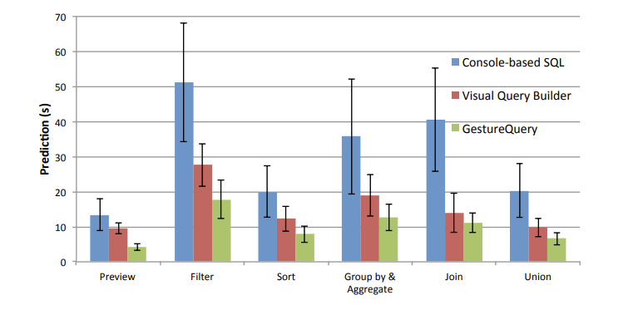
Experiments and Evaluation
User Survey:
30 college students (15 data-related & 15 naive users)
Completion time:
User: Most user found GQ easy to use except JOIN – works better for naive users
System: a high percentage of touch classifications being classified within 33ms, meeting the threshold for real-time interaction.

Slide 15
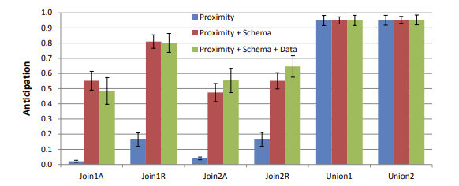
Experiments and Evaluation
2. Discoverability
Gesture Query outperformed Visual Query Builder in the discoverability of JOIN actions.
More users successfully completed tasks with GQ + Spent less time
3. Anticipation
Three different classifiers to anticipate a user’s intent
Proximity, schema compatibility, and data compatibility improved anticipation scores for most queries.
4. Speed up of Using Context Caching
Use of proximity caching and skipping proximity computation improved system performance

Slide 16
Conclusion & Future work
Conclusion:
GESTUREQUERY system significantly outperforms current methods on multiple usability metrics for all classes of users
Future opportunities:
Dealing with textual input in a gesture-oriented interface
Gestural interaction with databases

