Slide 1
Scorpion: Explaining Away Outliers in Aggregate Queries
Michael Wang
Role: Paper Author

Slide 2
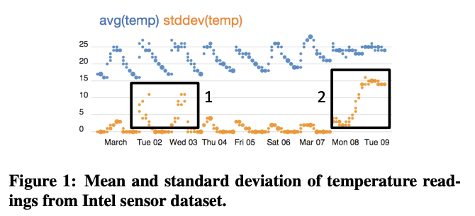
Notes:
usually requires manual inspection of outlier regions
Region 1: sensors that heat up around noon by proximity to windows
Region 2: erroneous readings from sensor running on low voltage

Slide 3
Why?
Many datasets contain outliers, found through aggregation
It's useful to perform why-analysis of outliers
problem diagnosis
better model quality
We want to be more efficient than manual inspection

Slide 4
Related Work: Profiler
Quick Review: visual data analysis and anomaly detection
suggests and provides views to help the user understand anomalies
Visual approach vs. technical approach
HCI vs. algorithmic

Slide 5
Technical Overview
Define problem mathematically
Design architecture
Improve algorithms

Slide 6
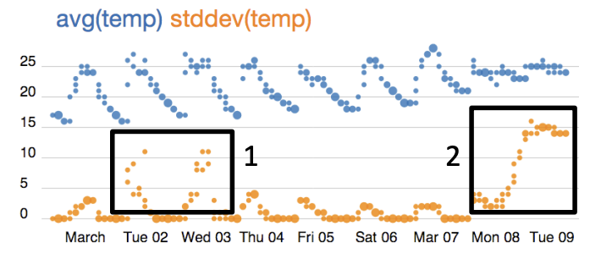
Definitions
provenance = set of data points that produces the outlier
hold-out result = set of data points that user indicates are NOT outliers

Slide 7

Technical Definitions
predicate = conjunction of range clauses and set containment clauses
influence = the change in aggregation function when removing points satisfying the predicate
A predicate with high influence conveys information about outliers.
Influential Predicates Problem:

Slide 8
Difficulties
Finding influential predicates is harder than returning top k outliers
Influence is sensitive to the aggregation function
Users can select multiple regions of outliers and hold-outs

Slide 9
Architecture
Provenance: finds input groups corresponding to user selection
Partitioner: generates granular predicates from input groups
Merger: combines predicates to increase influence
Scorer: evaluates Partitioner and Merger by computing influence

Slide 10
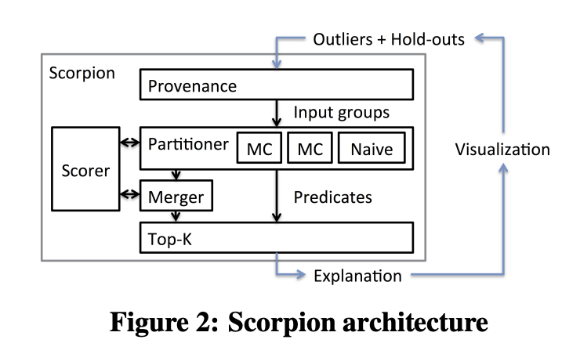
Architecture

Slide 11
Aggregation Properties
Influence is the change in aggregation function when removing points satisfying the predicate.
The cost of computing influence corresponds to the cost of aggregation.
incrementally removable
do not need to recompute on entire set when a small subset is removed
independent
the effect of any individual input on influence does not depend on other inputs
anti-monotone
non-influential predicates must not contain influential predicates

Slide 12
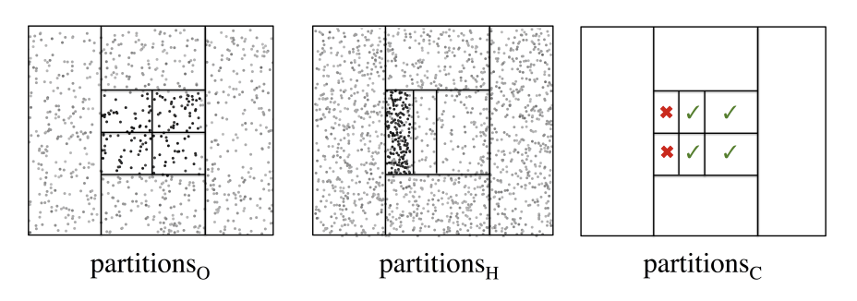
Algorithm: Decision Tree (DT) Partitioner
Because of the independence property, influence should not decrease when combining tuples of similar influence.
Uses trees to recursively partition into tuples of similar influence
Finds tuples of similar influence by weighted random sample
Separately partition outliers and holdouts and combines with product

Slide 13
Algorithm: Bottom-Up (MC) Partitioner
Because of the anti-monotonicity property, influential sub-predicates can be merged into influential predicates.
Finds influential single-attribute predicates
Computes product of predicates and prunes low influence
Iterates until best predicate is found

Slide 14
Additional Optimizations
The Merger combines adjacent predicates to increase influence.
Only merge top quartile of predicates by influence
Do not call the Scorer for incrementally removable aggregations
Other techniques:
Dimensionality reduction
User input on which attributes are important or ignored

Slide 15
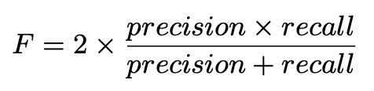
Evaluation
Objective: understand performance of DT and MC algorithms compared to naive implementation.
synthetic and real world datasets
measured with precision, recall, F-score, runtime

Slide 16
Results Overview
Vastly improved performance, good predicates on synthetic datasets
Good predicates on real-world datasets
Caveat: no end-user study

Slide 17
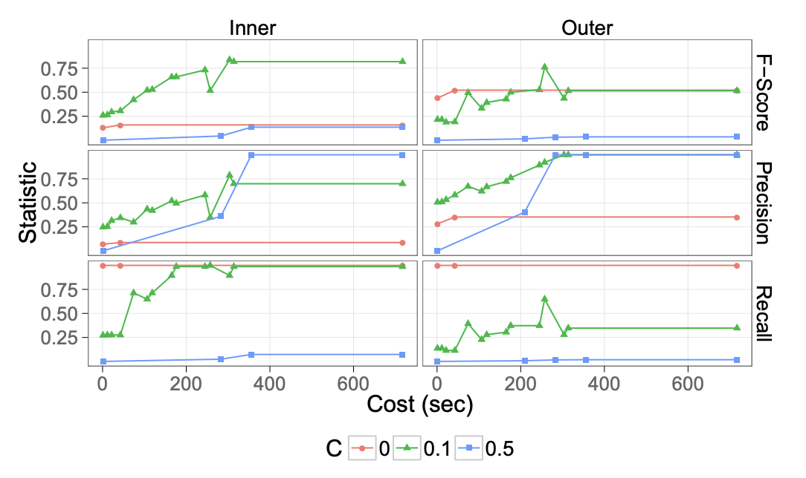

Slide 18
Takeaways
Predicates convey information about the data that satisfy the predicate.
Influential predicates can both identify and explain outliers.
Efficient algorithms for finding influential predicates can help end users.

