Slide 1
Dremel: Interactive Analysis of Web-Scale Datasets
Yixuan ZHOU
Role: Archaeologist

Slide 2
Brief Introduction
Interactive Analysis
Columnar Storage
Serving Tree Topology
SQL-like Language
Dremel complements MapReduce-based computing and is often used in conjunction with it.
Notes:
- Interactive Analysis: Dremel allows for interactive ad-hoc query processing, providing fast response times for data exploration, monitoring, debugging, and other tasks. - Columnar Storage: Dremel uses a column-striped storage representation, which enables it to read less data from storage and reduce CPU costs due to cheaper compression.
- Serving Tree Topology: Dremel utilizes a serving tree topology to efficiently process queries by aggregating results from lower levels of the tree. - SQL-like Language: Dremel provides a high-level, SQL-like language to express ad hoc queries, allowing users to execute queries natively without translating them into MapReduce jobs.

Slide 3
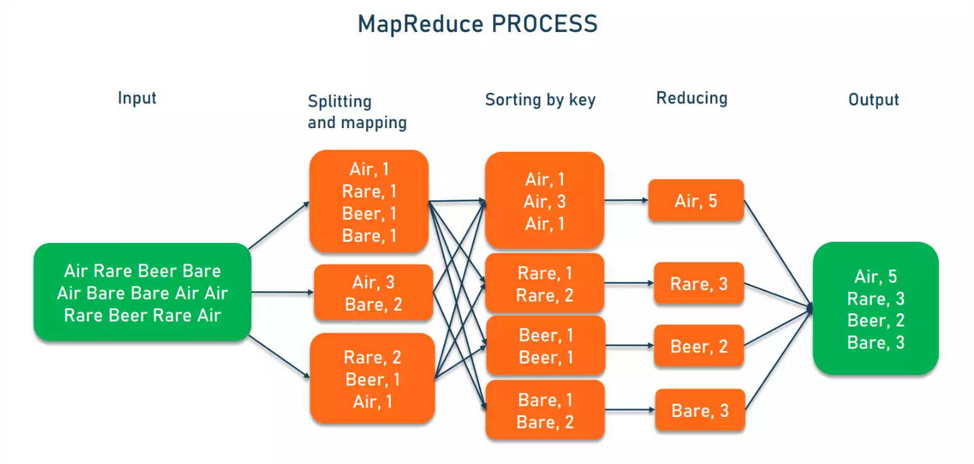
Influenced by: MapReduce: Simplified Data Processing on Large Clusters
Notes:
Like MapReduce, Dremel also leverages the concept of parallel processing. It allows for the parallel execution of queries on large datasets distributed across multiple machines or nodes, making it suitable for big data processing. – tree achietecture
MapReduce is a process of organizing a pile of chaotic and disorganized data according to certain characteristics, then processing it to obtain the final result. The 'Map' phase deals with disorganized and unrelated data; it parses each piece of data, extracting the key and value, in other words, extracting the data features. After the Shuffle phase in MapReduce, what the 'Reduce' phase sees is already well-organized data.
The Map function will be applied to each element inside the list, so the original list hasn’t been modified, which means that there could be some other calculations ongoing at the same time.

Slide 4
Importance
Facilitates parallel data processing across numerous machines.
Reduces time required for large dataset processing.
Enables processing of large datasets unmanageable by traditional methods.
Notes:
MapReduce is important because it enables the processing of large datasets that would otherwise be impossible to process using traditional methods. It provides a way to process data in parallel across a large number of machines, thereby reducing the time required to process large datasets.
This allows for the processing of large datasets that would otherwise be impossible to process using traditional methods.

Slide 5
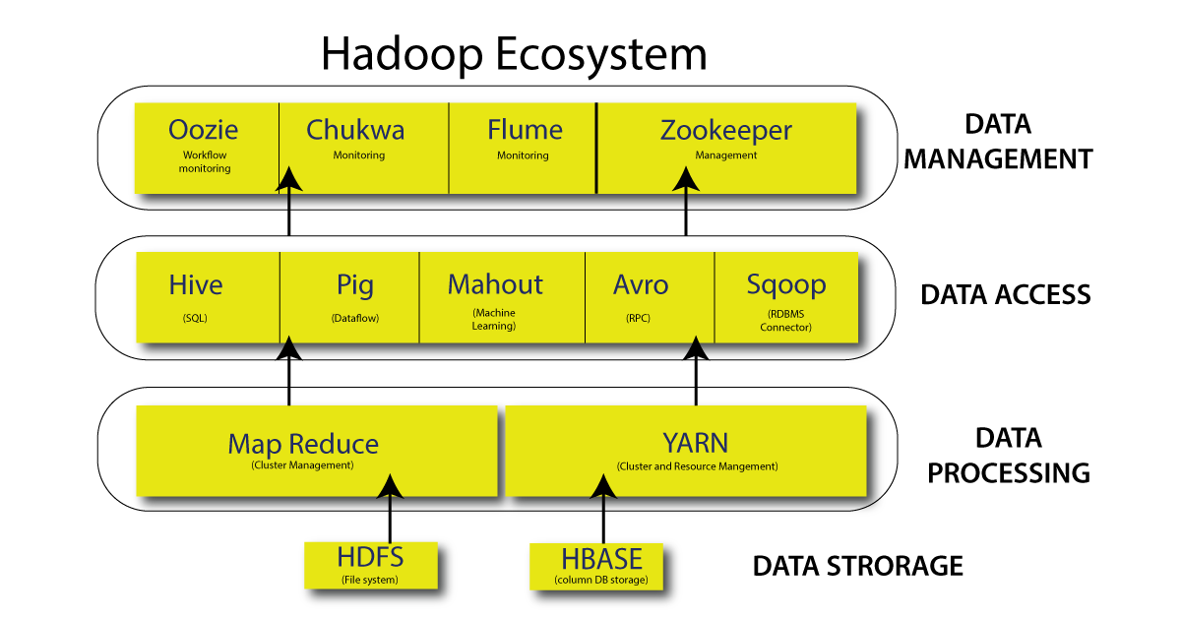
Notes:
a framework that allows for the distributed processing of large data sets across clusters of computers using simple programming models.
1. Hadoop Distributed File System (HDFS)
A distributed file system that runs on standard or low-end hardware. HDFS provides better data throughput than traditional file systems, in addition to high fault tolerance and native support of large datasets.
2. Yet Another Resource Negotiator (YARN)
Manages and monitors cluster nodes and resource usage. It schedules jobs and tasks.
3. Map Reduce
A framework that helps programs do the parallel computation on data. The map task takes input data and converts it into a dataset that can be computed in key-value pairs. The output of the map task is consumed by reduce tasks to aggregate output and provide the desired result.
4. Hadoop Common
Provides common Java libraries that can be used across all modules.

Slide 6
Influenced: Spark SQL: Relational Data Processing in Spark
Spark: Apache Spark is an open-source analytics engine used for big data workloads
RDD: an immutable distributed collection of datasets partitioned across a set of nodes of the cluster that can be recovered if a partition is lost, thus providing fault tolerance
DataFrame: is equivalent to a table in a relational database, and can also be manipulated in similar ways to the “native” distributed collections in Spark (RDDs).
Notes:
Hadoop processes data in batches. Spark processes data in real time.

Slide 7
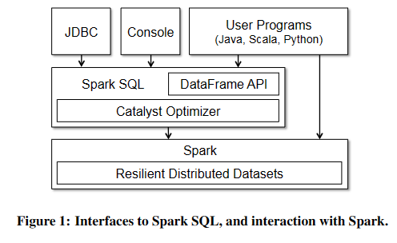
Influenced: Spark SQL: Relational Data Processing in Spark
Notes:
Spark SQL adopted Dremel’s columnar storage model.
Inspired by Dremel‘s user-friendly SQL-like interface for easy query composition， Spark SQL offers a similar intuitive interface for big data analysis.
It prioritizes accuracy in query results over speed， which is different from BlindDB, because the primary trade-off in BlinkDB is accuracy for speed.
(1) analyzing a logical plan to resolve references, (2) logical plan optimization, (3) physical planning, and (4) code generation to compile parts of the query to Java codes

Slide 8
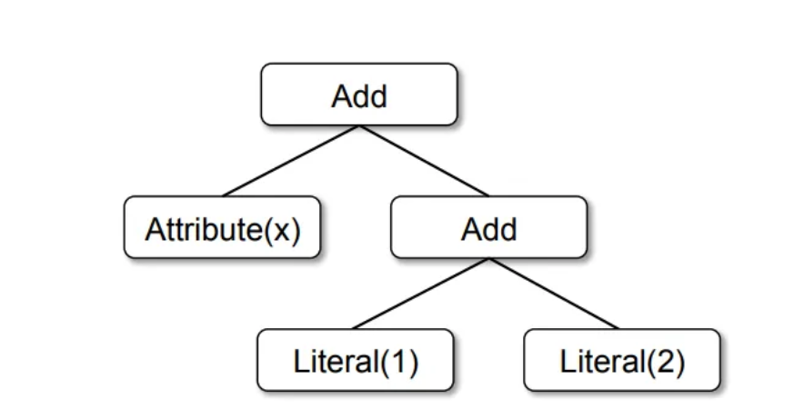
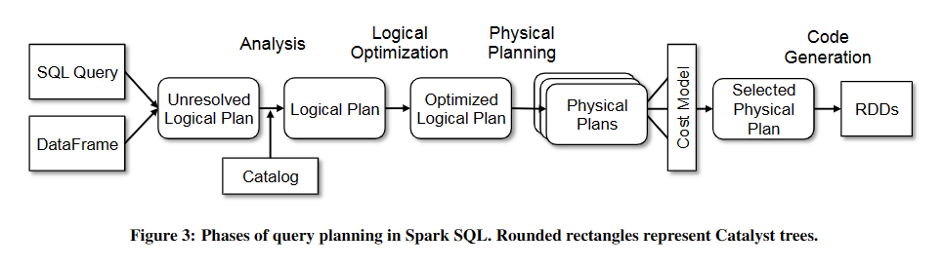
Influenced: Spark SQL: Relational Data Processing in Spark
Hive - Shark - Spark SQL
Notes:
any unresolved attribute found will then pass through the catalog (an entity dictionary) in order to be resolved
Abstract Syntax Tree representation is obtained
Logical Optimization: the Catalyst will transform that AST applying a set of rules iteratively
e.g. the filter can be pushed down to the data before it is even serialized into memory, thus reading only what satisfies the filter.
The physical optimization phase further optimizes the workload by taking the optimized AST as input, generating multiple physical plans, running them through a cost model an selecting the least expensive one.

