Slide 1
Assessment 1
Matthew Pana

Slide 2
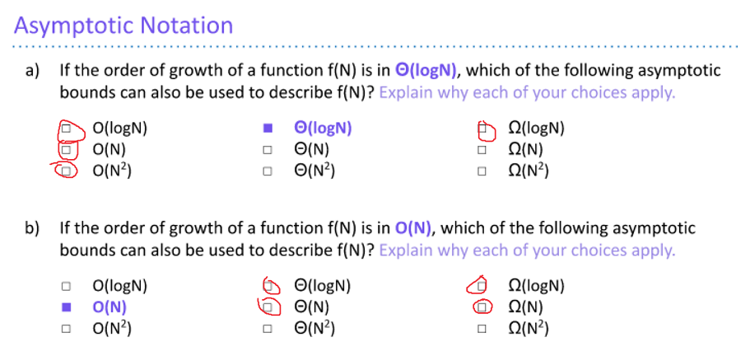
Problem 1

Slide 3
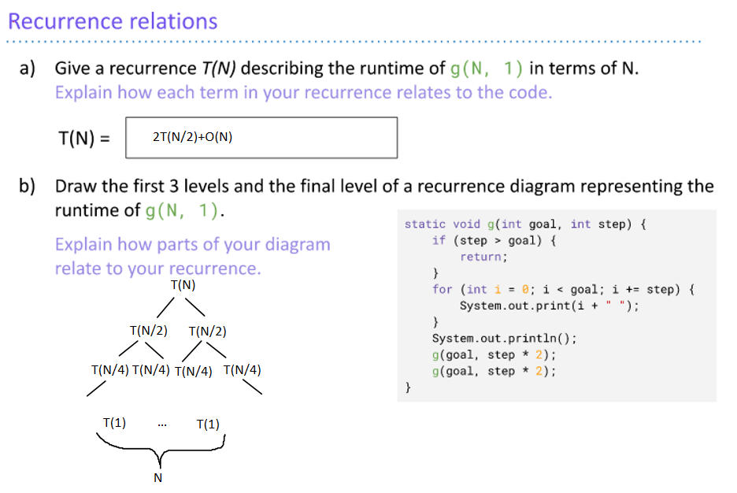
Problem 2

Slide 4
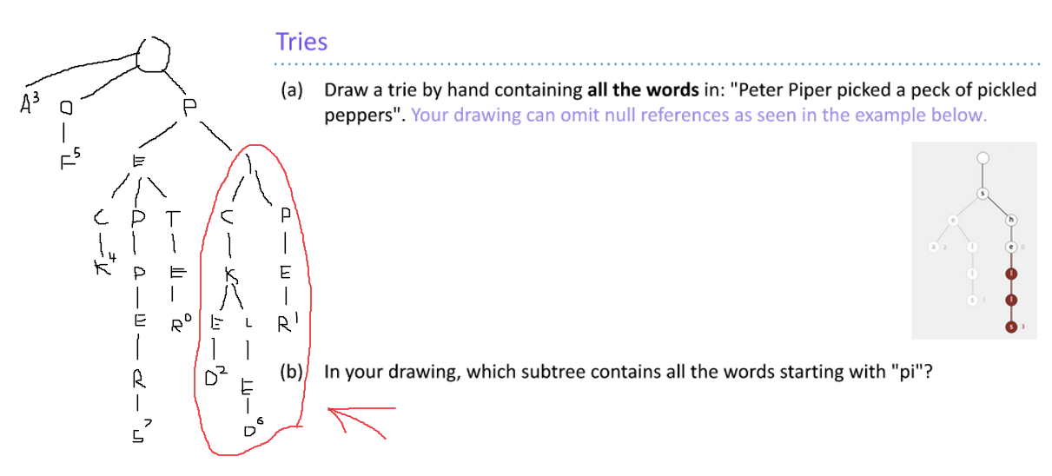
Problem 3

Slide 5
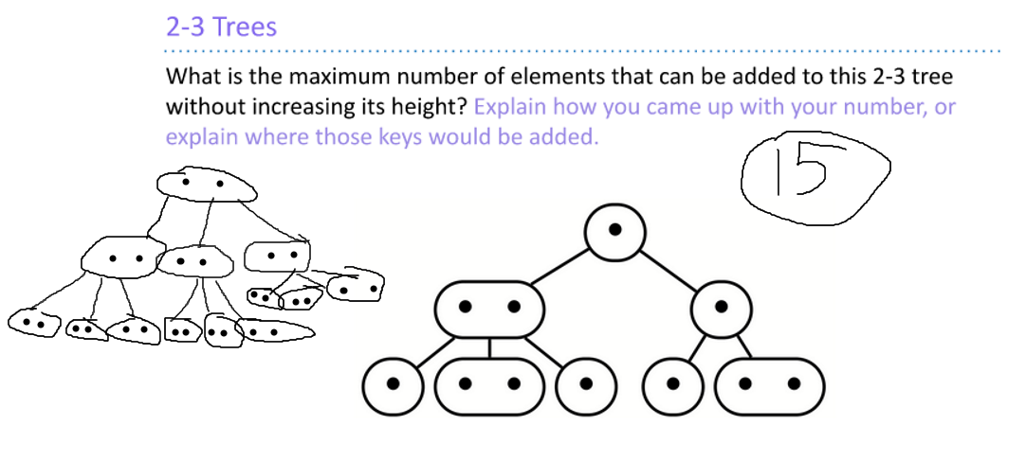
Problem 4

