Slide 1
Face Recognition Using Deep Neuron Network version of the Georgia Tech face recognition.
Prepared by Md Mahfuz Alam for the final Project for CS5567
GitHub : https://github.com/infoMahfuz/DeepLearning

Slide 2
Project Overview
The Face Recognition System is designed to identify and verify the individuals by analyzing and recognizing the facial features utilizing the Pre-train convolutional neuron ResNet50 Network a type of neural network architecture to develop the and effective model for face recognition used for feature extraction[3].

Slide 3
Methodology Overview
Transfer Deep Learning face image dataset and preprocessing to create training and testing sets to utilized in network, it takes pairs of facial images as input and learns to generate the similarity utilizing the pre-traing network convolutional neural network such as Restnet50 is employed for the feature extraction mainly focusing on the identification accuracy in different subjects[2].

Slide 4
Data Preparation
The face recognition system for the Georgia Tech dataset represented by multiple images split in train and testing in round, at first, we used 10 images to train and last 5 images to test from each subject folder that store in data and labels, and then we I used subject independent first 40 for the train then last 10 subject for test, each split has picked randomly to get more accuracy[1][2][3].

Slide 5
Network Architecture.
A network consist of two neural networks with shared weights, they are learning similarities between pairs of inputs and verification tasks, CNN pre-trained on a large image dataset like ResNet50, Global Average Pooling layer to reduce the spatial dimension of the features, fully connected layer follows the gap to generate the final feature and output layer[3].

Slide 6
Feature Extraction and Biometric Templates
In the feature extraction is one of crucial step to obtain descriptive representation of multiple facial images, these representation referred as biometric template to capture the essential necessary features for identity.

Slide 7
Feature Extraction and Biometric Templates
In the feature extraction is one of crucial step to obtain descriptive representation of multiple facial images, these representation referred as biometric template to capture the essential necessary features for each identity to facilitate the comparison and recognition[1][2][3].

Slide 8
Genuine and Imposter Score Sets
In genuine and imposter score I have calculated between the template belonging to same subject and score are computed using a similarities cosine similarities, and imposter score to measure the similarities between the templates from different subjects[1][2][3].

Slide 9
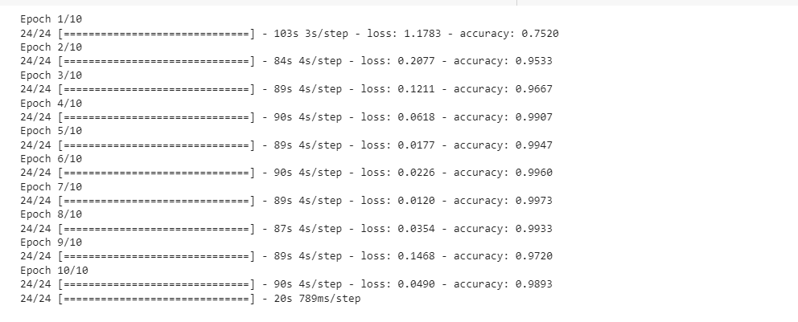
Model Accuracy

Slide 10
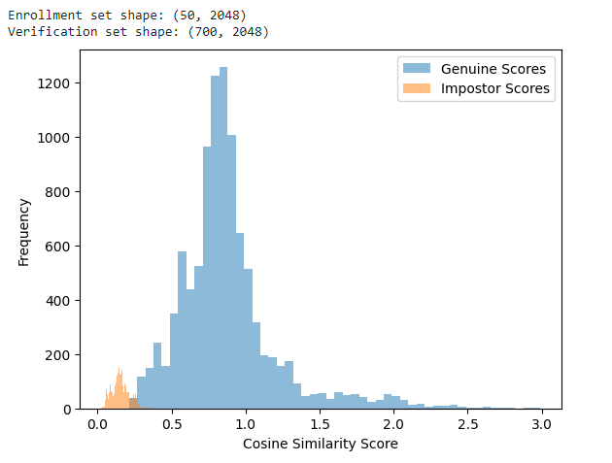
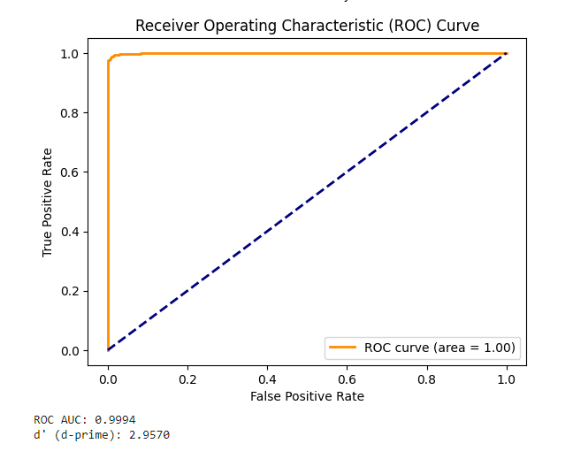
Score Distribution and Roc Curve for similarities between enrollment and verification

Slide 11
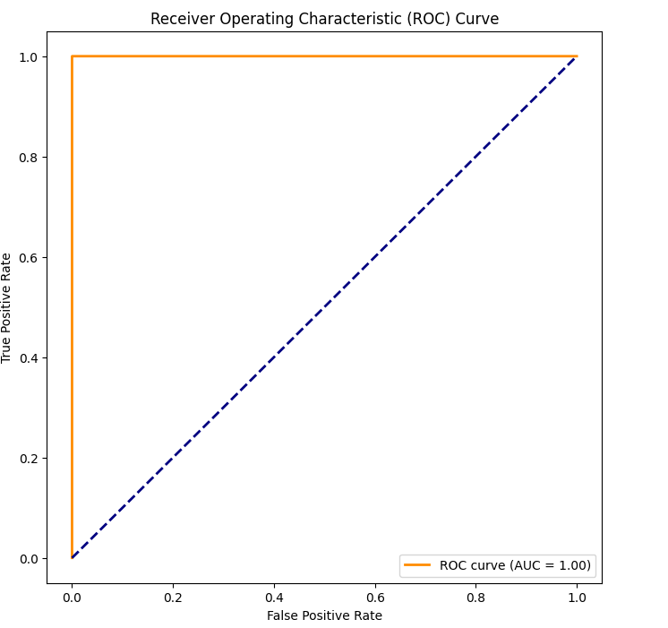
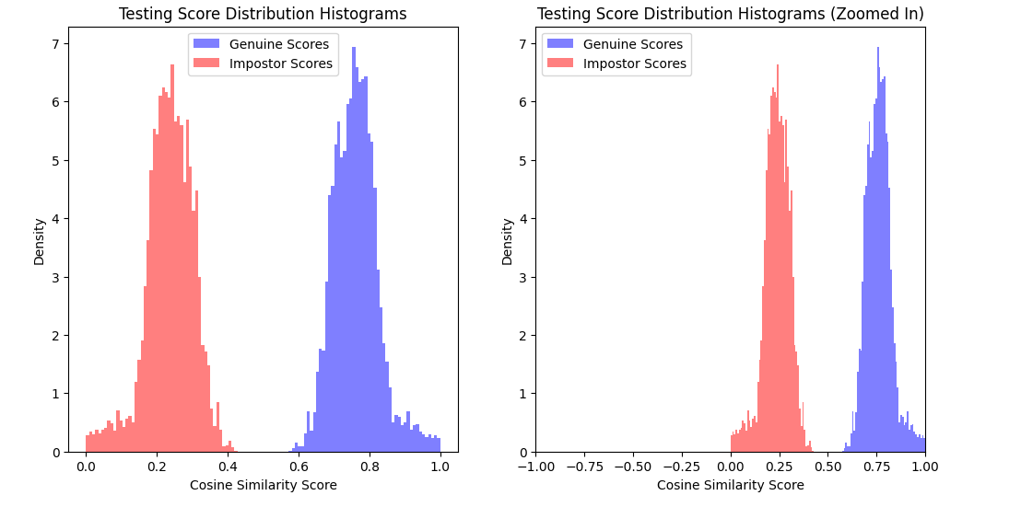
Score Distribution and Roc Curve for similarities between enrollment and verification for subject dependent.

Slide 12
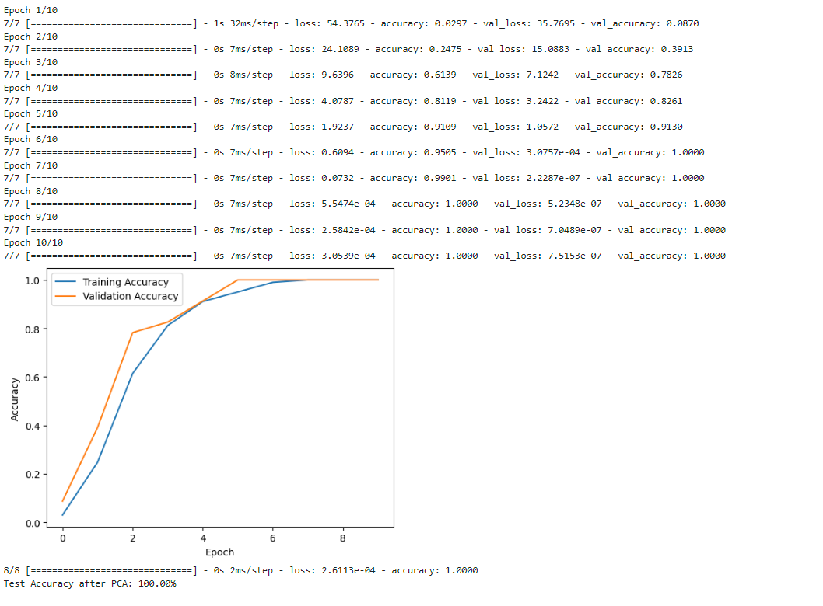
PCA dimensionality reduction on the templates.

Slide 13
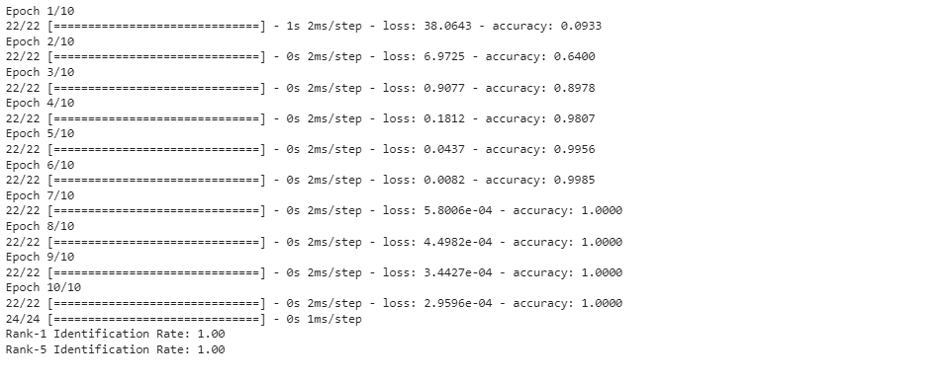
Generate the average rank 1 and rank 5 identification rates
In this section I have take the function to calculate the genuine score as input and competes the Rank 1 and rank 5 identification sets. That determines the ranks and the calculates the proportion correct match with in the top1 and top 5 ranks through the experiment. This rate remain unchanged even though performed several experiment.

Slide 14
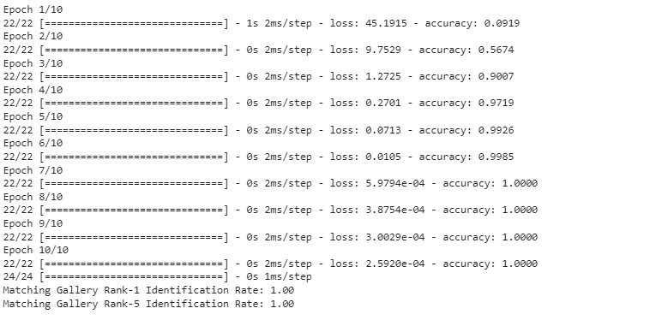
Generate the average rank 1 and rank 5 identification rates using a reasonable match threshold.
In this section referring to a similarities score threshold of two biometric sample consider to be match. To get this threshold value I have used the confusion matrix to get the genuine score based on the characteristic of system and the desired trade-off between the positives and false negative. The value remain unchanged in rank 1 and rank 5 identification calculation with a matching threshold.

Slide 15
Conclusion
Working through out in this project in this biometric system, had great exposure to perform and build the biometric application with subject- dependent and subject-independent, leveraging the transfer learning and PCA on identification rates.

Slide 16
References
[1] GeekforGeeks, Sanchhaya Education Private Limited 2008. https://www.geeksforgeeks.org/machine-learning-with-python/
[2] Real Python Tutorials 2012-2023. https://realpython.com/
[3] PythonProgramming.net January 22, 2015. https://pythonprogramming.net/machine-learning-tutorial-python-introduction/

