Slide 1
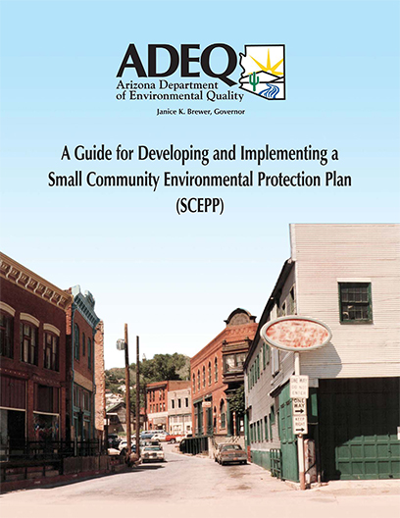
Arizona’s Small Communities Environmental Compliance Assistance Program

Slide 2
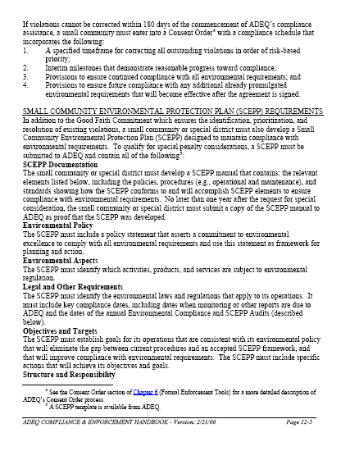
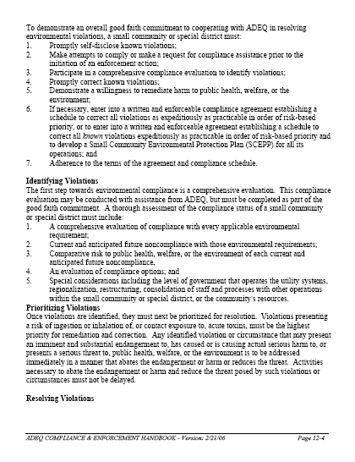
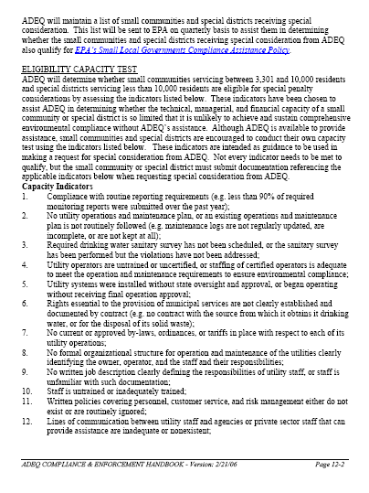
ADEQ’s
Small Community Policy
► Developed in recognition of the limited financial, technical, and administrative resources available to small communities for environmental compliance, and
► to promote the development of management tools to be used to identify, prioritize, correct, and prevent future environmental problems.
Policy found at: http://www.azdeq.gov/function/compliance/download/smallcomm-policy.pdf

Slide 3
ADEQ’s Small Community Policy
Special Penalty Considerations
► ADEQ will make special penalty considerations for small communities and special districts willing to work with ADEQ to achieve these goals.
► Once the requirements of the Small Community Policy have been met, a small community or special district will qualify for a significant reduction or waiver of penalties that might otherwise be imposed for environmental violations.

Slide 4
ADEQ’s Small Community Policy Eligibility for
Special Penalty Consideration
► Small communities include non-profit government entities (unincorporated or incorporated) owning facilities that supply municipal services to fewer than 3,300 residents as determined by the most recent U.S. Census Bureau Estimate (adjusted every July 1).
http://quickfacts.census.gov/qfd/states/04000.html
► Small communities qualifying for special consideration will continue to receive the benefits if they subsequently exceed the population limits so long as they have met and continue to meet the other requirements for special penalty consideration.

Slide 5
ADEQ’s Small Community Policy Eligibility for
Special Penalty Consideration
► Small communities that supply municipal services to between 3,301 and 10,000 residents as determined by the U.S. Census Bureau Estimate will be considered for eligibility on a case-by-case basis.
► At the request of the small community, ADEQ will conduct a capacity test to determine whether the community’s administrative, technical and financial capacity is such that the community’s compliance with environmental requirements would improve significantly with ADEQ assistance.

Slide 6
ADEQ’s Small Community Policy Eligibility for
Special Penalty Consideration
► Special districts that supply municipal services to fewer than 10,000 residents will be considered on a case-by-case basis.
► At the request of a special district, ADEQ will conduct a capacity test to determine whether the district’s administrative, technical and financial capacity is so limited that the district is unlikely to achieve and sustain environmental compliance without ADEQ assistance.

Slide 7
ADEQ’s Small Community Policy Eligibility for
Special Penalty Consideration
► Special district means any of the following entities established pursuant to Title 48 Arizona Revised Statues:
http://www.azleg.gov/ArizonaRevisedStatutes.asp?Title=48
▪ Municipal Improvement District ▪ Fire District ▪ County Improvement District ▪ Special Road District ▪ Sanitary District ▪ Drainage or Flood Protection District ▪ County Flood Control District ▪ County Jail District ▪ Regional Public Transportation Authority, and ▪ Regional Transportation Authority

Slide 8
ADEQ’s Small Community Policy Qualify for
Special Penalty Consideration
► To qualify for special penalty consideration, an eligible small community or special district must specifically request such consideration from ADEQ.
► Small communities serving between 3,301 and 10,000 residents and special districts serving less than 10,000 residents must include information to support application of the capacity test with their request.

Slide 9
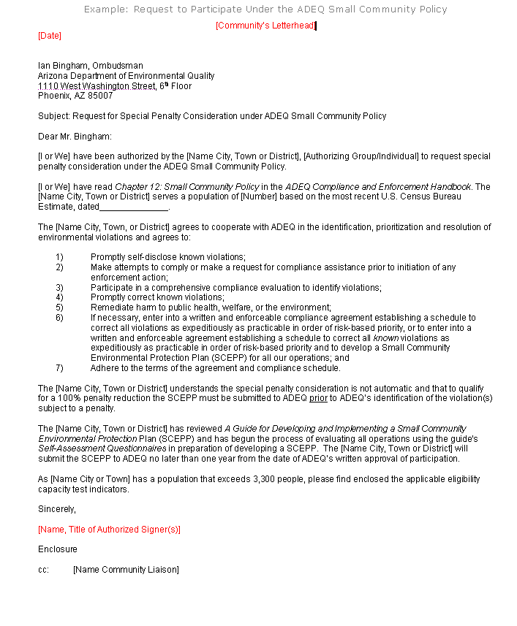
ADEQ’s Small Community Policy
Good Faith Commitment –
Request For Consideration
See your ADEQ Community Liaison for an example letter of a Request for Consideration to participate under the Small Community Policy.

Slide 10
ADEQ’s Small Community Policy Eligibility Capacity Test
Capacity Test Indicators:
► ADEQ’s Small Community Policy includes 18 indicators to assist in determining whether the technical, managerial and financial capacity of a small community or special district is so limited that it is unlikely to achieve and sustain comprehensive environmental compliance without ADEQ’s assistance.
► ADEQ is available to provide assistance but encourages small communities and special districts to conduct their own capacity test.
► Indicators are intended as guidance to be used in making a request to ADEQ for special penalty consideration.

Slide 11
ADEQ’s Small Community Policy
Two Types of Penalty Reductions Available to
Eligible Small Communities and Special Districts
Type 1 - 100% Penalty Reduction:
▪ Make a Good Faith Commitment to environmental compliance.
▪ Develop a comprehensive Small Community Environmental Protection Plan (SCEPP) designed to maintain compliance once achieved.
▪ A SCEPP can be developed with or without ADEQ assistance.
▪ A SCEPP must be submitted to ADEQ prior to ADEQ’s identification of violations subject to a penalty.

Slide 12
ADEQ’s Small Community Policy
Two Types of Penalty Reductions Available to
Eligible Small Communities and Special Districts
Type 2 - Up to a 75% Penalty Reduction:
▪ If a SCEPP manual has not yet been submitted to ADEQ, ADEQ will still offset a higher than normal amount of a civil settlement penalty for development of a SCEPP provided a Good Faith Commitment request for consideration has been made.
▪ If a small community or special district agrees to correct the violations at issue and adopts a SCEPP as a supplemental environmental project (SEP) described in a consent agreement, ADEQ will offset 75% of the civil penalty.

Slide 13
ADEQ’s Small Community Policy Qualify for
Special Penalty Consideration
► Receipt of special penalty considerations is not automatic.
► To receive these benefits, a small community or special district must make a written request to ADEQ.

Slide 14
ADEQ’s Small Community Policy
Demonstrate a Good Faith Commitment
Identification, Prioritization & Resolution
of Existing Violations
Demonstration of a Good Faith Commitment includes:
1) Promptly self-disclose known violations;
2) Make attempts to comply or make a request for compliance assistance prior to initiation of an enforcement action;
3) Participate in a comprehensive compliance evaluation to identify violations using the SCEPP Guidance including the Self-Assessment Questionnaires;
4) Promptly correct known violations;

Slide 15
ADEQ’s Small Community Policy
Demonstrate a Good Faith Commitment
Identification, Prioritization & Resolution
of Existing Violations
Demonstrate a willingness to remediate harm to public heath, welfare or the environment;
If necessary, enter into a written and enforceable consent agreement with a compliance schedule to correct all violations in order of risk-based priority and develop a SCEPP; and
Adhere to the terms of the agreement.

Slide 16
ADEQ’s Small Community Policy SCEPP Documentation
► A copy of the completed SCEPP manual must be submitted to ADEQ no later than one year after the request for special penalty consideration as proof that the SCEPP was developed.
► The SCEPP manual must contain the relevant elements listed in the Small Community Policy including policies, procedures (e.g., operational and maintenance), and standards showing the SCEPP conforms to and will accomplish SCEPP elements to ensure compliance with environmental requirements.

Slide 17
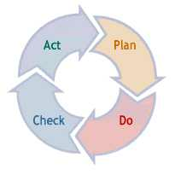
ADEQ’s Small Community Policy SCEPP Manual
Requirements & Template
1) Small Community Environmental Protection Plan
2) Environmental Policy
3) Scope of Operations Covered by the SCEPP
4) Environmental Aspects and Impacts, Objectives and Targets
5) Legal and Other Requirements
6) Environmental Management Programs (EMP)
7) Operational Control & Organizational Structure and Responsibilities
8) Training, Awareness and Competency
9) Communications & Registry of Stakeholders
10) Document Control
11) Environmental Records Control
12) Emergency Preparedness and Response
13) Noncompliance and Correction and Preventive Actions
14) Environmental Compliance Audit
15) SCEPP Audit
16) Management Review

Slide 18
ADEQ’s Small Community Policy SCEPP Manual Template
Basic Model: This management system approach accomplishes organizational integration by guiding the user through four processes:
Plan: Planning by setting community policy and commitments; identifying the characteristics of activities
and services; identifying applicable legal and other requirements; and developing objectives and targets to control and improve performance.
Do: Integrating management into normal operations through training, procedures, documentation, and operational controls.

Slide 19
ADEQ’s Small Community Policy SCEPP Manual Template
Check: Checking and corrective actions by monitoring and measuring for key parameters and performance metrics, adjusting to address concerns, and auditing and record keeping.
Act: Acting on the results to ensure policy commitments are met and continual improvement occurs.

Slide 20
Small Community Environmental Protection Plan (SCEPP)
This guidance was prepared by the Arizona Department of Environmental Quality under agreements with the Environmental Council of States (ECOS) and the U.S. EPA Environmental Policy and State Innovation Grant.
The SCEPP Manual and Template were financed in part by funds provided by ECOS and EPA.

Slide 21
ADEQ’s Small Community Policy Guidance Available Online
► Small Communities Environmental Compliance Assistance
http://www.azdeq.gov/function/compliance/smallcomm.html
  A Guide for Developing and Implementing a Small Community Environmental Protection Plan (SCEPP)
  Guidance Brochures
  Links to Additional Guidance and Resources

Slide 22
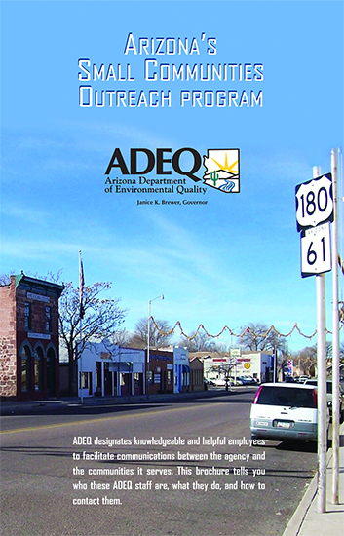
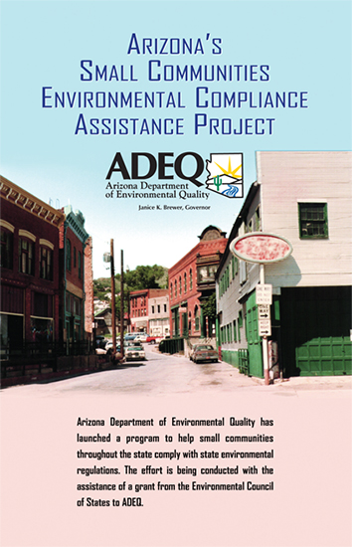
ADEQ’s Small Community Policy Additional Guidance - Brochures

Slide 23
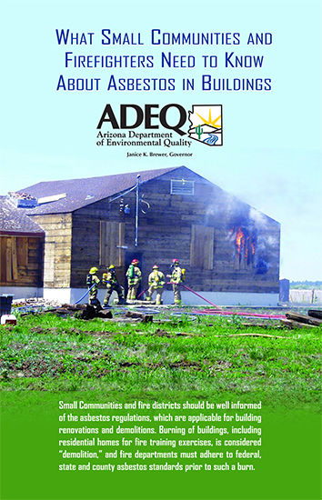
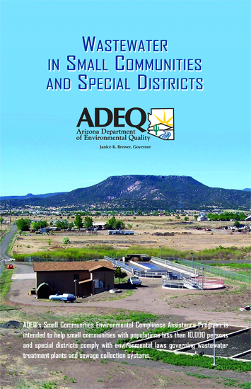
ADEQ’s Small Community Policy Additional Guidance - Brochures

Slide 24
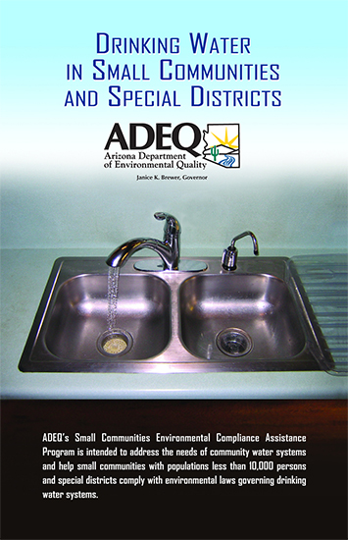
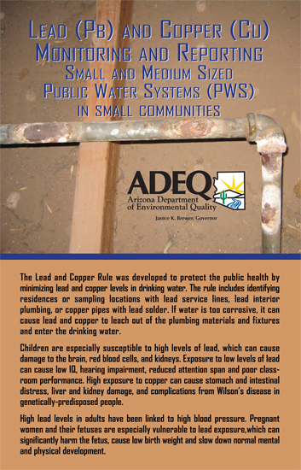
ADEQ’s Small Community Policy Additional Guidance - Brochures

Slide 25
For Assistance
Contact:
ADEQ Community Liaisons
Nancy Wrona (602) 771-2311
Melissa Hayes (520) 770-3309
Byron James (928) 337-3565
Roxanne Linsley (520) 628-6716
Sybil Smith (928) 679-7307
http://www.azdeq.gov/function/about/region.html
ADEQ Ombudsman
Ian Bingham (602) 771- 4322
Toll Free (800) 234-5677 ext. 771- 4322

