Slide 1
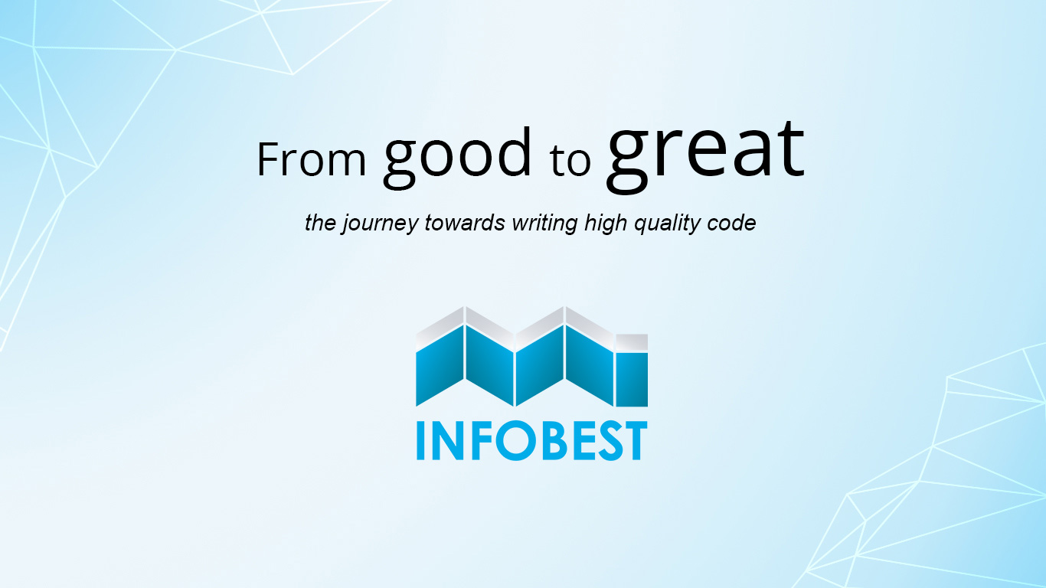
Professionalism and software quality

Slide 2


We rule the world.
Notes:
Nothing happens in our society, unless software is intimately involved with the monitoring and coordinating.
And we write that software. And that makes us the rulers of the world. Oh, other people think they make the rules. But then they hand those rules to us. And then we write those rules. And they execute in the machines that monitor and coordinate every aspect of our lives.
No correspondence is sent or received without software. No documents are written without software. No laws are passed or enforced without software. Nothing happens in our society unless software is somehow mediating it.
Software has become the most critical component in the infrastructure of our civilization.
Society doesn't really understand this yet. We don't really understand this yet, we programmers.
But the realization is beginning to dawn, both amongst society and amongst us.
That the software we write plays a critical role in our whole civilization.
That lives and fortunes are at stake.
And the realization is also beginning to dawn that much of this software is being written by people who do not profess a minimum level of discipline.

Slide 3

Being a professional is about taking responsibility.
You get out your checkbook ?
Notes:
Professionalism is certainly a badge of honor but it's also a marker of accountability and responsibility. The two go hand in hand obviously.
You can't take pride and honor in something that you can't be held accountable for.
It's a lot easier being a non-professional. Non-professionals don't have to take responsibility for anything. If a non-professional makes a mess, well, their employer cleans it up.
But when a professional makes a mess, the professional cleans it up. What would happen if you allowed a bug into production that cost your employer $10,000? The non-professional would just shrug it off and say, "Oh, sorry, stuff happens". But when you're a professional, you get out your checkbook and you right a check for $10,000. Yeah, it feels a little different when it's your own money on the line, doesn't it? But that's the feeling a professional has all the time. Because you see, being a professional is about taking responsibility.

Slide 4
Do not harm
to society
VW
to function
Knight Capitol, www.healthcare.gov
to structure
Toyota,
hard to read, hard to understand,
hard to change, hard to reuse
Notes:
First, you will do no harm to the society in which you live. - This is the rule that the VW programmers broke. The software that they wrote, the software that lied, might have helped their employer, Volkswagen, but it did not help society in general. In general, it was harmful to society and programmers must never do that. But how do you know if you're harming society or not? I mean, what about the software that drives weapons systems. Is that harmful to society? Or what about gambling software or sexist video games or pornography. If it's within the law it may still be harmful to society. Frankly that's just a matter for your own judgment. You'll just have to make the best call you can.
USA Obama care site - Who was responsible for that harm? Every programmer, team lead, architect, and director who knew that that system shouldn't be delivered and yet, remained silent.
Knight Capitol had promised to buy over seven billion dollars worth of stock. And they had to buy it. They, unfortunately, had to then sell it and they sold it at a loss of 460 million dollars. And unfortunately, they only had 360 million dollars in cash. They were bankrupt. 45 minutes, one dumb mistake, 460 million dollars. And what was that mistake? The mistake was that they did not know what their system was going to do.
Now again, this is all about risk. When the stakes are high, you have to drive your knowledge as close to perfection as you can get it. If there are lives at stake, you have to know that you're not going to kill anybody. And if there are fortunes at stake, you have to know that you're not gonna lose those fortunes. On the other hand, if you're writing a chat application or a simple shopping cart website, well then neither lives nor fortunes are at stake. Or are they? What if someone is using your chat application and they suddenly have a medical emergency and they type a message, "Help me, call 911" and your software drops that message? What if your website leaks personal information to hackers who use it to steal identities? And what if the poor functioning of your code drives customers and users away from that code to a competitor? What then? The point is that it's easy to underestimate the harm that your code can do. And that's because it's comforting to think that your code is not important enough to do any harm. But you're forgetting that software is very expensive to develop so at least the money spent developing that software are at stake. Not to mention the money that's at stake by the user depending on that software. No matter how you cut this, the bottom line is that there's almost always more at stake than you think.
The larger the mess, the less the certainty. Take the Toyota case, for example. Why didn't those developers know that their code could kill people? Do you think the fact that they had 10,000 global variables might have been a factor? Making a mess in the software undermines your ability to know what the code is going to do and, therefore, it undermines your ability to avoid harm. - Messy software is harmful software.
So what do we mean by harm to structure? Clearly tens of thousands of global variables is harmful to the structure of your code. So is leaving dead code in the code base. Structural harm is harm to the organization and content of the source code. Anything that makes the source code hard to read, hard to understand, hard to change, or hard to reuse is structural harm.

Slide 5
The first word of software is soft. It's supposed to be soft.
No product survives contact with the users.
Notes:
It's important for us to remember the reason that software exists in the first place. We invented it as a means to make the behavior of machines easy to change. To the extent that our software is hard to change, we have thwarted the very reason for its existence. Remember that there are two values to software. There's the value of its behavior, but then there's also the value of its softness, its structure.
Which of these two values is the greater? Which one should be prioritized above the other? We can answer these questions with a simple thought experiment. Imagine two programs. One does everything correctly but it's impossible to change. The other does nothing correctly but it's easy to change. Which of these two programs is the more valuable? Actually, the first case might as well be hardware and sometimes that's exactly what you want because the behavior is never going to change. But those cases are pretty rare. I hate to be the one to tell you this but in case you hadn't noticed it, software requirements tend to change. And when they change, that software will become useless forever. On the other hand, that second software, because it's easy to change, can be made to work. Oh, it might take a little bit of effort but then after that, that software will continue to work forever because it's easy to change.
No product survives contact with the users. As soon as you put the product into the user's hands, you'll find out that you built it wrong in 100 different ways. And if you can't change it because you made a mess you're doomed. Indeed, this is one of the problems we have with software startups. They'd be a lot better off, they'd get done a lot faster, with a lot fewer problems if they just protected the structure of their system from harm. - When it comes to software, it never pays to rush.

Slide 6
First make it work. Then make it right.
You understand of course that you're not done when the program works, right?
Notes:
You understand of course that you're not done when the program works, right. There's more to do.
Unfortunately most programmers don't think that way. Most programmers believe they are done when the program works. Illogical, getting the program to work is just the first and easiest step. The second and harder step is to clean the code. You ain't done 'til the jobs done right. This is actually a very large problem. There are many programmers who focus only on getting the code to work. Once it works they move on to the next program and then the next and then the next and then the next leaving behind them a wake of broken, tangled horrible code. Gosh Uncle Bob, why do they do that? Well Danny they do that because they feel that their value comes from speed. They know that they're paid a lot and so they feel this pressure to deliver a lot of functionality in a short amount of time. But then they realize how slowly they're actually going and hard it really is to get software working and that makes them feel like they're going too slowly. It makes them feel like they're failing. This feeling of failure creates a pressure that causes them to want to go faster and faster. It causes them to rush. When it comes to software it never pays to rush. So they rush to get the program working. Once it works, then they declare themselves to be done because in their minds it's already taken them too long. Yeah, well it's not just in their minds. Because their bosses want them to go fast too.
So the boss's pressure doesn't help but the real pressure comes from inside us. We consider speed of development to be a matter of our own self worth.

Slide 7
If not you, then who?
If you don't take responsibility for the structure of the system, who will? Your boss?
Notes:
So not only do you have the right as a stakeholder, but you also have the duty as an engineer to produce systems that do harm neither to behavior nor to structure.
Wo man, I man not sure that I want all that responsibility. You know like I think I'd be happier if they just told me what to do and then I do it.
Well Ruby a lot of programmers feel that way and it's a travesty. It's entirely unprofessional. Programmers who feel that way should be paid minimum wage. Because that's what their work output is worth.
Look, if you don't take responsibility for the structure of the system who will? Your boss?
Does your boss understand the solid principles?
Does your boss understand the principles of object oriented design?
Does your boss understand dependency inversion or design patterns?
Does your boss know how to do test driven development?
Does your boss know about the humble object pattern or self shunt or test specific subclasses?
Does your boss understand that things that change for different reasons should be separated, but things that change for the same reasons should be grouped together?
Does your boss understand software structure?
Or is your boss's understanding limited only to behavior? Structure matters.
If you're not going to care for it who will? If not you, then who? Yeah, yeah, but I mean what if my boss comes to me and says screw the structure just get it working? Well, you refuse. You have the right to refuse because you're a stakeholder. You have the duty to refuse because you're an engineer and engineers have responsibilities that your boss can't override. Yeah, but like then I'd be fired. Probably not. Most managers expect to have to fight for the things they want and need and they respect people who do likewise. Oh there will probably be a struggle, a confrontation, it won't be very comfortable. But you're a stakeholder and an engineer. It would not be professional for you to just back down and acquiesce. I don't know man. I'm just not real good at confrontation. None of us do. I mean we didn't become programmers because we like working with people. People skills are something that we have to learn a little bit more than other folks. We have to learn how to fight for what we know is right. Because taking responsibility for the things that matter and fighting for those things is how a professional behaves.

Slide 8
The Programmer's Oath
I promise that to the best of my ability and judgment

Slide 9
I will not produce harmful code.
One

Slide 10
The codes that I produce will always be my best work. I will not knowingly allow code that is defective, either in behavior or structure to accumulate.
Two

Slide 11
I will produce with each release, a quick, sure and repeatable proof, that every element of the code works as it should.
Three

Slide 12
I will make frequent small releases so that I do not impede the progress of others.
Four

Slide 13
I will fearlessly and relentlessly improve my creations at every opportunity. I will never degrade them.
Five

Slide 14
I will do all that I can to keep my own productivity and the productivity of others as high as possible. I will do nothing that decreases that productivity.
Six

Slide 15
I will continuously ensure that others can cover for me and that I can cover for them.
Seven

Slide 16
I will produce estimates that are honest, both in magnitude and precision. I will not make promises without certainty.
Eight

Slide 17
I will never stop learning and improving my craft.
Nine

Slide 18

Software quality
f(code, purpose)

Slide 19

Functionality
Suitability
This is the essential Functionality characteristic and refers to the appropriateness (to specification) of the functions of the software.
Accurateness
This refers to the correctness of the functions, an ATM may provide a cash dispensing function but is the amount correct?
Interoperability
A given software component or system does not typically function in isolation. This sub characteristic concerns the ability of a software component to interact with other components or systems.
Compliance
Where appropriate certain industry (or government) laws and guidelines need to be complied with, i.e. SOX. This sub characteristic addresses the compliant capability of software.
Security
This sub characteristic relates to unauthorized access to the software functions.
Notes:
The ISO 9126-1 software quality model identifies 6 main quality characteristics, namely:

Slide 20

Reliability
Maturity
This sub characteristic concerns frequency of failure of the software.
Fault tolerance
The ability of software to withstand (and recover) from component, or environmental, failure.
Recoverability
Ability to bring back a failed system to full operation, including data and network connections.
Notes:
To achieve high availability, which is considered five nines, or 99.999% availability, your software system can only be down for 5 minutes and 15 seconds or less during the course of a whole year!

Slide 21
Usability
Understandability
Determines the ease of which the systems functions can be understood, relates to user mental models in Human Computer Interaction methods.
Learnability
Learning effort for different users, i.e. novice, expert, casual etc.
Operability
Ability of the software to be easily operated by a given user in a given environment.

Slide 22
Efficiency
Resource behavior
Characterizes response times for a given thru put, i.e. transaction rate.
Characterizes resources used, i.e. memory, cpu, disk and network usage.
Time behavior

Slide 23
Maintainability
Analyzability
Characterizes the ability to identify the root cause of a failure within the software.
Changeability
Characterizes the amount of effort to change a system.
Stability
Characterizes the sensitivity to change of a given system that is the negative impact that may be caused by system changes.
Testability
Characterizes the effort needed to verify (test) a system change.

Slide 24
Portability
Adaptability
Characterizes the ability of the system to change to new specifications or operating environments.
Installability
Characterizes the effort required to install the software.
Conformance
Similar to compliance for functionality, but this characteristic relates to portability. One example would be Open SQL conformance which relates to portability of database used.
Replaceability
Characterizes the plug and play aspect of software components, that is how easy is it to exchange a given software component within a specified environment.

Slide 25
Code metrics
You can not improve what you cannot measure

Slide 26
Software package metrics
Number of classes and interfaces
Afferent couplings (Ca)
Efferent couplings (Ce)
Abstractness (A)
Instability (I = Ce / (Ce + Ca).
Distance from the main sequence (D = |A+I-1|)
Notes:
The term software package here refers to a group of related classes in object-oriented programming.
Number of classes and interfaces: The number of concrete and abstract classes (and interfaces) in the package is an indicator of the extensibility of the package.
Afferent couplings (Ca): The number of classes in other packages that depend upon classes within the package is an indicator of the package's responsibility. Afferent couplings signal inward.
Efferent couplings (Ce): The number of classes in other packages that the classes in a package depend upon is an indicator of the package's dependence on externalities. Efferent couplings signal outward.
Abstractness (A): The ratio of the number of abstract classes (and interfaces) in the analyzed package to the total number of classes in the analyzed package. The range for this metric is 0 to 1, with A=0 indicating a completely concrete package and A=1 indicating a completely abstract package.
Instability (I): The ratio of efferent coupling (Ce) to total coupling (Ce + Ca) such that I = Ce / (Ce + Ca). This metric is an indicator of the package's resilience to change. The range for this metric is 0 to 1, with I=0 indicating a completely stable package and I=1 indicating a completely unstable package.
Distance from the main sequence (D): The perpendicular distance of a package from the idealized line A + I = 1. D is calculated as D = | A + I - 1 |. This metric is an indicator of the package's balance between abstractness and stability. A package squarely on the main sequence is optimally balanced with respect to its abstractness and stability. Ideal packages are either completely abstract and stable (I=0, A=1) or completely concrete and unstable (I=1, A=0). The range for this metric is 0 to 1, with D=0 indicating a package that is coincident with the main sequence and D=1 indicating a package that is as far from the main sequence as possible.
Package dependency cycles: Package dependency cycles are reported along with the hierarchical paths of packages participating in package dependency cycles.

Slide 27
Maintainability Index Cyclomatic Complexity Depth of Inheritance Class Coupling Lines of Code
Code metrics by tools
Notes:
Maintainability Index - Calculates an index value between 0 and 100 that represents the relative ease of maintaining the code. A high value means better maintainability. Color coded ratings can be used to quickly identify trouble spots in your code. A green rating is between 20 and 100 and indicates that the code has good maintainability. A yellow rating is between 10 and 19 and indicates that the code is moderately maintainable. A red rating is a rating between 0 and 9 and indicates low maintainability.
Cyclomatic Complexity - Measures the structural complexity of the code. It is created by calculating the number of different code paths in the flow of the program. A program that has complex control flow will require more tests to achieve good code coverage and will be less maintainable.
Depth of Inheritance - Indicates the number of class definitions that extend to the root of the class hierarchy. The deeper the hierarchy the more difficult it might be to understand where particular methods and fields are defined or/and redefined.
Class Coupling - Measures the coupling to unique classes through parameters, local variables, return types, method calls, generic or template instantiations, base classes, interface implementations, fields defined on external types, and attribute decoration. Good software design dictates that types and methods should have high cohesion and low coupling. High coupling indicates a design that is difficult to reuse and maintain because of its many interdependencies on other types.
Lines of Code - Indicates the approximate number of lines in the code. The count is based on the IL code and is therefore not the exact number of lines in the source code file. A very high count might indicate that a type or method is trying to do too much work and should be split up. It might also indicate that the type or method might be hard to maintain.

Slide 28
Bibliography
Robert C. Martin – Clean Coder
http://www.sqa.net/iso9126.html
https://en.wikipedia.org/wiki/Software_package_metrics
Software Architect's Handbook by Joseph Ingeno

