Slide 1
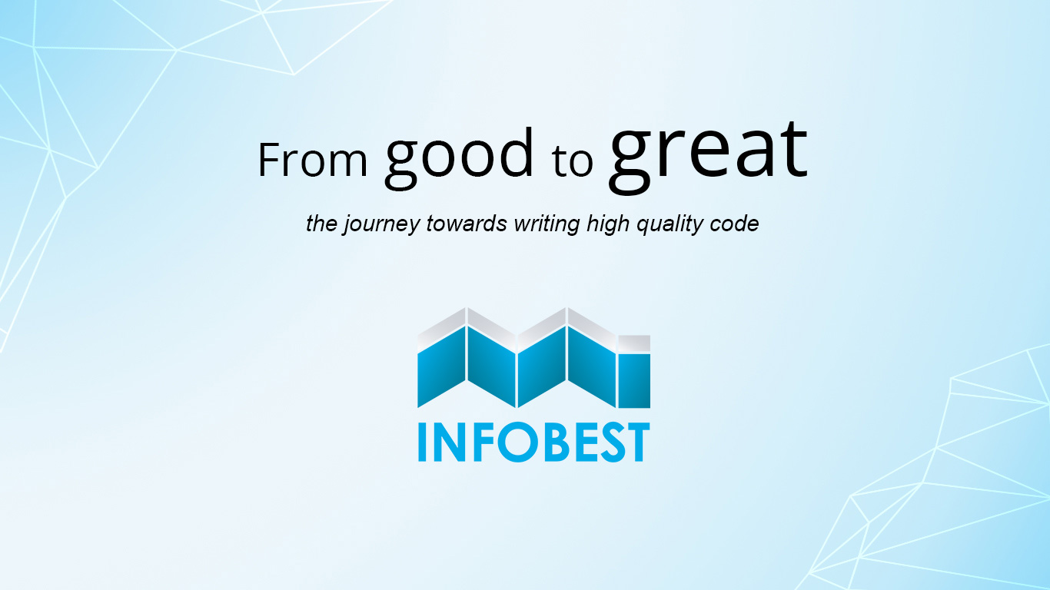
Test after

Slide 2
I will produce with each release, a quick, sure and repeatable proof, that every element of the code works as it should.
Three
Notes:
Quick in the sense that the tests have to run fast, minutes instead of hours. Sure in the sense that when they run they produce a binary output, pass or fail, and when they pass it means you can ship, and repeatable in the sense that the test can be run by anybody at any time, in any kind of environment, and in fact we want these tests run many, many times a day. Do you think it's too much to ask that programmers supply this level of proof? Do you think it's unreasonable that programmers should be held to that high a standard?
What you owe when you make that promise is a suite of tests, a suite of tests that runs in seconds or minutes, a suite of tests that covers every required behavior, and a suite of tests that produces the same binary pass/fail result every time it is run.

Slide 3

Who could ever release code that doesn't have defects in it?

Slide 4

FOUR REASONS TO CHANGE SOFTWARE
Adding a feature
Fixing a bug
Improving the design
Optimizing resource usage
Notes:
Changing code is great. It’s what we do for a living. But there are ways of changing code that make life difficult, and there are ways that make it much easier.
Adding a feature seems like the most straightforward type of change to make. The software behaves one way, and users say that the system needs to do something else also.
Is this fixing a bug or adding a new feature?
There is a big difference between adding new behavior and changing old behavior.
Behavior is the most important thing about software. It is what users depend on. Users like it when we add behavior (provided it is what they really wanted), but if we change or remove behavior they depend on (introduce bugs), they stop trusting us.
If we have to modify code (and HTML kind of counts as code), we could be changing behavior. If we are only adding code and calling it, we are often adding behavior.
Design improvement is a different kind of software change. When we want to alter software’s structure to make it more maintainable, generally we want to keep its behavior intact also. When we drop behavior in that process, we often call that a bug. One of the main reasons why many programmers don’t attempt to improve design often is because it is relatively easy to lose behavior or create bad behavior in the process of doing it.
The act of improving design without changing its behavior is called refactoring. The idea behind refactoring is that we can make software more maintainable without changing behavior if we write tests to make sure that existing behavior doesn’t change and take small steps to verify that all along the process.
Optimization is like refactoring, but when we do it, we have a different goal. In optimization, the “something else” is some resource used by the program, usually time or memory.

Slide 5
RISKY CHANGE
To mitigate risk, we have to ask three questions:
What changes do we have to make?
How will we know that we’ve done them correctly?
How will we know that we haven’t broken anything?
Notes:
Preserving existing behavior is one of the largest challenges in software development. Even when we are changing primary features, we often have very large areas of behavior that we have to preserve
How much change can you afford if changes are risky?
Most teams that I’ve worked with have tried to manage risk in a very conservative way. They minimize the number of changes that they make to the code base. Sometimes this is a team policy: “If it’s not broke, don’t fix it.” At other times, it isn’t anything that anyone articulates. The developers are just very cautious when they make changes. “What? Create another method for that? No, I’ll just put the lines of code right here in the method, where I can see them and the rest of the code. It involves less editing, and it’s safer.”
Avoiding change has other bad consequences. When people don’t make changes often they get rusty at it. Breaking down a big class into pieces can be pretty involved work unless you do it a couple of times a week. When you do, it becomes routine. You get better at figuring out what can break and what can’t, and it is much easier to do.
The last consequence of avoiding change is fear. Unfortunately, many teams live with incredible fear of change and it gets worse every day. Often they aren’t aware of how much fear they have until they learn better techniques and the fear starts to fade away.

Slide 6

Changes in a system can be made in two primary ways:
Edit and Pray
Cover and Modify
Notes:
Unfortunately, Edit and Pray is pretty much the industry standard. When you use Edit and Pray, you carefully plan the changes you are going to make, you make sure that you understand the code you are going to modify, and then you start to make the changes. When you’re done, you run the system to see if the change was enabled, and then you poke around further to make sure that you didn’t break anything. The poking around is essential. When you make your changes, you are hoping and praying that you’ll get them right, and you take extra time when you are done to make sure that you did.
Superficially, Edit and Pray seems like “working with care,” a very professional thing to do.
But safety isn’t solely a function of care. Effective software change, like effective surgery, really involves deeper skills. Working with care doesn’t do much for you if you don’t use the right tools and techniques.
Cover and Modify is a different way of making changes. The idea behind it is that it is possible to work with a safety net when we change software.
When we have a good set of tests around a piece of code, we can make changes and find out very quickly whether the effects were good or bad. We still apply the same care, but with the feedback we get, we are able to make changes more carefully.

Slide 7
Unit tests
Tests in isolation of individual components of software.
Error localization
Execution time
Coverage
Notes:
Unit testing is one of the most important components in legacy code work. System-level regression tests are great, but small, localized tests are invaluable. They can give you feedback as you develop and allow you to refactor with much more safety.
Testing in isolation is an important part of the definition of a unit test, but why is it important? After all, many errors are possible when pieces of software are integrated. Shouldn’t large tests that cover broad functional areas of code be more important? Well, they are important, I won’t deny that, but there are a few problems with large tests:
One of the most frustrating things about larger tests is that we can have error localization if we run our tests more often, but it is very hard to achieve. If we run our tests and they pass, and then we make a small change and they fail, we know precisely where the problem was triggered. It was something we did in that last small change. We can roll back the change and try again. But if our tests are large, execution time can be too long; our tendency will be to avoid running the tests often enough to really localize errors.
Testarea privatelor
Operatori de comparare

Slide 8
A unit test that takes 1/10th of a second to run is a slow unit test.
Unit tests run fast. If they don’t run fast, they aren’t unit tests.
Other kinds of tests often masquerade as unit tests. A test is not a unit test if:
It talks to a database.
It communicates across a network.
It touches the file system.
You have to do special things to your environment (such as editing configuration files) to run it.
Notes:
Tests that do these things aren’t bad. Often they are worth writing, and you generally will write them in unit test harnesses. However, it is important to be able to separate them from true unit tests so that you can keep a set of tests that you can run fast whenever you make changes.

Slide 9
Dependency is one of the most critical problems in software development.
Much legacy code work involves breaking dependencies so that change can be easier.
Notes:
The Legacy Code Dilemma - When we change code, we should have tests in place. To put tests in place, we often have to change code.
When you break dependencies in legacy code, you often have to suspend your sense of aesthetics a bit. Some dependencies break cleanly; others end up looking less than ideal from a design point of view. They are like the incision points in surgery: There might be a scar left in your code after your work, but everything beneath it can get better.If later you can cover code around the point where you broke the dependencies, you can heal that scar, too.reak dependencies, we can often write tests that make more invasive changes safer. The trick is to do these initial refactorings very conservatively.

Slide 10
Fakes & mocks
A fake object is an object that impersonates some collaborator of your class when it is being tested.
Mock objects are fakes that perform assertions internally
Notes:
One of the big problems that we confront in legacy code work is dependency. If we want to execute a piece of code by itself and see what it does, often we have to break dependencies on other code. But it’s hardly ever that simple. Often that other code is the only place we can easily sense the effects of our actions. If we can put some other code in its place and test through it, we can write our tests. In object orientation, these other pieces of code are often called fake objects.
Fake Objects Support Real TestsSometimes when people see the use of fake objects, they say, “That’s not really testing.” After all, this test doesn’t show us what really gets displayed on the real screen. Suppose that some part of the cash register display software isn’t working properly; this test would never show it. Well, that’s true, but that doesn’t mean that this isn’t a real test. Even if we could devise a test that really showed us exactly which pixels were set on a real cash register display, does that mean that the software would work with all hardware? No, it doesn’t—but that doesn’t mean that that isn’t a test, either. When we write tests, we have to divide and conquer. This test tells us how Sale objects affect displays, that’s all. But that isn’t trivial. If we discover a bug, running this test might help us see that the problem isn’t in Sale. If we can use information like that to help us localize errors, we can save an incredible amount of time.When we write tests for individual units, we end up with small, well-understood pieces. This can make it easier to reason about our code.
Fakes are easy to write and are a very valuable tool for sensing. If you have to write a lot of them, you might want to consider a more advanced type of fake called a mock object. Mock objects are fakes that perform assertions internally.
The nice thing about mocks is that we can tell them what calls to expect, and then we tell them to check and see if they received those calls.

Slide 11
Dependency-Breaking Techniques
Add a seam
01
EXTRACT INTERFACE
EXTRACT IMPLEMENTER
ADAPT PARAMETER
Break a chunk
02
EXPOSE STATIC METHOD
BREAK OUT METHOD OBJECT
Add a wrapper
03
ENCAPSULATE GLOBAL REFERENCES
EXTRACT AND OVERRIDE CALL
Notes:
Technically, these techniques are refactorings—each of them preserves behavior. But unlike most refactorings written up in the industry so far, these refactorings are intended to be done without tests, to get tests in place. In most cases, if you follow the steps carefully, the chance of mistakes is small. This doesn’t mean that they are completely safe. It is still possible to make mistakes when you perform them, so you should exercise care when you use them.
EXTRACT INTERFACE
In many languages, Extract Interface is a one of the safest dependency-breaking techniques. If you get a step wrong, the compiler tells you immediately, so there is very little chance of introducing a bug. The gist of it is that you create an interface for a class with declarations for all of the methods that you want to use in some context. When you’ve done that, you can implement the interface to sense or separate, passing a fake object into the class you want to test.
EXTRACT IMPLEMENTER (keep current name for interface and move code under a new name)
ADAPT PARAMETER => wrap parameter in a small interface if the original is to wide and only part of it is used
Move toward interfaces that communicate responsibilities rather than implementation details. This makes code easier to read and easier to maintain.
EXPOSE STATIC METHOD
Working with classes that can’t be instantiated in a test harness is pretty tricky. Here is a technique that I use in some cases. If you have a method that doesn’t use instance data or methods, you can turn it into a static method. When it is static, you can get it under test without having to instantiate the class.
BREAK OUT METHOD OBJECT
if your method is large or does use instance data and methods, consider using Break Out Method Object. In a nutshell, the idea behind this refactoring is to move a long method to a new class.
ENCAPSULATE GLOBAL REFERENCES (for global variables)
When you are trying to test code that has problematic dependencies on globals, you essentially have three choices. You can try to make the globals act differently under test, you can link to different globals, or you can encapsulate the globals so that you can decouple things further. The last option is called Encapsulate Global References.
EXTRACT AND OVERRIDE CALL (for global/static methods)
Extract and Override Call is a very useful refactoring; I use it very often. It is an ideal way to break dependencies on global variables and static methods. In general, I tend to use it unless there are many different calls against the same global. If there are, I often use Replace Global Reference with Getter(399) instead.

Slide 12
Techniques you can use to make changes without getting existing classes under test
SPROUT METHOD
SPROUT CLASS
WRAP METHOD
WRAP CLASS
Notes:
SPROUT METHOD
When you need to add a feature to a system and it can be formulated completely as new code, write the code in a new method. Call it from the places where the new functionality needs to be. You might not be able to get those call points under test easily, but at the very least, you can write tests for the new code.
SPROUT CLASS
Sprout Method is a powerful technique, but in some tangled dependency situations, it isn’t powerful enough.
Consider the case in which you have to make changes to a class, but there is just no way that you are going to be able to create objects of that class in a test harness in a reasonable amount of time, so there is no way to sprout a method and write tests for it on that class. Maybe you have a large set of creational dependencies, things that make it hard to instantiate your class. Or you could have many hidden dependencies. To get rid of them, you’d need to do a lot of invasive refactoring to separate them out well enough to compile the class in a test harness.
In these cases, you can create another class to hold your changes and use it from the source class.
WRAP METHOD
This is one form of Wrap Method. We create a method with the name of the original method and have it delegate to our old code. We use this when we want to add behavior to existing calls of the original method. If every time a client calls pay() we want logging to occur, this technique can be very useful.
There is another form of Wrap Method that we can use when we just want to add a new method, a method that no one calls yet. In the previous example, if we wanted logging to be explicit, we could add a makeLoggedPayment method to Employee like this:
WRAP CLASS
The class-level companion to Wrap Method is Wrap Class. Wrap Class uses pretty much the same concept. If we need to add behavior in a system, we can add it to an existing method, but we can also add it to something else that uses that method. In Wrap Class, that something else is another class.
The difference between Sprout Method and Wrap Method is pretty trivial. You are using Sprout Method when you choose to write a new method and call it from an existing method. You are using Wrap Method when you choose to rename a method and replace it with a new one that does the new work and calls the old one. I usually use Sprout Method when the code I have in the existing method communicates a clear algorithm to the reader. I move toward Wrap Method when I think that the new feature I’m adding is as important as the work that was there before. In that case, after I’ve wrapped, I often end up with a new high-level algorithm.
Choosing to use Wrap Class is a whole other issue. There is a higher threshold for this pattern. Generally two cases tip me toward using Wrap Class:
1. The behavior that I want to add is completely independent, and I don’t want to pollute the existing class with behavior that is low level or unrelated.
2. The class has grown so large that I really can’t stand to make it worse. In a case like this, I wrap just to put a stake in the ground and provide a roadmap for later changes.

Slide 13
Tests can only prove a program wrong, and can never prove it correct.
Notes:
That's the kind of proof that test-driven development gives us, not mathematical formal proof, but experimental empirical proof. The kind of proof that scientists depend upon everyday.

Slide 14
Is it worth it?
Notes:
The truth is, the work that you do to break dependencies and write tests for your changes is going to take some time, but in most cases, you are going to end up saving time—and a lot of frustration. When? Well, it depends on the project. In some cases, you might write tests for some code that you need to change, and it takes you two hours to do that. The change that you make afterward might take 15 minutes. When you look back on the experience, you might say, “I just wasted two hours—was it worth it?” It depends. You don’t know how long that work might have taken you if you hadn’t written the tests. You also don’t know how much time it would’ve taken you to debug if you made a mistake, time you could have saved if you had tests in place. I’m not only talking about the amount of time you would save if the tests caught the error, but also the amount of time tests save you when you are trying to find an error. With tests around the code, nailing down functional problems is often easier.

Slide 15
Bibliography
Michael Feathers - Working Effectively with Legacy Code
Robert C. Martin – Clean Coder

Slide 16
Annex: git cheat sheet
git clone https://github.com/infobest-aclabs/aclabs2019.git
git status
git branch –b my_special_branch
git pull
git commit –m ‘What have you worked on’
git push
git add .

