Slide 1

TDD

Slide 2
I will produce with each release, a quick, sure and repeatable proof, that every element of the code works as it should.
Three
Notes:
Quick in the sense that the tests have to run fast, minutes instead of hours. Sure in the sense that when they run they produce a binary output, pass or fail, and when they pass it means you can ship, and repeatable in the sense that the test can be run by anybody at any time, in any kind of environment, and in fact we want these tests run many, many times a day. Do you think it's too much to ask that programmers supply this level of proof? Do you think it's unreasonable that programmers should be held to that high a standard?
What you owe when you make that promise is a suite of tests, a suite of tests that runs in seconds or minutes, a suite of tests that covers every required behavior, and a suite of tests that produces the same binary pass/fail result every time it is run.

Slide 3
What if we had a suite of tests that was so comprehensive that virtually no bug could escape it? What if that suite of tests could execute in a matter of minutes? What if any programmer could run that suite of tests at the mere click of a button or the typing of a simple command? What if that suite of tests could never get out of date with a system? What effect would that suite of tests have on the fear of changing the code?

Slide 4
You are not allowed to write any production code until you have first written a failing unit test.
First law

Slide 5
You're not allowed to write more of a unit test than is sufficient to fail, and not compiling is failing.
Second law

Slide 6
You're not allowed to write more production code than is sufficient to pass the currently failing test.
Third law

Slide 7
The tests are a low level design document

Slide 8
Another word for testable is decoupled
Writing tests first makes production code testable.

Slide 9
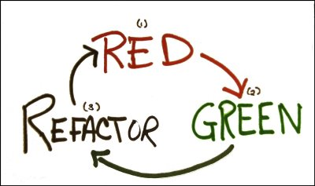
1. Create a unit tests that fails. 2. Write production code that makes that test pass. 3. Clean up the mess you just made.
RGR cycle

Slide 10

As the tests get more specific, the code gets more generic.

Slide 11
Transformation Priority Premise
({}–>nil) no code at all->code that employs nil
(nil->constant)
(constant->constant+) a simple constant to a more complex constant
(constant->scalar) replacing a constant with a variable or an argument
(statement->statements) adding more unconditional statements.
(unconditional->if) splitting the execution path

Slide 12
Transformation Priority Premise
(scalar->array)
(array->container)
(statement->recursion)
(if->while)
(expression->function) replacing an expression with a function or algorithm
(variable->assignment) replacing the value of a variable.

Slide 13
Bibliography
Robert C. Martin – Clean Code
Kent Beck - Test Driven Development: By Example

Slide 14
Annex: git cheat sheet
git clone https://github.com/infobest-aclabs/aclabs2019.git
git status
git branch –b my_special_branch
git pull
git commit –m ‘What have you worked on’
git push

