Slide 1

Technical debt
&
Refactorings

Slide 2
The codes that I produce will always be my best work. I will not knowingly allow code that is defective, either in behavior or structure to accumulate.
Two

Slide 3
I will fearlessly and relentlessly improve my creations at every opportunity. I will never degrade them.
Five

Slide 4
Technical Debt
Type I
Strategic
Type II
Stuff that happens

Slide 5
Design principles
Compiler warnings
Code smells
Standards Violation
Metrics violation
How do you know?
Notes:
Design principles – solid – how to measure them?
Compiler warnings - 0
Code smells
Standards Violation
Metrics violation

Slide 6
Maintainability Index Cyclomatic Complexity Depth of Inheritance Class Coupling Lines of Code
Code metrics by tools
Notes:
Maintainability Index - Calculates an index value between 0 and 100 that represents the relative ease of maintaining the code. A high value means better maintainability. Color coded ratings can be used to quickly identify trouble spots in your code. A green rating is between 20 and 100 and indicates that the code has good maintainability. A yellow rating is between 10 and 19 and indicates that the code is moderately maintainable. A red rating is a rating between 0 and 9 and indicates low maintainability.
Cyclomatic Complexity - Measures the structural complexity of the code. It is created by calculating the number of different code paths in the flow of the program. A program that has complex control flow will require more tests to achieve good code coverage and will be less maintainable.
Depth of Inheritance - Indicates the number of class definitions that extend to the root of the class hierarchy. The deeper the hierarchy the more difficult it might be to understand where particular methods and fields are defined or/and redefined.
Class Coupling - Measures the coupling to unique classes through parameters, local variables, return types, method calls, generic or template instantiations, base classes, interface implementations, fields defined on external types, and attribute decoration. Good software design dictates that types and methods should have high cohesion and low coupling. High coupling indicates a design that is difficult to reuse and maintain because of its many interdependencies on other types.
Lines of Code - Indicates the approximate number of lines in the code. The count is based on the IL code and is therefore not the exact number of lines in the source code file. A very high count might indicate that a type or method is trying to do too much work and should be split up. It might also indicate that the type or method might be hard to maintain.

Slide 7
the refactoring effort needed to add a feature non-invasively
Technical debt

Slide 8
When to refactor?

Slide 9
TDD Refactoring Litter-Pickup Refactoring Comprehension Refactoring Preparatory Refactoring Planned Refactoring Long-Term Refactoring
Notes:
Two different hats – add functionality & refactoring
Comprehension Refactoring: Making Code Easier to Understand - by refactoring I move the understanding from my head into the code itself. Ralph Johnson describes these early refactorings as wiping the dirt off a window so you can see beyond.
Preparatory Refactoring—Making It Easier to Add a Feature

Slide 10
Wasteful rework?

Slide 11
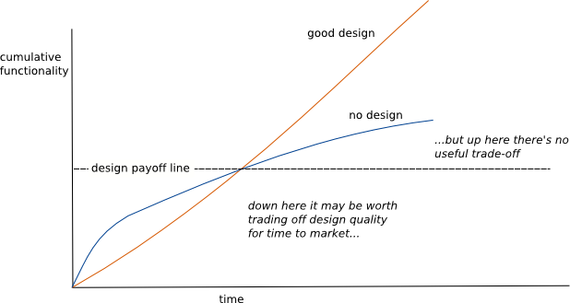
Design Stamina Hypothesis
Is it worth the effort to design software well?
Notes:
When I talk to software developers who have been working on a system for a while, I often hear that they were able to make progress rapidly at first, but now it takes much longer to add new features. Every new feature requires more and more time to understand how to fit it into the existing code base, and once it’s added, bugs often crop up that take even longer to fix. The code base starts looking like a series of patches covering patches, and it takes an exercise in archaeology to figure out how things work. This burden slows down adding new features—to the point that developers wish they could start again from a blank slate.
But some teams report a different experience. They find they can add new features faster because they can leverage the existing things by quickly building on what’s already there.
The difference between these two is the internal quality of the software. Software with a good internal design allows me to easily find how and where I need to make changes to add a new feature. Good modularity allows me to only have to understand a small subset of the code base to make a change. If the code is clear, I’m less likely to introduce a bug, and if I do, the debugging effort is much easier. Done well, my code base turns into a platform for building new features for its domain.

Slide 12
Bad Smells in Code by Kent Beck and Martin Fowler
“If it stinks, change it.”
— Grandma Beck, discussing child-rearing philosophy

Slide 13
COMMENTS
Notes:
It’s surprising how often you look at thickly commented code and notice that the comments are there because the code is bad.
When you feel the need to write a comment, first try to refactor the code so that any comment becomes superfluous.

Slide 14
MYSTERIOUS NAME
Notes:
Puzzling over some text to understand what’s going on is a great thing if you’re reading a detective novel, but not when you’re reading code.
When you can’t think of a good name for something, it’s often a sign of a deeper design malaise.

Slide 15
DUPLICATED CODE
Notes:
Duplication means that every time you read these copies, you need to read them carefully to see if there’s any difference. If you need to change the duplicated code, you have to find and catch each duplication.

Slide 16
LONG FUNCTION
Notes:
Programmers new to such a code base often feel that no computation ever takes place—that the program is an endless sequence of delegation. When you have lived with such a program for a few years, however, you learn just how valuable all those little functions are. All of the payoffs of indirection—explanation, sharing, and choosing—are supported by small functions.
A heuristic we follow is that whenever we feel the need to comment something, we write a function instead.

Slide 17
LONG PARAMETER LIST
Notes:
Classes are a great way to reduce parameter list sizes. They are particularly useful when multiple functions share several parameter values.

Slide 18
GLOBAL DATA
Notes:
Since our earliest days of writing software, we were warned of the perils of global data—how it was invented by demons from the fourth plane of hell, which is the resting place of any programmer who dares to use it.
The problem with global data is that it can be modified from anywhere in the code base, and there’s no mechanism to discover which bit of code touched it.
Global data is especially nasty when it’s mutable.

Slide 19
DIVERGENT CHANGE
Notes:
Divergent change occurs when one module is often changed in different ways for different reasons.

Slide 20
FEATURE ENVY
Notes:
A classic case of Feature Envy occurs when a function in one module spends more time communicating with functions or data inside another module than it does within its own module. We’ve lost count of the times we’ve seen a function invoking half-a-dozen getter methods on another object to calculate some value.
The function clearly wants to be with the data.

Slide 21
DATA CLUMPS
Notes:
Data items tend to be like children: They enjoy hanging around together. Often, you’ll see the same three or four data items together in lots of places: as fields in a couple of classes, as parameters in many method signatures. Bunches of data that hang around together really ought to find a home together.

Slide 22
REPEATED SWITCHES
Notes:
focus on the repeated switch, where the same conditional switching logic (either in a switch/case statement or in a cascade of if/else statements) pops up in different places. The problem with such duplicate switches is that, whenever you add a clause, you have to find all the switches and update them.

Slide 23
LARGE CLASS
Notes:
When a class is trying to do too much, it often shows up as too many fields. When a class has too many fields, duplicated code cannot be far behind.

Slide 24
DATA CLASS

Slide 25
Simplifying Conditional Logic

Slide 26
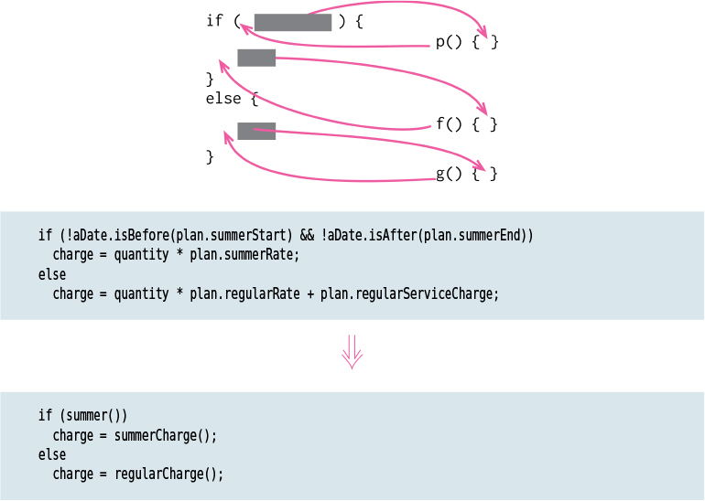
Decompose Conditional
Notes:
One of the most common sources of complexity in a program is complex conditional logic.
I highlight the condition and make it clear what I’m branching on. I also highlight the reason for the branching.

Slide 27
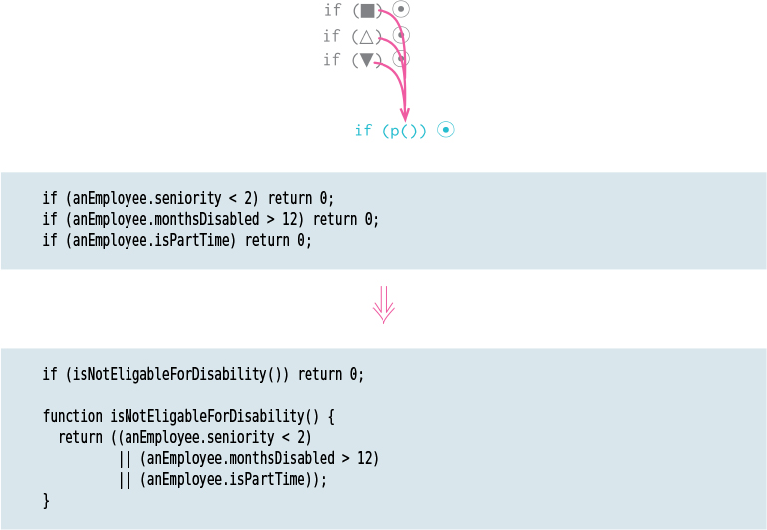
Consolidate Conditional Expression
Notes:
Consolidating the conditional code is important for two reasons. First, it makes it clearer by showing that I’m really making a single check that combines other checks. The sequence has the same effect, but it looks like I’m carrying out a sequence of separate checks that just happen to be close together.
Extracting a condition is one of the most useful things I can do to clarify my code. It replaces a statement of what I’m doing with why I’m doing it.
If I consider it to be truly independent checks that shouldn’t be thought of as a single check, I don’t do the refactoring.

Slide 28
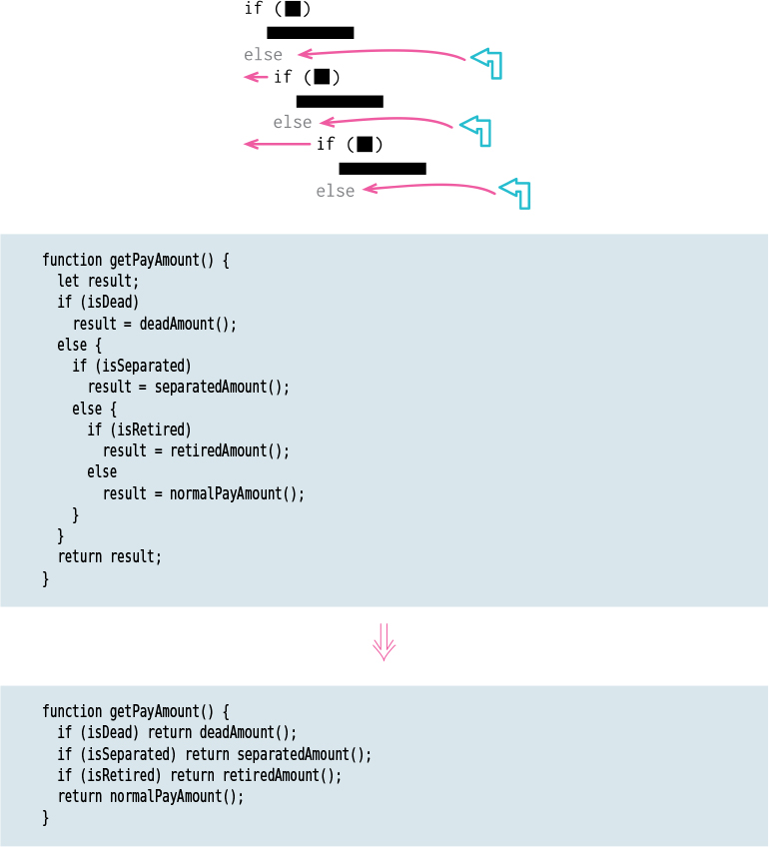
Replace Nested Conditional with Guard Clauses
Notes:
If both are part of normal behavior, I use a condition with an if and an else leg. If the condition is an unusual condition, I check the condition and return if it’s true. This kind of check is often called a guard clause.
Clarity is the key principle: If the method is clearer with one exit point, use one exit point; otherwise don’t.

Slide 29
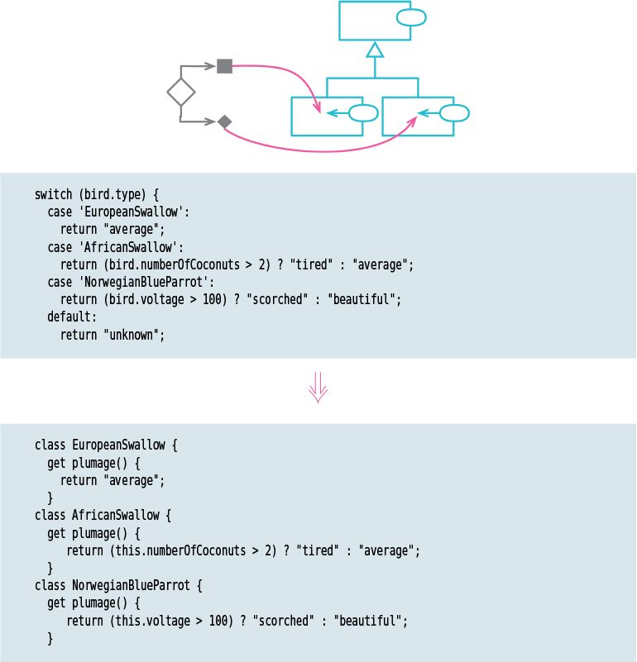
Replace Conditional with Polymorphism

Slide 30
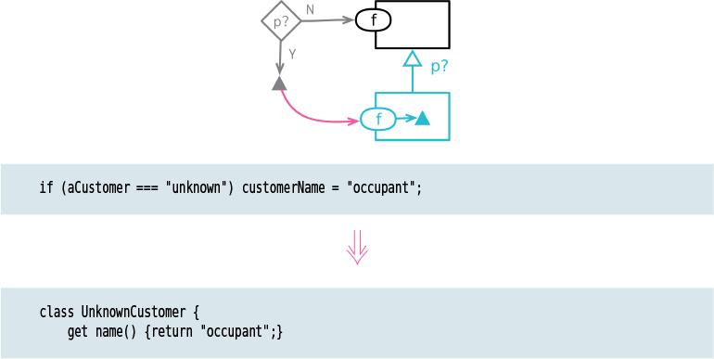
Introduce Special Case
Notes:
formerly: Introduce Null Object
A common case of duplicated code is when many users of a data structure check a specific value, and then most of them do the same thing. If I find many parts of the code base having the same reaction to a particular value, I want to bring that reaction into a single place.

Slide 31
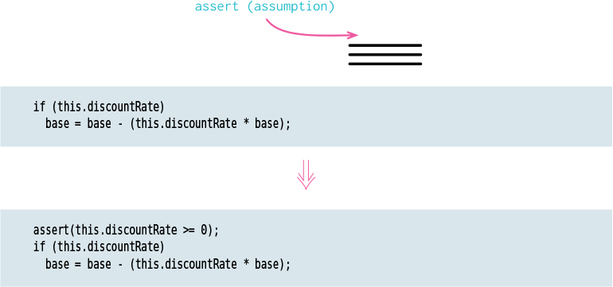
Introduce Assertion
Notes:
Often, sections of code work only if certain conditions are true. Such assumptions are often not stated but can only be deduced by looking through an algorithm. Sometimes, the assumptions are stated with a comment. A better technique is to make the assumption explicit by writing an assertion.
An assertion is a conditional statement that is assumed to be always true. Failure of an assertion indicates a programmer error. Assertion failures should never be checked by other parts of the system. Assertions should be written so that the program functions equally correctly if they are all removed; indeed, some languages provide assertions that can be disabled by a compile-time switch.

Slide 32
Annex: git cheat sheet
git clone https://github.com/infobest-aclabs/aclabs2019.git
git status
git branch –b my_special_branch
git pull
git commit –m ‘What have you worked on’
git push
git add .

Slide 33
Bibliography
Robert C. Martin – Clean Coder
Escaping the Technical Debt Cycle - Michael Feathers
https://www.youtube.com/watch?v=7hL6g1aTGvo
Workflows of Refactoring - Martin Fowler
https://www.youtube.com/watch?reload=9&v=vqEg37e4Mkw
https://martinfowler.com/articles/workflowsOfRefactoring/
Martin Fowler - Refactoring: Improving the Design of Existing Code

