Slide 1

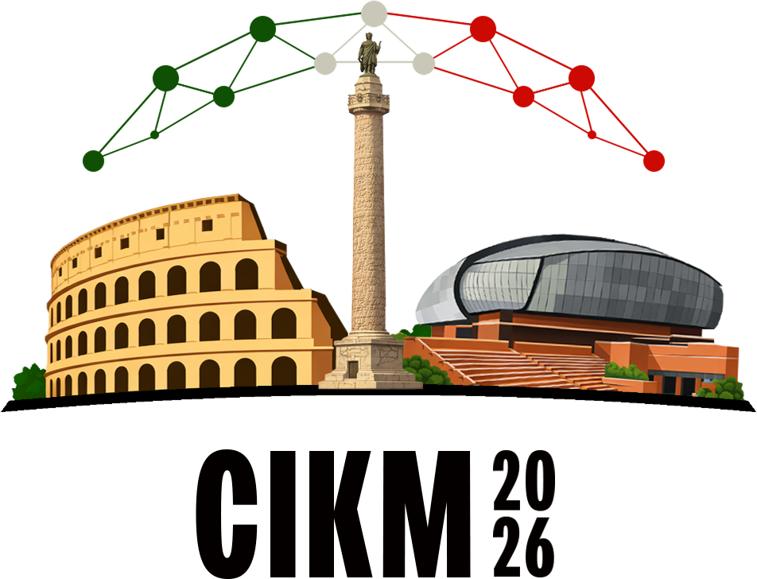

Agents write code faster
than humans can review it.
With autopilot, the pilot still works hardest at takeoff and landing.
Human
Involvement
review
Agent
delegation increases
execute
Research
Planning
Task Definition
Implementation
refine
A Phased Workflow for Operating LLM-Based Coding Agents
Ante Kapetanovic, Tomislav Duricic, Andro Mercep, Emanuel Lacic
Join us during the poster session

