Slide 1
INTRODUCTION TO
12 VOLT DC TO 220VOLT AC INVERTER

Slide 2
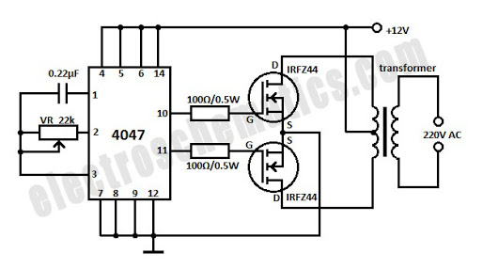
Schematic of the DC to AC Inverter Circuit

Slide 3
USED COMPONENT
IC 4047.
IRF44 MOSFET .
12 VOLT 1 AMP TRANSFORMMER.
100R 0.5 WATT RESISTOR .
22K VARIABLE RESISTOR.
0.22 UF CAPACITOR.

Slide 4
WORKING
This is a quite simple dc to ac inverter that provides 220VAC when a 12VDC power source is provided. It can be used to power very light loads like night lamps and cordless telephones, but can be modified into a powerful inverter by adding more mosfets. It uses 2 power irfz44 mosfets for driving the output power and the 4047 ic as an astable multivibrator operating at a frequency of around 50 HZ.
The 10 and 11 pin outputs of the IC directly drive power MOSFETS that are used in push-pull configuration. The output transformer has a 9V-0-9V, 2 amps on the secondary and 230V on the primary. Use suitable heat-sinks for mosfets.

Slide 5
COMPONENTG DESCRIPTION
1- IC 4047 (low power monostable /astable multivibrator)
The CD4047B is capable of operating in either the Monostable or astable mode.
It requires an external capacitor (Between pins 1 and 3) and an external resistor
(Between pins 2 and 3) to determine the output pulse width In the monostable
mode, and the output frequency in the Astable mode.
FEATURES
Wide supply voltage range 3volt to 15 volt.
High noise immunity 0.45VDD.
Low power TTL compatibility.
Low power consumption.
Monostable or Astable operation.

Slide 6
IRF44 MOSFET(Power mosfet)
Third generation power mosfets from Vishay provide the Designer with the best combination of fast switching, Ruggedized device design, low on-resistance and Cost-effectiveness.
FEATURES
• Dynamic dV/dt Rating
• 175 °C Operating Temperature
• Fast Switching
• Ease of Paralleling
• Simple Drive Requirements
• Compliant to RoHS Directive 2002/95/EC

Slide 7
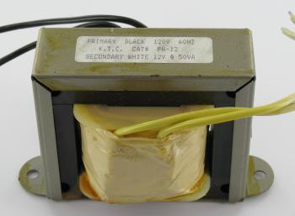
TRANSFORMER

Slide 8
TRANSFORMER WORKING
1- Transformers are composed of a laminated iron core with one or more windings of wire. They are called transformers because they transform voltage and current from one level to another. An alternating current flowing through one coil of wire, the primary, induces a voltage in one or more other coils of wire, the secondary coils. It is the changing voltage of AC current that induces voltage in the other coils through the changing magnetic field. DC voltage such as from a battery or DC power supply will not work in a transformer. Only AC makes a transformer work. The magnetic field flows through the iron core. The faster the voltage change.
2- A transformer can actually be used in reverse and will work fine. For example, if you have a step up transformer built for transforming 120 volts to 240 volts, you can also use it for a step down transformer by putting 240 volts into the secondary side and you will get 120 volts on the primary side. Effectively, the secondary becomes the primary and vice versa.

Slide 9
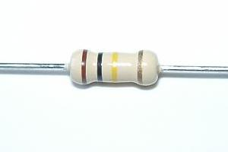
RESISTOR
A resistor is a passive two-terminal electrical component that implements electrical resistance as a circuit element. Resistors act to reduce current flow, and, at the same time, act to lower voltage levels within circuits. In electronic circuits resistors are used to limit current flow, to adjust signal levels, bias active elements, terminate transmission lines among other uses. High-power resistors that can dissipate many watts of electrical power as heat may be used as part of motor controls, in power distribution systems, or as test loads for generators. Fixed resistors have resistances that only change slightly with temperature, time or operating voltage. Variable resistors can be used to adjust circuit elements (such as a volume control or a lamp dimmer), or as sensing devices for heat, light, humidity, force, or chemical activity

Slide 10
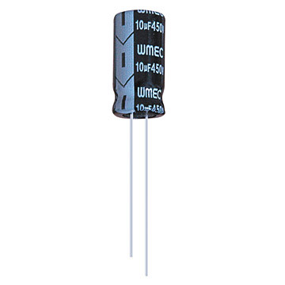
CAPACITOR
A capacitor (originally known as a condenser) is a passive two-terminal electrical component used to store energy electrostatically in an electric field. The forms of practical capacitors vary widely, but all contain at least two electrical conductors (plates) separated by a dielectric (i.E. Insulator). The conductors can be thin films, foils or sintered beads of metal or conductive electrolyte, etc. The nonconducting dielectric acts to increase the capacitor's charge capacity. A dielectric can be glass, ceramic, plastic film, air, vacuum, paper, mica, oxide layer etc. Capacitors are widely used as parts of electrical circuits in many common electrical devices. Unlike a resistor, an ideal capacitor does not dissipate energy. Instead, a capacitor stores energy in the form of an electrostatic field between its plates.
When there is a potential difference across the conductors ( When a capacitor is attached across a battery), an electric field develops across the dielectric, causing positive charge +Q to collect on one plate and negative charge −qto collect on the other plate. If a battery has been attached to a capacitor for a sufficient amount of time, no current can flow through the capacitor. However, if a time-varying voltage is applied across the leads of the capacitor, displacement current can flow.

Slide 11
PRACTICLE APPLICATION
DC power source usage
Uninterruptible power supplies
HVDC power transmission
Electroshock weapons

Slide 12
THANK YOU

