Slide 1
CLOUD FORMATION
CloudFormation Terms and Template Anatomy
AWS CloudFormation docs cover the sections you define inside a template in the Template Anatomy of CloudFormation template section. Here’s the list condensed:
AWSTemplateFormatVersion
Description
Metadata
Parameters
Mappings
Conditions
Resources
Outputs

Slide 2
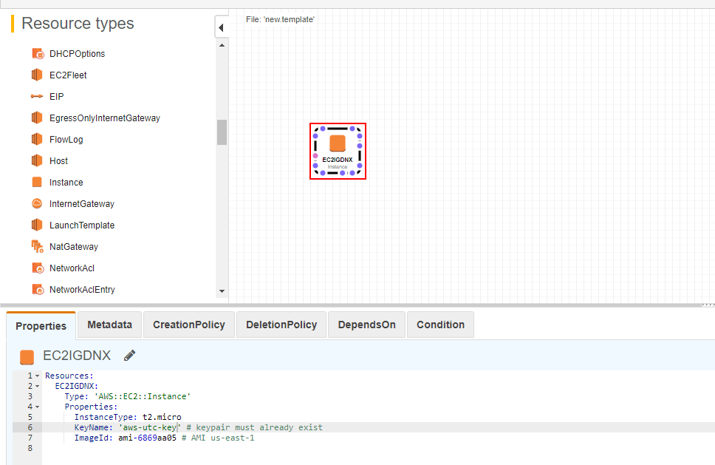
USING DESIGNER
ImageId: ami-00c03f7f7f2ec15c3
KeyName: sankar-aws
InstanceType: t2.micro
Properties has to be applied when we go for designer mode (change key name and image id)

Slide 3
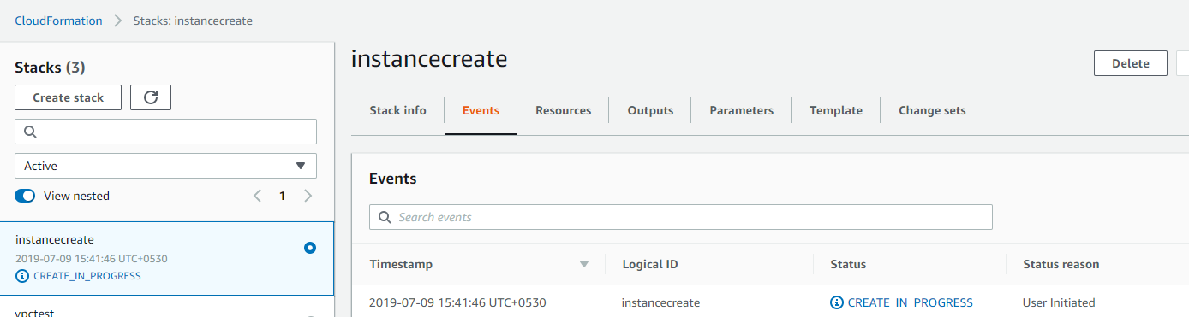

Slide 4
{ "AWSTemplateFormatVersion":"Version Date", "Description":"A description of template", "Metadata":{ }, "Parameters":{ }, "Mappings":{ }, "Conditions":{ }, "Resources":{ }, "Output":{ } }

Slide 5
AWSTemplateFormatVersion
Description
The description is a text line that describes your template. It must follow the format version section.
{
"AWSTemplateFormatVersion":"2010-09-09",
"Description":"This template creates infrastructure in AWS cloud"
}
Metadata
Metadata is an optional section used to provide the details of the template.
{ "Metadata":{ "Instances":{ "Description":"Information about the instances" }, "Databases":{ "Description":"Information about the databases" } } }
Parameters
Parameters is an optional section used to pass parameters to the template variables at runtime.

Slide 6
{ "Parameters":{ "InstanceType":{ "Description":"EC2 instance type", "Type":"String", "Default":"t2.micro", "AllowedValues":[ "t1.micro","t2.micro","t2.small","t2.medium","m1.small", "m1.medium","m1.large","m1.xlarge","m2.xlarge","m2.2xlarge", "m2.4xlarge","m3.medium","m3.large","m3.xlarge","m3.2xlarge" ], "ConstraintDescription":"Provide a valid EC2 instance type." } } }
Mappings
Mappings is an optional section used to define named-value pairs. For example, if we want to set a named-value pair by region name, then we can provide a mapping
{ "Mappings":{ "RegionMap":{ "us-east-1":{ "32":"ami-6411e20d"}, "us-west-1":{ "32":"ami-c9c7978c"}, "eu-west-1":{ "32":"ami-37c2f643"}, "ap-southeast-1":{ "32":"ami-66f28c34"}, "ap-northeast-1":{ "32":"ami-9c03a89d"} } } }

Slide 7
The above example defines a Mapping to map a 32-bit Image ID to a user region.
We can retrieve a value from this map using the “Fn::FindInMap” intrinsic function, seen below:
{
"ImageId":{
"Fn::FindInMap":["RegionMap",{"Ref":"AWS::Region"},"32"]
}
}
Conditions
This section defines the conditions that will be used by the CloudFormation. It is like “If” in any programming language. We can combine multiple conditions with the COMMA(,) delimiter
We can use some intrinsic functions to define the conditions. Some are:
Fn::And
Fn::If
Fn:Not
Fn::Or
Fn::Equals
{ "Conditions":{ "CreateProdResources":{ "Fn::Equals":[ {"Ref":"EnvType"},"production"] } } }

Slide 8
Resources
Resources is a required section of any CloudFormation template. This section is used to define the resources that are required for our infrastructure
"Resources":{ "LogicalID":{ "Type":"Resource Type", "Properties":{ Set of properties } } }
Properties
This is an additional option to define the resource properties. This is an optional section.
{ "Resources":{ "MyInstance":{ "Type":"AWS::EC2::Instance", "Properties":{ "AvailabilityZone":"us-west-2b", "ImageId": { "Fn::FindInMap" : [ "RegionMap", { "Ref" : "AWS::Region" }, { "Fn::FindInMap" : [ "AWSInstanceType2Arch", { "Ref" : "EC2InstanceType" }, "Arch" ] } ] }, } } } }

Slide 9
Output
This section is used to get output values from the CloudFormation engine, i.e. EC2 instance physical ID. The output will be shown on the CloudFormation console
{ "Outputs":{ "InstanceID":{ "Description":"The EC2 Instance ID", "Value":{ "Ref":"MyInstance" } } } }
Template sample:
https://github.com/tongueroo/cloudformation-examples/blob/master/templates/single-instance.yml
Create Stack thru CLI:
aws cloudformation create-stack --stack-name myteststack --template-body file:///home/testuser/mytemplate.json --parameters ParameterKey=Parm1,ParameterValue=test1 ParameterKey=Parm2,ParameterValue=test2
Delete Stack thru CLI
aws cloudformation delete-stack --stack-name single-instance
Update Stack thru CLI
aws cloudformation update-stack --stack-name example --template-body file://templates/instance_and_route53.yml --parameters file://parameters/instance_and_route53.json

