Slide 1
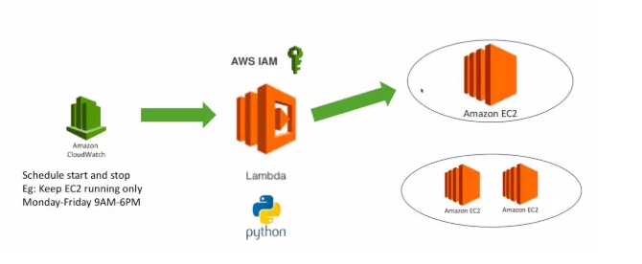
Lambda
AWS Lambda is a responsive cloud service that inspects actions within the application and responds by deploying the user-defined codes, known as functions. It automatically manages the compute resources across multiple availability zones and scales them when new actions are triggered.
AWS Lambda supports the code written in Java, Python and Node.js, and the service can launch processes in languages supported by Amazon Linux (includes Bash, Go & Ruby).

Slide 2
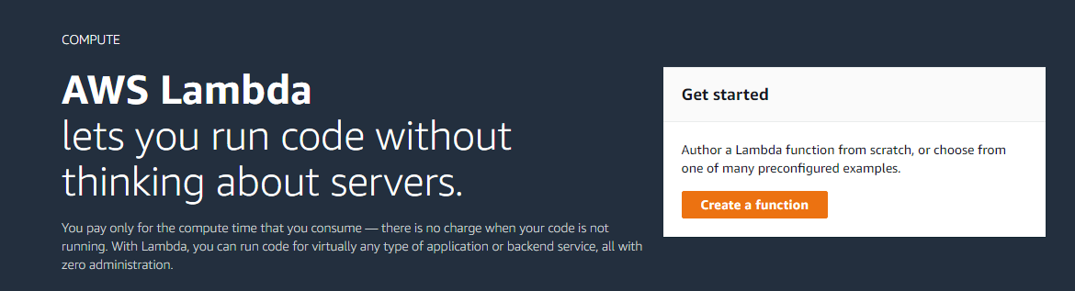
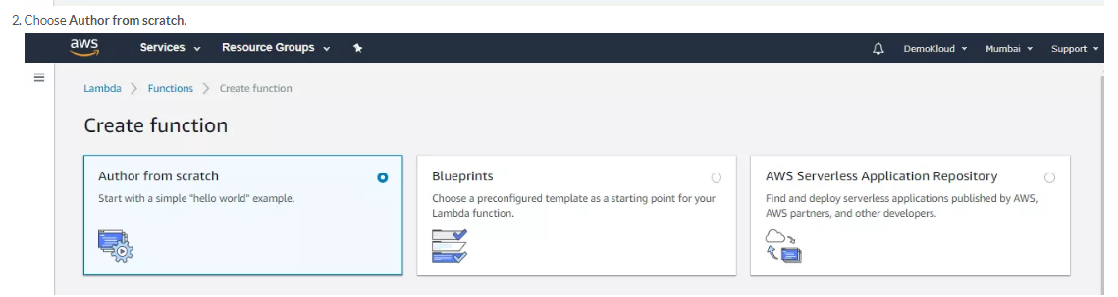
Go to services → choose Lambda

Slide 3
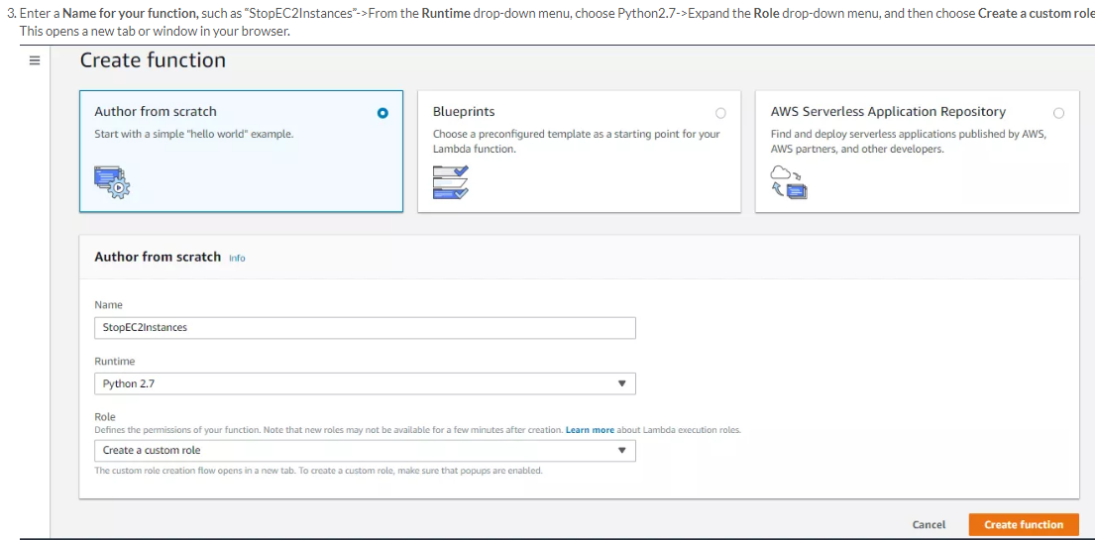
4. Select create custom role with limited permission, then go to IAM role and create policy

Slide 4
Go to IAM, select the role which created in the above step and choose edit policy and paste
The below code
{
"Version": "2012-10-17",
"Statement": [
{
"Effect": "Allow",
"Action": [
"logs:CreateLogGroup",
"logs:CreateLogStream",
"logs:PutLogEvents"
],
"Resource": "arn:aws:logs:*:*:*"
},
{
"Effect": "Allow",
"Action": [
"ec2:Start*",
"ec2:Stop*"
],
"Resource": "*"
}
] }

Slide 5
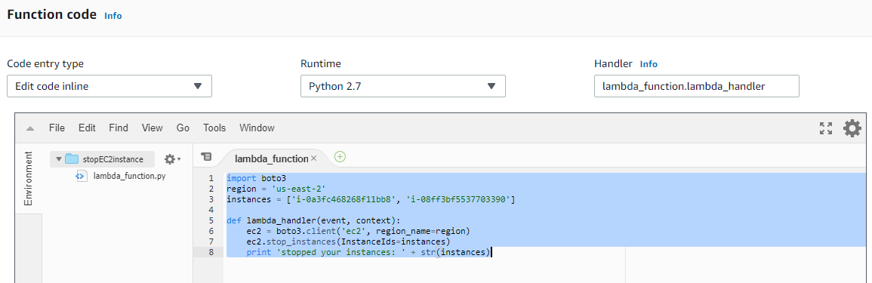
Scroll down to function code and paste the below code
import boto3client=boto3.client('ec2')
def lambda_handler(event, context):
response=client.describe_instances()
for reservation in response["Reservations"]:
for instance in reservation["Instances"]:
print(instance["InstanceId"] + "stopping")
id=[instance["InstanceId"]]
client.start_instances(InstanceIds=id)
return("Completed")
Note : If permission issue, add EC2 full access policy to the role

Slide 6
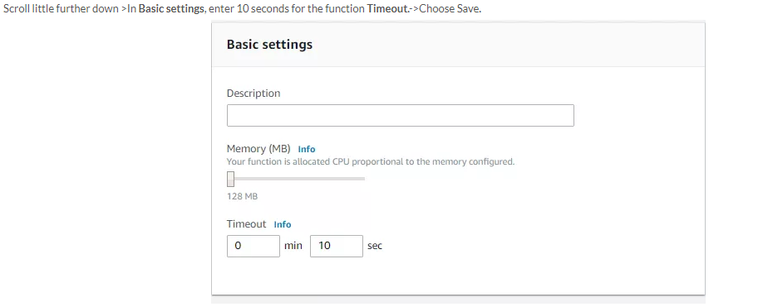
Boto Functions https://boto3.amazonaws.com/v1/documentation/api/latest/reference/services/ec2.html

Slide 7
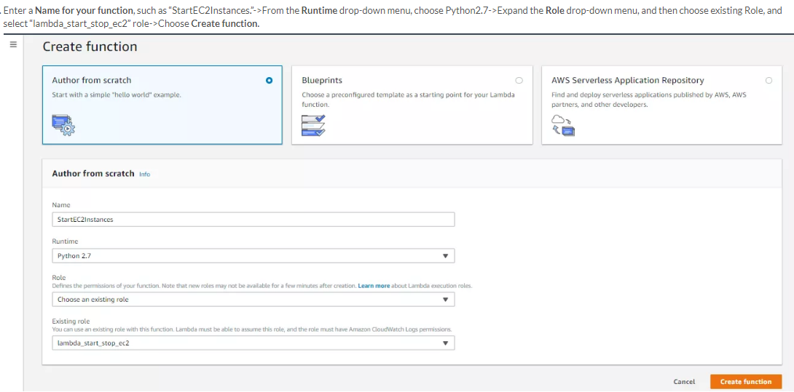
Note : Same IAM role , just change the function name

Slide 8
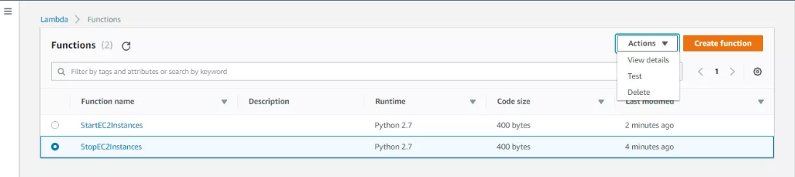
import boto3
region = 'us-east-2'
instances = ['i-006e8fecfb9eb7f93']
ec2 = boto3.client('ec2', region_name=region)
def lambda_handler(event, context):
ec2.stop_instances(InstanceIds=instances)
print('stopped your instances: ' + str(instances))

Slide 9
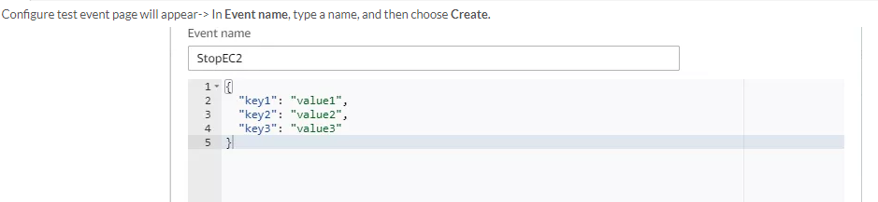
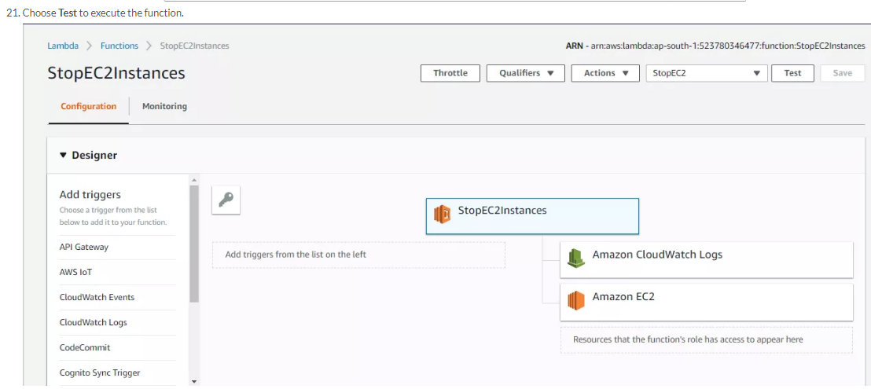

Slide 10
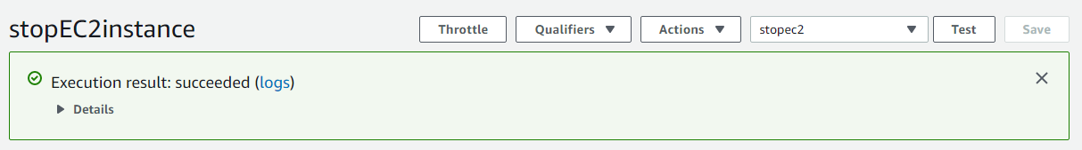
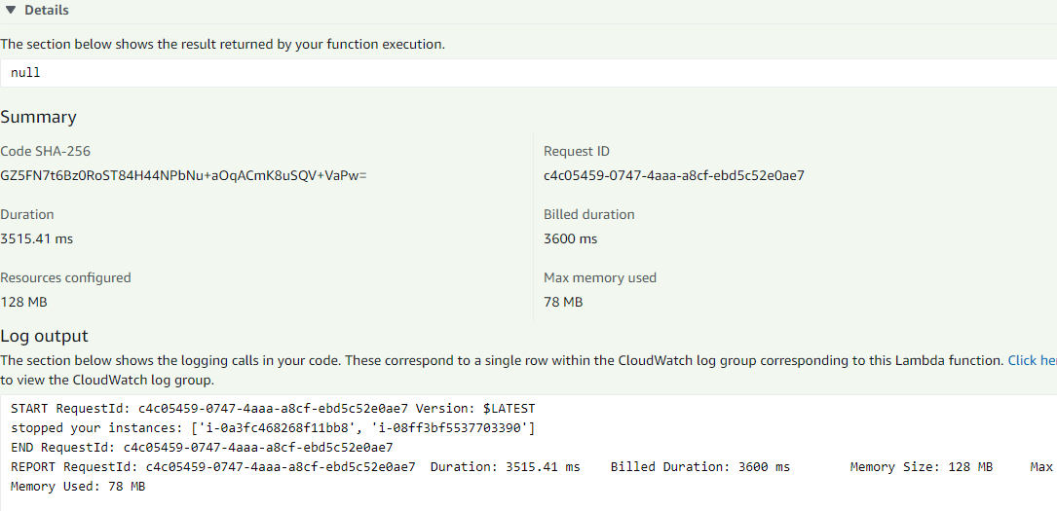

Slide 11
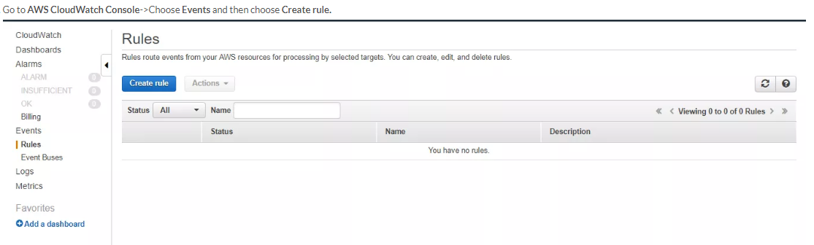

Slide 12
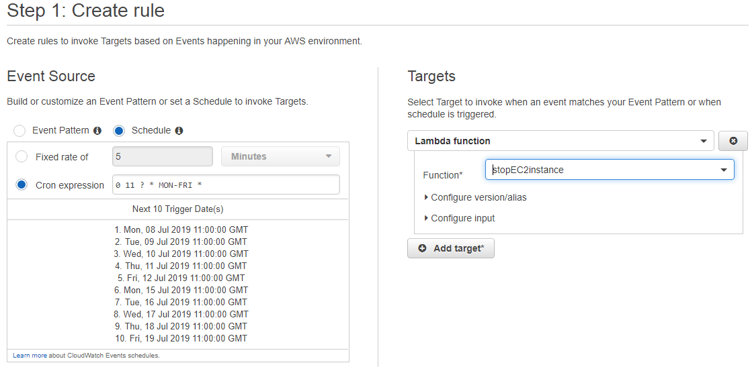

Slide 13
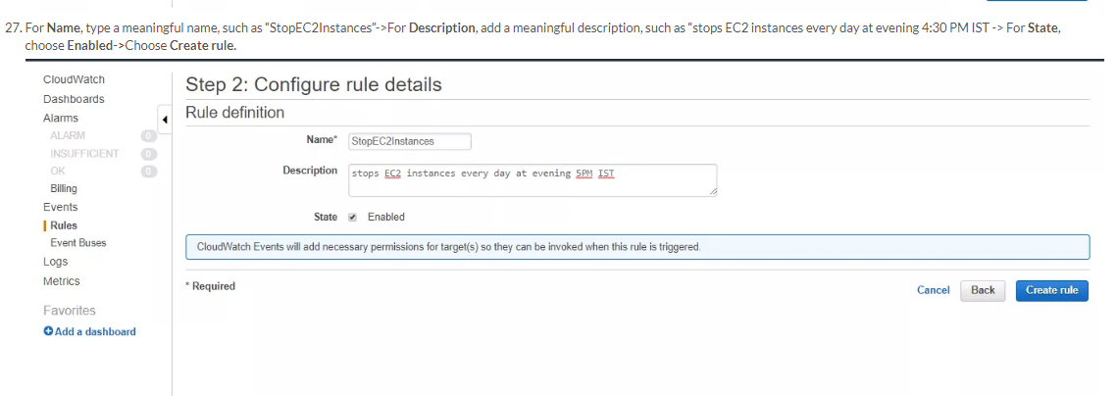

Slide 14
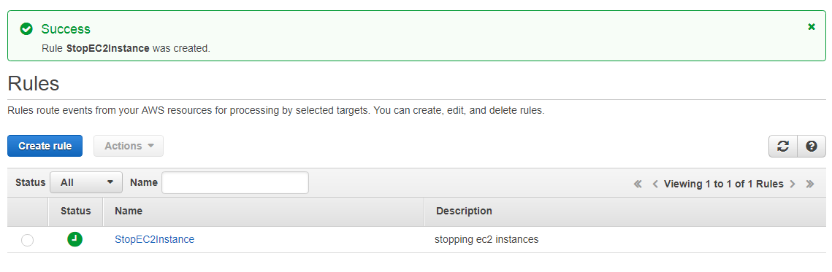

Slide 15
To Stop Particular Instance
import boto3
region = 'us-east-2'instances = ['i-09fdb6daf49132427']
def lambda_handler(event, context):
ec2 = boto3.client('ec2', region_name=region)
ec2.stop_instances(InstanceIds=instances)
print 'stopped your instances: ' + str(instances)

