Slide 1
EEEN 311 Logic Circuits & Microprocessors
The x86 Microprocessor
[Week 10]

Slide 2
OBJECTIVES
Use INT 10H function calls to:
Clear the screen.
Set the cursor position.
Write characters to the screen in text mode.
Draw lines on the screen in graphics mode.
Change the video mode.
Use INT 21H function calls to:
Input characters from the keyboard.
Output characters to the screen.
Input or output strings.

Slide 3
OBJECTIVES
(cont)
Use the LABEL directive to set up structured data items.
Code Assembly language instructions to define and invoke macros.
Explain how macros are expanded by the assembler.
Use the LOCAL directive to define local variables within macros.
Use the INCLUDE directive to retrieve macros from other files.

Slide 4
INTERRUPTS
An interrupt is a signal to the processor emitted by hardware or software indicating an event that needs immediate attention.
BIOS interrupt calls are a facility that DOS programs and some other software, such as boot loaders, use to invoke the facilities of the Basic Input/Output System on IBM PC compatible computers.
http://en.wikipedia.org/wiki/BIOS_interrupt_call
http://en.wikipedia.org/wiki/DOS_interrupt_call

Slide 5
INT 21H and 10H
The INT instruction is somewhat like a FAR call.
Saves CS:IP and the flags on the stack and goes to the subroutine associated with that interrupt.
In x86 processors, 256 interrupts, numbered 00 to FF.
INT 10H and INT 21H are the most widely used with various functions selected by the value in the AH register.

Slide 6
BIOS INT 10H PROGRAMMING
INT 10H subroutines are burned into the ROM BIOS.
Used to communicate with the computer's screen video.
Manipulation of screen text/graphics can be done via INT 10H.
Among the functions associated with INT 10H are changing character or background color, clearing the screen, and changing the location of the cursor.
Chosen by putting a specific value in register AH.

Slide 7
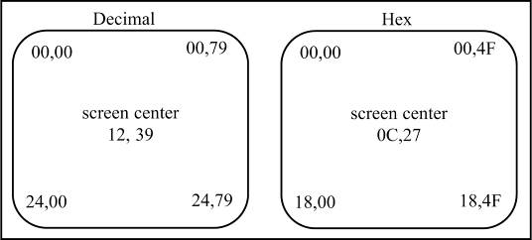
BIOS INT 10H PROGRAMMING monitor screen in text mode
The monitor screen in the x86 PC is divided into 80 columns and 25 rows in normal text mode.
Columns are numbered from 0 to 79.
Rows are numbered 0 to 24.
The top left corner has been assigned 00,00, the top right 00,79.
Bottom left is 24,00, bottom right 24,79.
Figure 4-1 Cursor Locations (row, column)

Slide 8
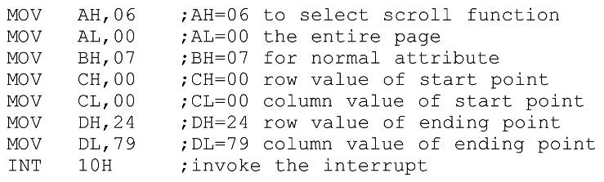
BIOS INT 10H PROGRAMMING screen clearing with INT 10H function 06H
To clear the screen using INT 10H, these registers must contain certain values before INT 10H is called:
AH = 06, AL = 00, BH = 07, CX = 0000, DH = 24, DL = 79.
Option AH = 06 calls the scroll function, to scroll upward.
CH & CL registers hold starting row & column.
DH & DL registers hold ending row & column.

Slide 9
BIOS INT 10H PROGRAMMING setting the cursor to a specific location
INT 10H function AH = 02 will change the position of the cursor to any location.
Desired position is identified by row/column values in DX.
Where DH = row and DL = column.
Video RAM can have multiple pages of text.
When AH = 02, page zero is chosen by making BH = 00.
After INT 10H (or INT 21H) has executed, registers not used by the interrupt remain unchanged.

Slide 10
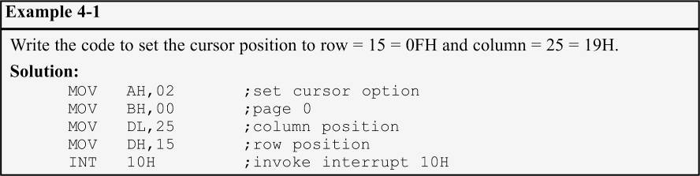
BIOS INT 10H PROGRAMMING setting the cursor to a specific location
Example 4-1 demonstrates setting the cursor to a specific location.

Slide 11

BIOS INT 10H PROGRAMMING get current cursor position
In text mode, determine where the cursor is located at any time by executing the following:
After execution of the program, registers DH & DL will have current row and column positions.
CX provides information about the shape of the cursor.
In text mode, page 00 is chosen for the currently viewed page.

Slide 12
BIOS INT 10H PROGRAMMING changing the video mode
To change the video mode, use INT 10H with AH = 00 and AL = video mode.

Slide 13
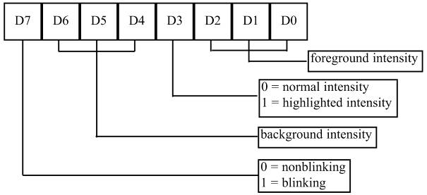
BIOS INT 10H PROGRAMMING attribute byte in monochrome monitors
An attribute associated with each character on the screen provides information to the video circuitry.
Character (foreground) & background color/intensity.
The attribute byte for each character on the monochrome monitor is limited.
Actual character displayed
For foreground only.

Slide 14
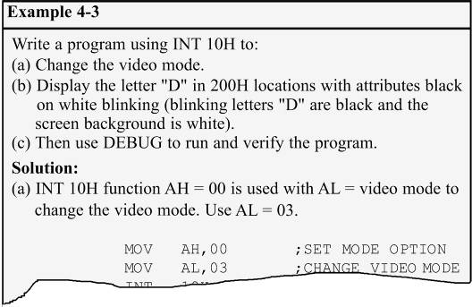
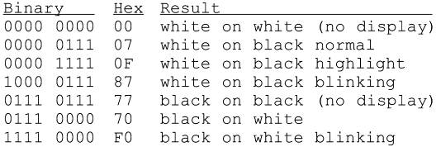
BIOS INT 10H PROGRAMMING attribute byte in monochrome monitors
See the entire example on page 134 of your textbook.
Possible variations of attributes in Fig. 4-2.

Slide 15
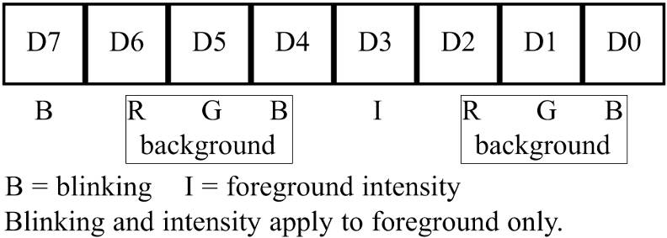
BIOS INT 10H PROGRAMMING attribute byte in CGA text mode
CGA mode is the common denominator for all color monitors, as S all color monitors & video circuitry are upwardly compatible,
CGA attribute byte bit definition is as shown:
Figure 4-3 CGA Attribute Byte

Slide 16
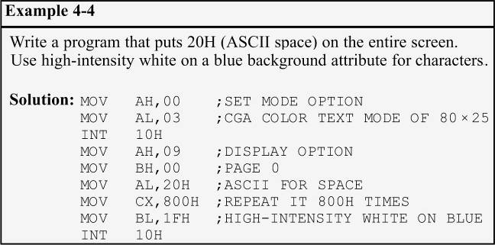
BIOS INT 10H PROGRAMMING attribute byte in CGA text mode
The background can take eight different colors by combining the prime colors red, blue, and green.
The foreground can be any of 16 different colors by combining red, blue, green, and intensity
Example 4-4 shows the use of the attribute byte in CGA mode.

Slide 17
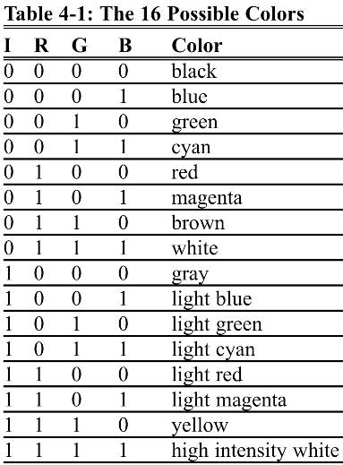
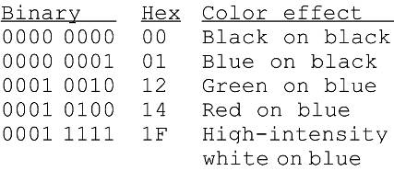
BIOS INT 10H PROGRAMMING attribute byte in CGA text mode
Some possible CGA colors and variations.

Slide 18
BIOS INT 10H PROGRAMMING graphics: pixel resolution & color
In text mode, the screen is viewed as a matrix of rows and columns of characters.
In graphics mode, a matrix of horizontal & vertical pixels.
Number of pixels depends on monitor resolution & video board.
Two facts associated with every pixel on the screen must be stored in the video RAM:
Location of the pixel, and Attributes. (color and intensity)
The higher the number of pixels and colors, the larger the amount of memory that is needed to store them
Memory requirements go up with resolution & number of colors.
CGA mode can have a maximum of 16K bytes of video memory due to its inherent design structure.

Slide 19
BIOS INT 10H PROGRAMMING graphics: modes
Text mode of 80 × 25 characters.
A total of 2K (80×25 = 2000) for characters, plus 2K for attributes, as each character has one attribute byte.
Each screen (frame) takes 4K, which results in CGA supporting a total of four pages of data, where each page represents one full screen.
In this mode, 16 colors are supported.
To select this mode, use AL = 03 for mode selection in INT 10H option AH = 00.

Slide 20
BIOS INT 10H PROGRAMMING graphics: modes
Graphics mode of 320 × 200. (medium resolution)
64,000 pixels. (320 columns×200 rows = 64,000)
Dividing total video RAM of 128K bits (16K×8 bits = 128K) by 64,000 pixels gives 2 bits for the color of each pixel.
2 bits give four possibilities, thus 320 × 200 resolution CGA can support no more than 4 colors.
To select this mode, use AL = 04.

Slide 21
BIOS INT 10H PROGRAMMING graphics: modes
Graphics resolution of 640 × 200. (high resolution)
128,000 pixels. (200×640 = 128,000)
Dividing gives 1 bit (128,000/128,000 = 1) for color, which can can be on (white) or off (black).
640 × 200 high-resolution CGA can support only black and white.
To select this mode, use AL = 06.
With a fixed amount of video RAM, the number of supported colors decreases as resolution increases.
To create more colors in video boards there must be memory available to store the extra colors.

Slide 22
BIOS INT 10H PROGRAMMING INT 10H and pixel programming
To address a single pixel on the screen, use INT 10H with AH = 0CH.
The X (column) and Y (row) coordinates of the pixel must be known, and vary, depending on monitor resolution.
Registers are CX = the column point (the X coordinate) and DX = the row point. (Y coordinate)
To turn the pixel on/off, AL=1 or AL=0 for black and white.
The value of AL can be modified for various colors.
If the display mode supports more than one page, BH = page number.

Slide 23
BIOS INT 10H PROGRAMMING drawing lines in graphics mode
To draw a horizontal line, choose row/column values to point to the beginning of the line and increment the column until it reaches the end of the line.
To draw a vertical line, increment the vertical value held by the DX register, and keep CX constant.
Linear equation y = mx + b can be used for any line.

Slide 24
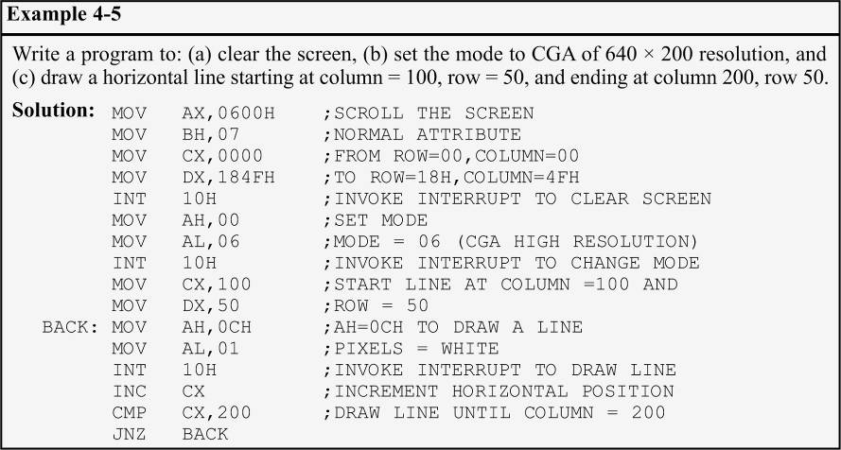
BIOS INT 10H PROGRAMMING drawing lines in graphics mode
Drawing a horizontal line

Slide 25
DOS INTERRUPT 21H
In previous chapters, a fixed set of data was defined in the data segment & results viewed in a memory dump.
This section uses information inputted from the keyboard, and displayed on the screen.
A much more dynamic way of processing information.
When the OS is loaded, INT 21H can be invoked to perform some extremely useful functions.
Commonly referred to as DOS INT 21H function calls.
In contrast to BIOS-ROM based INT 10H.

Slide 26

DOS INTERRUPT 21H Option 09 outputting a data string the monitor
INT 21H can send a set of ASCII data to the monitor.
Set AH = 09 and DX = offset address of the ASCII data.
Displays ASCII data string pointed at by DX until it encounters the dollar sign "$".
The data segment and code segment, to display the message "The earth is but one country" :

Slide 27
DOS INTERRUPT 21H Option 02 outputting a single character
To output only a single character, 02 is put in AH, and DL is loaded with the character to be displayed.
The following displays the letter "J" :
This option can also be used to display '$' on the monitor as the string display option (option 09) will not display '$‘.

Slide 28
DOS INTERRUPT 21H Option 01 inputting a single character, with echo
This functions waits until a character is input from the keyboard, then echoes it to the monitor.
After the interrupt, the input character will be in AL.

Slide 29
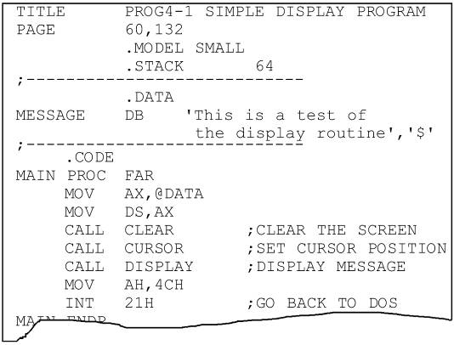
DOS INTERRUPT 21H Option 01 inputting a single character, with echo
Program 4-1 combines INT 10H and INT 21H.
The program does the following:
(1) Clears the screen.
(2) Sets the cursor to the center of the screen.
(3) Displays the message "This is a test of the display routine".
See the entire program listing on page 139 of your textbook.

Slide 30
DOS INTERRUPT 21H Option 0AH inputting a data string from the keyboard
A means by which one can get keyboard data from & store it in a predefined data segment memory area.
Register AH = 0AH.
DX = offset address at which the string of data is stored.
Commonly referred to as a buffer area.
DOS requires a buffer area be defined in the data segment.
The first byte specifies the size of the buffer.
The number of characters from the keyboard is in the second byte.
Keyed-in data placed in the buffer starts at the third byte.

Slide 31
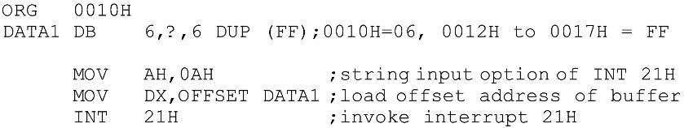
DOS INTERRUPT 21H Option 0AH inputting a data string from the keyboard
This program accepts up to six characters from the keyboard, including the return (carriage return) key.
Six buffer locations were reserved, and filled with FFH.
Memory contents of offset 0010H:
The PC won’t exit INT 21H until it encounters a RETURN.

Slide 32

DOS INTERRUPT 21H Option 0AH inputting a data string from the keyboard
Assuming the data entered through the keyboard was "USA" <RETURN>, the contents of memory locations starting at offset 0010H would look like:
0010H = 06 DOS requires the size of the buffer here.
0011H = 03 The keyboard was activated three times (excluding the RETURN key) to key in letters U, S, and A.
0012H = 55H ASCII hex value for letter U.
0013H = 53H ASCII hex value for letter S.
0014H = 41H ASCII hex value for letter A.
0015H = 0DH ASCII hex value for CR. (carriage return)

Slide 33

DOS INTERRUPT 21H inputting more than buffer size
Entering more than six characters (five + the CR = 6) will cause the computer to sound the speaker.
The contents of the buffer will look like this:
Location 0015 has ASCII 20H for <SPACE>
Location 0016 has ASCII 61H for "a“.
Location 0017 has 0D for <RETURN> key.
The actual length is 05 at memory offset 0011H.

Slide 34


DOS INTERRUPT 21H inputting more than buffer size
If only the CR key is activated & no other character:
0AH is placed in memory 0020H.
0021H is for the count.
0022H IS the first location to have data that was entered.
CR is not included in the count.
If only the <RETURN> key is activated, 0022H has 0DH, the hex code for CR.
The actual number of characters entered is 0 at location 0021.

Slide 35
DOS INTERRUPT 21H use of carriage return and line feed
In Program 4-2, the EQU statement is used to equate CR (carriage return) with its ASCII value of 0DH, and LF (line feed) with its ASCII value of 0AH.
See pages 141 & 142
Program 4-3 prompts the user to type in a name with a maximum of eight letters.
The program gets the length and prints it to the screen.
See page 143.
Program 4-4 demonstrates many functions described in this chapter.
See pages 144 & 145.

Slide 36
DOS INTERRUPT 21H Option 07 keyboard input without echo
Option 07 requires the user to enter a single character, which is not displayed (or echoed) on the screen.
The PC waits until a single character is entered and provides the character in AL.

Slide 37

DOS INTERRUPT 21H using LABEL to define a string buffer
The LABEL directive can be used in the data segment to assign multiple names to data.
Used to assign the same offset address to two names.
The attribute can be:
BYTE; WORD; DWORD; FWORD; QWORD; TBYTE.
In the following:
The offset address assigned to JOE is the same offset address for TOM since the LABEL directive does not occupy any memory space.

Slide 38
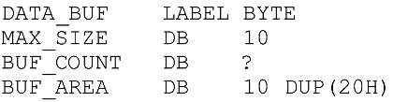
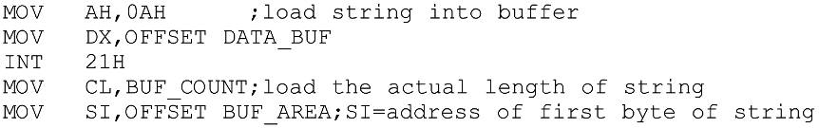
DOS INTERRUPT 21H using LABEL to define a string buffer
Use this directive to define a buffer area for the string keyboard input:
In the code segment the data can be accessed by name as follows:

Slide 39
WHAT IS A MACRO, AND HOW IS IT USED?
There are applications in Assembly language programming where a group of instructions performs a task used repeatedly.
It does not make sense to rewrite them every time.
Macros allow the programmer to write the task once only & invoke it whenever, wherever it is needed.
Reduces time to write code & reduce possibility of errors.

Slide 40

WHAT IS A MACRO, AND HOW IS IT USED? MACRO definition
Every macro definition must have three parts:
The MACRO directive indicates the beginning of the macro definition, ENDM directive signals the end.
In between is the body of the macro.
The name must be unique and must follow Assembly language naming conventions.
Dummies are names, parameters, or registers that are mentioned in the body of the macro.
The macro can be invoked (or called) by its name, and appropriate values substituted for dummy parameters.

Slide 41
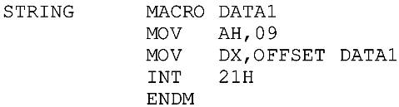
WHAT IS A MACRO, AND HOW IS IT USED? MACRO definition
A macro for displaying a string of data using the widely used function 09 of INT 21H:

Slide 42


WHAT IS A MACRO, AND HOW IS IT USED? MACRO definition
In the following code segment, the macro can be invoked by its name with the user's actual data:
Instruction "STRING MESSAGE1" invokes the macro.
The assembler expands the macro by providing the following code in the .LST file:
The (1) indicates that the code is from the macro.
Earlier versions of MASM, used a plus sign (+).

Slide 43
WHAT IS A MACRO, AND HOW IS IT USED? comments in a macro
Two types of comments in the macro:
Listable; Nonlistable.
Comments preceded by one semicolon (;) will show up in the ".lst" file when the program is assembled.
Those preceded by a double semicolon (;;) will not.

Slide 44
WHAT IS A MACRO, AND HOW IS IT USED? comments in a macro
Three directives designed to make programs that use macros more readable, affecting the ".lst" file, with no effect on the ".obj" or ".exe" files:
.LALL (List ALL) will list all instructions/comments preceded by a single semicolon in the ".lst" file.
.SALL (Suppress ALL) suppresses the listing of the macro body and the comments.
Used to make the list file shorter and easier to read
Will not eliminate any opcode from the object file.
.XALL (eXecutable ALL) is used to list only the part of the macro that generates opcodes.
The default listing directive.

Slide 45
WHAT IS A MACRO, AND HOW IS IT USED? LOCAL directive and its use in macros
If a macro is expanded more than once, and there is a label in the label field of the body of the macro, these labels must be declared as LOCAL.
Otherwise, an assembler error would be generated when the same label was encountered in two or more places.
Rules which must be observed in the macro body:
1. All labels in the label field must be declared LOCAL.
2. LOCAL directive must be right after the MACRO directive.
3. The LOCAL directive can be used to declare all names and labels at once.

Slide 46
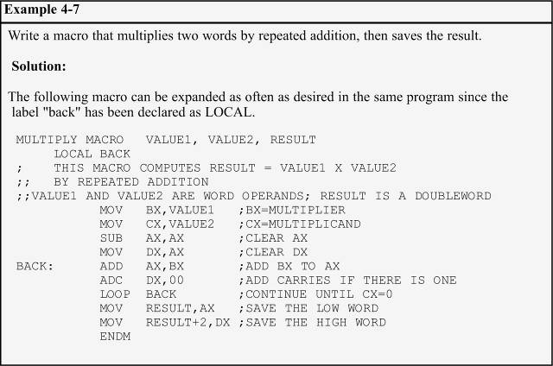
WHAT IS A MACRO, AND HOW IS IT USED? LOCAL directive and its use in macros
In example 4-7, the "BACK" label is defined as LOCAL right after the MACRO directive.

Slide 47
WHAT IS A MACRO, AND HOW IS IT USED? INCLUDE directive
The INCLUDE directive allows a programmer to write macros, save them in a file, and later bring them into any file.
Used to bring this file into any ".asm" file, to allow the program can call any of the macros as needed.
See Program 4 -7 on pages 155-157.
In the list file of Program 4-7, the letter "C" in front of the lines indicates that they are copied from another file and included in the present file.

