Slide 1
EEEN 311 Logic Circuits & Microprocessors
The x86 Microprocessor
[Week 2]

Slide 2
OBJECTIVES
Describe the Intel family of microprocessors from 8085 to Pentium®.
In terms of bus size, physical memory & special features.
Explain the function of the EU (execution unit) and BIU (bus interface unit).
Describe pipelining and how it enables the CPU to work faster.
List the registers of the 8086.
Code simple MOV and ADD instructions.
Describe the effect of these instructions on their operands.
State the purpose of the code segment, data segment, stack segment, and extra segment.
Explain the difference between a logical address and a physical address.
Describe the "little endian" storage convention of x86 microprocessors.
State the purpose of the stack.
Explain the function of PUSH and POP instructions.
List the bits of the flag register and briefly state the purpose of each bit.
Demonstrate the effect of ADD instructions on the flag register.
List the addressing modes of the 8086 and recognize examples of each mode.
Know how to use flowcharts and pseudocode in program development.

Slide 3
BRIEF HISTORY OF THE x86 FAMILY evolution from 8080/8085 to 8086
In 1978, Intel Corporation introduced the 16-bit 8086 microprocessor, a major improvement over the previous generation 8080/8085 series.
The 8086 capacity of 1 megabyte of memory exceeded the 8080/8085 maximum of 64K bytes of memory.
8080/8085 was an 8-bit system, which could work on only 8 bits of data at a time.
Data larger than 8 bits had to be broken into 8-bit pieces to be processed by the CPU.
8086 was a pipelined processor, as opposed to the non-pipelined 8080/8085.

Slide 4
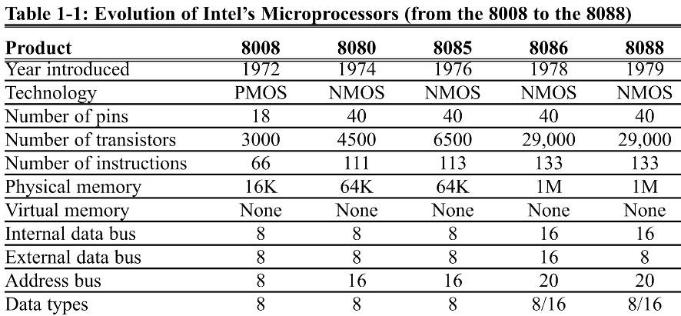
BRIEF HISTORY OF THE x86 FAMILY evolution from 8080/8085 to 8086

Slide 5
BRIEF HISTORY OF THE x86 FAMILY evolution from 8080/8085 to 8086
The 8086 microprocessor has a 16-bit data bus, internally and externally.
All registers are 16 bits wide, and there is a 16-bit data bus to transfer data in and out of the CPU
There was resistance to a 16-bit external bus as peripherals were designed around 8-bit processors.
A printed circuit board with a 16-bit data bus also cost more.
As a result, Intel came out with the 8088 version.
Identical to the 8086, but with an 8-bit external data bus.
It has the same memory capacity of 1 megabyte.
Picked up by IBM as the microprocessor in designing the PC.
The 8088-based IBM PC was a great success, because IBM & Microsoft made it an open system.
Documentation and specifications of the hardware and software of the PC were made public.
Making it possible for many vendors to clone the hardware successfully & spawn a major growth in both hardware and software designs based on the IBM PC.
In contrast to Apple computer which was a fully closed system.

Slide 6
BRIEF HISTORY OF THE x86 FAMILY 80286, 80386, and 80486
Intel introduced the 80286 in 1982, which IBM picked up for the design of the PC AT.
16-bit internal & external data buses.
24 address lines, for 16mb memory. (2²⁴ = 16mb)
Virtual memory for the first time.
Virtual memory is way to fool microprocessor into thinking that it has access to an almost unlimited amount of memory by swapping data between disk storage and RAM.
80286 can operate in one of two modes:
Real mode - a faster 8088/8086 with the same maximum of 1 megabyte of memory.
Protected mode - which allows for 16M of memory.
Also capable of protecting the operating system & programs from accidental or deliberate destruction by a user.

Slide 7
BRIEF HISTORY OF THE x86 FAMILY 80286, 80386, and 80486
In 1985 Intel introduced 80386 (or 80386DX).
32-bit internally/externally, with a 32-bit address bus.
Capable of handling memory of up to 4 gigabytes. (2³²)
Virtual memory increased to 64 terabytes. (2⁴⁶)
Later Intel introduced 386SX, internally identical, but with a 16-bit external data bus & 24-bit address bus.
This makes the 386SX system much cheaper.
Since general-purpose processors could not handle mathematical calculations rapidly, Intel introduced numeric data processing chips.
Math co-processors, such as 8087, 80287, 80387.
On the 80486, in 1989, Intel put a greatly enhanced 80386 & math coprocessor on a single chip.
Plus additional features such as cache memory.
Cache memory is static RAM with a very fast access time.
All programs written for the 8088/86 will run on 286, 386, and 486 computers.

Slide 8
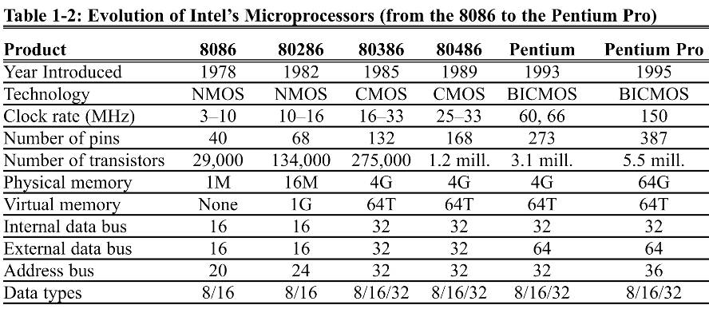
BRIEF HISTORY OF THE x86 FAMILY 80286, 80386, and 80486

Slide 9
BRIEF HISTORY OF THE x86 FAMILY Pentium® & Pentium® Pro
In 1992, Intel released the Pentium®. (not 80586)
A name can be copyrighted, but numbers cannot.
On release, Pentium® had speeds of 60 & 66 MHz.
Designers utilized over 3 million transistors on the Pentium® chip using submicron fabrication technology.
New design features made speed twice that of 80486/66.
Over 300 times faster than that of the original 8088.
Pentium® is fully compatible with previous x86 processors but includes several new features.
Separate 8K cache memory for code and data.
64-bit bus, and a vastly improved floating-point processor.

Slide 10
BRIEF HISTORY OF THE x86 FAMILY Pentium® & Pentium® Pro
The Pentium® is packaged in a 273-pin PGA chip
BICMOS technology, combines the speed of bipolar transistors with power efficiency of CMOS technology
64-bit data bus, 32-bit registers & 32-bit address bus.
Capable of addressing 4gb of memory.
In 1995 Intel Pentium® Pro was released—the sixth generation x86.
5.5 million transistors.
Designed primarily for 32-bit servers & workstations.

Slide 11
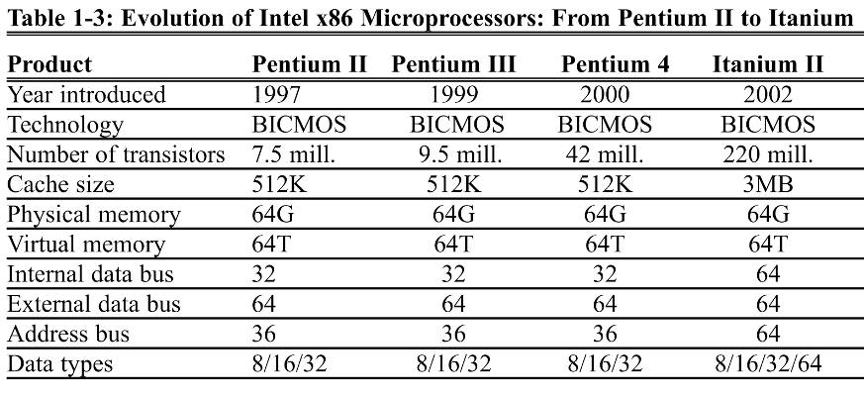
BRIEF HISTORY OF THE x86 FAMILY Pentium® & Pentium® Pro

Slide 12
BRIEF HISTORY OF THE x86 FAMILY Pentium® II
In 1997 Intel introduced the Pentium® II processor
7.5-million-transistor processor featured MMX (MultiMedia Extension) technology incorporated into the CPU.
For fast graphics and audio processing.
In 1998 the Pentium® II Xeon was released.
Primary market is for servers and workstations.
In 1999, Celeron® was released.
Lower cost & good performance make it ideal for PCs used to meet educational and home business needs.

Slide 13
BRIEF HISTORY OF THE x86 FAMILY Pentium® III
In 1999 Intel released Pentium® III.
9.5-million-transistor processor.
70 new instructions called SIMD.
Enhance video/audio performance in 3-D imaging, and streaming audio.
In 1999 Intel introduced the Pentium® III Xeon.
Designed more for servers and business workstations with multiprocessor configurations.

Slide 14
BRIEF HISTORY OF THE x86 FAMILY Pentium® 4
The Pentium® 4 debuted late in 1999.
Speeds of 1.4 to 1.5 GHz.
System bus operates at 400 MHz
Completely new 32-bit architecture, called NetBurst.
Designed for heavy multimedia processing.
Video, music, and graphic file manipulation on the Internet.
New cache and pipelining technology & expansion of the multimedia instruction set make the P4 a high-end media processing microprocessor.

Slide 15
BRIEF HISTORY OF THE x86 FAMILY Intel 64 Architecture
Intel has selected Itanium® as the new brand name for the first product in its 64-bit family of processors.
Formerly called Merced.
The evolution of microprocessors is increasingly influenced by the evolution of the Internet.
Itanium® architecture is designed to meet Internet-driven needs for servers & high-performance workstations.
Itanium® will have the ability to execute many instructions simultaneously, plus extremely large memory capabilities.

Slide 16
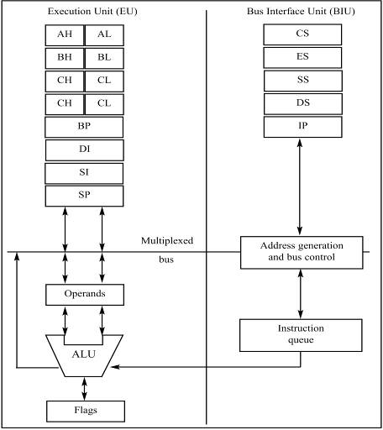
Inside The 8088/86
There are two ways to make the CPU process information faster:
Increase the working frequency.
Using technology available, with cost considerations.
Change the internal architecture of the CPU.
Figure 1-1
Internal Block Diagram of the 8088/86 CPU
(Reprinted by permission of Intel Corporation, Copyright Intel Corp.1989)

Slide 17
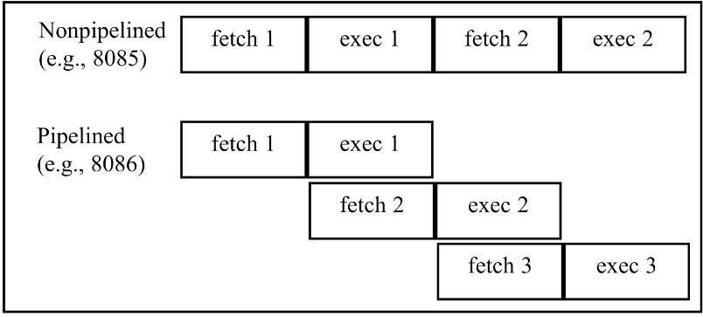
Inside The 8088/86 pipelining
8085 could either fetch or execute at any given time.
The idea of pipelining in its simplest form is to allow the CPU to fetch and execute at the same time.
Figure 1-2 Pipelined vs Nonpipelined Execution

Slide 18
INSIDE THE 8088/86 pipelining
Intel implemented pipelining in 8088/86 by splitting the internal structure of the into two sections:
The execution unit (EU) and the bus interface unit (BIU).
These two sections work simultaneously.
The BIU accesses memory and peripherals, while the EU executes instructions previously fetched.
This works only if the BIU keeps ahead of the EU, so the BIU of the 8088/86 has a buffer, or queue
The buffer is 4 bytes long in 8088 and 6 bytes in 8086.
8088/86 pipelining has two branches, fetch & execute.
In more powerful computers, it can have many stages.

Slide 19
INSIDE THE 8088/86 pipelining
If an instruction takes too long to execute, the queue is filled to capacity and the buses will sit idle.
In some circumstances, the microprocessor must flush out the queue.
When a jump instruction is executed, the BIU starts to fetch information from the new location in memory and information fetched previously is discarded.
The EU must wait until the BIU fetches the new instruction
In computer science terminology, a branch penalty.
In a pipelined CPU, too much jumping around reduces the efficiency of a program.

Slide 20
INSIDE THE 8088/86 registers
In the CPU, registers store information temporarily.
One or two bytes of data to be processed.
The address of data.
General-purpose registers in 8088/86 processors can be accessed as either 16-bit or 8-bit registers.
All other registers can be accessed only as the full 16 bits.
In 8088/86, data types are either 8 or 16 bits.
To access 12-bit data, for example, a 16-bit register must be used with the highest 4 bits set to 0.

Slide 21
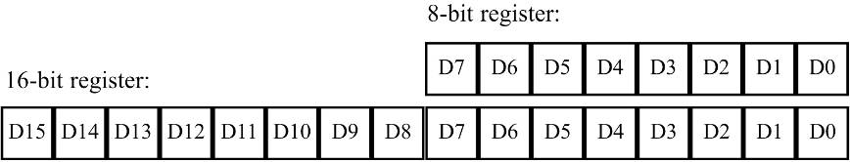
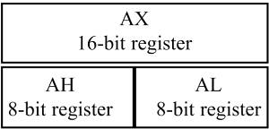
INSIDE THE 8088/86 registers
The bits of a register are numbered in descending order, as shown:
Some instructions use only specific registers.
The first letter of each register indicates its use.
AX is used for the accumulator.
BX is a base addressing register.
CX is a counter in loop operations.
DX points to data in I/O operations.

Slide 22
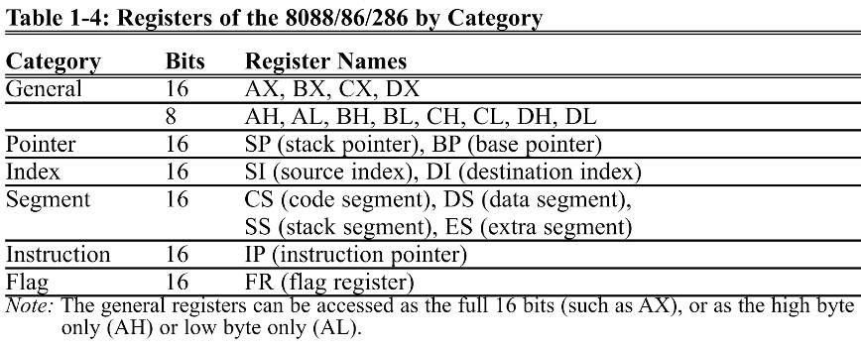
INSIDE THE 8088/86 registers
AX accumulator, BX base addressing register, CX counter in loop operations, DX to point data in I/O operations.

Slide 23
INTRODUCTION TO ASSEMBLY PROGRAMMING
The CPU can work only in binary, very high speeds.
It is tedious & slow for humans to deal with 0s & 1s in order to program the computer.
A program of 0s & 1s is called machine language.
Early computer programmers actually coded programs in machine language.
Eventually, Assembly Languages were developed, which provided mnemonics for machine code.
Mnemonic is typically used in computer science and engineering literature to refer to codes & abbreviations that are relatively easy to remember.

Slide 24
INTRODUCTION TO ASSEMBLY PROGRAMMING
Assembly language is referred to as a low-level language because it deals directly with the internal structure of the CPU.
Assembly language programs must be translated into machine code by a program called an assembler.
To program in Assembly language, programmers must know the number of registers and their size.
As well as other details of the CPU.
Today there are many different programming languages, such as C/C++, BASIC, C#, etc.
Called high-level languages because the programmer does not have to be concerned with internal CPU details.
High-level languages are translated into machine code by a program called a compiler.
To write a program in C, one must use a C compiler to translate the program into machine language

Slide 25
INTRODUCTION TO ASSEMBLY PROGRAMMING
An Assembly language program consists of a series of lines of Assembly language instructions.
An Assembly language instruction consists of a mnemonic, optionally followed by one or two operands.
Operands are the data items being manipulated.
Mnemonics are commands to the CPU, telling it what to do with those items.
Two widely used instructions are move & add.

Slide 26
INTRODUCTION TO ASSEMBLY PROGRAMMING MOV instruction
The MOV instruction copies data from one location to another, using this format:
This instruction tells the CPU to move (in reality, copy) the source operand to the destination operand.
For example, the instruction "MOV DX,CX" copies the contents of register CX to register DX.
After this instruction is executed, register DX will have the same value as register CX.
Instruction does not affect the source operand.

Slide 27
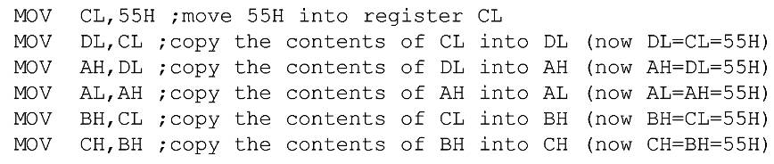
INTRODUCTION TO ASSEMBLY PROGRAMMING MOV instruction
This program first loads CL with value 55H, then moves this value around to various registers inside the CPU.

Slide 28
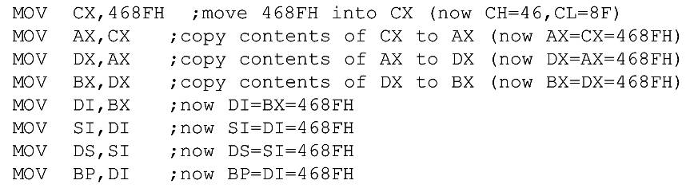
INTRODUCTION TO ASSEMBLY PROGRAMMING MOV instruction
The use of 16-bit registers is shown here:

Slide 29
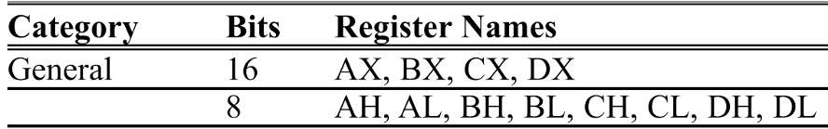
INTRODUCTION TO ASSEMBLY PROGRAMMING MOV instruction
In the 8086 CPU, data can be moved among all the registers, as long as the source and destination registers match in size (Except the flag register.)
There is no such instruction as "MOV FR,AX“.
Code such as "MOV AL,DX" will cause an error.
One cannot move the contents of a 16-bit register into an 8-bit register.

Slide 30
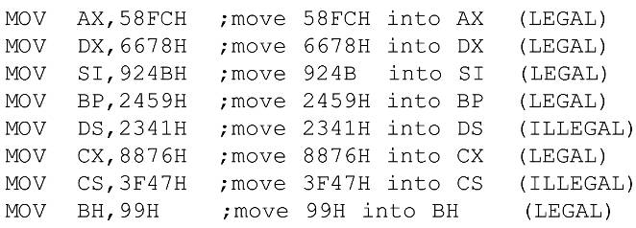
INTRODUCTION TO ASSEMBLY PROGRAMMING MOV instruction
Using the MOV instruction, data can be moved directly into non-segment registers only.
The following demonstrates legal & illegal instructions.

Slide 31
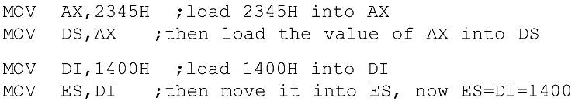
INTRODUCTION TO ASSEMBLY PROGRAMMING MOV instruction
Values cannot be loaded directly into any segment register (CS, DS, ES, or SS).
To load a value into a segment register, load it to a non-segment register, then move it to the segment register.

Slide 32
INTRODUCTION TO ASSEMBLY PROGRAMMING MOV instruction
If a value less than FFH is moved into a 16-bit register, the rest of the bits are assumed to be zeros.
For example, in "MOV BX,5" the result will be BX = 0005.
BH = 00 and BL = 05.
Moving a value that is too large into a register will cause an error.

Slide 33

INTRODUCTION TO ASSEMBLY PROGRAMMING ADD instruction
The ADD instruction has the following format:
ADD tells the CPU to add the source & destination operands and put the result in the destination.
To add two numbers such as 25H and 34H, each can be moved to a register, then added together:
Executing the program above results in: AL = 59H (25H + 34H = 59H) and BL = 34H.
The contents of BL do not change.

Slide 34

INTRODUCTION TO ASSEMBLY PROGRAMMING ADD instruction
The program above can be written in many ways, depending on the registers used, such as:
The program above results in DH = 59H and CL = 34H.

Slide 35
INTRODUCTION TO ASSEMBLY PROGRAMMING ADD instruction
Is it necessary to move both data items into registers before adding them together?
No, it is not necessary.
In the case above, while one register contained one value, the second value followed the instruction as an operand.
This is called an immediate operand.

Slide 36

INTRODUCTION TO ASSEMBLY PROGRAMMING ADD instruction
An 8-bit register can hold numbers up to FFH.
For numbers larger than FFH (255 decimal), a 16-bit register such as AX, BX, CX, or DX must be used.
The following program can add 34EH & 6A5H:
Running the program gives DX = 9F3H.
(34E + 6A5 = 9F3) and AX = 34E.

Slide 37
INTRODUCTION TO ASSEMBLY PROGRAMMING ADD instruction
Any 16-bit non-segment registers could have been used to perform the action above:
The general-purpose registers are typically used in arithmetic operations
Register AX is sometimes referred to as the accumulator.

Slide 38
INTRODUCTION TO PROGRAM SEGMENTS
A typical Assembly language program consists of at least three segments:
A code segment - which contains the Assembly language instructions that perform the tasks that the program was designed to accomplish.
A data segment - used to store information (data) to be processed by the instructions in the code segment.
A stack segment - used by the CPU to store information temporarily.

Slide 39
INTRODUCTION TO PROGRAM SEGMENTS origin and definition of the segment
A segment is an area of memory that includes up to 64K bytes, and begins on an address evenly divisible by 16 (such an address ends in 0H)
8085 addressed a maximum of 64K of physical memory, since it had only 16 pins for address lines. (2¹⁶ = 64K)
Limitation was carried into 8088/86 design for compatibility.
In 8085 there was 64K bytes of memory for all code, data, and stack information.
In 8088/86 there can be up to 64K bytes in each category at any given time.
The code segment, data segment, and stack segment.

Slide 40
INTRODUCTION TO PROGRAM SEGMENTS logical address and physical address
In literature concerning 8086, there are three types of addresses mentioned frequently:
The physical address - the 20-bit address actually on the address pins of the 8086 processor, decoded by the memory interfacing circuitry.
This address can have a range of 00000H to FFFFFH.
An actual physical location in RAM or ROM within the 1 mb memory range.
The offset address - a location in a 64K-byte segment range, which can can range from 0000H to FFFFH.
The logical address - which consists of a segment value and an offset address.

Slide 41
INTRODUCTION TO PROGRAM SEGMENTS code segment
To execute a program, 8086 fetches the instructions (opcodes and operands) from the code segment.
The logical address of an instruction always consists of a CS (code segment) and an IP (instruction pointer), shown in CS:IP format.
The physical address for the location of the instruction is generated by shifting the CS left one hex digit, then adding it to the IP.
IP contains the offset address.
The resulting 20-bit address is called the physical address since it is put on the external physical address bus pins.

Slide 42
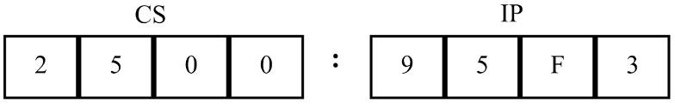
INTRODUCTION TO PROGRAM SEGMENTS code segment
Assume values in CS & IP as shown in the diagram:
The offset address contained in IP, is 95F3H.
The logical address is CS:IP, or 2500:95F3H.
The physical address will be 25000 + 95F3 = 2E5F3H

Slide 43
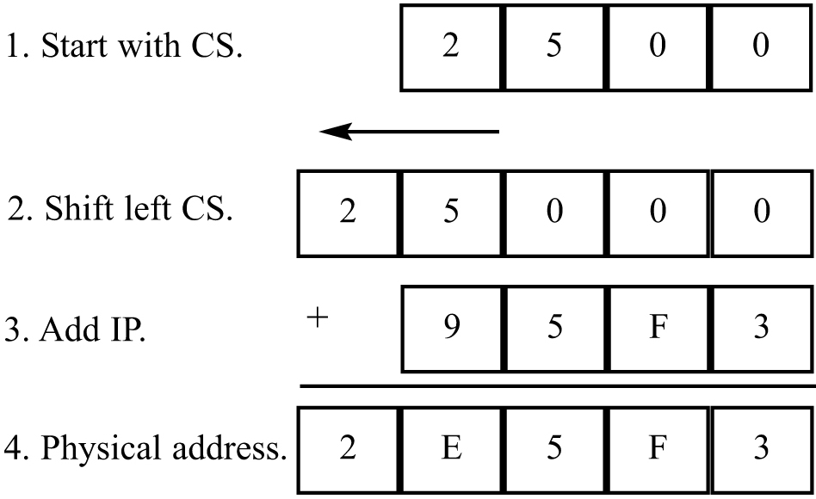
INTRODUCTION TO PROGRAM SEGMENTS code segment
Calculate the physical address of an instruction:
The microprocessor will retrieve the instruction from memory locations starting at 2E5F3.

Slide 44
INTRODUCTION TO PROGRAM SEGMENTS code segment
Calculate the physical address of an instruction:
Since IP can have a minimum value of 0000H and a maximum of FFFFH, the logical address range in this example is 2500:0000 to 2500:FFFF.

Slide 45
INTRODUCTION TO PROGRAM SEGMENTS code segment
Calculate the physical address of an instruction:
This means that the lowest memory location of the code segment above will be 25000H (25000 + 0000) and the highest memory location will be 34FFFH (25000 + FFFF).

Slide 46
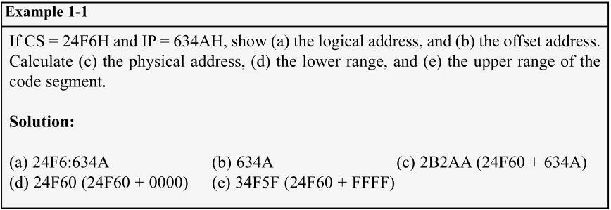
INTRODUCTION TO PROGRAM SEGMENTS code segment
What happens if the desired instructions are located beyond these two limits?
The value of CS must be changed to access those instructions.

