Slide 1
EEEN 311 Logic Circuits & Microprocessors
The x86 Microprocessor
[Week 2]

Slide 2
OBJECTIVES
State the purpose of the code segment, data segment, stack segment, and extra segment.
Explain the difference between a logical address and a physical address.
Describe the "little endian" storage convention of x86 microprocessors.
State the purpose of the stack.
Explain the function of PUSH and POP instructions.
List the bits of the flag register and briefly state the purpose of each bit.
Demonstrate the effect of ADD instructions on the flag register.
List the addressing modes of the 8086 and recognize examples of each mode.
Know how to use flowcharts and pseudocode in program development.

Slide 3
INTRODUCTION TO PROGRAM SEGMENTS code segment logical/physical address
In the next code segment, CS and IP hold the logical address of the instructions to be executed.
The following Assembly language instructions have been assembled (translated into machine code) and stored in memory.
The three columns show the logical address of CS:IP, the machine code stored at that address, and the corresponding Assembly language code.
The physical address is put on the address bus by the CPU to be decoded by the memory circuitry.

Slide 4
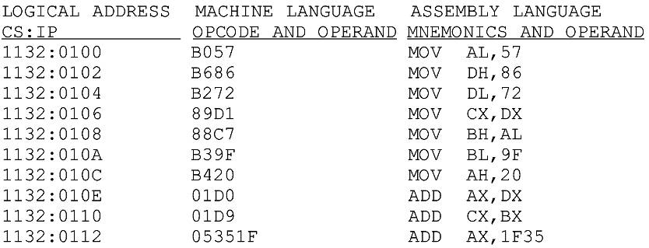
INTRODUCTION TO PROGRAM SEGMENTS code segment logical/physical address
Instruction "MOV AL,57" has a machine code of B057.
B0 is the opcode and 57 is the operand.

Slide 5
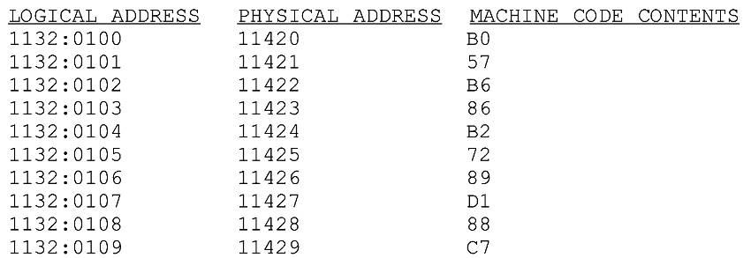
INTRODUCTION TO PROGRAM SEGMENTS code segment logical/physical address
Instruction "MOV AL,57" has a machine code of B057.
B0 is the opcode and 57 is the operand.
The byte at address 1132:0100 contains B0, the opcode for moving a value into register AL.
Address 1132:0101 contains the operand to be moved to AL.

Slide 6
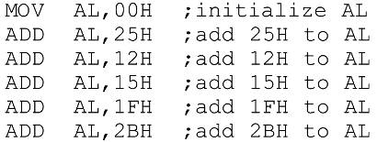
INTRODUCTION TO PROGRAM SEGMENTS data segment
Assume a program to add 5 bytes of data, such as 25H, 12H, 15H, 1FH, and 2BH.
One way to add them is as follows:
In the program above, the data & code are mixed together in the instructions.
If the data changes, the code must be searched for every place it is included, and the data retyped
From this arose the idea of an area of memory strictly for data

Slide 7
INTRODUCTION TO PROGRAM SEGMENTS data segment
In x86 microprocessors, the area of memory set aside for data is called the data segment.
The data segment uses register DS and an offset value.
DEBUG assumes that all numbers are in hex.
No "H" suffix is required.
MASM assumes that they are in decimal.
The "H" must be included for hex data.
The next program demonstrates how data can be stored in the data segment and the program rewritten so that it can be used for any set of data.

Slide 8
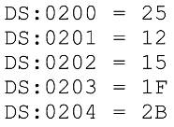
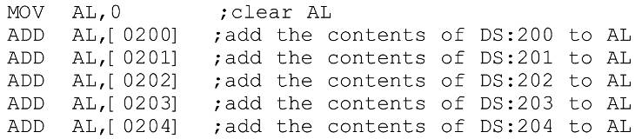
INTRODUCTION TO PROGRAM SEGMENTS data segment
Assume data segment offset begins at 200H.
The data is placed in memory locations:
The program can be rewritten as follows:

Slide 9
INTRODUCTION TO PROGRAM SEGMENTS data segment
The offset address is enclosed in brackets, which indicate that the operand represents the address of the data and not the data itself.
If the brackets were not included, as in "MOV AL,0200", the CPU would attempt to move 200 into AL instead of the contents of offset address 200. decimal.
This program will run with any set of data.
Changing the data has no effect on the code.

Slide 10
INTRODUCTION TO PROGRAM SEGMENTS data segment
If the data had to be stored at a different offset address the program would have to be rewritten
A way to solve this problem is to use a register to hold the offset address, and before each ADD, increment the register to access the next byte.
8088/86 allows only the use of registers BX, SI, and DI as offset registers for the data segment
The term pointer is often used for a register holding an offset address.

Slide 11
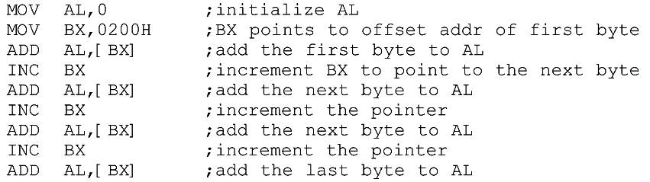
INTRODUCTION TO PROGRAM SEGMENTS data segment
In the following example, BX is used as a pointer:
The INC instruction adds 1 to (increments) its operand.
"INC BX" achieves the same result as "ADD BX,1“
If the offset address where data is located is changed, only one instruction will need to be modified.

Slide 12
INTRODUCTION TO PROGRAM SEGMENTS data segment logical/physical address
The physical address for data is calculated using the same rules as for the code segment.
The physical address of data is calculated by shifting DS left one hex digit and adding the offset value, as shown in coming examples

Slide 13
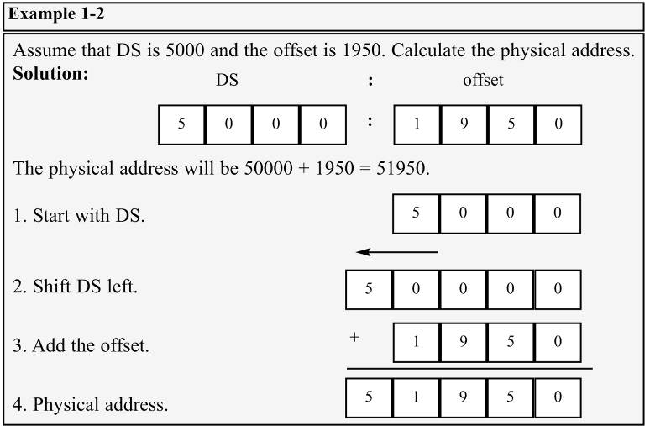
INTRODUCTION TO PROGRAM SEGMENTS data segment logical/physical address

Slide 14
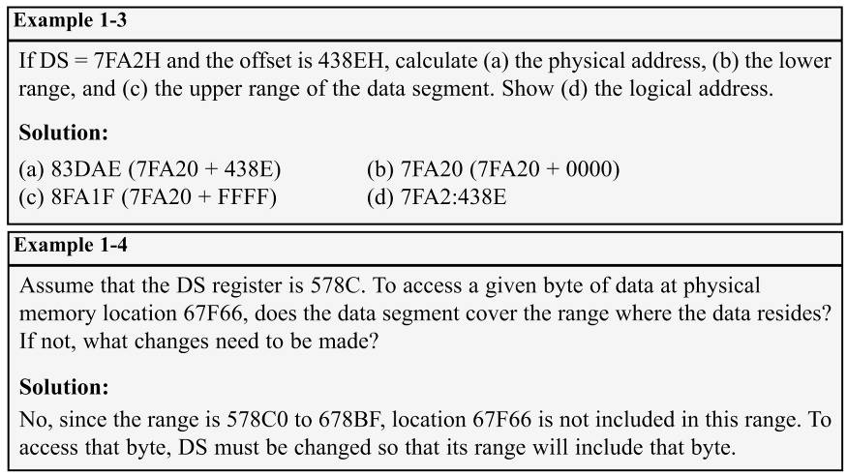
INTRODUCTION TO PROGRAM SEGMENTS data segment logical/physical address

Slide 15
INTRODUCTION TO PROGRAM SEGMENTS little endian convention
Previous examples used 8-bit or 1-byte data.
What happens when 16-bit data is used?
The low byte goes to the low memory location and the high byte goes to the high memory address.
Memory location DS:1500 contains F3H.
Memory location DS:1501 contains 35H.
(DS:1500 = F3 DS:1501 = 35)
This convention is called little endian vs big endian.
From a Gulliver’s Travels story about how an egg should be opened—from the little end, or the big end.

Slide 16
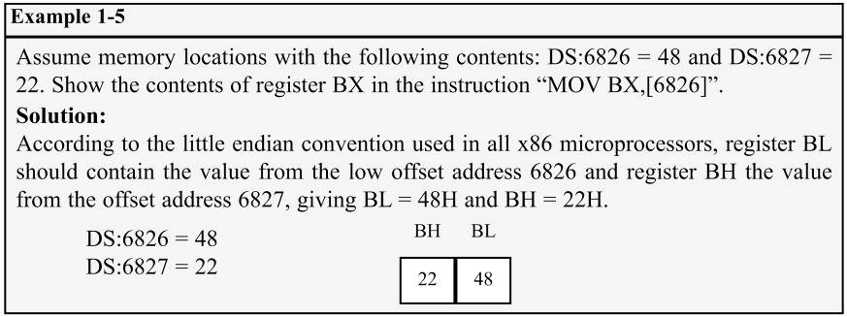
INTRODUCTION TO PROGRAM SEGMENTS little endian convention
In the big endian method, the high byte goes to the low address.
In the little endian method, the high byte goes to the high address and the low byte to the low address.
All Intel microprocessors and many microcontrollers use the little endian convention.
Freescale (formerly Motorola) microprocessors, along with some other microcontrollers, use big endian.

Slide 17
INTRODUCTION TO PROGRAM SEGMENTS extra segment (ES)
ES is a segment register used as an extra data segment.
In many normal programs this segment is not used.
Use is essential for string operations.

Slide 18
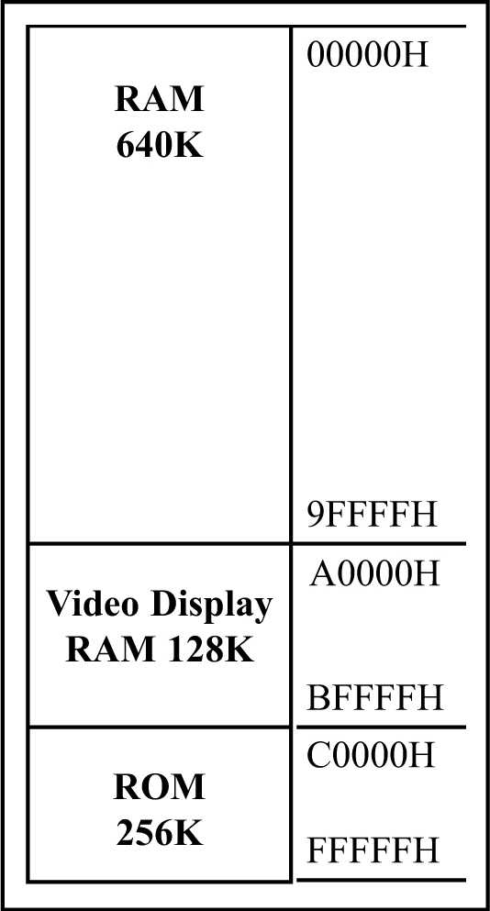
INTRODUCTION TO PROGRAM SEGMENTS memory map of the IBM PC
The 20-bit address of 8088/86 allows 1mb (1024K bytes) of memory space with the address range 00000–FFFFF.
During the design phase of the first IBM PC, engineers had to decide on the allocation of the 1-megabyte memory space to various sections of the PC.
This memory allocation is called a memory map.
Figure 1-3 Memory Allocation in the PC

Slide 19
INTRODUCTION TO PROGRAM SEGMENTS memory map of the IBM PC
Of this 1 megabyte, 640K bytes from addresses 00000–9FFFFH were set aside for RAM
128K bytes A0000H– BFFFFH were allocated for video memory
The remaining 256K bytes from C0000H–FFFFFH were set aside for ROM
Figure 1-3 Memory Allocation in the PC

Slide 20
INTRODUCTION TO PROGRAM SEGMENTS more about RAM
In the early 80s, most PCs came with 64K to 256K bytes of RAM, more than adequate at the time
Users had to buy memory to expand up to 640K.
Managing RAM is left to Windows because...
The amount of memory used by Windows varies.
Different computers have different amounts of RAM.
Memory needs of application packages vary.
For this reason, we do not assign any values for the CS, DS, and SS registers.
Such an assignment means specifying an exact physical address in the range 00000–9FFFFH, and this is beyond the knowledge of the user.

Slide 21
INTRODUCTION TO PROGRAM SEGMENTS video RAM
From A0000H to BFFFFH is set aside for video
The amount used and the location vary depending on the video board installed on the PC

Slide 22
1.INTRODUCTION TO PROGRAM SEGMENTS more about ROM
C0000H to FFFFFH is set aside for ROM.
Not all the memory in this range is used by the PC's ROM.
64K bytes from location F0000H–FFFFFH are used by BIOS (basic input/output system) ROM.
Some of the remaining space is used by various adapter cards (such as the network card), and the rest is free.
The 640K bytes from 00000 to 9FFFFH is referred to as conventional memory.
The 384K bytes from A0000H to FFFFFH are called the UMB (upper memory block).

Slide 23
INTRODUCTION TO PROGRAM SEGMENTS function of BIOS ROM
There must be some permanent (nonvolatile) memory to hold the programs telling the CPU what to do when the power is turned on
This collection of programs is referred to as BIOS.
BIOS stands for basic input-output system.
It contains programs to test RAM and other components connected to the CPU.
It also contains programs that allow Windows to communicate with peripheral devices.
The BIOS tests devices connected to the PC when the computer is turned on and to report any errors.

Slide 24
THE STACK what is a stack? why is it needed?
The stack is a section of read/write memory (RAM) used by the CPU to store information temporarily.
The CPU needs this storage area since there are only a limited number of registers.
There must be some place for the CPU to store information safely and temporarily.
The main disadvantage of the stack is access time.
Since the stack is in RAM, it takes much longer to access compared to the access time of registers.
Some very powerful (expensive) computers do not have a stack.
The CPU has a large number of registers to work with.

Slide 25
THE STACK how stacks are accessed
The stack is a section of RAM, so there must be registers inside the CPU to point to it.
The SS (stack segment) register.
The SP (stack pointer) register.
These registers must be loaded before any instructions accessing the stack are used.
Every register inside the x86 can be stored in the stack, and brought back into the CPU from the stack memory, except segment registers and SP.
Storing a CPU register in the stack is called a push.
Loading the contents of the stack into the CPU register is called a pop.

Slide 26
THE STACK how stacks are accessed
The x86 stack pointer register (SP) points at the current memory location used as the top of the stack.
As data is pushed onto the stack it is decremented.
As data is popped off the stack into the CPU, it is incremented.
When an instruction pushes or pops a general-purpose register, it must be the entire 16-bit register.
One must code "PUSH AX".
There are no instructions such as "PUSH AL" or "PUSH AH".

Slide 27
THE STACK how stacks are accessed
The SP is decremented after the push is to make sure the stack is growing downward from upper addresses to lower addresses.
The opposite of the IP. (instruction pointer)
To ensure the code section & stack section of the program never write over each other, they are located at opposite ends of the RAM set aside for the program.
They grow toward each other but must not meet.
If they meet, the program will crash.

Slide 28
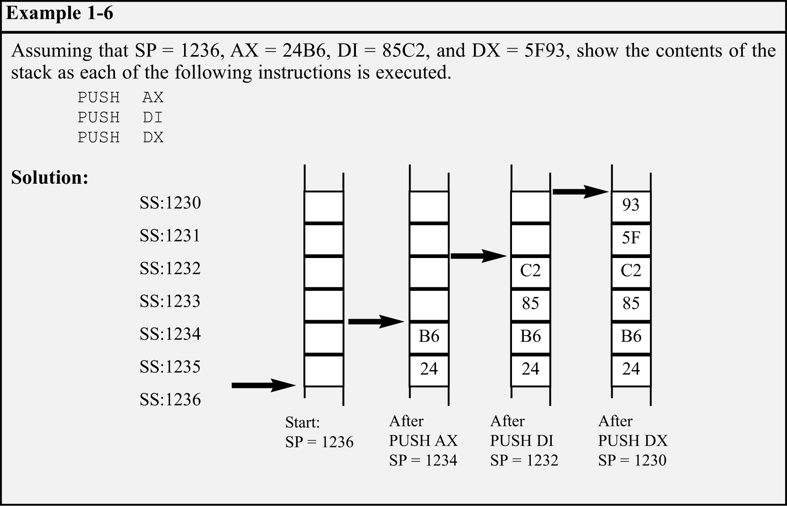
THE STACK pushing onto the stack
As each PUSH is executed, the register contents are saved on the stack and SP is decremented by 2.

Slide 29
THE STACK pushing onto the stack
For every byte of data saved on the stack, SP is decremented once.
Since the push is saving the contents of a 16-bit register, it decrements twice.

Slide 30
THE STACK pushing onto the stack
In the x86, the lower byte is always stored in the memory location with the lower address.
24H, the content of AH, is saved in the memory location with the address 1235.
AL is stored in location 1234.

Slide 31
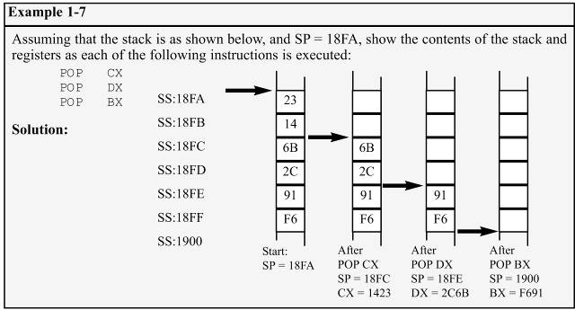
THE STACK popping the stack
With every pop, the top 2 bytes of the stack are copied to the x86 CPU register specified by the instruction & the stack pointer is incremented twice.
While the data actually remains in memory, it is not accessible, since the stack pointer, SP is beyond that point.

Slide 32
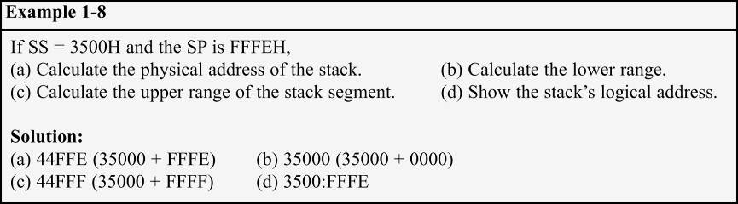
THE STACK logical vs physical stack address
The exact physical location of the stack depends on the value of the stack segment (SS) register and SP, the stack pointer.
To compute physical addresses for the stack, shift left SS, then add offset SP, the stack pointer register.
Windows assigns values for the SP and SS.

Slide 33
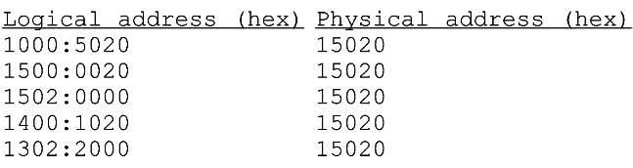
THE STACK a few more words about x86 segments
Can a single physical address belong to many different logical addresses?
Observe the physical address value of 15020H.
Many possible logical addresses represent this single physical address:
An illustration of the dynamic behavior of the segment and offset concept in the 8086 CPU.

Slide 34
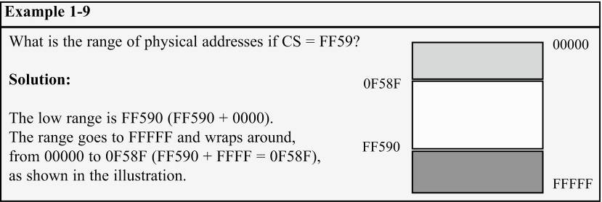
THE STACK a few more words about x86 segments
When adding the offset to the shifted segment register results in an address beyond the maximum allowed range of FFFFFH, wrap-around will occur.

Slide 35
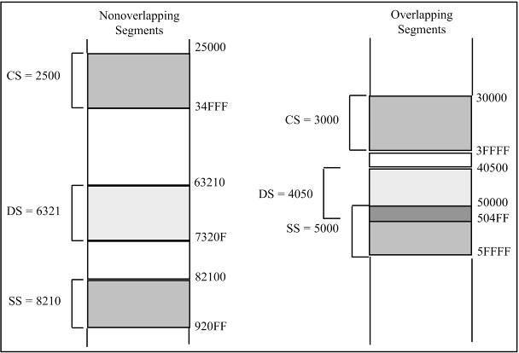
THE STACK overlapping
In calculating the physical address, it is possible that two segments can overlap.

Slide 36
FLAG REGISTER
Many Assembly language instructions alter flag register bits & some instructions function differently based on the information in the flag register.
The flag register is a 16-bit register sometimes referred to as the status register.
Although 16 bits wide, only some of the bits are used.
The rest are either undefined or reserved by Intel.

Slide 37
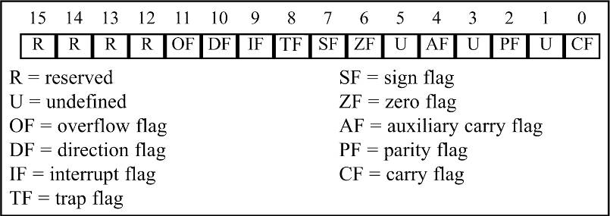
1.6 FLAG REGISTER
Six flags, called conditional flags, indicate some condition resulting after an instruction executes.
These six are CF, PF, AF, ZF, SF, and OF.
The remaining three, often called control flags, control the operation of instructions before they are executed.

Slide 38
FLAG REGISTER bits of the flag register
Flag register bits used in x86 Assembly language programming, with a brief explanation each:
CF (Carry Flag) - Set when there is a carry out, from d7 after an 8-bit operation, or d15 after a 16-bit operation.
Used to detect errors in unsigned arithmetic operations.
PF (Parity Flag) - After certain operations, the parity of the result's low-order byte is checked.
If the byte has an even number of 1s, the parity flag is set to 1; otherwise, it is cleared.
AF (Auxiliary Carry Flag) - If there is a carry from d3 to d4 of an operation, this bit is set; otherwise, it is cleared.
Used by instructions that perform BCD (binary coded decimal) arithmetic.

Slide 39
FLAG REGISTER bits of the flag register
Flag register bits used in x86 Assembly language programming, with a brief explanation each:
ZF (Zero Flag) - Set to 1 if the result of an arithmetic or logical operation is zero; otherwise, it is cleared.
SF (Sign Flag) - Binary representation of signed numbers uses the most significant bit as the sign bit.
After arithmetic or logic operations, the status of this sign bit is copied into the SF, indicating the sign of the result.
TF (Trap Flag) - When this flag is set it allows the program to single-step, meaning to execute one instruction at a time.
Single-stepping is used for debugging purposes.

Slide 40
FLAG REGISTER bits of the flag register
Flag register bits used in x86 Assembly language programming, with a brief explanation each:
IF (Interrupt Enable Flag) - This bit is set or cleared to enable/disable only external maskable interrupt requests.
DF (Direction Flag) - Used to control the direction of string operations.
OF (Overflow Flag) - Set when the result of a signed number operation is too large, causing the high-order bit to overflow into the sign bit.
Used only to detect errors in signed arithmetic operations.

Slide 41
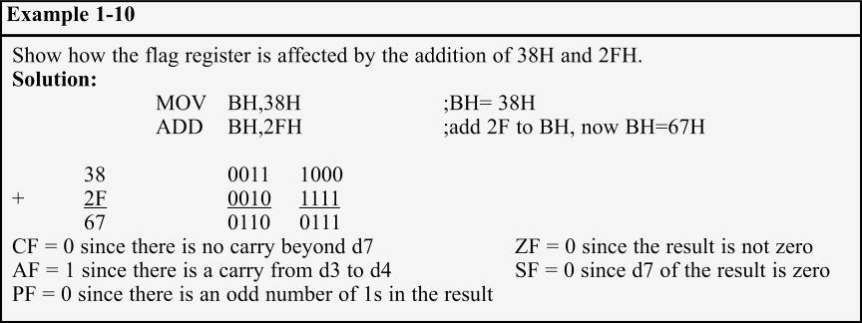
FLAG REGISTER flag register and ADD instruction
Flag bits affected by the ADD instruction:
CF (carry flag); PF (parity flag); AF (auxiliary carry flag).
ZF (zero flag); SF (sign flag); OF (overflow flag).

Slide 42
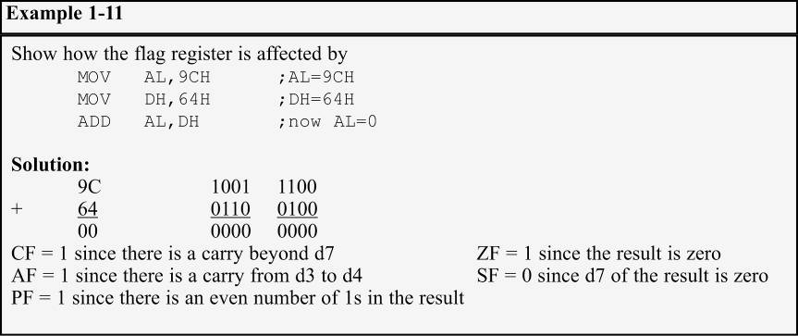
FLAG REGISTER flag register and ADD instruction
Flag bits affected by the ADD instruction:
CF (carry flag); PF (parity flag); AF (auxiliary carry flag).
ZF (zero flag); SF (sign flag); OF (overflow flag).

Slide 43
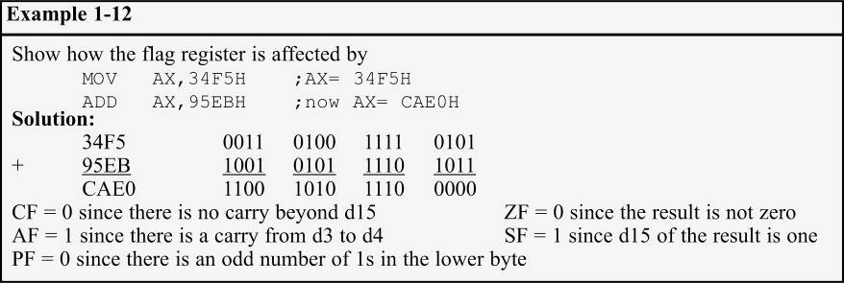
FLAG REGISTER flag register and ADD instruction
It is important to note differences between 8- and 16-bit operations in terms of impact on the flag bits.
The parity bit only counts the lower 8 bits of the result and is set accordingly.

Slide 44
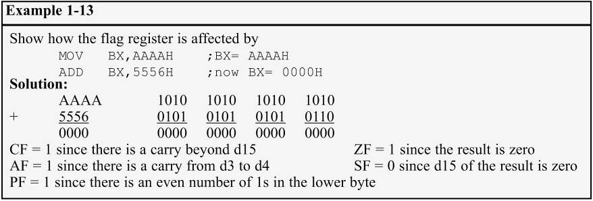
FLAG REGISTER flag register and ADD instruction
The carry flag is set if there is a carry beyond bit d15 instead of bit d7.
Since the result of the entire 16-bit operation is zero (meaning the contents of BX), ZF is set to high.

Slide 45
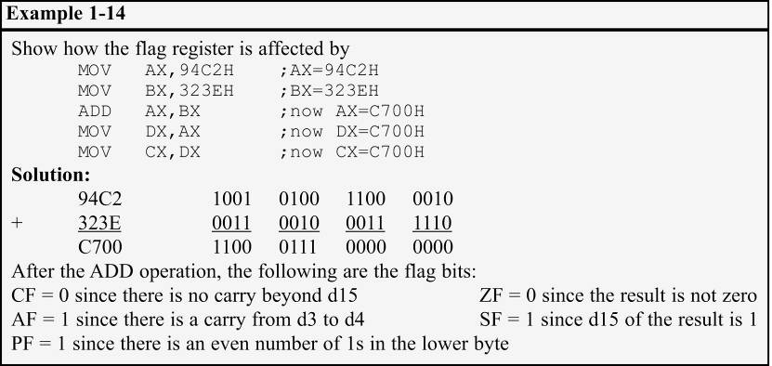
FLAG REGISTER flag register and ADD instruction
Instructions such as data transfers (MOV) affect no flags.

Slide 46
FLAG REGISTER use of the zero flag for looping
A widely used application of the flag register is the use of the zero flag to implement program loops.
A loop is a set of instructions repeated a number of times.

Slide 47
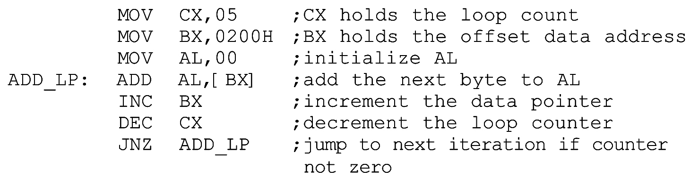
FLAG REGISTER use of the zero flag for looping
As an example, to add 5 bytes of data, a counter can be used to keep track of how many times the loop needs to be repeated.
Each time the addition is performed the counter is decremented and the zero flag is checked.
When the counter becomes zero, the zero flag is set (ZF = 1) and the loop is stopped.

Slide 48
FLAG REGISTER use of the zero flag for looping
Register CX is used to hold the counter.
BX is the offset pointer.
(SI or DI could have been used instead)

Slide 49
FLAG REGISTER use of the zero flag for looping
AL is initialized before the start of the loop
In each iteration, ZF is checked by the JNZ instruction
JNZ stands for "Jump Not Zero“, meaning that if ZF = 0, jump to a new address.
If ZF = 1, the jump is not performed, and the instruction below the jump will be executed.

Slide 50
FLAG REGISTER use of the zero flag for looping
JNZ instruction must come immediately after the instruction that decrements CX.
JNZ needs to check the effect of "DEC CX" on ZF.
If any instruction were placed between them, that instruction might affect the zero flag.

Slide 51
x86 ADDRESSING MODES
The CPU can access operands (data) in various ways, called addressing modes.
The number of addressing modes is determined when the microprocessor is designed & cannot be changed
The x86 provides seven distinct addressing modes:
1 - Register
2 - Immediate
3 - Direct
4 - Register indirect
5 - Based relative
6 - Indexed relative
7 - Based indexed relative

Slide 52

x86 ADDRESSING MODES register addressing mode
Register addressing mode involves use of registers to hold the data to be manipulated.
Memory is not accessed, so it is relatively fast.
Examples of register addressing mode:
The the source & destination registers must match in size.
Coding "MOV CL,AX" will give an error, since the source is a 16-bit register and the destination is an 8-bit register.

Slide 53

x86 ADDRESSING MODES immediate addressing mode
In immediate addressing mode, as the name implies, when the instruction is assembled, the operand comes immediately after the opcode.
The source operand is a constant.
This mode can be used to load information into any of register except the segment and flag registers.

Slide 54

x86 ADDRESSING MODES immediate addressing mode
To move information to the segment registers, the data must first be moved to a general-purpose register, then to the segment register.

Slide 55
x86 ADDRESSING MODES direct addressing mode
In direct addressing mode, the data is in some memory location(s).
In most programs, the data to be processed is often in some memory location outside the CPU.
The address of the data in memory comes immediately after the instruction.

Slide 56
x86 ADDRESSING MODES direct addressing mode
The address of the operand is provided with the instruction, as an offset address.
Calculate the physical address by shifting left the DS register and adding it to the offset:
Note the bracket around the address.
If the bracket is absent, executing the command will give an error, as it is interpreted to move the value 2400 (16-bit data) into register DL.
An 8-bit register.

Slide 57
x86 ADDRESSING MODES register indirect addressing mode
In register indirect addressing mode, the address of the memory location where the operand resides is held by a register.
The registers used for this purpose are SI, DI, and BX.
If these three registers are used as pointers, they must be combined with DS in order to generate the 20-bit physical address.
Notice that BX is in brackets.
The physical address is calculated by shifting DS left one hex position and adding BX to it.

Slide 58
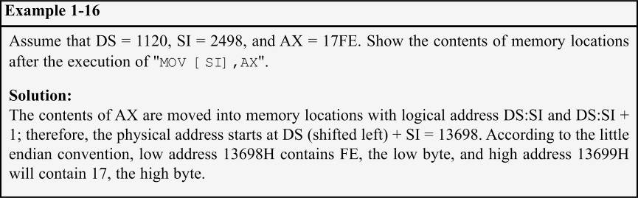
x86 ADDRESSING MODES register indirect addressing mode
The same rules apply when using register SI or DI.
Example 1-16 shows 16-bit data.

Slide 59
x86 ADDRESSING MODES based relative addressing mode
In based relative addressing mode, base registers BX & BP, and a displacement value, are used to calculate the effective address.
Default segments used for the calculation of the physical address (PA) are DS for BX and SS for BP.
Alternatives are "MOV CX,[BX+10]" or "MOV CX,10[BX]"
Again the low address contents will go into CL and the high address contents into CH.

Slide 60
x86 ADDRESSING MODES based relative addressing mode
In the case of the BP register:
Alternatives are "MOV AL,[BP+5]" or "MOV AL,5[BP]".
BP+5 is called the effective address since the fifth byte from the beginning of the offset BP is moved to register AL.

Slide 61
x86 ADDRESSING MODES indexed relative addressing mode
The indexed relative addressing mode works the same as the based relative addressing mode.
Except that registers DI & SI hold the offset address.

Slide 62
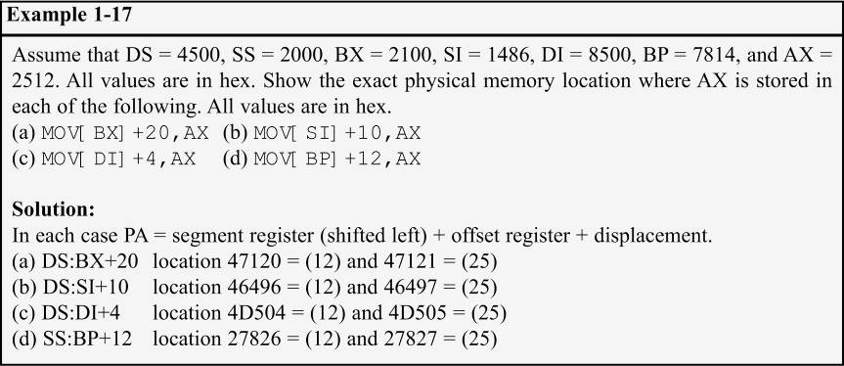
x86 ADDRESSING MODES indexed relative addressing mode
The indexed relative addressing mode works the same as the based relative addressing mode.
Except that registers DI & SI hold the offset address.

Slide 63
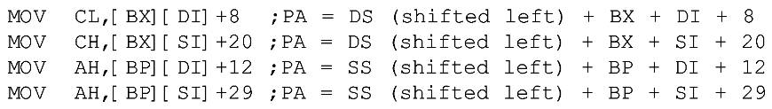
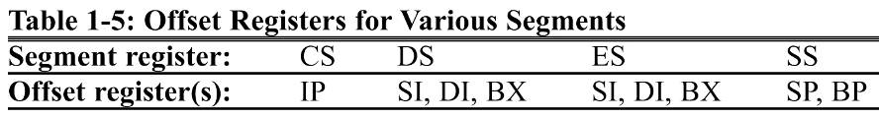
x86 ADDRESSING MODES based indexed addressing mode
By combining based & indexed addressing modes, a new addressing mode is derived called the based indexed addressing mode.
One base register and one index register are used.
The coding of the instructions can vary.

Slide 64
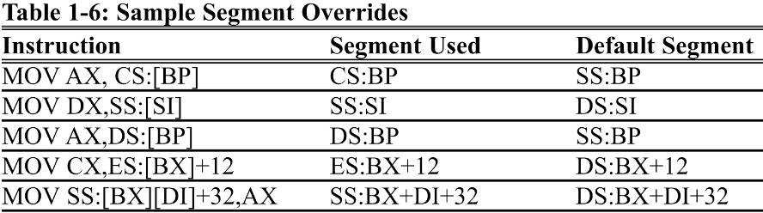
x86 ADDRESSING MODES segment overrides
The x86 CPU allows the program to override the default segment and use any segment register.
In "MOV AL,[BX]", the physical address of the operand to be moved into AL is DS:BX.
To override that default, specify the desired segment in the instruction as "MOV AL,ES:[BX]"

Slide 65
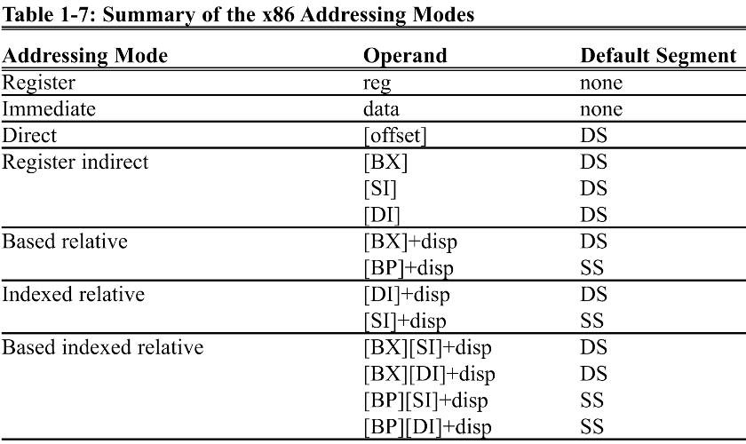
x86 ADDRESSING MODES summary

