Slide 1
EEEN 311 Logic Circuits & Microprocessors
The x86 Microprocessor
[Week 7]

Slide 2
OBJECTIVES
Flowcharts, Pseudocodes
Demonstrate how 8-bit and 16-bit unsigned numbers are added in the x86.
Convert data to any of the forms:
ASCII,packed BCD,unpacked BCD.
Explain the effect of unsigned arithmetic instructions on the flags.
Code the following Assembly language unsigned arithmetic instructions:
Addition instructions: ADD and ADC.
Subtraction instructions SUB and SBB.
Multiplication and division instructions MUL and DIV.
Code BCD arithmetic instructions:
DAA and DAS.
Code the Assembly language logic instructions:
AND, OR, and XOR.
Logical shift instructions SHR and SHL.

Slide 3
FULL SEGMENT DEFINITION EXE vs. COM files
The EXE file is used widely as it can be of any size.
There are occasions when, due to a limited amount of memory, one needs to have very compact code.
COM files must fit in a single segment.
The x86 segment size is 64K bytes, thus the COM file cannot be larger than 64K.
To limit the size to 64K requires defining the data inside the code segment and using the end area of the code segment for the stack.
In contrast to the EXE file, the COM file has no separate data segment definition.

Slide 4
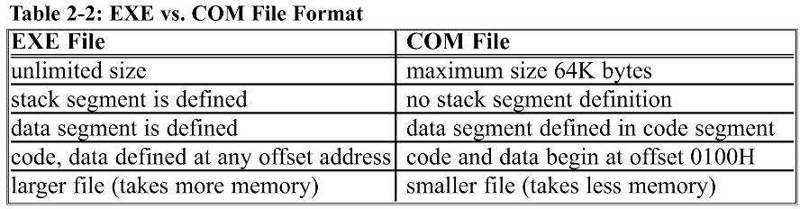
FULL SEGMENT DEFINITION EXE vs. COM files
The header block, which occupies 512 bytes of memory, precedes every EXE file.
It contains information such as size, address location in memory, and stack address of the EXE module.
The COM file does not have a header block.

Slide 5
FLOWCHARTS AND PSEUDOCODE structured programming
Structured programming is a term used to denote:
Programming techniques that make a program easier to code, debug and maintain over time.
Structured programming uses three basic types of program control structures:
Sequence.
Control.
Iteration.

Slide 6
FLOWCHARTS AND PSEUDOCODE structured programming
Principles a structured program should follow:
The program should be designed before it is coded.
By using flowcharting or pseudocode, the design is clear for those coding, as well as those maintaining the program later.
Use comments within the program and documentation.
This will help other figure out what the program does and how it does it.
The main routine should consist primarily of calls to subroutines that perform the work of the program.
Sometimes called top-down programming.
Using subroutines to accomplish repetitive tasks saves time in coding, and makes the program easier to read.

Slide 7
FLOWCHARTS AND PSEUDOCODE
Principles a structured program should follow:
Data control is very important.
The programmer should document the purpose of each variable, and which subroutines might alter its value.
Each subroutine should document its input/output variables, and which input variables might be altered within it.

Slide 8
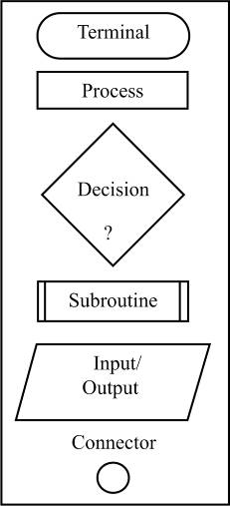
FLOWCHARTS AND PSEUDOCODE flowcharts
Flowcharts use graphic symbols to represent different types of program operations.
The symbols are connected together to show the flow of execution of the program.
Flowcharting has been standard industry practice for decades.
Flowchart templates help you draw the symbols quickly and neatly.

Slide 9
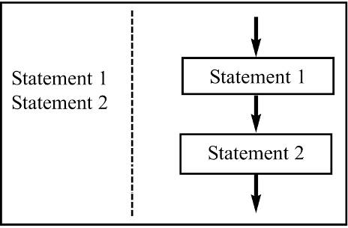
FLOWCHARTS AND PSEUDOCODE pseudocode
An alternative to flowcharts, pseudocode, involves writing brief descriptions of the flow of the code.
SEQUENCE is executing instructions one after the other.
Figure 2-15 SEQUENCE Pseudocode vs. Flowchart

Slide 10
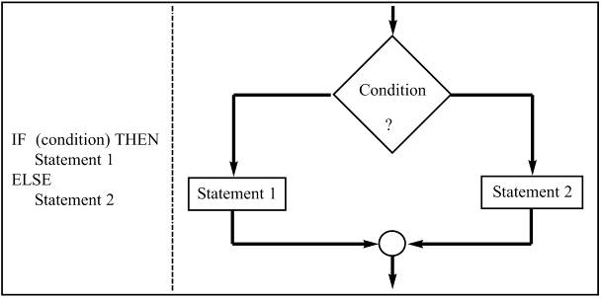
FLOWCHARTS AND PSEUDOCODE pseudocode
An alternative to flowcharts, pseudocode, involves writing brief descriptions of the flow of the code.
IF-THEN-ELSE and IF-THEN are control programming structures, which can indicate one statement or a group of statements.
Figure 2-16 IF-THEN-ELSE Pseudocode vs. Flowchart

Slide 11
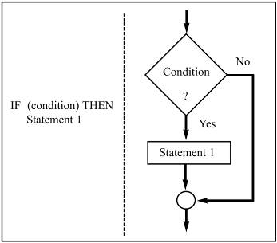
FLOWCHARTS AND PSEUDOCODE pseudocode
An alternative to flowcharts, pseudocode, involves writing brief descriptions of the flow of the code.
IF-THEN-ELSE and IF-THEN are control programming structures, which can indicate one statement or a group of statements.
Figure 2-17 IF-THEN Pseudocode vs. Flowchart

Slide 12
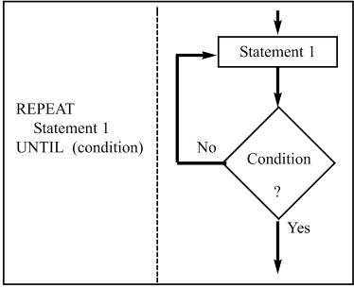
FLOWCHARTS AND PSEUDOCODE pseudocode
An alternative to flowcharts, pseudocode, involves writing brief descriptions of the flow of the code.
REPEAT-UNTIL and WHILE-DO are iteration control structures, which execute a statement or group of statements repeatedly.
Figure 2-18 REPEAT-UNTIL Pseudocode vs. Flowchart
REPEAT-UNTIL structure always executes the statement(s) at least once, and checks the condition after each iteration.

Slide 13
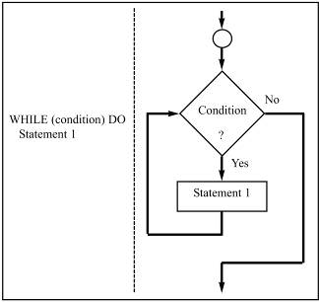
FLOWCHARTS AND PSEUDOCODE pseudocode
An alternative to flowcharts, pseudocode, involves writing brief descriptions of the flow of the code.
REPEAT-UNTIL and WHILE-DO are iteration control structures, which execute a statement or group of statements repeatedly.
Figure 2-19 WHILE-DO
Pseudocode vs. Flowchart
WHILE-DO may not execute the statement(s) at all, as the condition is checked at the beginning of each iteration.

Slide 14
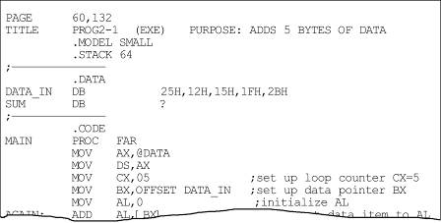
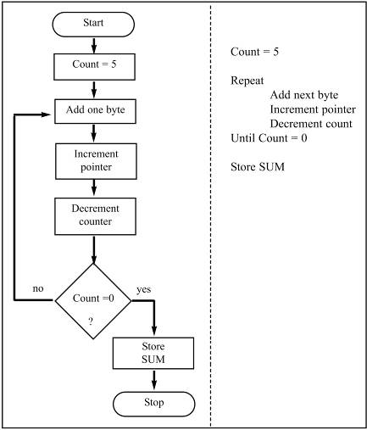
FLOWCHARTS AND PSEUDOCODE control structures
Flowchart vs. pseudocode for Program 2-1, showing steps for initializing/decrementing counters.
Housekeeping, such as initializing the data segment register in the MAIN procedure are not included in the flowchart or pseudocode.

Slide 15
FLOWCHARTS AND PSEUDOCODE control structures
The purpose of flowcharts or pseudocode is to show the program flow, and what the program does.
Pseudocode gives the same information as a flowchart, in a more compact form.
Often written in layers, in a top-down manner.
Code specific to a certain language or operating platform is not described in the pseudocode or flowchart.
Ideally, one could take a flowchart or pseudocode and code the program in any language.

Slide 16
UNSIGNED ADDITION AND SUBTRACTION
Unsigned numbers are defined as data in which all the bits are used to represent data.
Applies to the ADD and SUB instructions.
No bits are set aside for the positive or negative sign.
Between 00 and FFH (0 to 255 decimal) for 8-bit data.
Between 0000 and FFFFH (0 to 65535 decimal) for 16-bit data.

Slide 17
UNSIGNED ADDITION AND SUBTRACTION addition of unsigned numbers
The form of the ADD instruction is:
ADD and ADC are used to add two operands.
The destination operand can be a register or in memory.
The source operand can be a register, in memory, or immediate.
Memory-to-memory operations are never allowed in x86 Assembly language.
The instruction could change ZF, SF, AF, CF, or PF bits of the flag register.

Slide 18
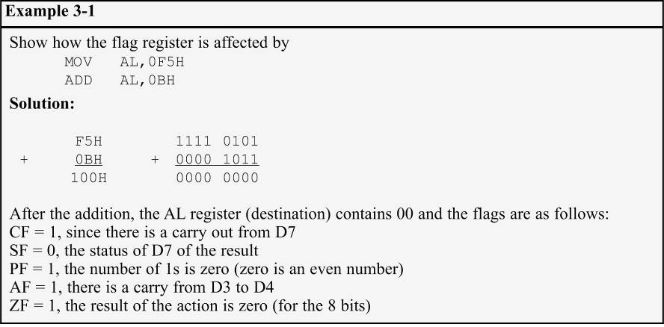
UNSIGNED ADDITION AND SUBTRACTION addition of unsigned numbers

Slide 19
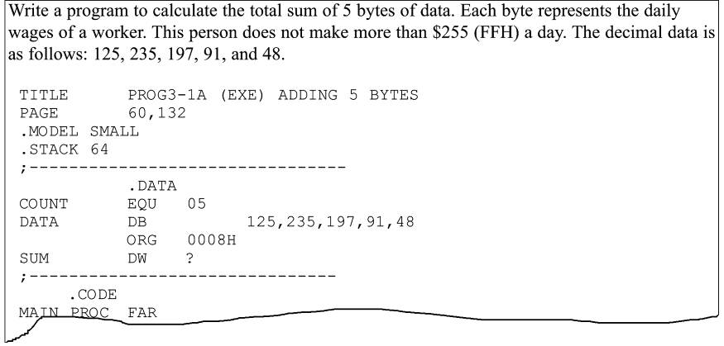
UNSIGNED ADDITION AND SUBTRACTION CASE1 addition of individual byte/word data
Program 3-1a uses AH to accumulate carries as the operands are added to AL.

Slide 20
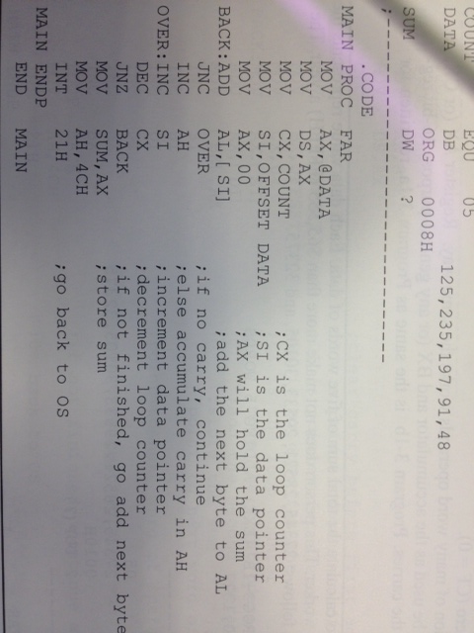
UNSIGNED ADDITION AND SUBTRACTION CASE1 addition of individual byte/word data
Program 3-1a uses AH to accumulate carries as the operands are added to AL.

Slide 21
UNSIGNED ADDITION AND SUBTRACTION CASE1 addition of individual byte/word data
Numbers are converted to hex by the assembler:
125=7DH 235=0EBH 197=0C5H 91=5BH 48=30H
Three iterations of the loop are shown below.
In the first, 7DH is added to AL.
CF = 0 and AH = 00.
CX = 04 and ZF = 0.
Second, EBH is added to AL & since a carry occurred, AH is incremented
AL = 68H and CF = 1.
CX = 03 and ZF = 0.
Third, C5H is added to AL, again a carry increments AH.
AL = 2DH, CX = 02 and ZF = 0.

Slide 22
UNSIGNED ADDITION AND SUBTRACTION CASE1 addition of individual byte/word data
This process continues until CX = 00 and the zero flag becomes 1, causing JNZ to fall through.
The result will be saved in the word-sized memory set aside in the data segment.

Slide 23
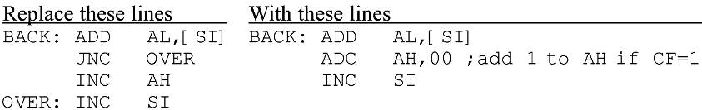
UNSIGNED ADDITION AND SUBTRACTION CASE1 addition of individual byte/word data
Due to pipelining it is strongly recommended that the following lines of the program be replaced:
The "ADC AH,00" instruction in reality means add 00+AH+CF and place the result in AH.
More efficient since the instruction "JNC OVER" has to empty the queue of pipelined instructions and fetch the instructions from the OVER target every time the carry is zero (CF = 0).
Program 3-1b is the same as 3-1a, rewritten for word addition. (See the program listing on page 94 of your textbook.)

Slide 24
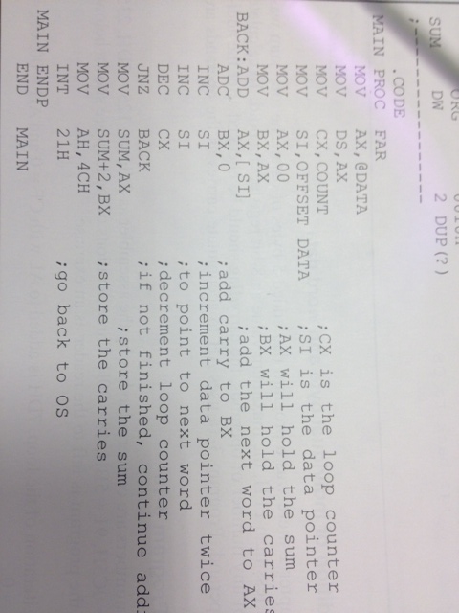
UNSIGNED ADDITION AND SUBTRACTION CASE1 addition of individual byte/word data

Slide 25
UNSIGNED ADDITION AND SUBTRACTION CASE2 addition of multiword numbers
Assume a program to total U.S. budget for the last 100 years or mass of planets in the solar system.
Numbers being added could be 8 bytes wide or more.
The programmer must write the code to break the large numbers into smaller chunks to be processed.
A 16-bit register & an 8 byte operand is wide would take a total of four iterations.
An 8-bit register with the same operands would require eight iterations.
Powerful new CPUs such as Itanium have registers of 64bits wide and larger.

Slide 26
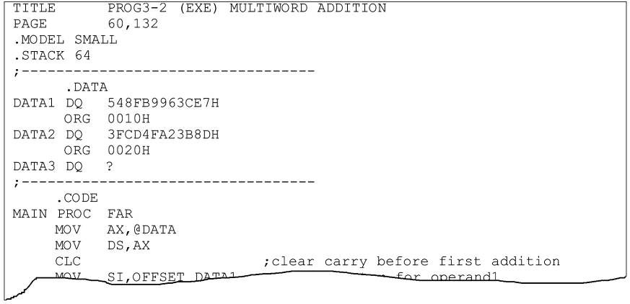
UNSIGNED ADDITION AND SUBTRACTION CASE2 addition of multiword numbers
In writing program 3-2, the first decision was the directive for coding the data in the data segment.
DQ was chosen since it can represent data as large as 8 bytes wide.

Slide 27
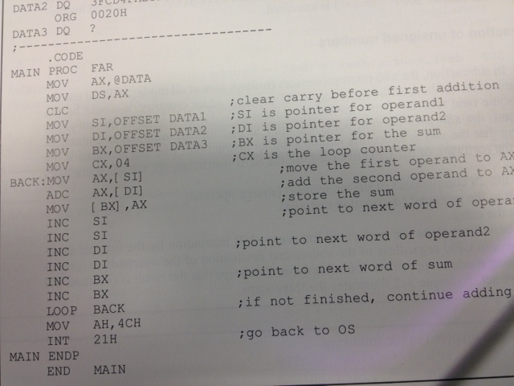
UNSIGNED ADDITION AND SUBTRACTION CASE2 addition of multiword numbers

Slide 28
UNSIGNED ADDITION AND SUBTRACTION CASE2 addition of multiword numbers
In addition of multibyte (or multiword) numbers, the ADC instruction is always used, as the carry must be added to the next-higher byte (or word) in the next iteration.
Before executing ADC, the carry flag is cleared (CF = 0) using the CLC (clear carry) instruction.
Three pointers have been used:
SI for DATA1; DI for DATA2.
BX for DATA3. (where the result is saved)

Slide 29
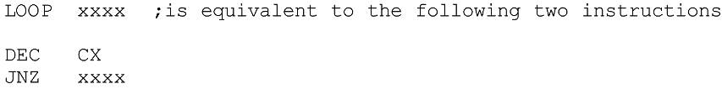
UNSIGNED ADDITION AND SUBTRACTION CASE2 addition of multiword numbers
A new instruction, "LOOP XXXX", replaces the often used "DEC CX" and "JNZ XXXX".
When "LOOP xxxx" is executed, CX decrements automatically, and if CX is not 0, the processor will jump to target address xxxx.
If CX is 0, the next instruction (below "LOOP xxxx") is executed.

Slide 30
UNSIGNED ADDITION AND SUBTRACTION subtraction of unsigned numbers
In subtraction, x86 processors use 2's complement.
Internal adder circuitry performs the subtraction command.
x86 steps in executing the SUB instruction:
1. Take the 2's complement of the subtrahend. (source operand)
2. Add it to the minuend. (destination operand)
3. Invert the carry.
The steps are performed for every SUB instruction regardless of source & destination of the operands.

Slide 31
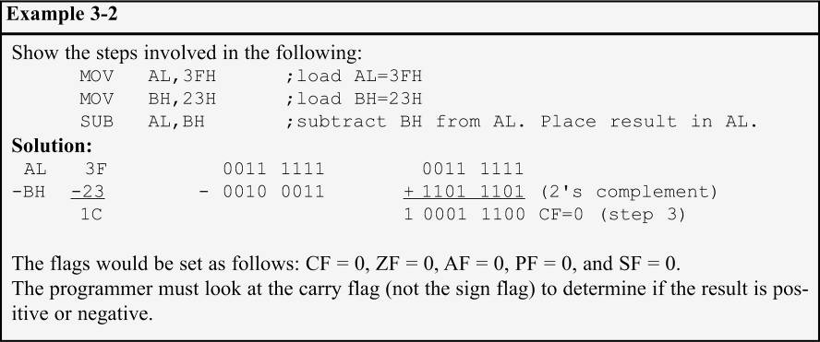
UNSIGNED ADDITION AND SUBTRACTION subtraction of unsigned numbers
After the execution, if CF = 0, the result is positive.
If CF = 1, the result is negative and the destination has the 2's complement of the result.

Slide 32
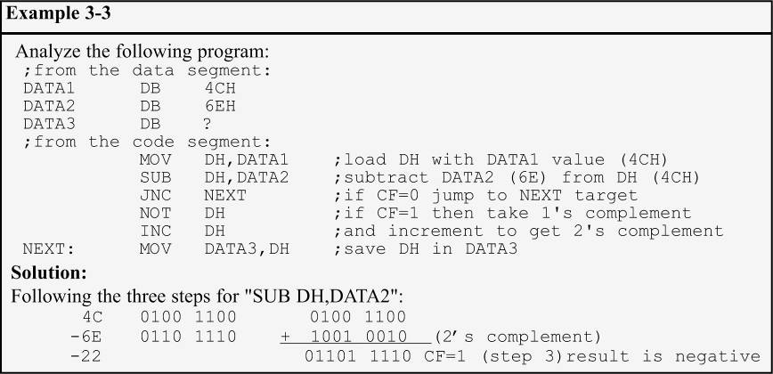
UNSIGNED ADDITION AND SUBTRACTION subtraction of unsigned numbers
NOT performs the 1's complement of the operand.
The operand is incremented to get the 2's complement.

Slide 33
UNSIGNED ADDITION AND SUBTRACTION SBB subtract with borrow
SBB is used for multibyte (multiword) numbers.
It will take care of the borrow of the lower operand.
If the carry flag is 0, SBB works like SUB.
If the carry flag is 1, SBB subtracts 1 from the result.
The PTR (pointer) data specifier directive is widely used to specify the size of the operand when it differs from the defined size.

Slide 34
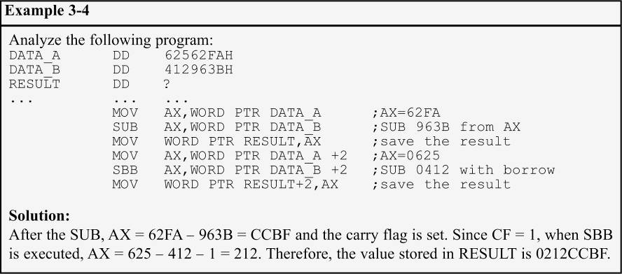
UNSIGNED ADDITION AND SUBTRACTION SBB - subtract with borrow
"WORD PTR" tells the assembler to use a word operand, though the data is defined as a doubleword.

Slide 35
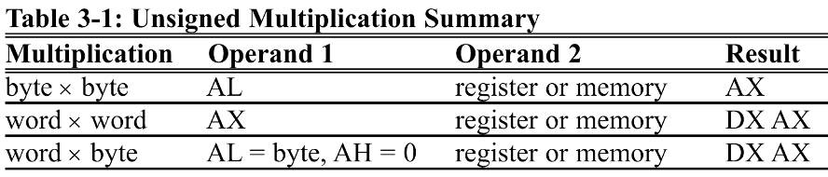
UNSIGNED MULTIPLICATION & DIVISION multiplication of unsigned numbers
In multiplying two numbers in the x86 processor, use of registers AX, AL, AH, and DX is necessary.
The function assumes the use of those registers.
Three multiplication cases:
byte times byte; word times word; byte times word.

Slide 36
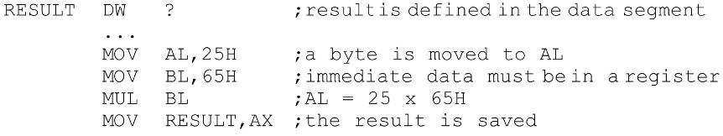
UNSIGNED MULTIPLICATION & DIVISION multiplication of unsigned numbers
byte × byte - one of the operands must be in the AL register and the second can be in a register or in memory.
After the multiplication, the result is in AX.
25H is multiplied by 65H and the result is saved in word-sized memory named RESULT.
Register addressing mode was used.
Examples of other address modes appear on textbook page 98.

Slide 37
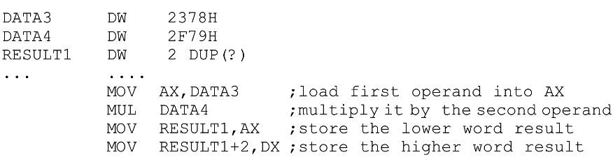
UNSIGNED MULTIPLICATION & DIVISION multiplication of unsigned numbers
word × word - one operand must be in AX & the second operand can be in a register or memory.
After multiplication, AX & DX will contain the result.
Since word-by-word multiplication can produce a 32-bit result, AX will hold the lower word and DX the higher word.

Slide 38
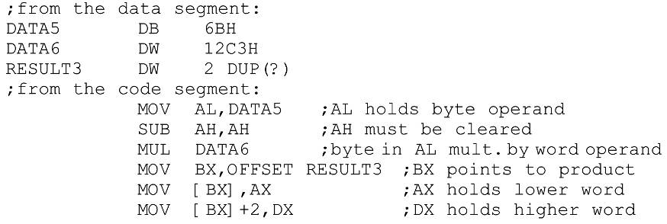
UNSIGNED MULTIPLICATION & DIVISION multiplication of unsigned numbers
word × byte - similar to word-by-word multiplication except that AL contains the byte operand and AH must be set to zero.

Slide 39
UNSIGNED MULTIPLICATION & DIVISION division of unsigned numbers
Like multiplication, division of two numbers in the x86 uses of registers AX, AL, AH, and DX.
Four division cases:
byte over byte; word over word.
word over byte; doubleword over word.
In divide, in cases where the CPU cannot perform the division, an interrupt is activated.
Referred to as an exception, and the PC will display a Divide Error message.
If the denominator is zero. (dividing any number by 00)
If the quotient is too large for the assigned register.

Slide 40
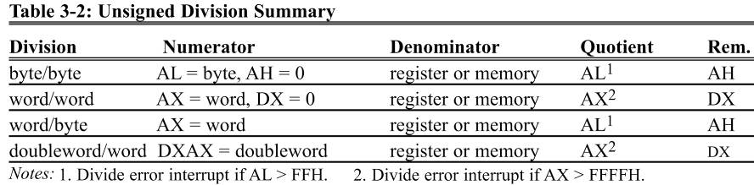
UNSIGNED MULTIPLICATION & DIVISION division of unsigned numbers
byte/byte - the numerator must be in the AL register and AH must be set to zero.
The denominator cannot be immediate but can be in a register or memory, supported by the addressing modes.
After the DIV instruction is performed, the quotient is in AL and the remainder is in AH.

Slide 41
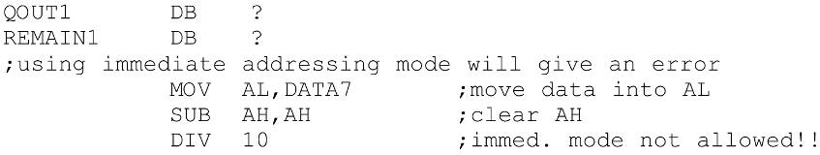
UNSIGNED MULTIPLICATION & DIVISION division of unsigned numbers
Various addressing modes of the denominator.

Slide 42
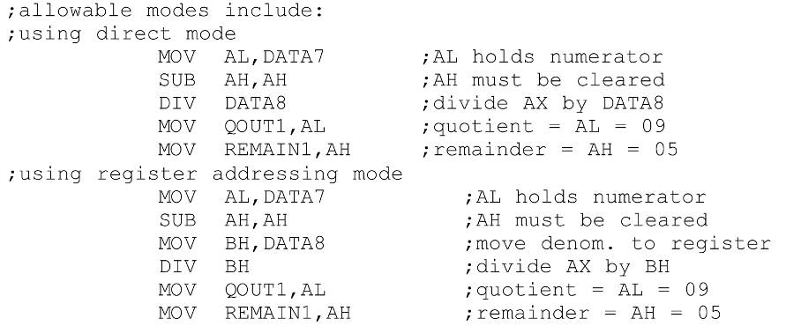
3.2: division of unsigned numbers
Various addressing modes of the denominator.

Slide 43
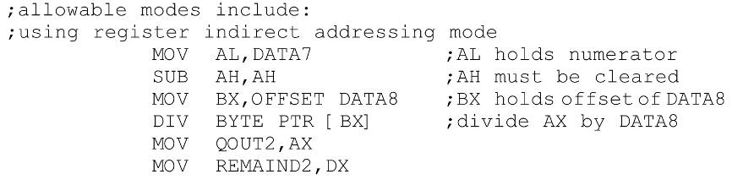
UNSIGNED MULTIPLICATION & DIVISION division of unsigned numbers
Various addressing modes of the denominator.

Slide 44
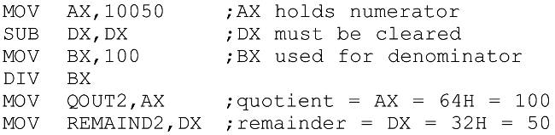
3.2: UNSIGNED MULTIPLICATION & DIVISION division of unsigned numbers
word/word - the numerator is in AX, and DX must be cleared.
The denominator can be in a register or memory.
After DIV, AX will have the quotient.
The remainder will be in DX.

Slide 45
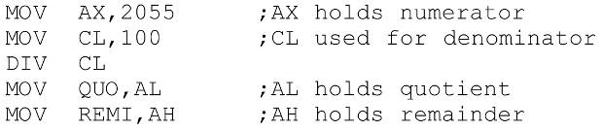
3.2: UNSIGNED MULTIPLICATION & DIVISION division of unsigned numbers
word/byte - the numerator is in AX & the denominator can be in a register or memory.
After DIV, AL will contain the quotient, AH the remainder.
The maximum quotient is FFH.
This program divides AX = 2055 by CL = 100.
The quotient is AL = 14H (20 decimal)
The remainder is AH = 37H (55 decimal).

Slide 46
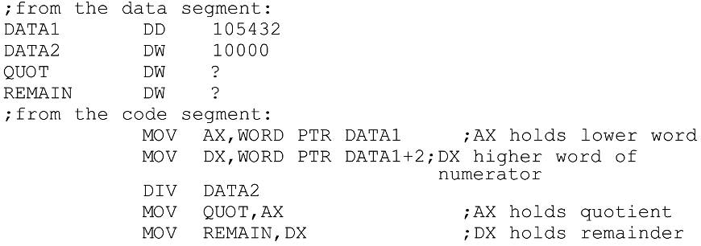
UNSIGNED MULTIPLICATION & DIVISION division of unsigned numbers
doubleword/word - the numerator is in AX and DX.
The most significant word in DX, least significant in AX.
The denominator can be in a register or in memory.
After DIV, the quotient will be in AX, the remainder in DX.
The maximum quotient FFFFH.

Slide 47
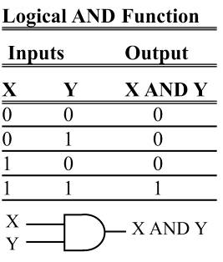
LOGIC INSTRUCTIONS AND
AND destination, source
This instruction will perform a logical AND on the operands and place the result in the destination.
Destination operand can be a register or in memory.
Source operand can be a register, memory, or immediate.
AND will automatically change the CF & OF to zero.
PF, ZF, and SF are set according to the result.
The rest of the flags are either undecided or unaffected.

Slide 48
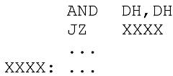
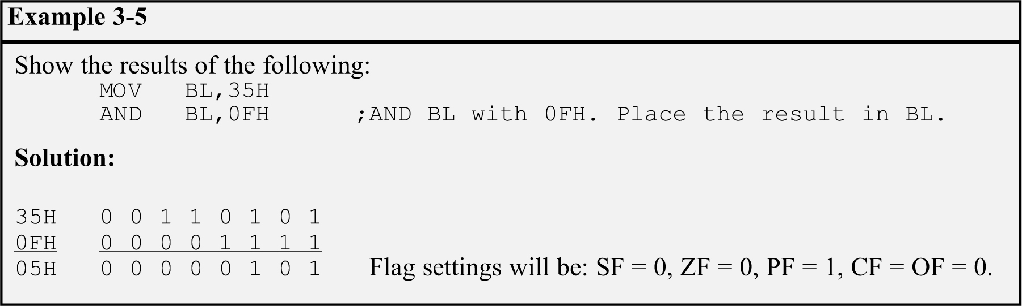
LOGIC INSTRUCTIONS AND
AND can mask certain bits of the operand, and also to test for a zero operand:
This code will AND DH with itself and set ZF = 1 if the result is zero.

Slide 49
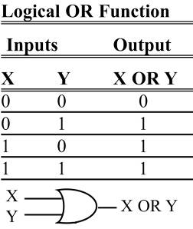
LOGIC INSTRUCTIONS OR
OR destination, source
Destination/source operands are Ored, result placed in the destination.
Can set certain bits of an operand to 1.
Destination operand can be a register or in memory.
Source operand can be a register, in memory, or immediate.
Flags are set the same as for the AND instruction.
CF & OF will be reset to zero.
SF, ZF, and PF will be set according to the result.
All other flags are not affected.

Slide 50
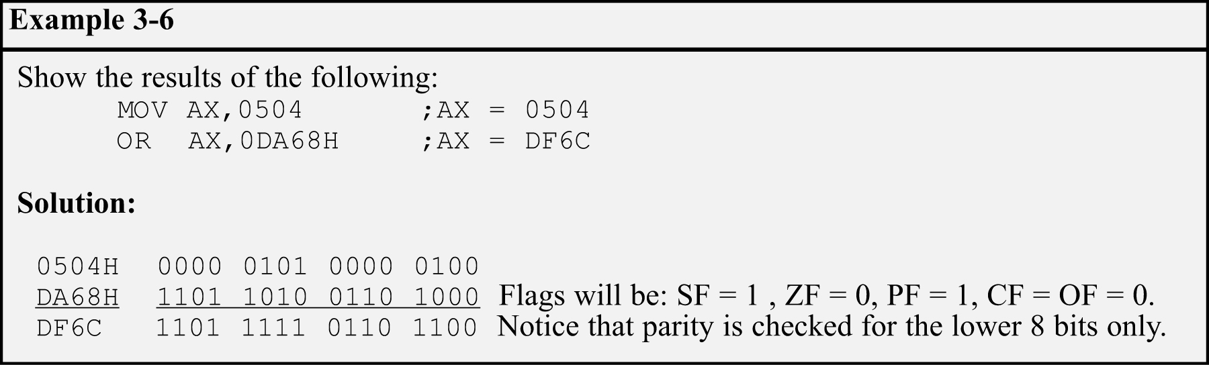
LOGIC INSTRUCTIONS OR
The OR instruction can also be used to test for a zero operand.
"OR BL,0" will OR the register BL with 0 and make ZF = 1 if BL is zero.
"OR BL,BL" will achieve the same result.

Slide 51
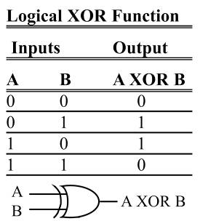
LOGIC INSTRUCTIONS XOR
XOR dest, src
XOR will eXclusive-OR operands and place result in the destination.
Sets the result bits to 1 if they are not equal, otherwise, reset to 0.
Flags are set the same as for AND.
Operand rules are the same as in the AND and OR instructions.

Slide 52
LOGIC INSTRUCTIONS XOR
XOR can be used to see if two registers have the same value.
"XOR BX,CX" will make ZF = 1 if both registers have the same value, and if they do, the result (0000) is saved in BX, the destination.
A widely used application of XOR is to toggle bits of an operand.
Toggling bit 2 of register AL would cause it to change to the opposite value; all other bits remain unchanged.

Slide 53
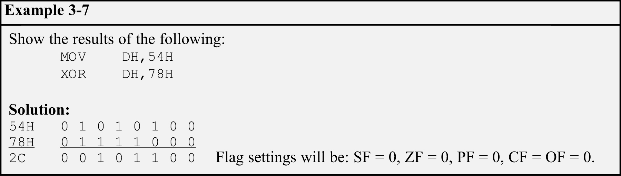
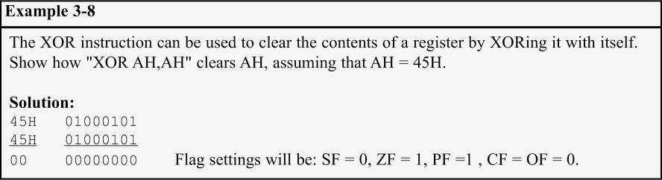
LOGIC INSTRUCTIONS XOR

Slide 54
LOGIC INSTRUCTIONS SHIFT
Shifts the contents of a register or memory location right or left.
There are two kinds of shifts:
Logical - for unsigned operands.
Arithmetic - for signed operands.
The number of times (or bits) the operand is shifted can be specified directly if it is once only.
Through the CL register if it is more than once.

Slide 55

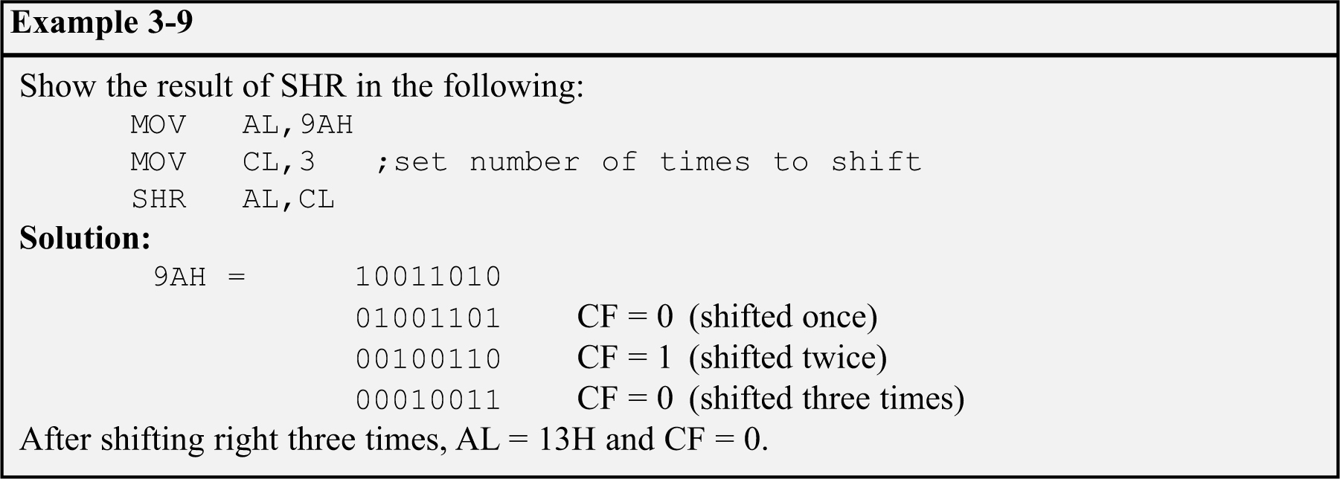
LOGIC INSTRUCTIONS SHIFT RIGHT
SHR - logical shift right.
Operand is shifted right bit by bit.
For every shift the LSB (least significant bit) will go to the carry flag. (CF)
The MSB (most significant bit) is filled with 0.

Slide 56
LOGIC INSTRUCTIONS SHIFT RIGHT
If the operand is to be shifted once only, this is specified in the SHR instruction itself.
After the shift, BX = 7FFFH and CF = 1. SHIFT.

Slide 57
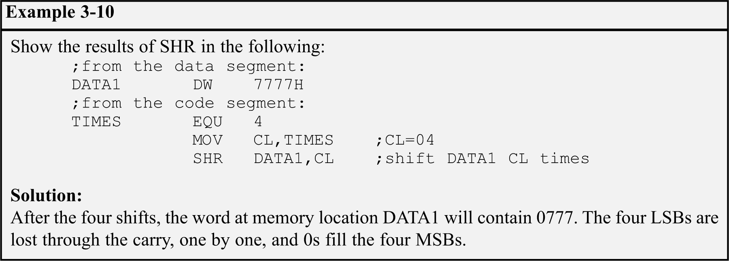
LOGIC INSTRUCTIONS SHIFT RIGHT
The operand to be shifted can be in a register or in memory.
Immediate addressing mode is not allowed for SHIFT.
"SHR 25,CL" will cause the assembler to give an error.

Slide 58

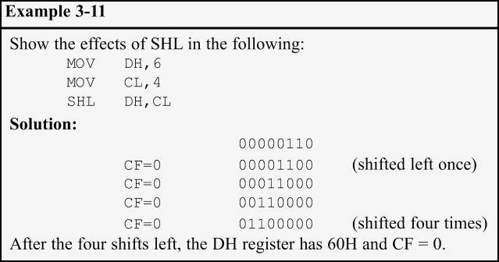
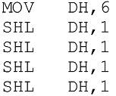
LOGIC INSTRUCTIONS SHIFT LEFT
SHL - Logical shift left, the reverse of SHR.
After every shift, the LSB is filled with 0.
MSB goes to CF.
All rules are the same as for SHR.
3-11 can also be coded as:

