Slide 1
EEEN 311 Logic Circuits & Microprocessors
The x86 Microprocessor
[Week 9]

Slide 2
UNSIGNED MULTIPLICATION & DIVISION division of unsigned numbers
Like multiplication, division of two numbers in the x86 uses of registers AX, AL, AH, and DX.
Four division cases:
byte over byte; word over word.
word over byte; doubleword over word.
In divide, in cases where the CPU cannot perform the division, an interrupt is activated.
Referred to as an exception, and the PC will display a Divide Error message.
If the denominator is zero. (dividing any number by 00)
If the quotient is too large for the assigned register.

Slide 3
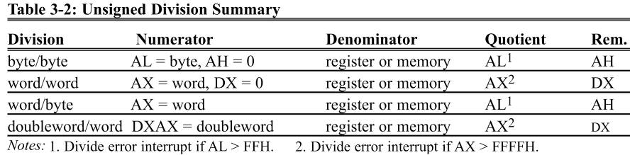
UNSIGNED MULTIPLICATION & DIVISION division of unsigned numbers
byte/byte - the numerator must be in the AL register and AH must be set to zero.
The denominator cannot be immediate but can be in a register or memory, supported by the addressing modes.
After the DIV instruction is performed, the quotient is in AL and the remainder is in AH.

Slide 4
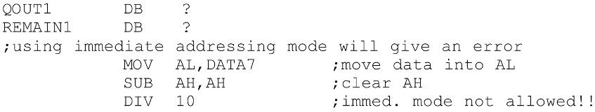
UNSIGNED MULTIPLICATION & DIVISION division of unsigned numbers
Various addressing modes of the denominator.

Slide 5
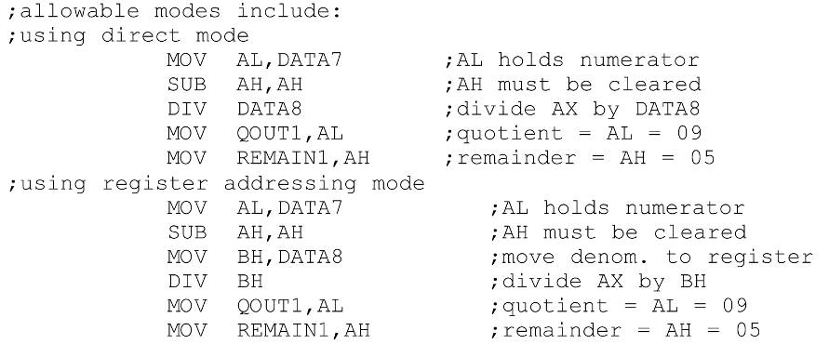
division of unsigned numbers
Various addressing modes of the denominator.

Slide 6
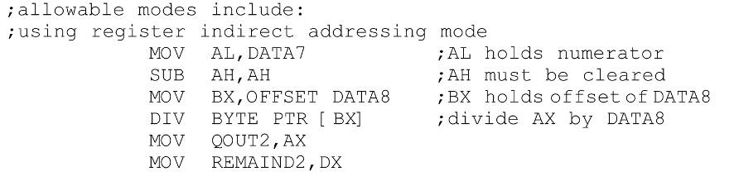
UNSIGNED MULTIPLICATION & DIVISION division of unsigned numbers
Various addressing modes of the denominator.

Slide 7
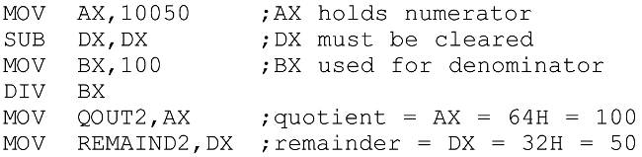
UNSIGNED MULTIPLICATION & DIVISION division of unsigned numbers
word/word - the numerator is in AX, and DX must be cleared.
The denominator can be in a register or memory.
After DIV, AX will have the quotient.
The remainder will be in DX.

Slide 8
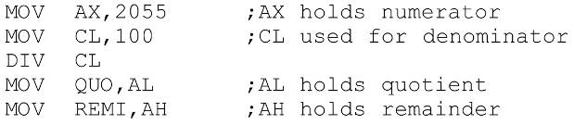
UNSIGNED MULTIPLICATION & DIVISION division of unsigned numbers
word/byte - the numerator is in AX & the denominator can be in a register or memory.
After DIV, AL will contain the quotient, AH the remainder.
The maximum quotient is FFH.
This program divides AX = 2055 by CL = 100.
The quotient is AL = 14H (20 decimal)
The remainder is AH = 37H (55 decimal).

Slide 9
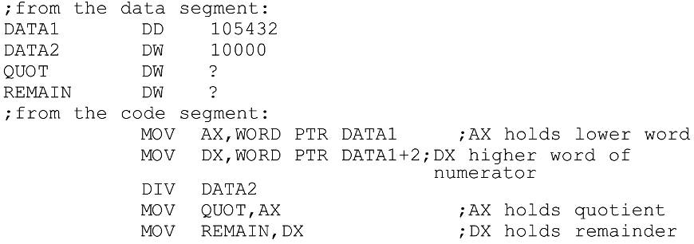
UNSIGNED MULTIPLICATION & DIVISION division of unsigned numbers
doubleword/word - the numerator is in AX and DX.
The most significant word in DX, least significant in AX.
The denominator can be in a register or in memory.
After DIV, the quotient will be in AX, the remainder in DX.
The maximum quotient FFFFH.

Slide 10
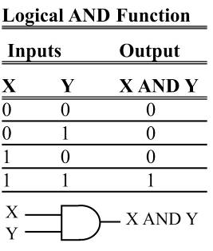
LOGIC INSTRUCTIONS AND
AND destination, source
This instruction will perform a logical AND on the operands and place the result in the destination.
Destination operand can be a register or in memory.
Source operand can be a register, memory, or immediate.
AND will automatically change the CF & OF to zero.
PF, ZF, and SF are set according to the result.
The rest of the flags are either undecided or unaffected.

Slide 11
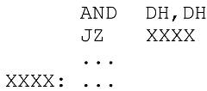
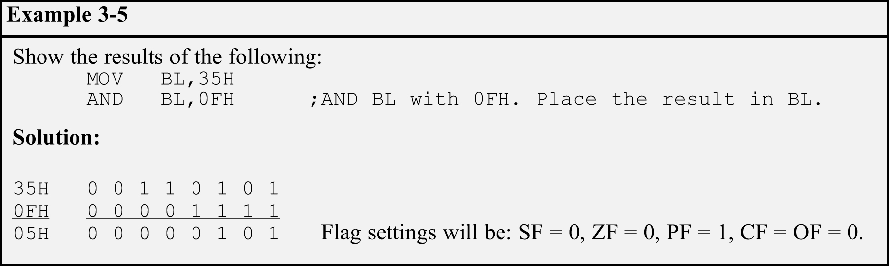
LOGIC INSTRUCTIONS AND
AND can mask certain bits of the operand, and also to test for a zero operand:
This code will AND DH with itself and set ZF = 1 if the result is zero.

Slide 12
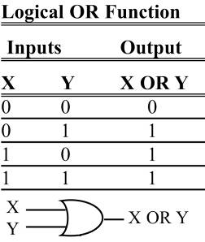
LOGIC INSTRUCTIONS OR
OR destination, source
Destination/source operands are Ored, result placed in the destination.
Can set certain bits of an operand to 1.
Destination operand can be a register or in memory.
Source operand can be a register, in memory, or immediate.
Flags are set the same as for the AND instruction.
CF & OF will be reset to zero.
SF, ZF, and PF will be set according to the result.
All other flags are not affected.

Slide 13
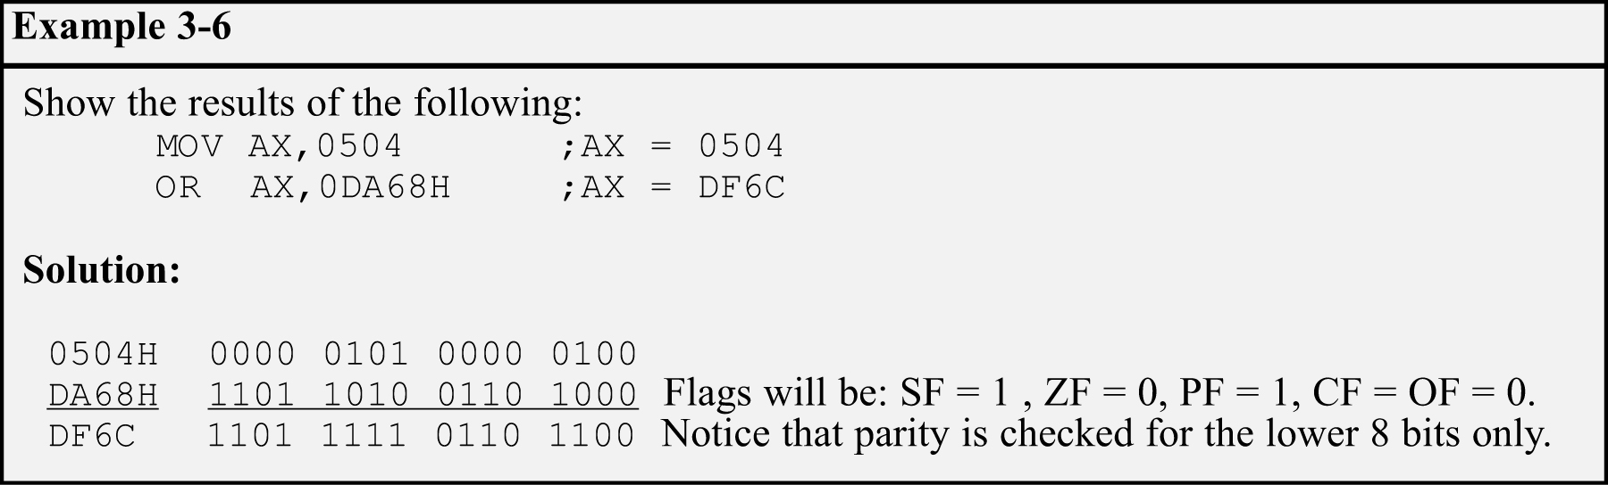
LOGIC INSTRUCTIONS OR
The OR instruction can also be used to test for a zero operand.
"OR BL,0" will OR the register BL with 0 and make ZF = 1 if BL is zero.
"OR BL,BL" will achieve the same result.

Slide 14
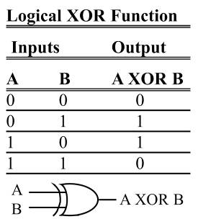
LOGIC INSTRUCTIONS XOR
XOR dest, src
XOR will eXclusive-OR operands and place result in the destination.
Sets the result bits to 1 if they are not equal, otherwise, reset to 0.
Flags are set the same as for AND.
Operand rules are the same as in the AND and OR instructions.

Slide 15
LOGIC INSTRUCTIONS XOR
XOR can be used to see if two registers have the same value.
"XOR BX,CX" will make ZF = 1 if both registers have the same value, and if they do, the result (0000) is saved in BX, the destination.
A widely used application of XOR is to toggle bits of an operand.
Toggling bit 2 of register AL would cause it to change to the opposite value; all other bits remain unchanged.

Slide 16
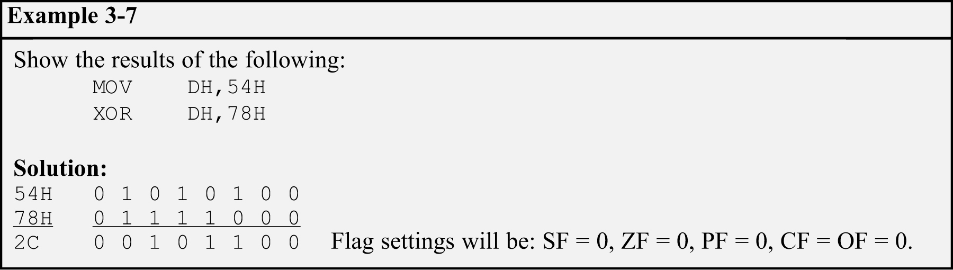
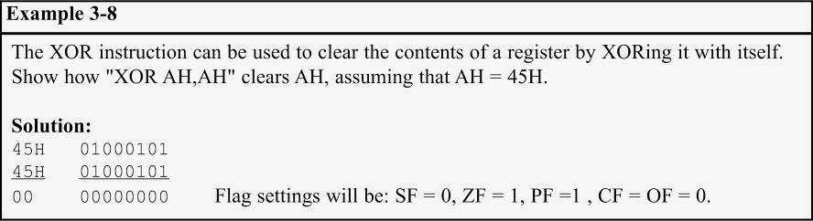
LOGIC INSTRUCTIONS XOR

Slide 17
LOGIC INSTRUCTIONS SHIFT
Shifts the contents of a register or memory location right or left.
There are two kinds of shifts:
Logical - for unsigned operands.
Arithmetic - for signed operands.
The number of times (or bits) the operand is shifted can be specified directly if it is once only.
Through the CL register if it is more than once.

Slide 18

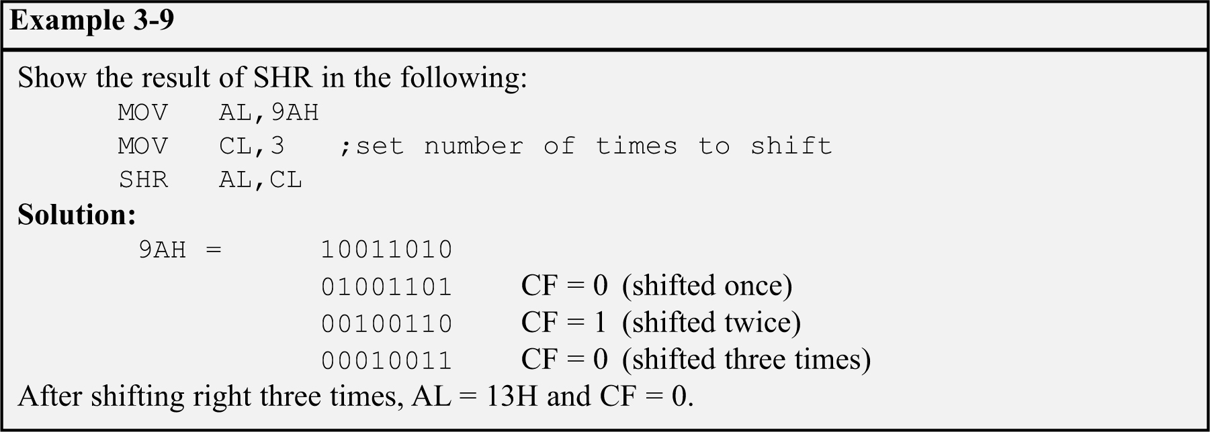
LOGIC INSTRUCTIONS SHIFT RIGHT
SHR - logical shift right.
Operand is shifted right bit by bit.
For every shift the LSB (least significant bit) will go to the carry flag. (CF)
The MSB (most significant bit) is filled with 0.

Slide 19
LOGIC INSTRUCTIONS SHIFT RIGHT
If the operand is to be shifted once only, this is specified in the SHR instruction itself.
After the shift, BX = 7FFFH and CF = 1. SHIFT.

Slide 20
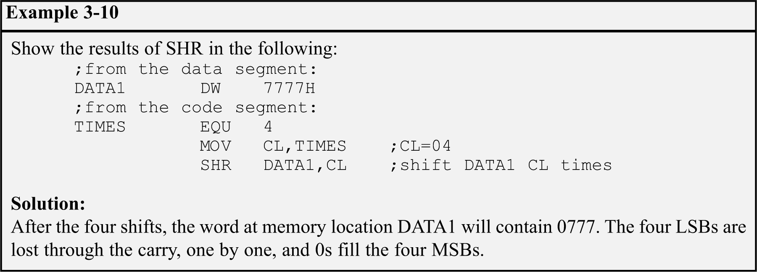
LOGIC INSTRUCTIONS SHIFT RIGHT
The operand to be shifted can be in a register or in memory.
Immediate addressing mode is not allowed for SHIFT.
"SHR 25,CL" will cause the assembler to give an error.

Slide 21

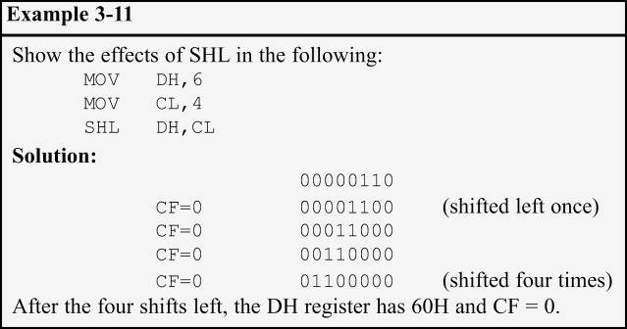
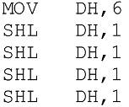
LOGIC INSTRUCTIONS SHIFT LEFT
SHL - Logical shift left, the reverse of SHR.
After every shift, the LSB is filled with 0.
MSB goes to CF.
All rules are the same as for SHR.
3-11 can also be coded as:

Slide 22
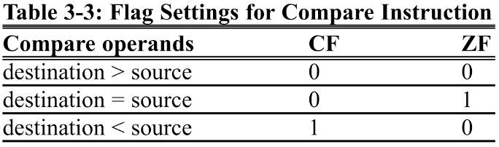
LOGIC INSTRUCTIONS COMPARE of unsigned numbers
CMP destination,source
Compares two operands & changes flags according to the result of the comparison, leaving the operand unchanged.
Destination operand can be in a register or in memory.
Source operand can be in a register, in memory, or immediate.
CF, AF, SF, PF, ZF, and OF flags reflect the result.
Only CF and ZF are used.

Slide 23
LOGIC INSTRUCTIONS COMPARE of unsigned numbers
Compare is really a SUBtraction.
Except that the values of the operands do not change.
Flags are changed according to the execution of SUB.
Operands are unaffected regardless of the result.
Only the flags are affected.

Slide 24
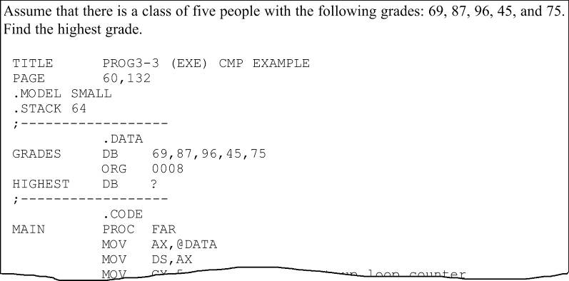
LOGIC INSTRUCTIONS COMPARE of unsigned numbers
Program 3-3 uses CMP to find the highest byte in a series of 5 bytes defined in the data segment.
See the entire program listing on page 107 of your textbook.

Slide 25
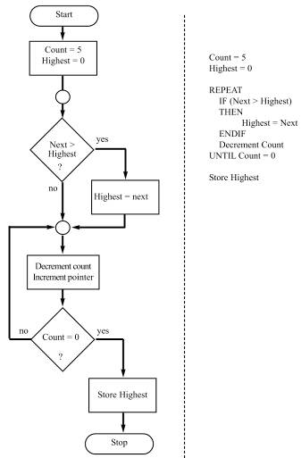
LOGIC INSTRUCTIONS COMPARE of unsigned numbers
Program 3-3 searches five data items to find the highest grade, with a variable called "Highest" holding the highest grade found so far.
A REPEAT-UNTIL structure was used in the program, where grades are compared, one by one, to Highest.
If any of them is higher, that value is placed in Highest, continuing until all data items are checked.

Slide 26
LOGIC INSTRUCTIONS COMPARE of unsigned numbers
Program 3-3, coded in Assembly language, uses register AL to hold the highest grade found so far.
AL is given the initial value of 0.
A loop compares each of the 5 bytes with AL.
If AL contains a higher value, the loop continues to check the next byte.
If AL is smaller than the byte checked, the contents of AL are replaced by that byte and the loop continues.

Slide 27
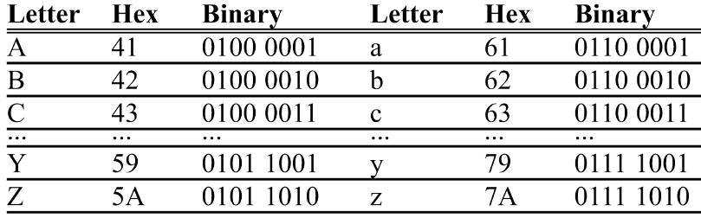
LOGIC INSTRUCTIONS COMPARE of unsigned numbers
There is a relationship between the pattern of lowercase/uppercase ASCII letters, as shown below for A and a:
The only bit that changes is d5.
To change from lowercase to uppercase, d5 must be masked.
A 0100 0001 41H
a 0110 0001 61H
The only bit that changes is d5.
To change from lowercase to uppercase, d5 must be masked.

Slide 28
LOGIC INSTRUCTIONS COMPARE of unsigned numbers
Program 3-4 uses CMP to determine if an ASCII character is uppercase or lowercase.
It detects if the letter is in lowercase, and if it is, it is ANDed with 1101 1111B = DFH.
Otherwise, it is simply left alone.
To determine if it is a lowercase letter, it is compared with 61H and 7AH to see if it is in the range a to z.
Anything above or below this range should be left alone.

Slide 29
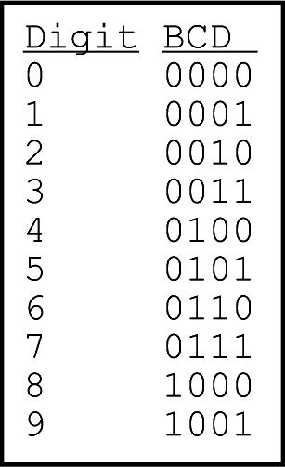
BCD AND ASCII CONVERSION BCD number system
BCD stands for binary coded decimal.
Needed because we use the digits 0 to 9 for numbers in everyday life.
Computer literature features two terms for BCD numbers:
Unpacked BCD.
Packed BCD.

Slide 30
BCD AND ASCII CONVERSION BCD unpacked vs. packed
In unpacked BCD, the lower 4 bits of the number represent the BCD number.
The rest of the bits are 0.
"0000 1001" and "0000 0101" are unpacked BCD for 9 & 5.
Unpacked BCD it takes 1 byte of memory location.
Or a register of 8 bits to contain the number.
In packed BCD, a single byte has two BCD numbers.
One in the lower 4 bits; One in the upper 4 bits.
"0101 1001" is packed BCD for 59.
As it takes only 1 byte of memory to store the packed BCD operands, it is twice as efficient in storing data.

Slide 31
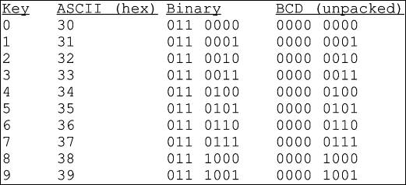
BCD AND ASCII CONVERSION ASCII numbers
In ASCII keyboards, when key "0" is activated "011 0000" (30H) is provided to the computer.
31H (011 0001) is provided for key "1", etc.
To convert ASCII data to BCD, removed the tagged "011" in the higher 4 bits of the ASCII.
Each ASCII number is ANDed with "0000 1111“. (0FH)

Slide 32
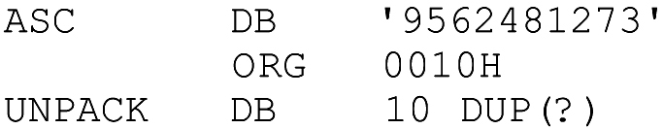
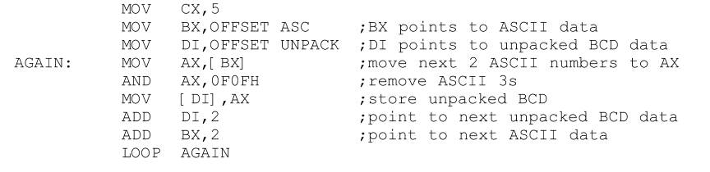
BCD AND ASCII CONVERSION ASCII to unpacked BCD conversion
Programs 3-5a, 3-5b, and 3-5c show three methods for converting the 10 ASCII digits to unpacked BCD.
Using this data segment:
The data is defined as DB, a byte definition directive, and is accessed in word-sized chunks.
Program 3-5a

Slide 33
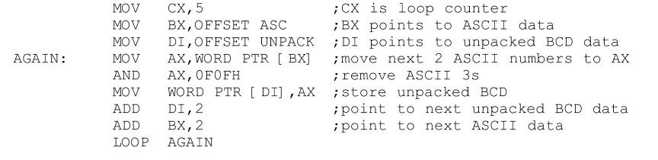
BCD AND ASCII CONVERSION ASCII to unpacked BCD conversion
Programs 3-5a, 3-5b, and 3-5c show three methods for converting the 10 ASCII digits to unpacked BCD.
Using this data segment:
Using the PTR directive as shown, makes the code more readable for programmers.
Program 3-5b

Slide 34
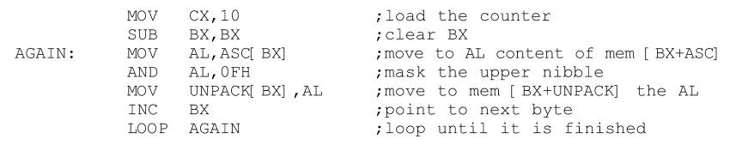
BCD AND ASCII CONVERSION ASCII to unpacked BCD conversion
Programs 3-5a, 3-5b, and 3-5c show three methods for converting the 10 ASCII digits to unpacked BCD.
Using this data segment:
3-5c uses based addressing mode since BX+ASC is used as a pointer.
Program 3-5c

Slide 35
BCD AND ASCII CONVERSION ASCII/BCD conversions
To convert ASCII to packed BCD, it is converted to unpacked BCD (eliminating the 3), then combined to make packed BCD.
To convert packed BCD to ASCII, it must first be converted to unpacked.
The unpacked BCD is tagged with 011 0000 (30H).

Slide 36
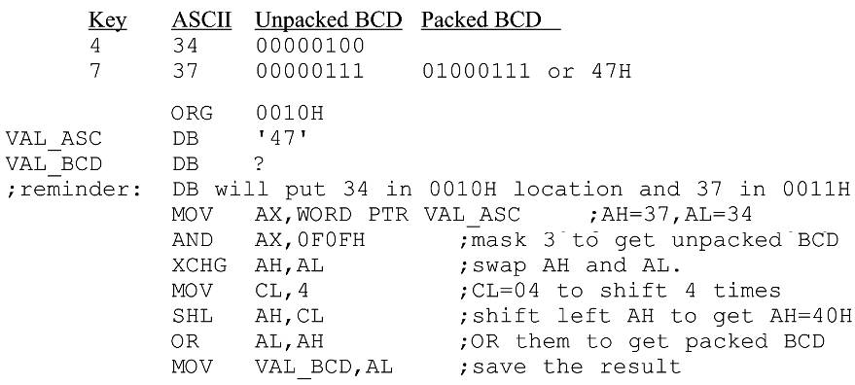
BCD AND ASCII CONVERSION ASCII to packed BCD conversion
For 4 & 7, the keyboard gives 34 & 37, respectively.
The goal is to produce packed BCD 47H or “0100 0111“.

Slide 37
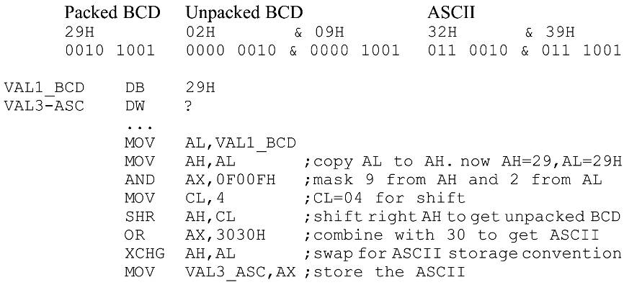
BCD AND ASCII CONVERSION packed BCD to ASCII conversion
Converting from packed BCD to ASCII.

Slide 38

BCD AND ASCII CONVERSION BCD addition and subtraction
After adding packed BCD numbers, the result is no longer BCD.
Adding them gives 0011 1111B (3FH). (not BCD)
The result should have been 17 + 28 = 45 (0100 0101).
To correct, add 6 (0110) to the low digit: 3F + 06 = 45H.
The same could have happened in the upper digit.
This problem is so pervasive that the vast majority of microprocessors have an instruction to deal with it.

Slide 39
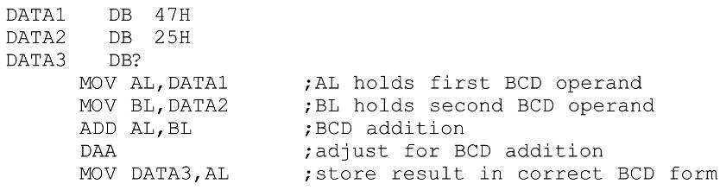
BCD AND ASCII CONVERSION DAA
DAA (decimal adjust for addition) is provided in the x86 for correcting the BCD addition problem.
DAA will add 6 to the lower, or higher nibble if needed
Otherwise, it will leave the result alone.
After execution, DATA3 will contain 72H.

Slide 40
BCD AND ASCII CONVERSION DAA general rules & summary
General rules for DAA:
The source can be an operand of any addressing mode.
The destination must be AL in order for DAA to work.
DAA must be used after the addition of BCD operands.
BCD operands can never have any digit greater than 9.
DAA works only after an ADD instruction.
It will not work after the INC instruction.
After an ADD or ADC instruction:
If the lower nibble (4 bits) is greater than 9, or if AF = 1.
Add 0110 to the lower 4 bits.
If the upper nibble is greater than 9, or if CF = 1.
Add 0110 to the upper nibble.

Slide 41
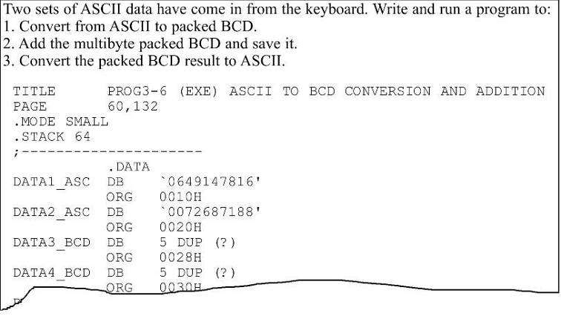
BCD AND ASCII CONVERSION DAA summary of action
Use of DAA after adding multibyte packed BCD numbers.
Program 3-6
See the entire program listing on pages 116-117 of your textbook.

Slide 42
BCD AND ASCII CONVERSION BCD subtraction and correction
DAS (decimal adjust for subraction) is provided in the x86 for correcting the BCD subtraction problem.
When subtracting packed BCD (single-byte or multibyte) operands, the DAS instruction is used after SUB or SBB.
AL must be used as the destination register.
After a SUB or SBB instruction:
If the lower nibble is greater than 9, or if AF = 1.
Subtract 0110 from the lower 4 bits.
If the upper nibble is greater than 9, or CF = 1.
Subtract 0110 from the upper nibble.

Slide 43
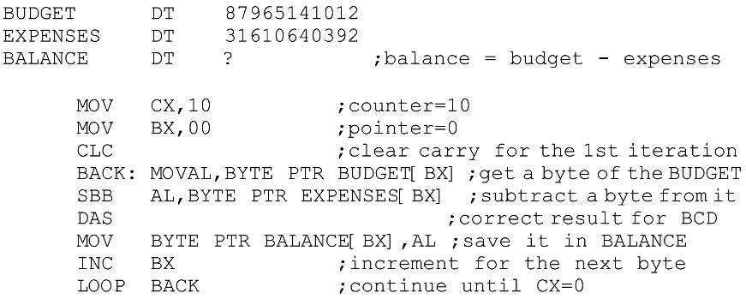
BCD AND ASCII CONVERSION BCD subtraction and correction
Due to the widespread use of BCD numbers, a specific data directive, DT, has been created.
To represent BCD numbers 0 to 1020 - 1. (twenty 9s)

Slide 44
ROTATE INSTRUCTIONS
ROR, ROL and RCR, RCL are designed specifically to perform a bitwise rotation of an operand.
They allow a program to rotate an operand right or left.
Similar to shift instructions, if the number of times an operand is to be rotated is more than 1, this is indicated by CL.
The operand can be in a register or memory.
There are two types of rotations.
Simple rotation of the bits of the operand
Rotation through the carry.

Slide 45
ROTATE INSTRUCTIONS ROR/ROL rotate right/rotate left
In ROR (Rotate Right), as bits are shifted from left to right, they exit from the right end (LSB) and enter the left end (MSB).
As each bit exits LSB, a copy is given to the carry flag.
In ROR the LSB is moved to the MSB, & copied to CF.
In ROL (Rotate Left), as bits are shifted from right to left, they exit the left end (MSB) and enter the right end (LSB).
Every bit that leaves the MSB is copied to the carry flag.
In ROL the MSB is moved to the LSB and is also copied to CF
Programs 3-7 & 3-8 on page 120 show applications of rotation instructions

Slide 46
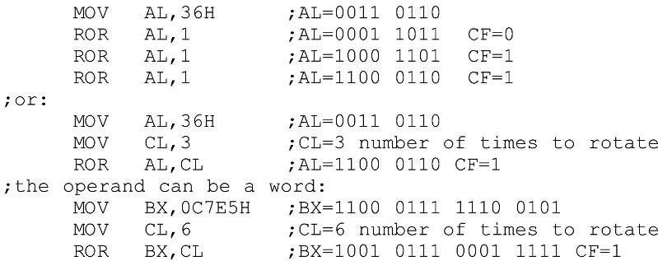

ROTATE INSTRUCTIONS ROR rotate right
If the operand is to be rotated once, the 1 is coded.
If it is to be rotated more than once, register CL is used to hold the number of times it is to be rotated.

Slide 47

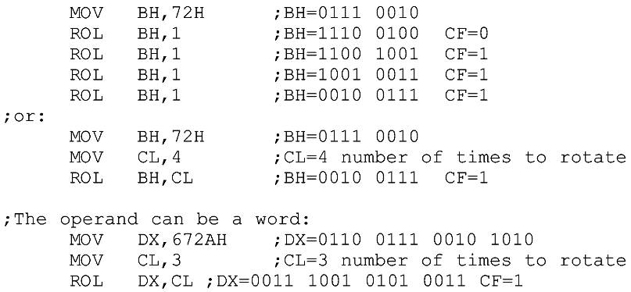
ROTATE INSTRUCTIONS ROL rotate left
If the operand is to be rotated once, the 1 is coded.
If it is to be rotated more than once, register CL is used to hold the number of times it is to be rotated.

Slide 48
ROTATE INSTRUCTIONS RCR/RCL right/left through carry
In RCR, as bits are shifted from left to right, they exit the right end (LSB) to the carry flag, and the carry flag enters the left end (MSB).
The LSB is moved to CF and CF is moved to the MSB.
CF acts as if it is part of the operand.
In RCL, as bits are shifted from right to left they exit the left end (MSB) and enter the carry flag, and the carry flag enters the right end (LSB).
The MSB is moved to CF and CF is moved to the LSB.
CF acts as if it is part of the operand.

Slide 49
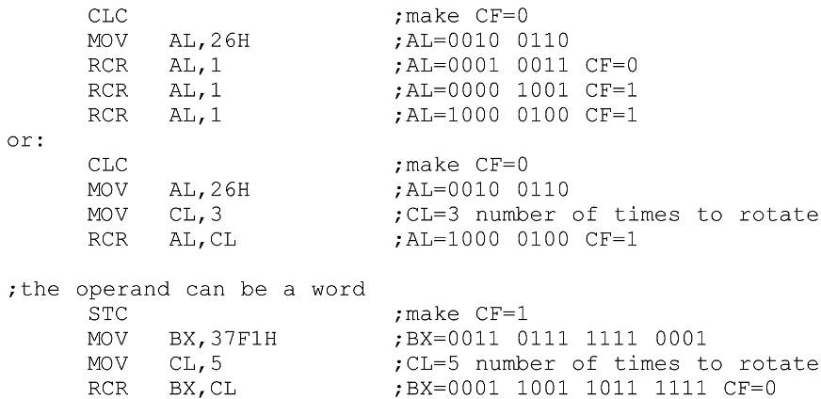

ROTATE INSTRUCTIONS RCR right through carry
If the operand is to be rotated once, the 1 is coded.
If more than once, register CL holds the number of rotations.

Slide 50
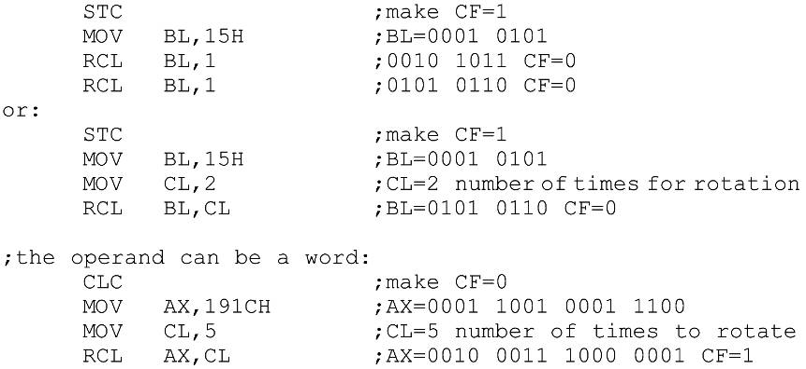

ROTATE INSTRUCTIONS RCL left through carry
If the operand is to be rotated once, the 1 is coded.
If more than once, register CL holds the number of rotations.

Slide 51
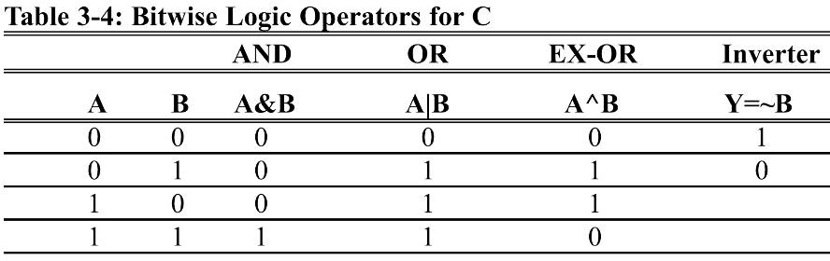
BITWISE OPERATORS IN THE C LANGUAGE
While every C programmer is familiar with logical operators, many aren’t versed in bitwise operators
AND (&), OR (|), EX-OR (^)
inverter (~), Shift Right (>>), and Shift Left (<<)

Slide 52
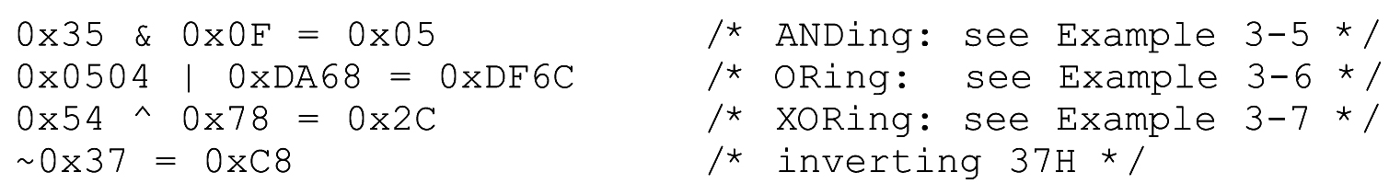
BITWISE OPERATORS IN THE C LANGUAGE
Examples 3-5, 3-6 & 3-7 using C logical operators.
"0x" in the C language indicates data is in hex format.

Slide 53
BITWISE OPERATORS IN THE C LANGUAGE
Examples 3-5, 3-6 & 3-7 using C logical operators.
"0x" in the C language indicates data is in hex format.

Slide 54
BITWISE OPERATORS IN THE C LANGUAGE
Examples 3-5, 3-6 & 3-7 using C logical operators.
"0x" in the C language indicates data is in hex format.

Slide 55
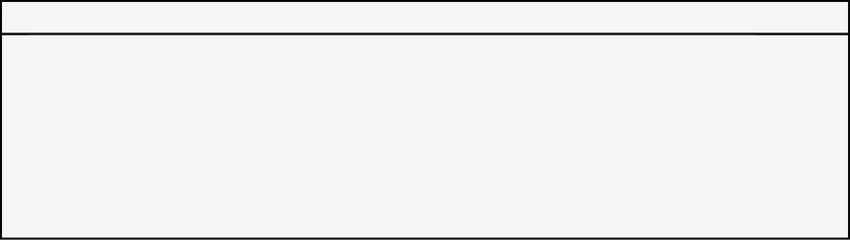
BITWISE OPERATORS IN THE C LANGUAGE
Example of the NOT instruction in x86 processors.
"0x" in the C language indicates data is in hex format.

Slide 56
BITWISE OPERATORS IN THE C LANGUAGE shift operators
There are two bitwise shift operators in C:
Shift Right ( >>) and Shift Left (<<).
Perform the same operation as SHR/SHL in Assembly.
Their format in C is as follows:

Slide 57
BITWISE OPERATORS IN THE C LANGUAGE shift operators
Example of the use of shift operators in C:

Slide 58
BITWISE OPERATORS IN THE C LANGUAGE shift operators
Example of the use of shift operators in C:

Slide 59
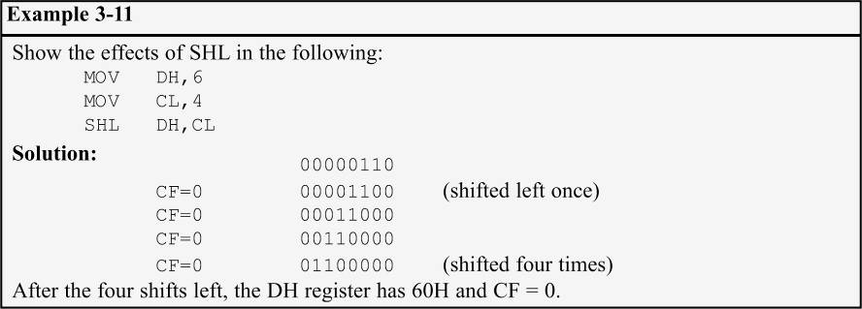
BITWISE OPERATORS IN THE C LANGUAGE shift operators
Example of the use of shift operators in C:

Slide 60
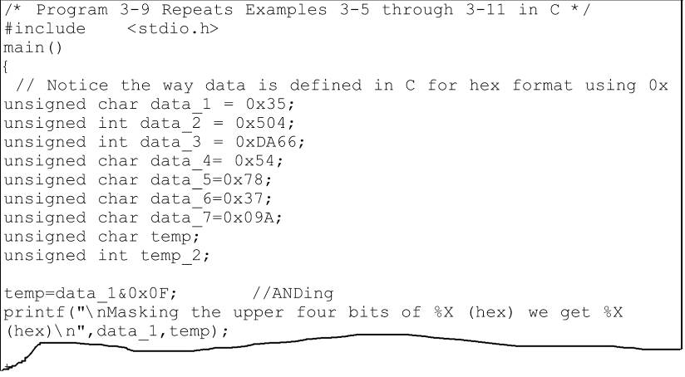
BITWISE OPERATORS IN THE C LANGUAGE shift operators
Syntax of bitwise operators in C.
See the entire program listing on page 123 of your textbook.

