Slide 1

Golang
Soutenance

Slide 2
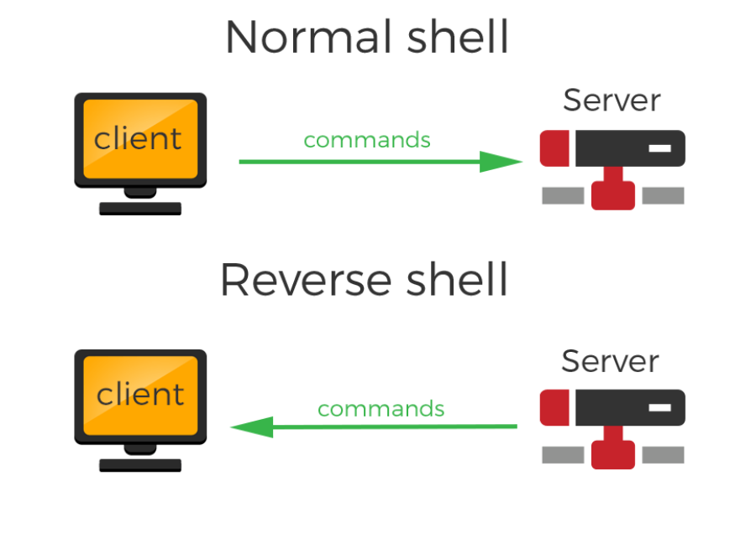
Projet 1
Déploiement d’un reverse shell
YOUR COMPANY NAME | LONG AND INTERESTING PRESENTATION TITLE | VERSION NO. XX | 06/06/2012

Slide 3
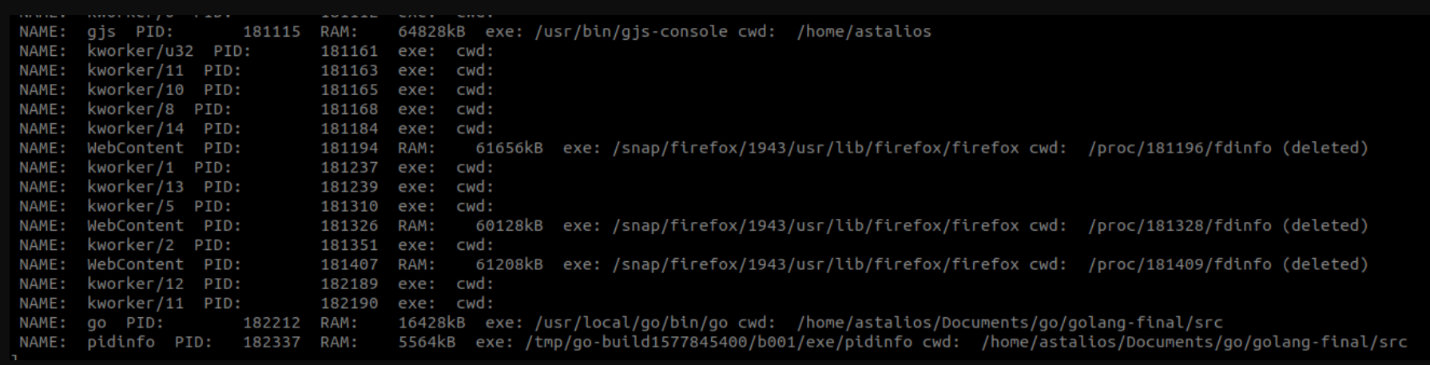
Récolte des CWD et des EXE de chaque PID

Slide 4

Projet 2
Création d’une API Rest + Tchat
YOUR COMPANY NAME | LONG AND INTERESTING PRESENTATION TITLE | VERSION NO. XX | 06/06/2012

Slide 5
Une API Rest, qu’est ce que c’est ?
Interface de Programmation d’Application
Lien entre fournisseur et utilisateur
Respecte un ensemble de contraintes
Utilise le protocole HTTP-HTTPS
YOUR COMPANY NAME | LONG AND INTERESTING PRESENTATION TITLE | VERSION NO. XX | 06/06/2012

Slide 6
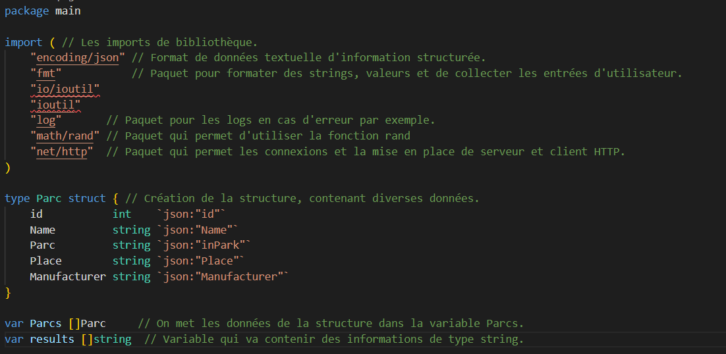
- Import des paquets
- Création de la structure
- Déclaration des variables
YOUR COMPANY NAME | LONG AND INTERESTING PRESENTATION TITLE | VERSION NO. XX | 06/06/2012

Slide 7
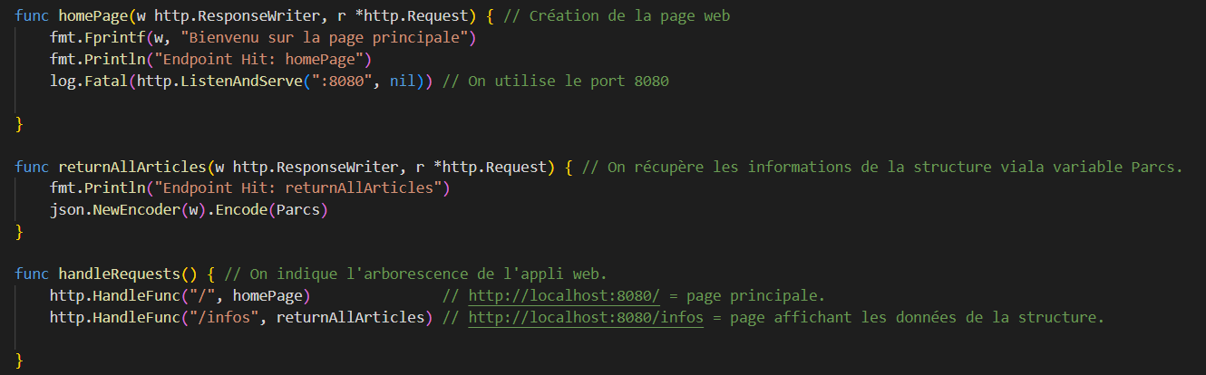
- Fonction pour les pages web
- Mise en place de l’arborescence
- Affichage des données de la structure
YOUR COMPANY NAME | LONG AND INTERESTING PRESENTATION TITLE | VERSION NO. XX | 06/06/2012

Slide 8
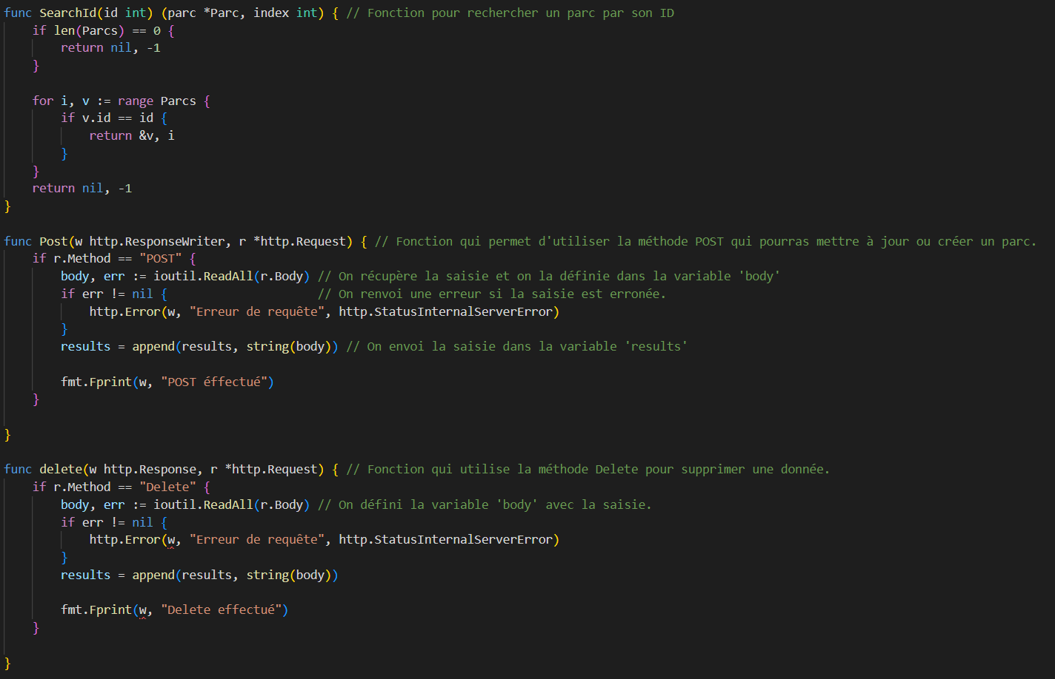
- Fonction ‘search’, chercher par id
- Fonction ‘Post’, ajouté et mise à jour
- Fonction ‘Delete’, suppression
YOUR COMPANY NAME | LONG AND INTERESTING PRESENTATION TITLE | VERSION NO. XX | 06/06/2012

Slide 9
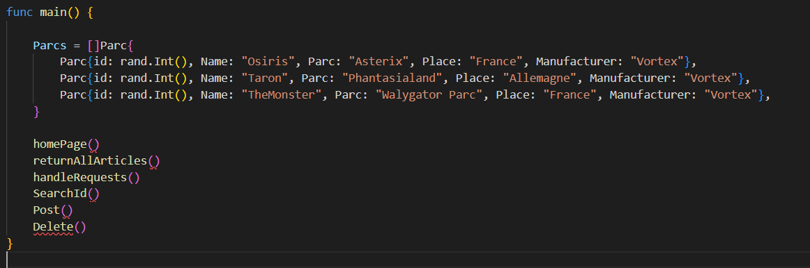
- Fonction principale
- Ajout des données de base json
- Fonctions créer appelées
YOUR COMPANY NAME | LONG AND INTERESTING PRESENTATION TITLE | VERSION NO. XX | 06/06/2012

Slide 10
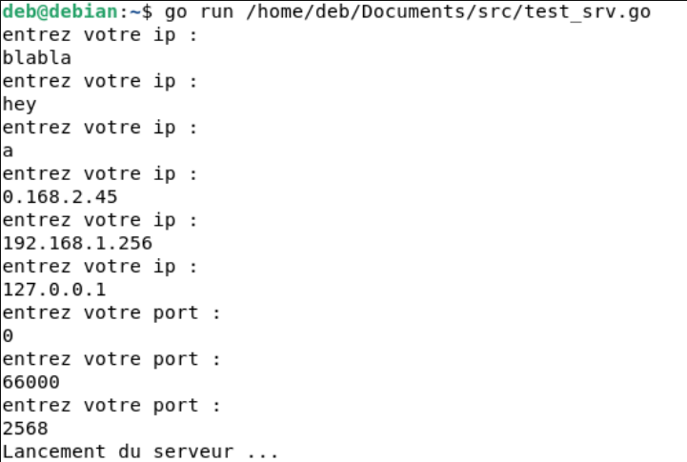
Sécurité de l’entrée utilisateur
YOUR COMPANY NAME | LONG AND INTERESTING PRESENTATION TITLE | VERSION NO. XX | 06/06/2012

Slide 11
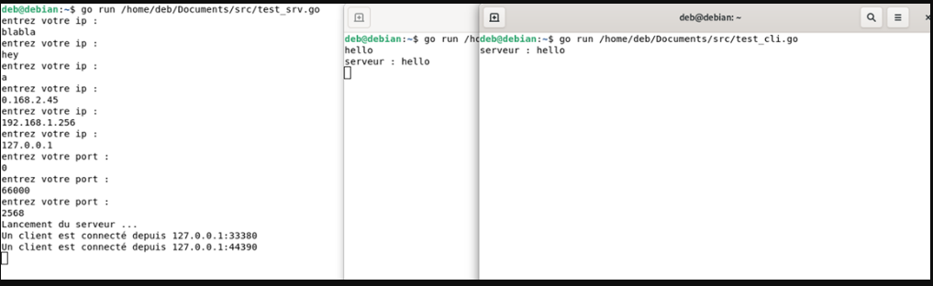
Messages partagés

Slide 12
Mise en place du Tchat
Communication entre tous les postes
Nombre d’utilisateur modulable
YOUR COMPANY NAME | LONG AND INTERESTING PRESENTATION TITLE | VERSION NO. XX | 06/06/2012

Slide 13
Expanding on an idea
This is the place where you can add a block of text to present a single idea. Remember to keep it brief, as people cannot read and listen at the same time.
YOUR COMPANY NAME | LONG AND INTERESTING PRESENTATION TITLE | VERSION NO. XX | 06/06/2012

Slide 14
some bullets
Caution, using too many bullets
can kill your presentation
So, be sure to use them sparingly
You want your audience to get
your ideas quickly and easily
YOUR COMPANY NAME | LONG AND INTERESTING PRESENTATION TITLE | VERSION NO. XX | 06/06/2012

Slide 15
Section 2
Images and Photos

Slide 16

Horizontal image & title
YOUR COMPANY NAME | LONG AND INTERESTING PRESENTATION TITLE | VERSION NO. XX | 06/06/2012

Slide 17
Vertical Image
YOUR COMPANY NAME | LONG AND INTERESTING PRESENTATION TITLE | VERSION NO. XX | 06/06/2012

Slide 19
Short descritption text of the image above
Short description Text of the image above
YOUR COMPANY NAME | LONG AND INTERESTING PRESENTATION TITLE | VERSION NO. XX | 06/06/2012

Slide 20
This is a small amount of text that describes the image above. Keep it short, sweet and to the point. Your audience is not so excited to do a lot of reading and they will appreciate your brevity.
This is a small amount of text that describes the image above. Keep it short, sweet and to the point. Your audience is not so excited to do a lot of reading and they will appreciate your brevity.
This is a small amount of text that describes the image above. Keep it short, sweet and to the point. Your audience is not so excited to do a lot of reading and they will appreciate your brevity.
YOUR COMPANY NAME | LONG AND INTERESTING PRESENTATION TITLE | VERSION NO. XX | 06/06/2012

Slide 21
The rubicon team
Martin Sanchez
Astrid Niedrigger
Claudia Schuster
Jeff Wallingford
This is a small text that describes the biography of the person featured above in about four lines, no more.
This is a small text that describes the biography of the person featured above in about four lines, no more.
This is a small text that describes the biography of the person featured above in about four lines, no more.
This is a small text that describes the biography of the person featured above in about four lines, no more.
YOUR COMPANY NAME | LONG AND INTERESTING PRESENTATION TITLE | VERSION NO. XX | 06/06/2012

Slide 22

Embedded Video
YOUR COMPANY NAME | LONG AND INTERESTING PRESENTATION TITLE | VERSION NO. XX | 06/06/2012

Slide 23
section 3
Charts and Graphs

Slide 24
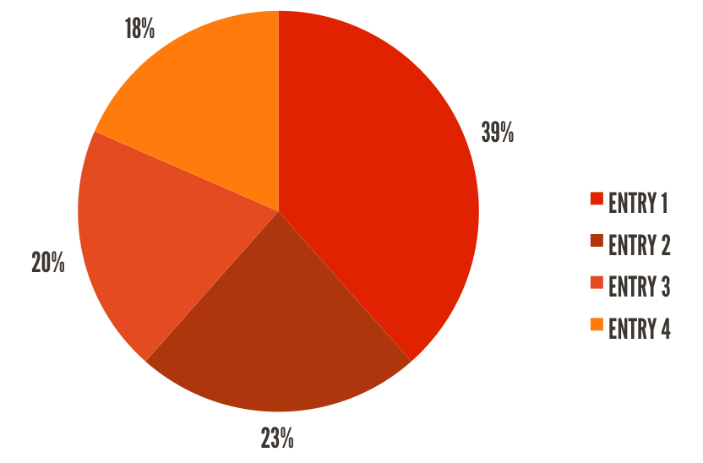
Pie Chart
YOUR COMPANY NAME | LONG AND INTERESTING PRESENTATION TITLE | VERSION NO. XX | 06/06/2012

Slide 25
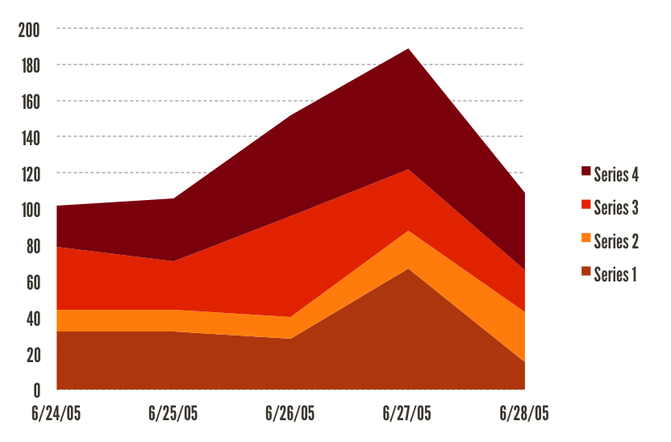
Area chart
YOUR COMPANY NAME | LONG AND INTERESTING PRESENTATION TITLE | VERSION NO. XX | 06/06/2012

Slide 26
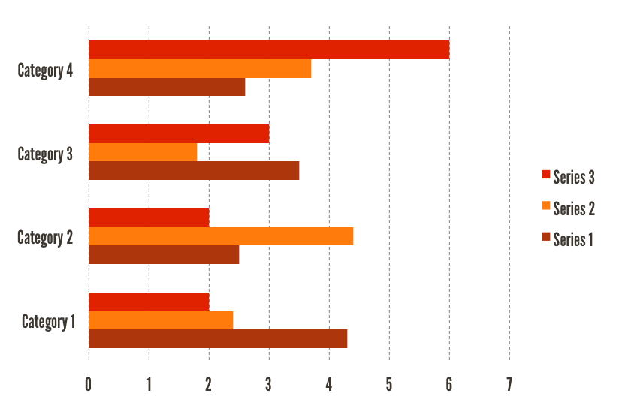
Bar Chart
YOUR COMPANY NAME | LONG AND INTERESTING PRESENTATION TITLE | VERSION NO. XX | 06/06/2012

Slide 27
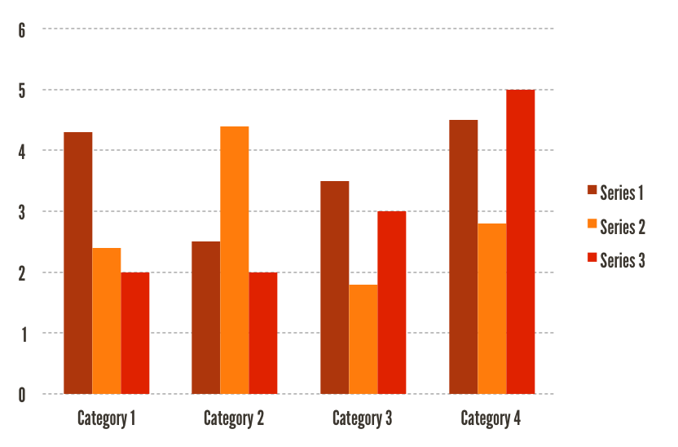
Column Chart
YOUR COMPANY NAME | LONG AND INTERESTING PRESENTATION TITLE | VERSION NO. XX | 06/06/2012

Slide 28
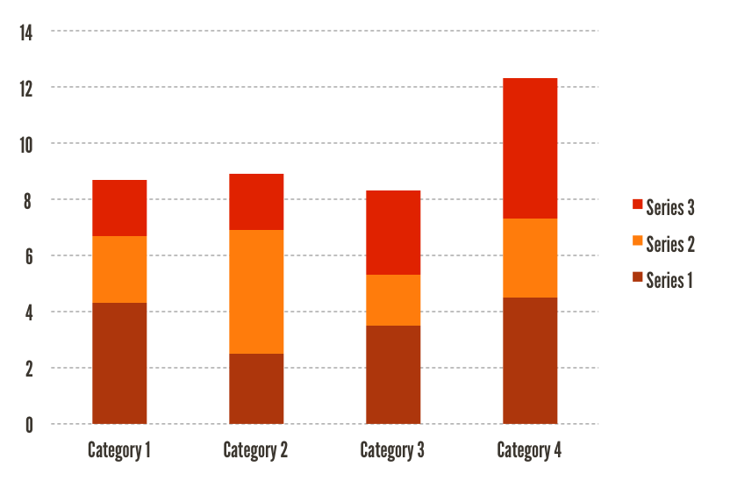
Stacked column chart
YOUR COMPANY NAME | LONG AND INTERESTING PRESENTATION TITLE | VERSION NO. XX | 06/06/2012

Slide 29
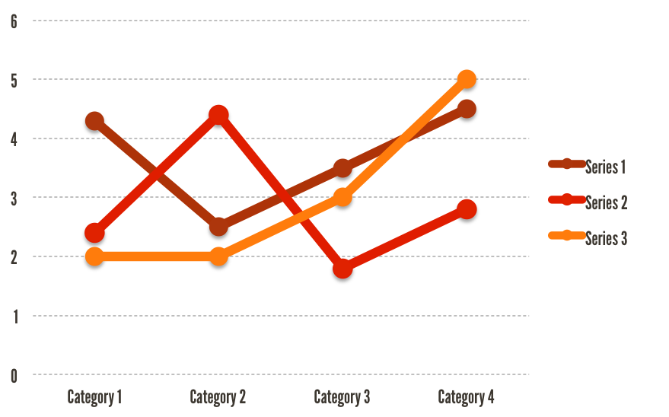
Line chart
YOUR COMPANY NAME | LONG AND INTERESTING PRESENTATION TITLE | VERSION NO. XX | 06/06/2012

Slide 30
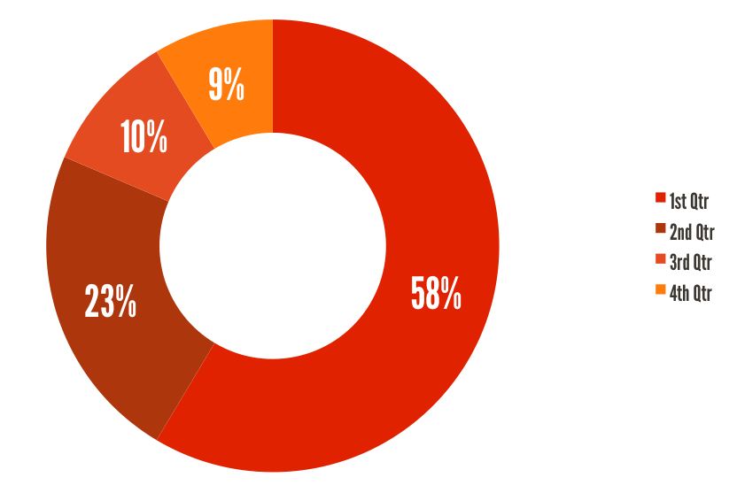
Ring Chart
YOUR COMPANY NAME | LONG AND INTERESTING PRESENTATION TITLE | VERSION NO. XX | 06/06/2012

Slide 31







Extra shapes & lines
YOUR COMPANY NAME | LONG AND INTERESTING PRESENTATION TITLE | VERSION NO. XX | 06/06/2012

