Slide 1

Learn Teach Code: Let’s Study
PHP
2017.12.2
Hojin lee / infohojin@naver.com

Slide 2
Install PHP
Windows
Go to php.net and download free. Before check your system 32-bit / 64-bit
Mac
Apple Mac OS preinstalled PHP 5.6 version. Or bitnami mapm package install for Mac
Linux
If you install Linux server, maybe auto-install Apache + PHP + MySQL.

Slide 3
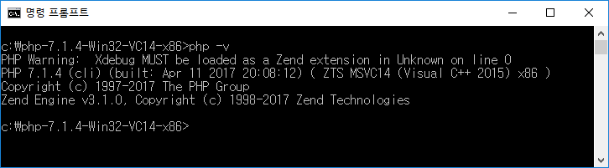
PHP Version check
PHP가 정상적 설치후에 동작을 확인해 봅니다.
#] php -v

Slide 4
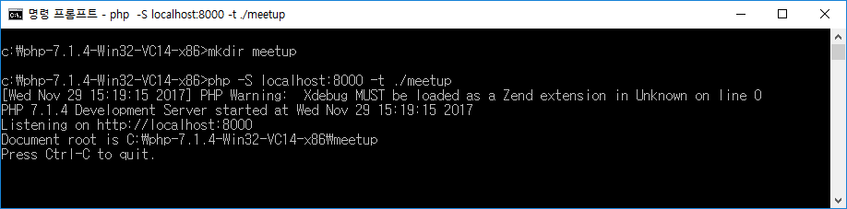
PHP Internal Server
예제 소스를 저장할 폴더를 하나 생성을 합니다. mkdir meetup
#] php -S localhost:8000 -t ./meetup

Slide 5
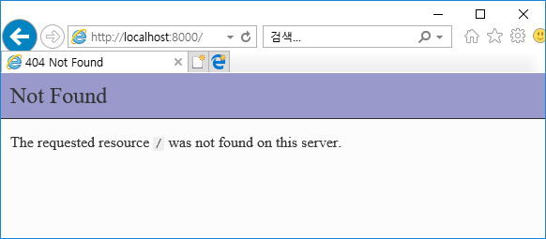
Browser Check
http://localhost:8000/

Slide 6
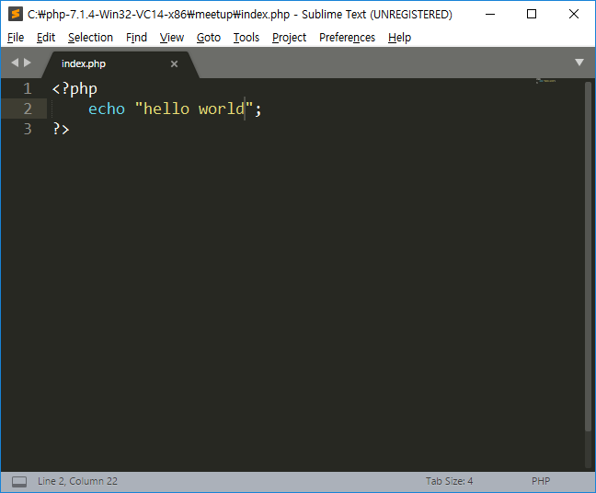
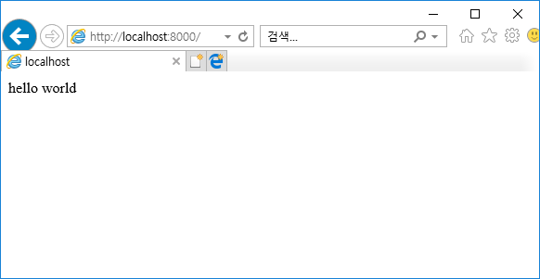
Hello World
Typing below and save file to “index.php”
Reload

Slide 7
PHP Start Code
<?php
echo "hello world";
PHP Declare
?>

Slide 8
echo "hello world";

Slide 9

Javascript Client Side Script Language
Source Transfer
PC : Program action

Slide 10
PHP Server Side Script Language
Result
Program action

Slide 11
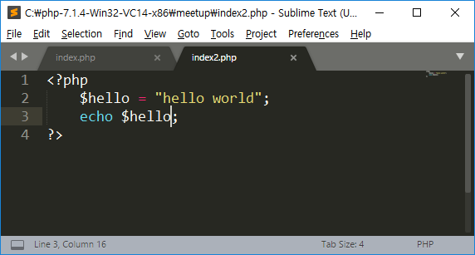
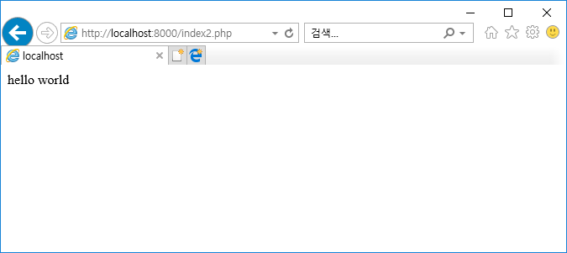
Variable
$
Name =
Typing below and save file to “index2.php”
http://localhost:8000/index2.php

Slide 12
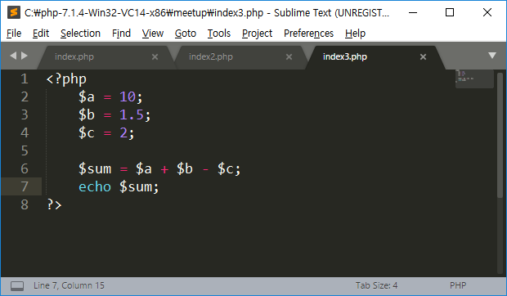
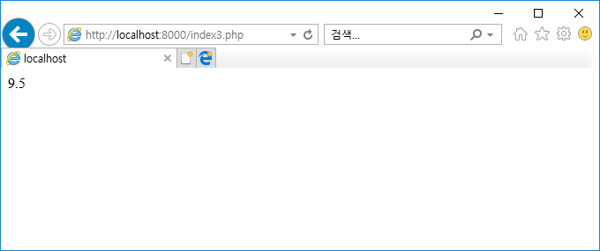
Operation
+ - / *
Typing below and save file to “index3.php”
http://localhost:8000/index3.php

Slide 13
if ( ) {
} else {
}
condition
NO(False)
Question
True Condition
YES(True)
False Condition

Slide 14
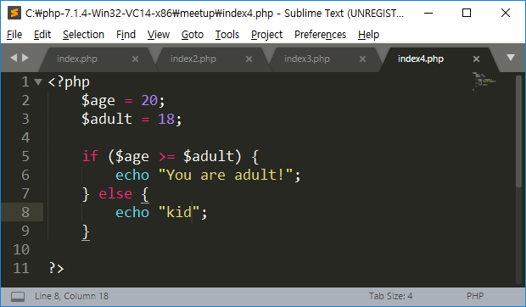
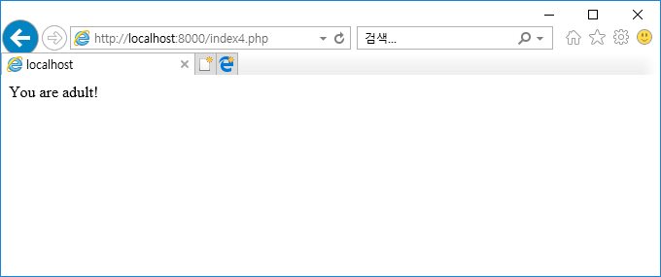
Typing below and save file to “index4.php”
http://localhost:8000/index4.php

Slide 15
For loop

Slide 16
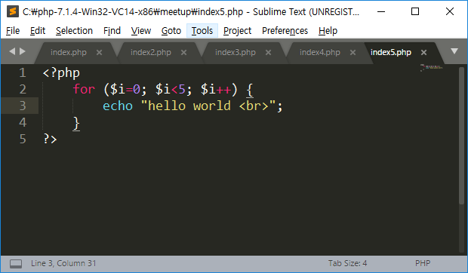
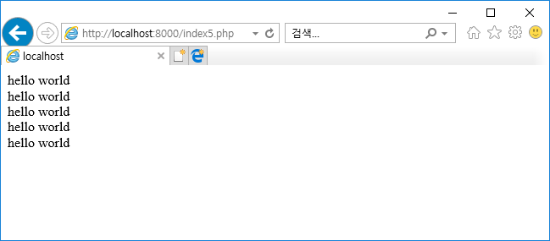
Typing below and save file to “index5.php”
http://localhost:8000/index5.php

Slide 17
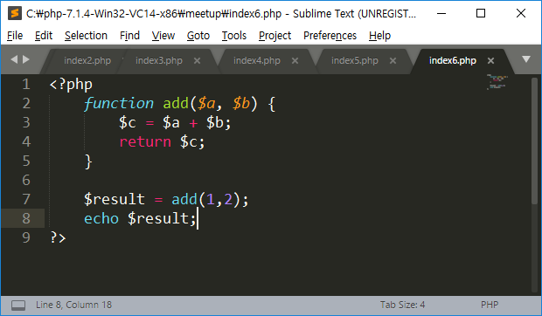
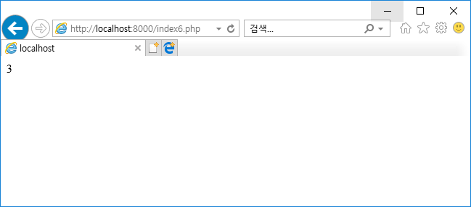
Function
http://localhost:8000/index6.php

Slide 18
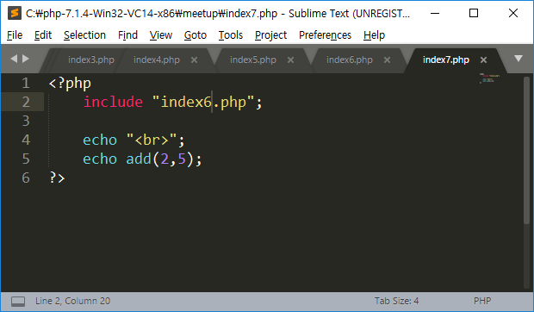
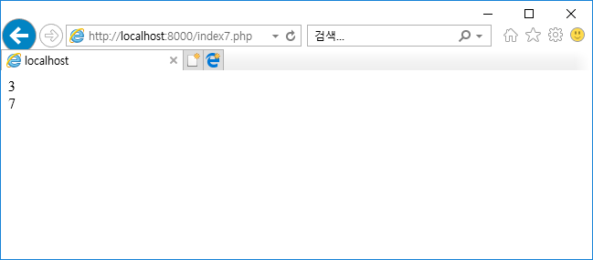
include
http://localhost:8000/index7.php

Slide 19
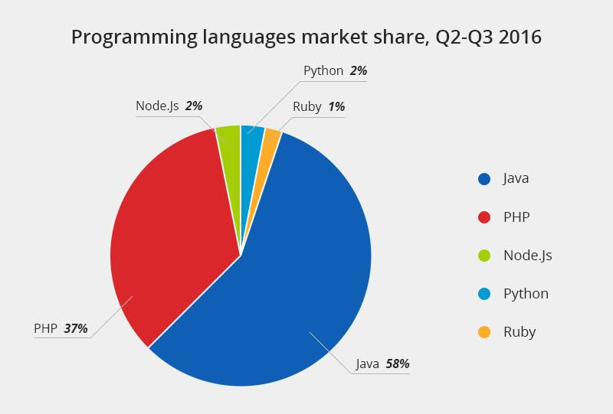
PHP is a top language for the web

Slide 20
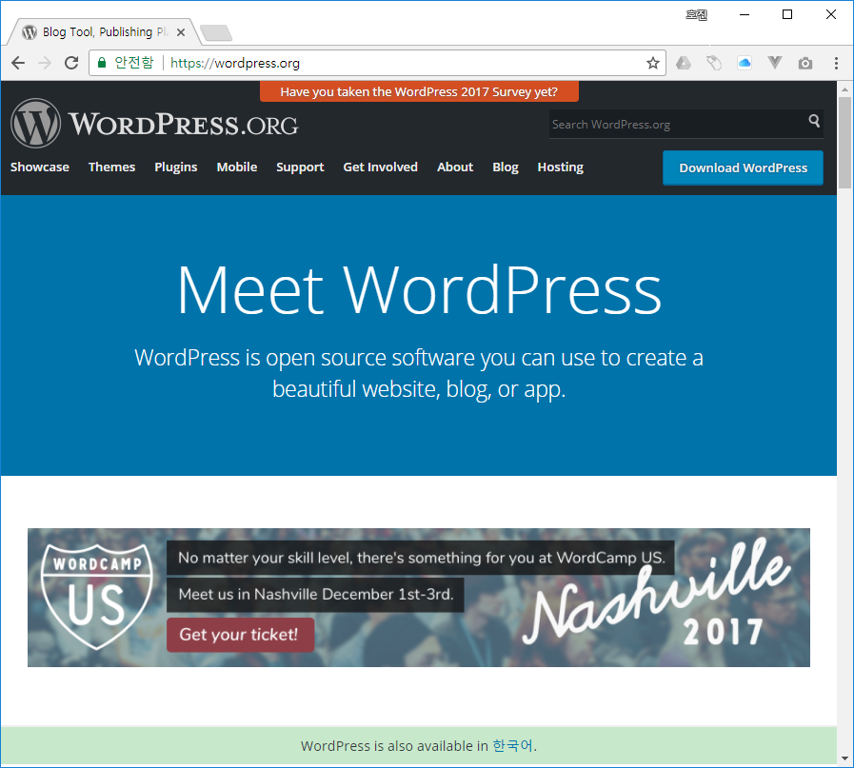
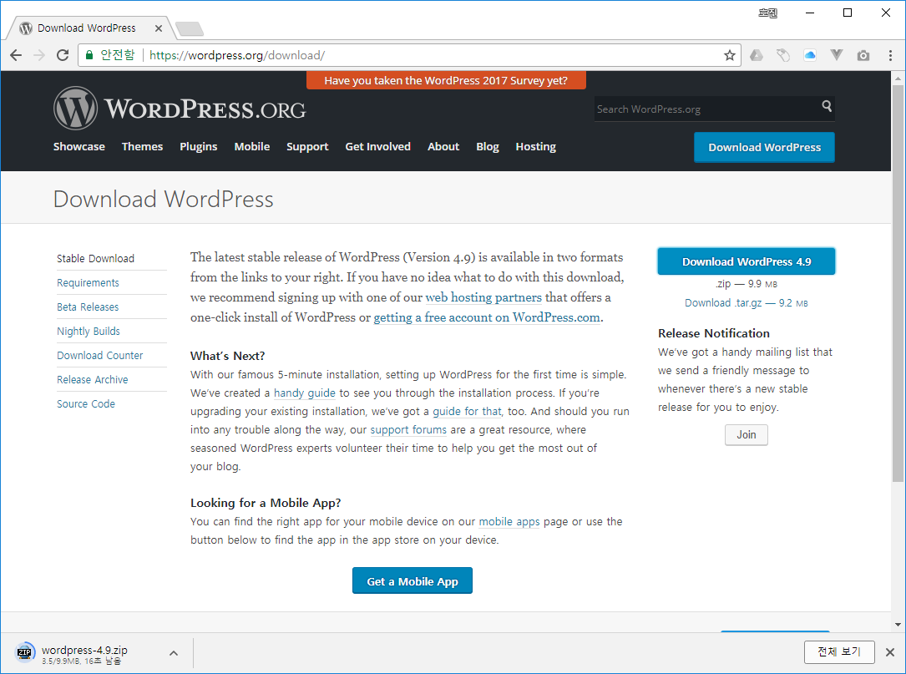
WordPress uses the PHP language
Free Download

Slide 21
WordPress 4.9
***.php files

Slide 22
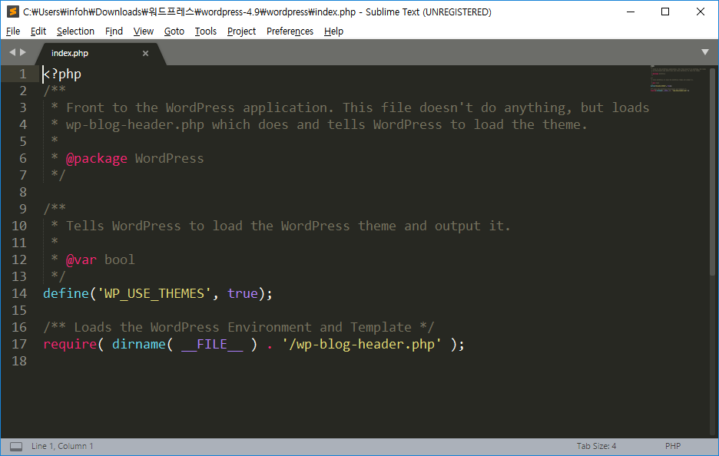
WordPress index.php

