Slide 1
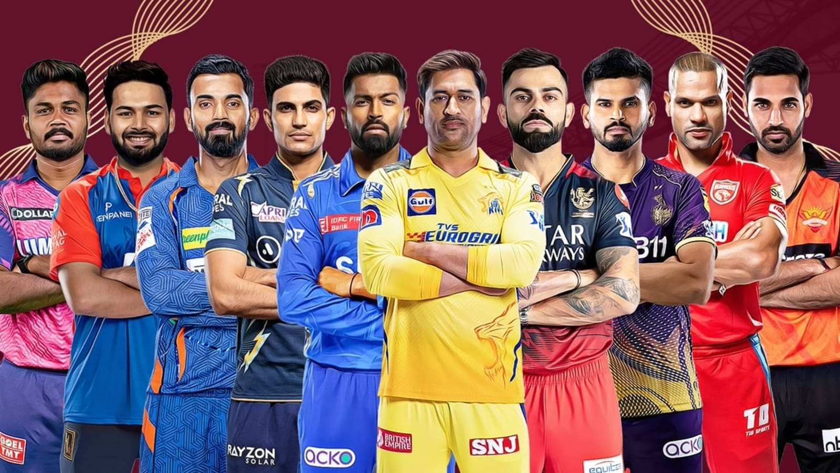

Slide 2


IPL MATCH WIN PREDICTOR
DESHANT KUMAR JAIN

Slide 3
OBJECTIVE
LOAD DATA
PRE PROCESSING
EDA
MACHINE LEARNING PIPELINE (DATA EXTRACT PART)
INTEGRATE THE PIPELINE MIN THE UI PATH ( WHICH IS CREATED USING ETREAM LIT)
DEPLOY THE MODEL ON THE HEROKU CLOND SERVICES
AWS/ GCP/ AZURE

Slide 4
BATING
CITY
TARGET
CURRENT SCORE THERE
HOW MANY OVER COMP
WHAT IS CURRENT SCORE THERE
PREDICT PROBILITY

