Slide 1

Project Title Retail Sales Prediction
Presented by Deshant Jain

Slide 2
Content
1. Problem Statement
2. Data Summary
3. Data Preprocessing
4. Exploratory Data Analysis
5. Feature Engineering
6. Model Implementation
7. Conclusion

Slide 3
Problem Description
Number of Stores: XYZ operates over 3,000 stores in 7 different countries.
Prediction Task: Store managers need to predict daily sales for up to six weeks in advance.
Influencing Factors: Sales are affected by promotions, competition, school and state holidays, seasonality, and locality.
Variation in Accuracy: Due to the unique circumstances of each store, prediction accuracy varies among managers.
Data Provided: Historical sales data for 1,115 stores is available.
Forecasting Goal: The task is to forecast the "Sales" column for the provided test set.
Temporary Closures: Some stores were temporarily closed for refurbishment

Slide 4
Data Description
Data 1-
Columns- 9,
Rows- 1017210
Data 2 –
Columns – 10,
Rows – 1115

Slide 5
Data fields :- Data 1
Id - an Id that represents a (Store, Date) duple within the set
Store - a unique Id for each store
Sales - the turnover for any given day (Dependent Variable)
Customers - the number of customers on a given day
Open - an indicator for whether the store was open: 0 = closed, 1 = open
State Holiday - indicates a state holiday. Normally all stores, with few exceptions, are closed on state holidays. Note that all schools are closed on public holidays and weekends. a = public holiday, b = Easter holiday, c = Christmas, 0 = None
School Holiday - indicates if the (Store) was affected by the closure of public schools

Slide 6
Data fields :- Data 2
Store Type - differentiates between 4 different store models: a, b, c, d
Assortment - describes an assortment level: a = basic, b = extra, c = extended. An assortment strategy in retailing involves the number and type of products that stores display for purchase by consumers.
Competition Distance – the distance in meters to the nearest competitor store
Competition Open Since[Month/Year] - gives the approximate year and month of the time the nearest competitor was opened
Promo - indicates whether a store is running a promo on that day
Promo2 - Promo2 is a continuing and consecutive promotion for some stores: 0
= store is not participating, 1 = store is participating

Slide 7
Data fields :- Data 2
Promo2 Since[Year/Week] - describes the year and calendar week when the store started participating in Promo2
Promo Interval - describes the consecutive intervals Promo2 is started, naming the months the promotion is started anew. E.g. "Feb, May, Aug, Nov" means each round starts in February, May, August, and November of any given year for that store.

Slide 8
Objective
To create a robust sales forecasting model using historical sales data, considering the various factors that influence sales.

Slide 9
We will perform the following steps
Load and inspect the data.
Analysing Sales Dataset
Explore and visualize the data.
Engineer relevant features.
Split the data into training and test sets.
Build and evaluate forecasting models.
predictions for the test set.

Slide 10
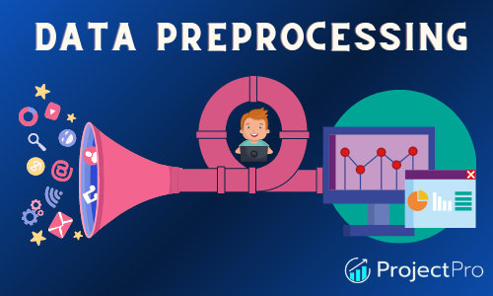

Slide 11
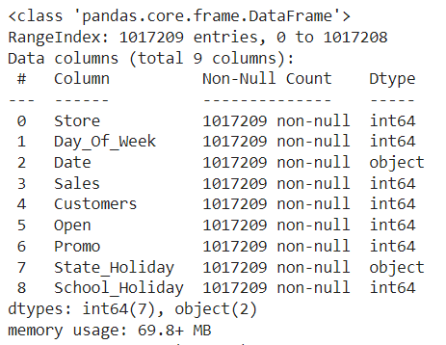
Analysing the Sales Dataset
Observation
The Date column is in string format and needs conversion to datetime.
The State_Holiday column has mixed types.

Slide 12
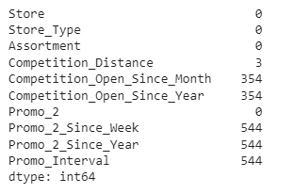
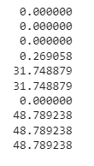
Analysing the Store Dataset
Observation
Columns having >30% null values are dropped
Null values in ‘Competition Distance’ are imputed with median of feature.
Removing those stores observations that are temporarily closed (~ 17.3K) & stores generating zero sales.

Slide 13
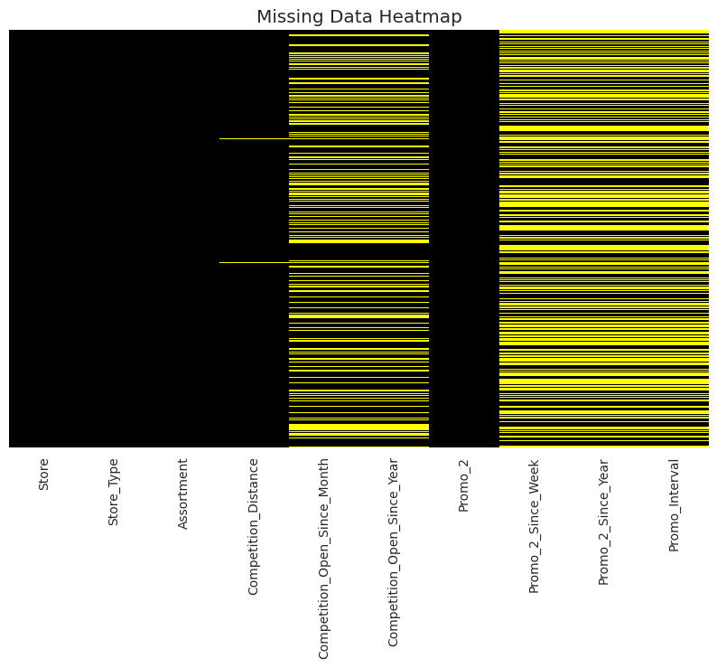

Slide 14

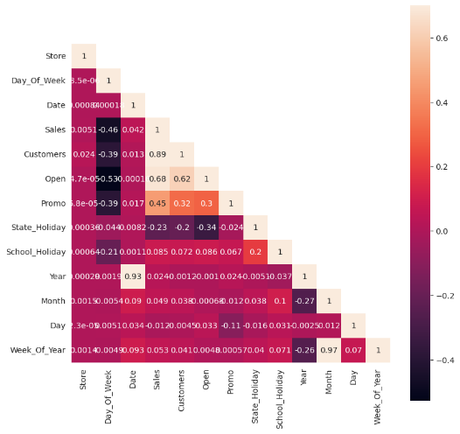
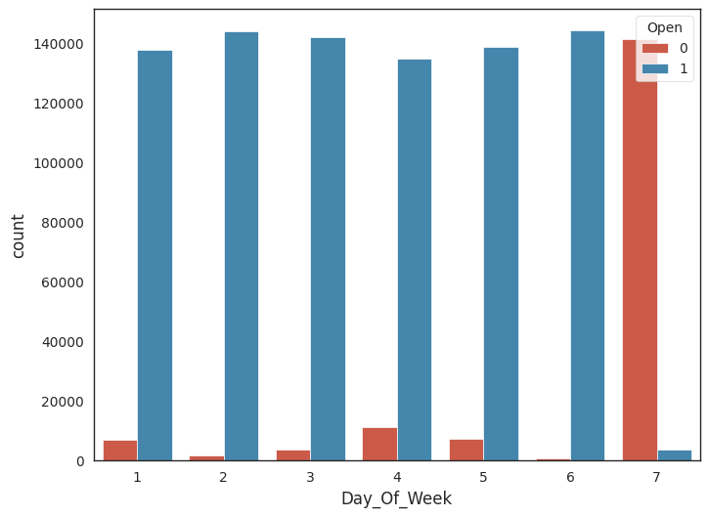

Slide 15
Number of retail sales cases per day of the week
As we can see that in the graph given below that Stores mainly closed on Sunday

Slide 16
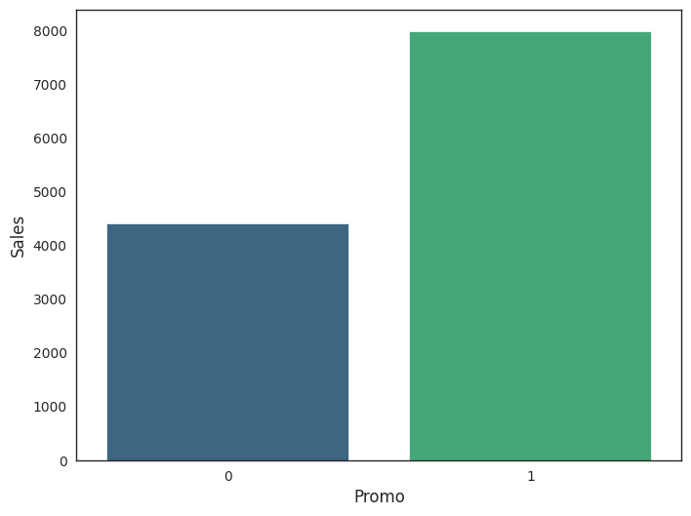
Impact of Promo on sales
As we can see that in the graph given below that Stores mainly closed on Sunday

Slide 17
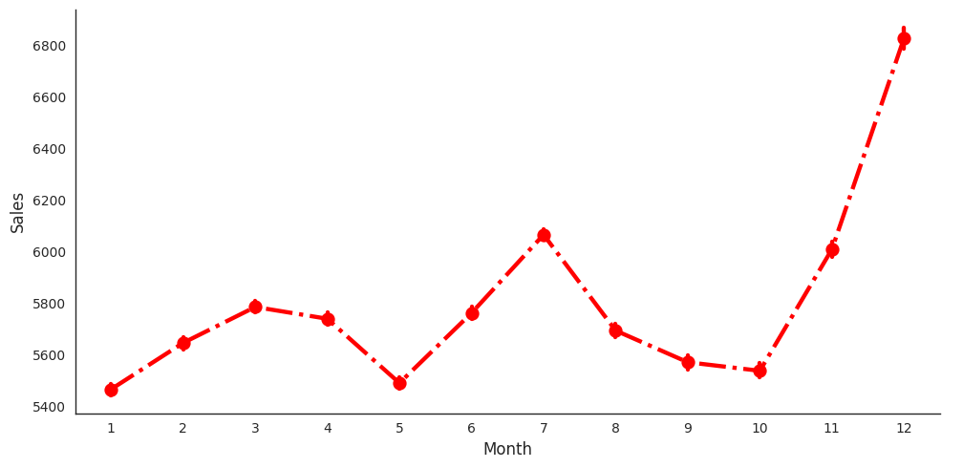
Impact of Month on sales
Nov and Dec sales highly increase

Slide 18
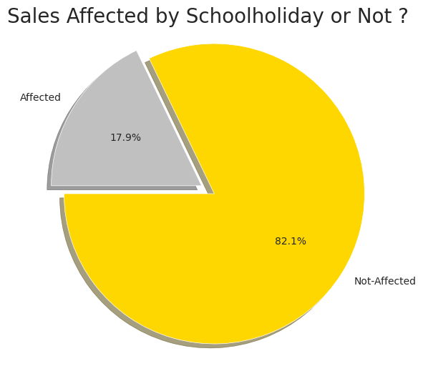
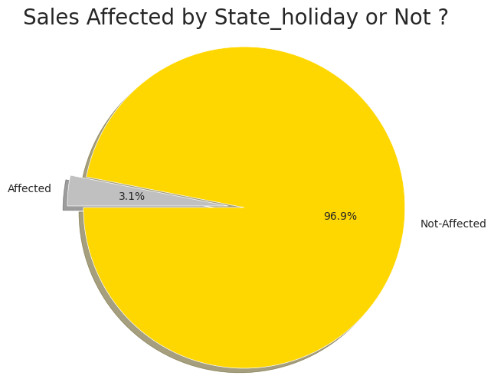
School and State holidays effect on sales

Slide 19
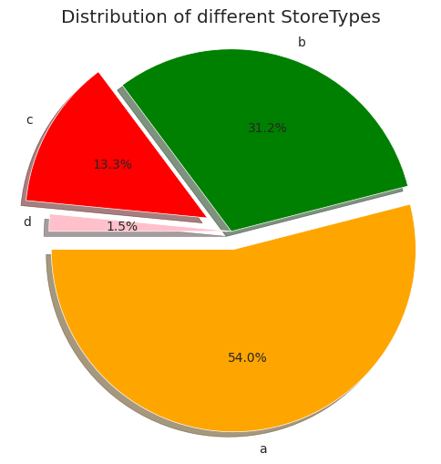
Distribution Of different store types

Slide 20
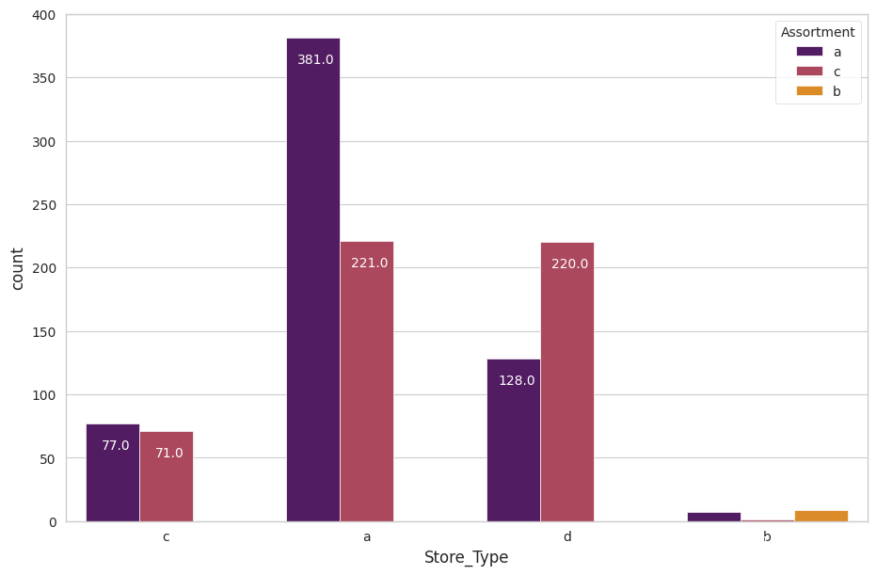
Checking stores with their assortment type

Slide 21
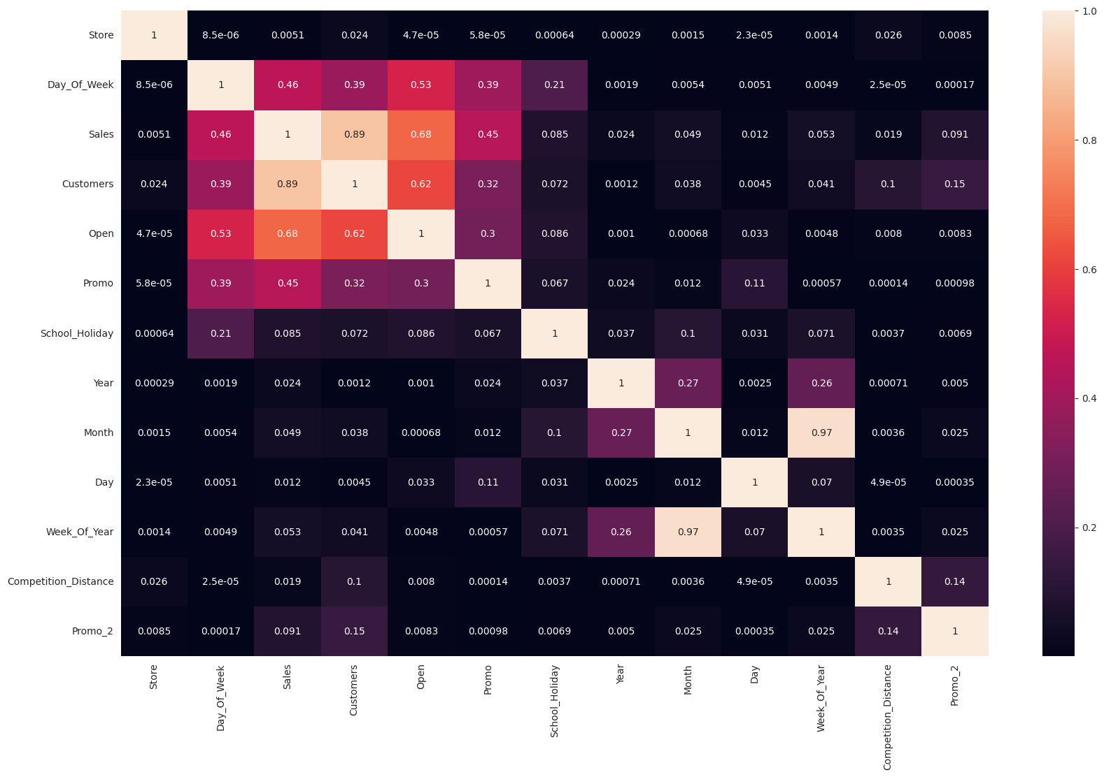
Heatmap for merged dataset

Slide 22
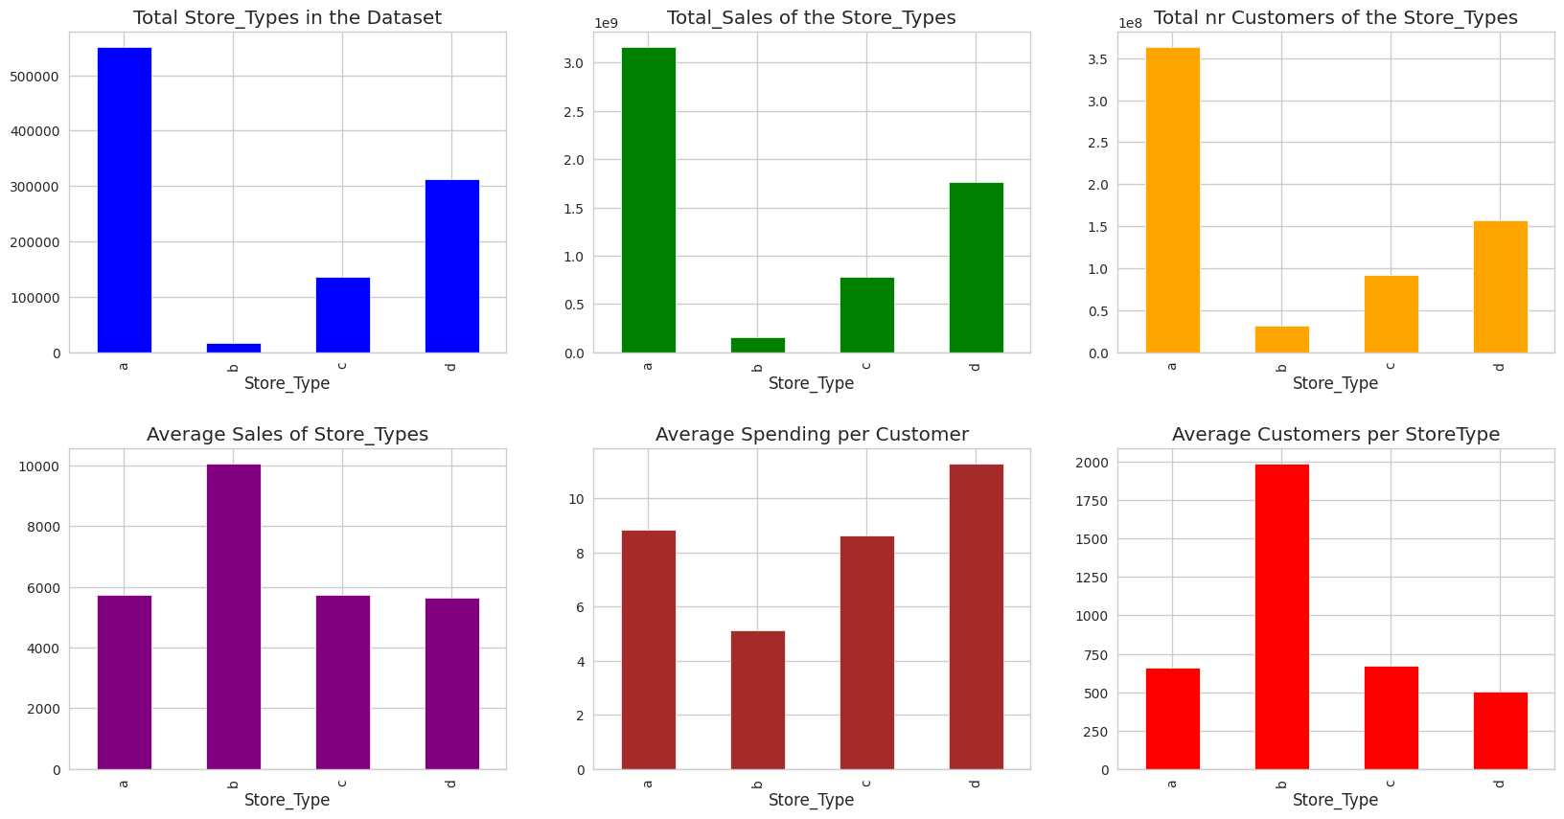
Store Types and average sales/customer/spending relation

Slide 23
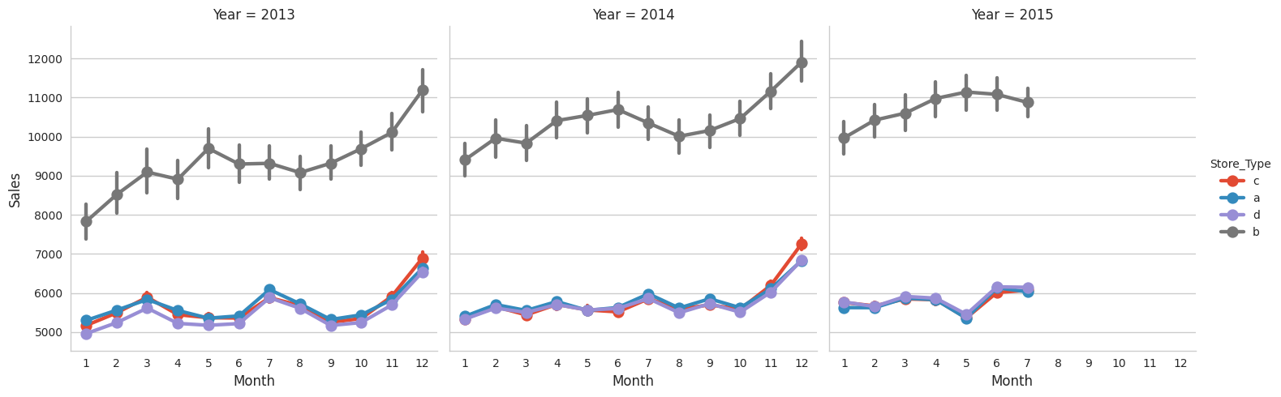
Yearly Distribution of Sales according to store types

Slide 24
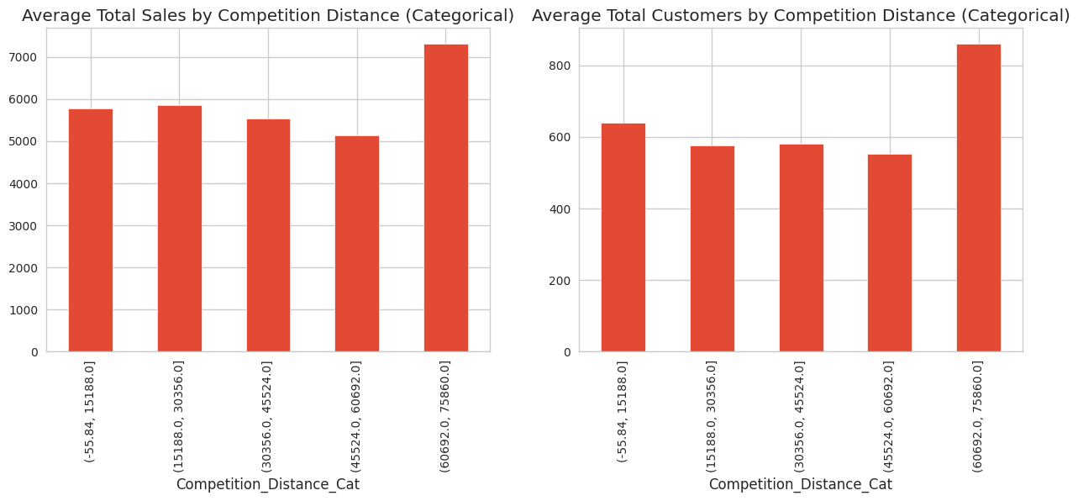
Impact of Competition Distance on Sales and Customers

Slide 25
EDA (summary)
1. Sales are highly correlated to customers.
2. Stores opened on ‘State Holiday’ makes a good amount of sales.
3. There is no such significant difference in sales on ‘School Holidays’.
4. Even though store type ‘b’ has very less number of stores but these are outperforming other store types in terms of sales and avg customers.
5. Sales are consistent for the second quarter of the year but it starts increasing in the last quarter.

Slide 26
Feature Engineering
Extracting week, month, year from Date and adding them in dataset.
Merging both dataset.
One hot encoding for Storetype, Assortment.
Splitting dataset into Training and Test set and applying MinMaxScaler for scaling dataset.

Slide 27
Models Implemented
Linear Regression (Baseline Model)
Lasso Regression
Decision Tree Regress
Random Forest Regressor

Slide 28
Model Evaluation
MODEL | TRAINING SCORE | TESTING SCORE
Linear Regression | 0.780750 | 0.782392
Lasso Regression | 0.780731 | 0.780769
Decision Tree Regress | 0.99996 | 0.915942
Decision Tree(hyperparameters) | 0.963506 | 0.935400
Random Forest Regressor | 0.963506 | 0.935417

Slide 29
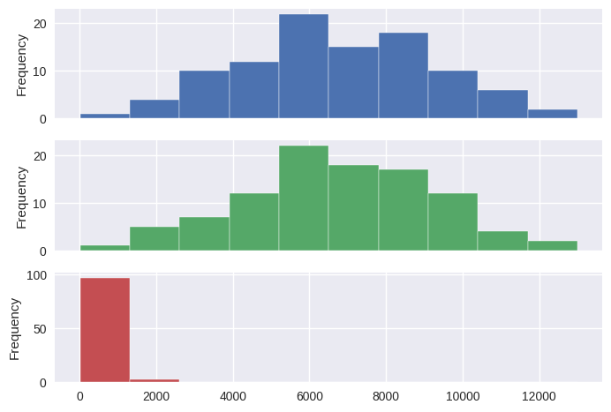
Insights from Random Forest Regressor
Predictions from random forest model are very close to actual values in our X dataset as we have good score. The figure shows actual values, predicted & the difference between them respectively.
Since this is Sales prediction MAE is a good metric. We’re getting Mean Absolute Error ~ $ 380 And MAPE of 5.65%

Slide 30
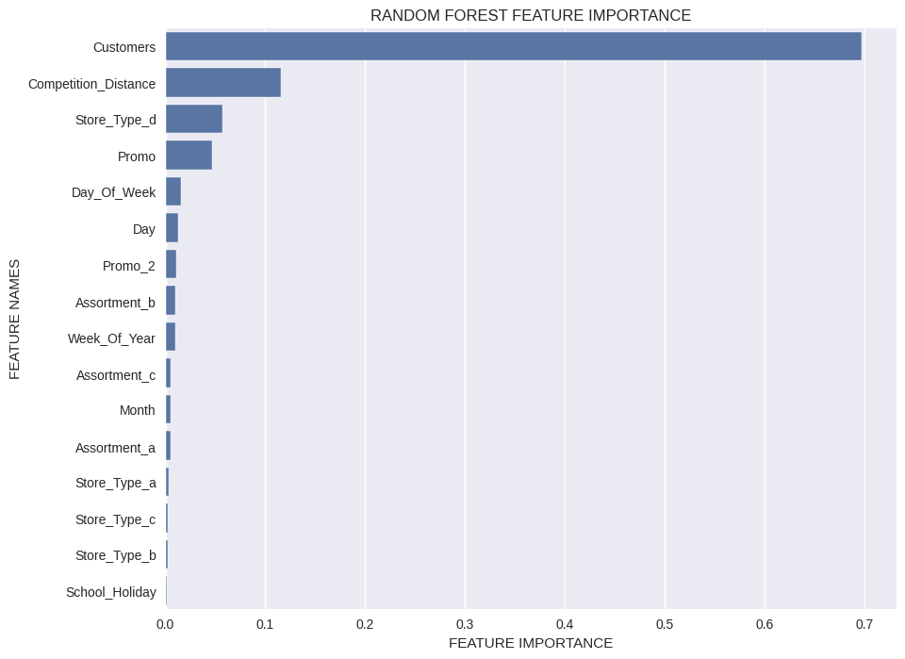
Feature Importance

Slide 31


