Slide 1
CLIENT SHOWCASE · 2026
One platform for people & money
Saptta HRMS + Saptta Accounts — workforce, payroll, and finance on a single login. Built for India. Ready for GCC.
2-in-1
30
$95
14 days
HR + Finance
Employees incl.
Complete / mo
Free trial
Saptta · Client Showcase · 1/11 · saptta.com · hello@saptta.com

Slide 2
S
Saptta
CHALLENGE
The problem every growing company faces
Without Saptta
✗ HR and Finance use different tools
✗ Payroll re-keyed into accounting
✗ Leave ≠ attendance in reports
✗ Managers email HR for approvals
✗ No audit trail on sensitive data
With Saptta Complete
✓ One employee record — one truth
✓ Attendance → payroll → payslip flow
✓ Manager & employee self-service
✓ PF, GST, Tally exports built-in
✓ Encrypted PII + role-based access
CEO insight: the hidden cost is leadership time reconciling two versions of your own company.
Saptta · Client Showcase · 2/11 · saptta.com · hello@saptta.com

Slide 3
S
Saptta
PLATFORM
Two products. One platform.
Saptta HRMS
$59/mo
Payroll & statutory
Leave & attendance
Recruitment & performance
Manager + employee ESS
Saptta Accounts
$59/mo
Invoicing & GST
Ledger & bank rec
Inventory & purchases
Unlimited finance users
Saptta Complete ★
$95/mo
Everything in HRMS + Accounts
20% savings vs separate
30 employees included
Recommended for owners
Sign up → Product switcher → HR workspace ↔ Finance workspace → Single SSO
Saptta · Client Showcase · 3/11 · saptta.com · hello@saptta.com

Slide 4
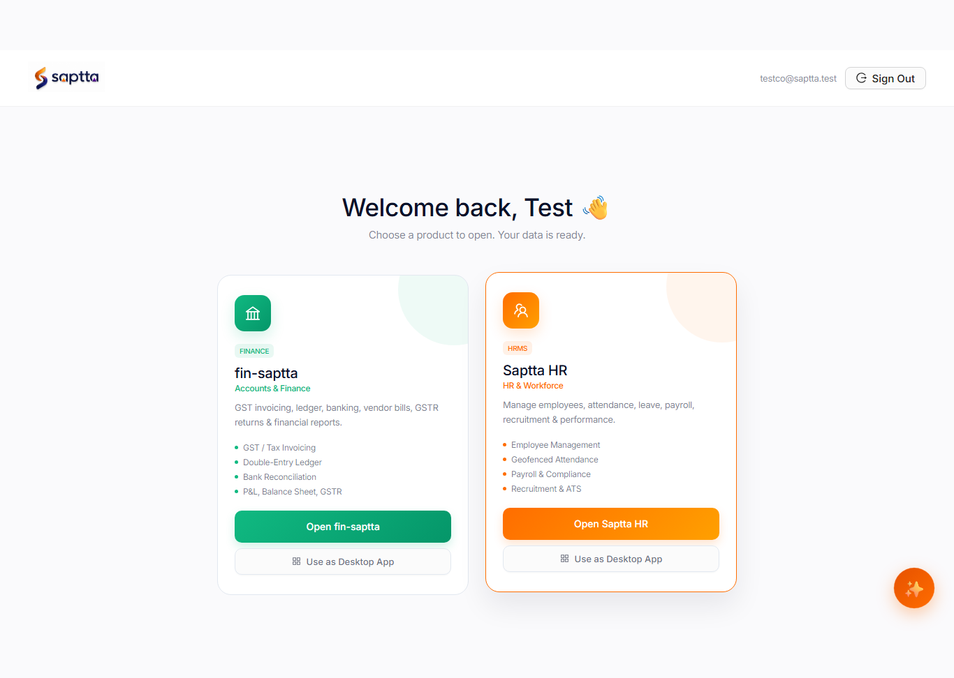
S
Saptta
LIVE PRODUCT
One login. Two products.
• Unified platform login
• Switch HR ↔ Finance instantly
• Same workspace, same users
• No duplicate employee master
Product switcher — HR & Finance
Saptta · Client Showcase · 4/11 · saptta.com · hello@saptta.com

Slide 5
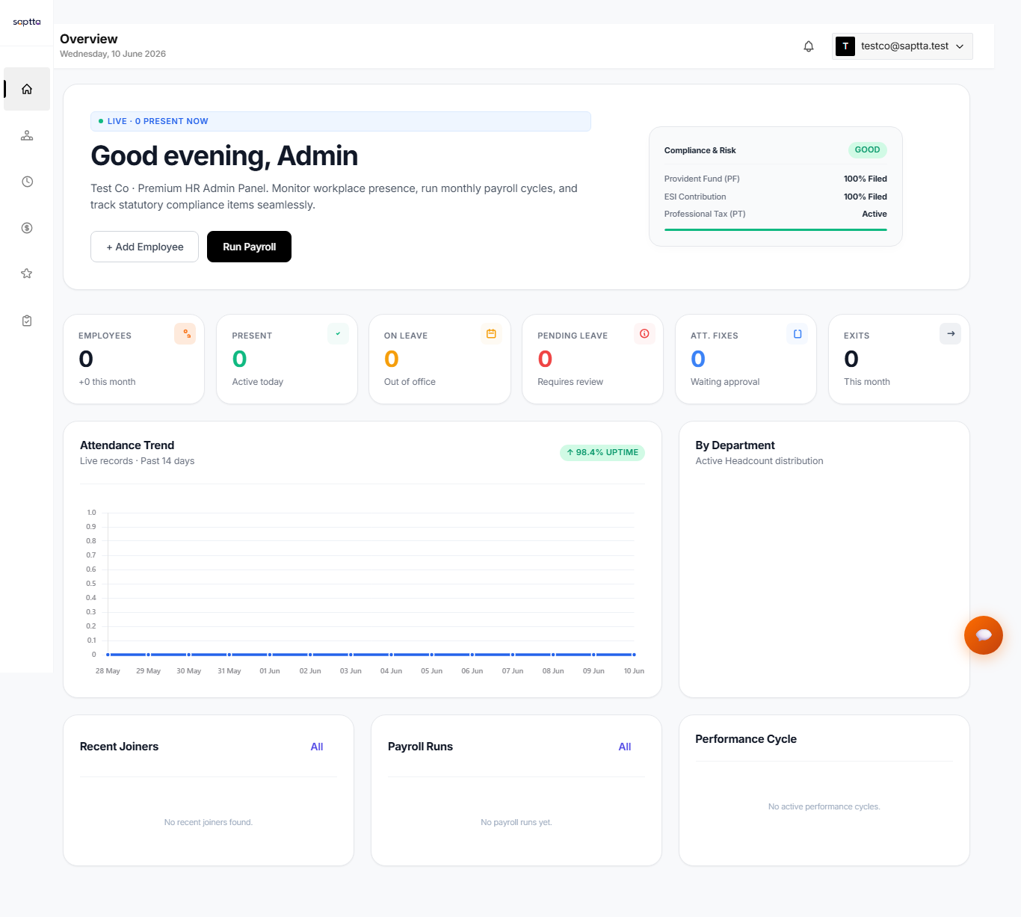
S
Saptta
SAPTTA HRMS
HR dashboard built for leaders
• Today's present / absent panel
• Pending leave & payroll actions
• 22+ employees demo-ready
• Manager & employee ESS
Headcount, attendance, priorities
Saptta · Client Showcase · 5/11 · saptta.com · hello@saptta.com

Slide 6
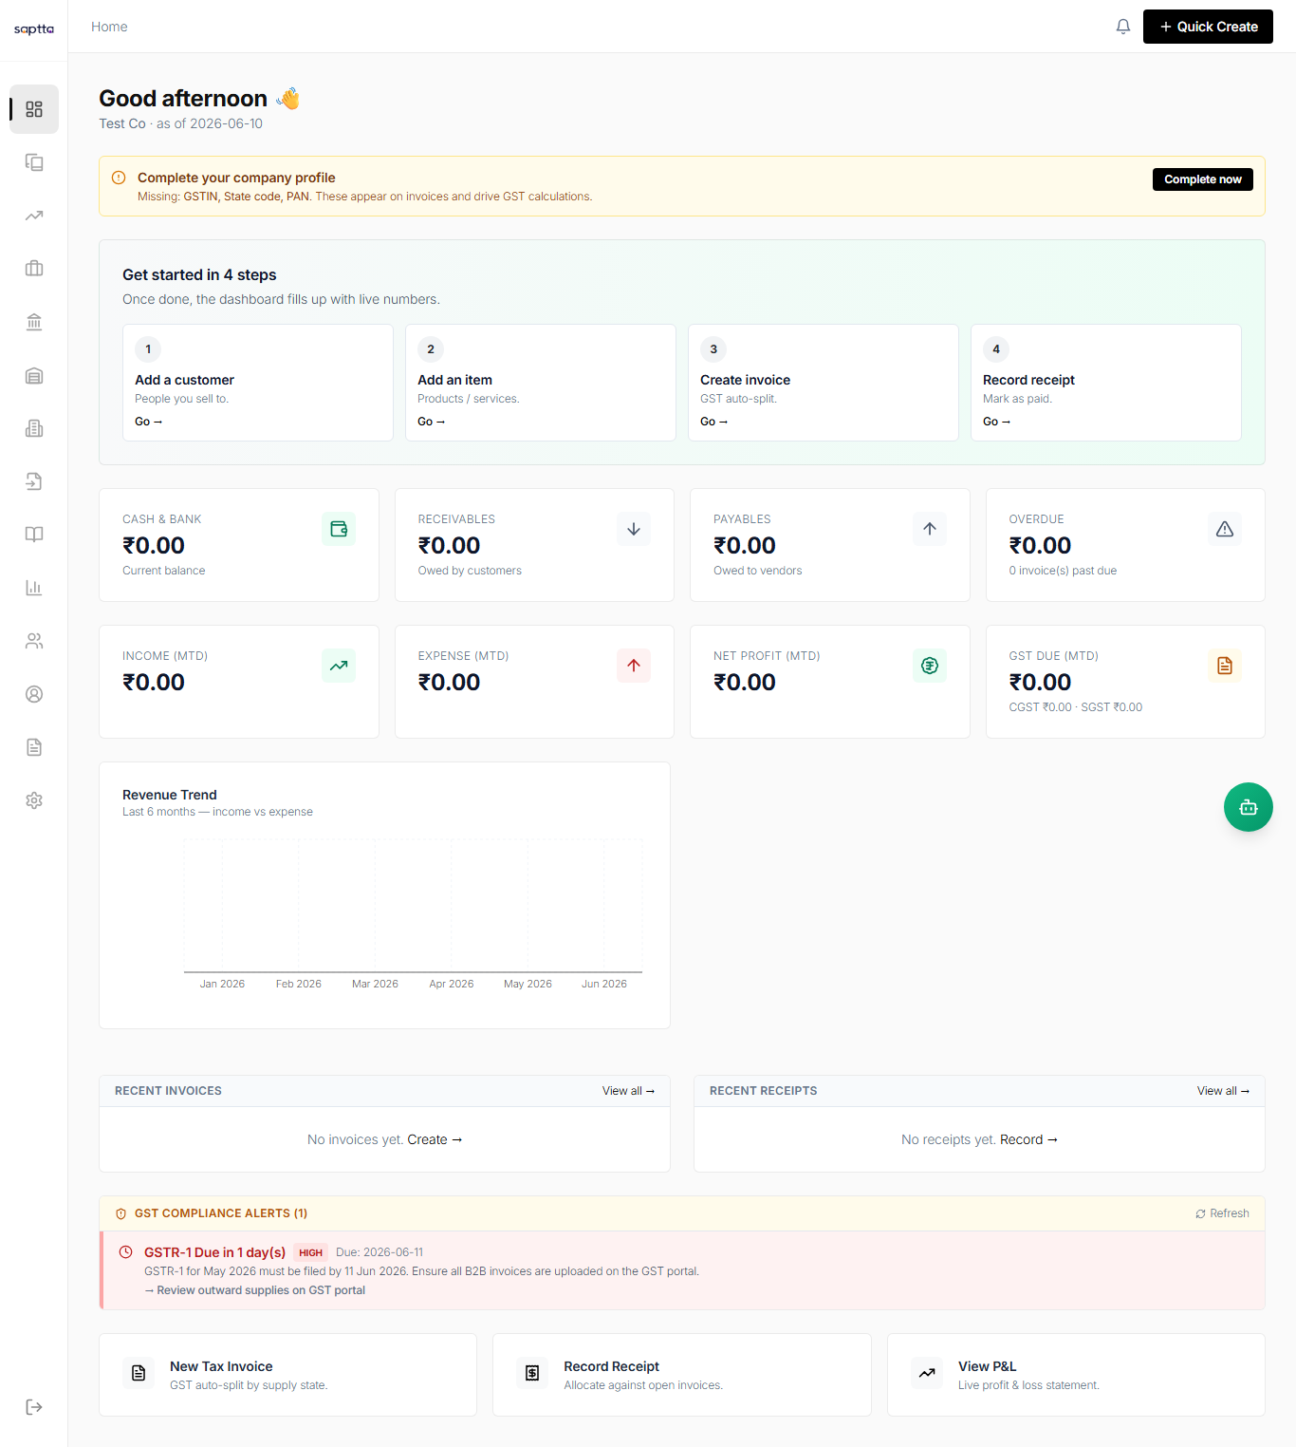
S
Saptta
SAPTTA ACCOUNTS
Finance your CA will use
• Full accounting workspace
• GST-ready compliance
• Tally XML export
• Unlimited finance users (flat fee)
Invoicing, ledger, GST
Saptta · Client Showcase · 6/11 · saptta.com · hello@saptta.com

Slide 7
S
Saptta
HRMS
Hire to retire — full HR lifecycle
Recruit
ATS, careers, AI rank
Onboard
Checklists, documents
Operate
Attendance, leave
Pay
Run, payslip, bank
Grow
Performance reviews
Comply
Letters, policies
Engage
ESS portal
Exit
Settlement, revoke
Saptta · Client Showcase · 7/11 · saptta.com · hello@saptta.com

Slide 8
S
Saptta
TRUST
Compliance built for real businesses
India (production-ready)
PF ECR · ESI · PT · TDS · Form 16
Gratuity accrual + exit estimate
Salary register · Bank advice · Tally XML
Pre-payroll review → approve → publish
GCC & Kuwait (demo-ready MVP)
KW · AE · SA jurisdiction signup
PIFSS · GOSI · indemnity accrual
IBAN · WPS-style exports
Validate rates with local consultant
Saptta · Client Showcase · 8/11 · saptta.com · hello@saptta.com

Slide 9
S
Saptta
PRICING
Simple pricing — beat HR-only tools
Plan | USD / mo | India INR | Best for
HRMS | $59 | ₹4,999 | HR team replacing legacy HR
Accounts | $59 | ₹4,999 | Finance + CA workflow
Complete ★ | $95 | ₹7,999 | Owners wanting one platform
At 30 employees
Saptta Complete: $95
Keka HR only: ~₹9,999
ZenHR GCC: ~$150
You save 20%+ vs separate
50
100
+30
emp → $125
emp → $200
+$1.50/emp
Saptta · Client Showcase · 9/11 · saptta.com · hello@saptta.com

Slide 10
S
Saptta
OUTCOMES
Results company heads see in 90 days
60%
Same day
Zero
100%
Less payroll prep
Payslip publish
Spreadsheet re-key
Audit on changes
CHRO wins
Manager leave approvals
Recruitment pipeline visible
Compliance expiry alerts
CFO wins
Payroll cost in finance view
GST + ledger same platform
Export-ready for CA
Saptta · Client Showcase · 10/11 · saptta.com · hello@saptta.com

Slide 11
See your company on Saptta
45-minute live demo on your scenarios · Trial workspace in 24 hours
1
Discovery
2
Live demo
3
Trial
Headcount, tools, pain points
HR + Finance, one login
Your team tests in 24h
hello@saptta.com · saptta.com · 14-day free trial · Free Complete setup (launch offer)
Saptta · Client Showcase · 11/11 · saptta.com · hello@saptta.com

