Slide 1












Business Profile
www.infologia.in

Slide 2











ABOUT US
Infologia Technologies, established in 2017, is a Chennai-based IT services company delivering innovative solutions globally. Specializing in custom software, web and mobile applications, enterprise solutions, and logistics automation, Infologia has completed 89+ projects across industries like logistics, e-governance, CRM, and ERP. As a certified CargoWise Service Partner (2022), DP World Business Partner (2024), and Magaya Service Partner (2025), we excel in cloud automation, IT-enabled solutions. Our mission is to drive digital transformation with scalable, client-centric technology solutions.
Core Expertise:
CargoWise Service Partner since 2022
DP world Business Partner since 2024
Magaya Service Partner since 2025

Slide 3


















MILESTONES
Expansion Stage
Advanced Product Development
Logistics Focus
Magaya Partnership
Growth into Telecommunication and Automobile industries, incorporating Blockchain technology to enhance projects.
Created HRMS, HMS, E-Magazine, ERP and CRM solutions for clients in Saudi Arabia and other countries.
Developed Track and Trace, API Invoice, Analytical Dashboards for logistics sector.
Established as a certified Service Partner with Magaya, expanding our logistics technology portfolio.
2017
2019
2020
2021
2022
2023
2024
2025
The Startup Stage
Privileged Collaborations
CargoWise Partnership
DP World Partnership
Founded by young, creative developers focused on website and web application development with high-quality services.
Partnered with Vishala designs for TNPSC portal, a prestigious project commissioned by Tamil Nadu State Government.
Became registered CargoWise Service Partners with a team of 15 certified professionals.
Achieved significant milestone becoming an official Business Partner with DP World.

Slide 4













OUR SERVICES
Web & Mobile Application Development
CargoWise Services & Solutions
Management Services
General IT Solutions
Custom solutions that enhance user experience and drive business growth.
Responsive Web Design
Native & Hybrid Mobile Apps
User Experience Optimization
As certified partners, we provide specialized logistics solutions.
Implementation
Integration
API Services
eAdaptor Services
Document Customization
Streamline operations with our specialized management software.
ERP Solutions
CRM Systems
HRMS
HMS
Comprehensive technical solutions for modern business needs.
Data Management
Software Development
IT Consulting
Support & Maintenance
Disaster Recovery
Managed IT Services

Slide 5








CARGOWISE SERVICES
As certified CargoWise Platinum Service Partners, we simplify logistics operations with state-of-the-art technology and specialized expertise. Our team includes 15 certified CargoWise professionals who ensure your logistics solutions are efficient and reliable.
We transform logistics challenges into streamlined operations through
CargoWise Consulting & Support
Cargowise Automation
ERP Integration
CargoWise Implementation
CargoWise Customizations
CargoWise Configurations
CargoWise Integrations
AP/AR Invoice Automation
Commercial Invoice Automation
Bill of Lading Import Automation
Bill of Lading Export Automation
Integration To Financial System
Integration To Customs And E- invoicing
Integration to Suppliers And Retailers
Integration To Transport Companies
Integration to Shipping Lines And
Stevedores

Slide 6

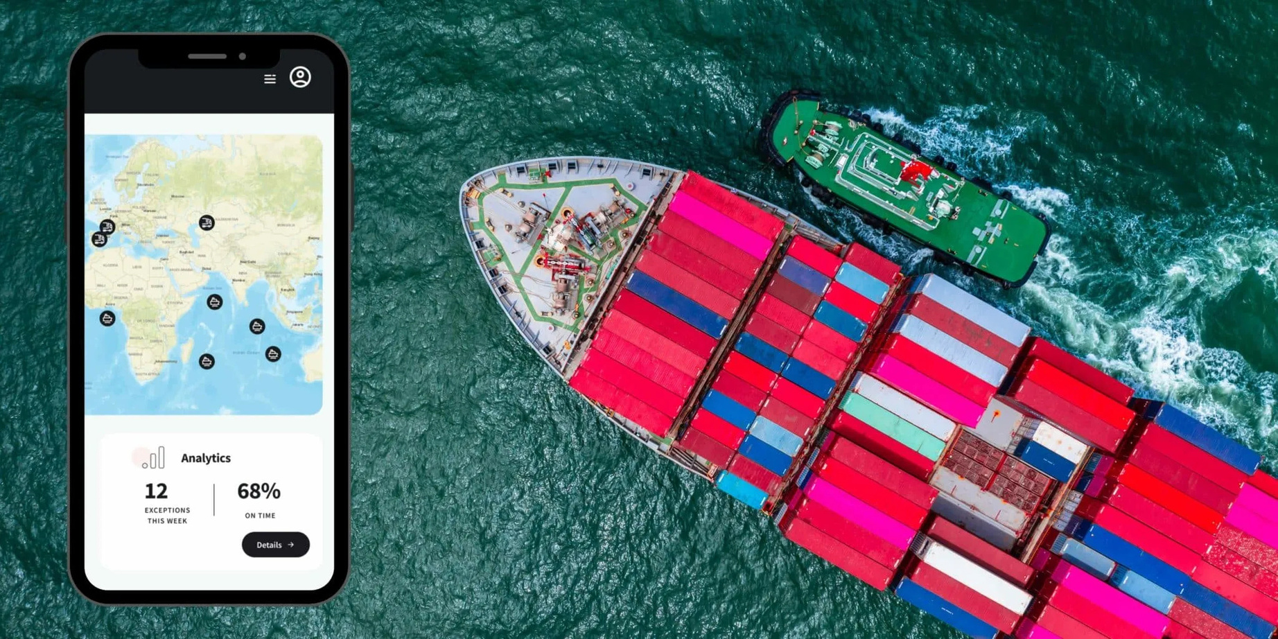

CARGOWISE SUCCESS STORIES (1/5)
CARGOWISE CONTAINER TRACKING INTEGRATION
Real-time container tracking integration
Client Type: Freight Forwarder
Region: Europe
Requirement: Real-time container tracking inside CargoWise to eliminate manual updates.
Solution Delivered:
Built multi-carrier API integrations using REST/JSON
Automated milestone, ETA/ETD and status updates into CW1
Deployed error-handling and webhook-based notifications
Dedicated Customer Portal
Tech Stack: REST API, JSON, CW1 WebServices, EDI Integrations, ASP.Net, C#
Outcome:
93% reduction in manual tracking
Accurate, real-time visibility directly in CW1

Slide 7

CARGOWISE SUCCESS STORIES (2/5)
UK CUSTOMS INTEGRATION
UK Customs automation
Client Type: Freight Forwarder
Region: UK
Requirement: Automated data synchronization for HMRC customs declarations
Solution Delivered:
Two-way integration between UK Customs integration from external system
Automated declaration updates, responses and status sync
Full mapping of customs fields and error notification framework
Tech Stack: XML, JSON, CW1 Integration Framework, ASM API, EDI Integrations
Outcome:
98% elimination of manual data entry
Faster and error-free customs processing

Slide 8

CARGOWISE SUCCESS STORIES (3/5)
WORKFLOW AUTOMATION & DOCUMENT CUSTOMIZATION
Standardized operations and automation
Client Type: Global Freight Forwarder
Region: USA, India, Dubai,Turkiye, Canada, Mexico
Requirement: Standardized operations through automation and custom documents
Solution Delivered:
Workflow automation for operations, finance, and exceptions
Custom reports, HBL/MBL, invoice templates and communication formats
Automated notifications and milestone trigger
Custom field integrations
Tech Stack: CW1 Workflow Engine, XML Templates, SQL, CW1 Reports
Outcome:
60% increase in operational efficiency
Consistent documentation across regions

Slide 9

CARGOWISE SUCCESS STORIES (4/5)
CARGOWISE UNIFORCE INTEGRATION
Unified shipment and financial visibility
Client Type: Freight Forwarder
Region: Netherland
Requirement: Unified shipment and financial visibility across two platforms.
Solution Delivered:
Bi-directional API integration between CW1 and Uniforce
Automated shipment, event, and charge synchronization
Complete UAT, documentation and post go live support
Tech Stack: REST API, JSON, eAdaptor, Middleware, Windows Services
Outcome:
Centralized visibility across both systems Accurate, Removed double entry and reduced operational delays

Slide 10
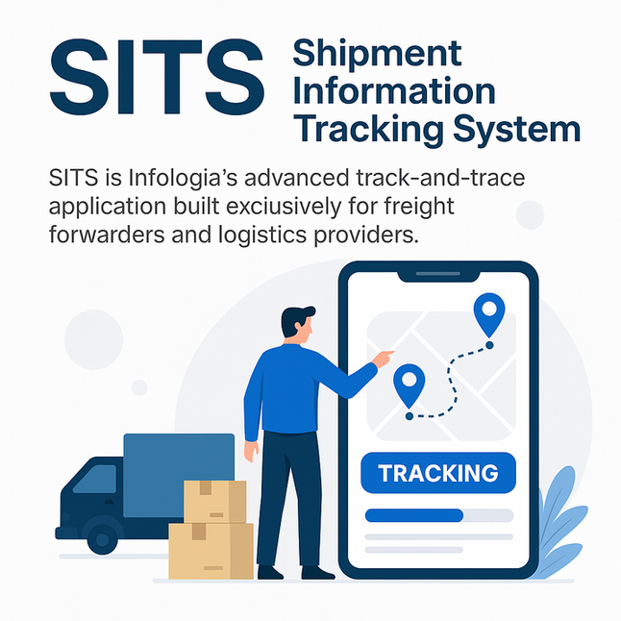






PRODUCT - SITS
Container Tracking System
Real-Time Monitoring
Automated Notifications
Mobile Accessibility
Seamless Integration
SITS is Infologia’s advanced track-and-trace application built exclusively for freight forwarders and logistics providers. Designed to provide real-time shipment visibility, SITS enables users to monitor cargo movement across multiple modes of transport with accuracy and ease.
The platform integrates seamlessly with existing logistics systems, consolidating data into a single interface that delivers live updates, automated alerts, and comprehensive shipment histories. This ensures forwarders can proactively manage delays, enhance customer communication, and optimize operational efficiency.
With SITS, businesses gain not only end-to-end visibility but also the ability to deliver a superior customer experience, setting them apart in the competitive logistics landscape.

Slide 11
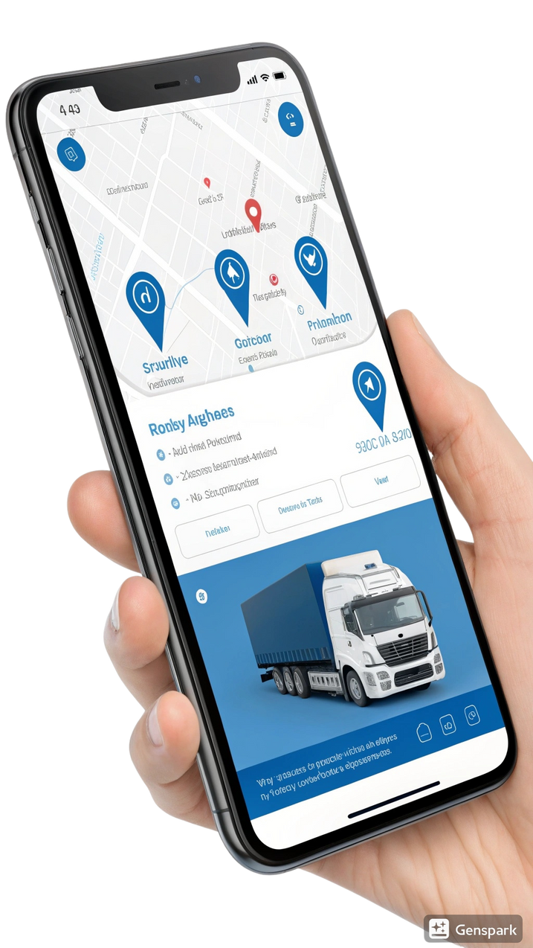



PRODUCT - TMS
Truck Management System
Our Truck Management System (TMS) is a comprehensive digital platform designed to streamline, automate and enhance truck transportation operations across countries. It centralizes critical operational flows into a single robust solution.
Centralized Operations
Unifies trip creation, milestone tracking, document management and vendor coordination, replacing fragmented manual processes.
Real-Time Visibility
Ensures transparency with live updates from booking to delivery, enabling confident scaling for logistics businesses.
Integrated Finance
Seamlessly manages Accounts Receivable (AR) & Payable (AP) alongside operational workflows for complete financial control.

Slide 12











OUR CLIENTS

Slide 13









"Thanks to Infologia for invaluable support in our Datawarehouse project. Their expertise and dedication were key to our success. Excited to continue working with them!"
Bharanidharan Viswanathan
Managing Director
SUCCESS STORY
At Infologia Technologies, client satisfaction is our top priority. Our commitment to excellence and dedication to delivering exceptional solutions has earned us widespread recognition and trust in the industry.
"Infologia Technologies efficiently streamlined our custom decorations process, delivering on time and within budget. Highly recommended for reliable, cost-effective IT services."
Jijesh Puliyappottammal
IT Manager
"It offers everything a user would need to run their business for a fair price. It has different functions that you can use when needed and only get charged for the usage."
Logistics Client
CargoWise Implementation
300+
Five-star ratings from satisfied clients across industries
"We have two implementations and our business analysts were able to pick up the functionality quickly. All the utilities and features that this system provides have been invaluable."
Enterprise Client
Software Solutions

Slide 14















CLIENTS TESTIMONIALS
Infologia team had a very good understanding of our requirements and completed the project within the timeframe
AJ Worldwide Services Inc
Great Work. Professional Team
New Globe Logistik LLP
We want to extend our heartfelt thanks to infologia for their invaluable support during our datawarehouse project. Their expertise in using our datawarehouse tool efficiently has been a game - changer, enabling us to make informed decisions and drive our initiatives forward. infologia’s dedication to excellence and top - notch customer service have been key to the project’s success, and we’re excited to continue working with them in the future.
Intoglo Private Limited

Slide 15










INFOLOGIA TECHNOLOGIES PVT LTD
BIG THANKS
www.infologia.in
info@infologia.in
No 15, 3rd Floor, Sarayu Park, 2rd
Main Road, New Colony, Chromepet Chennai - 44
044-3555 8065

