Slide 1


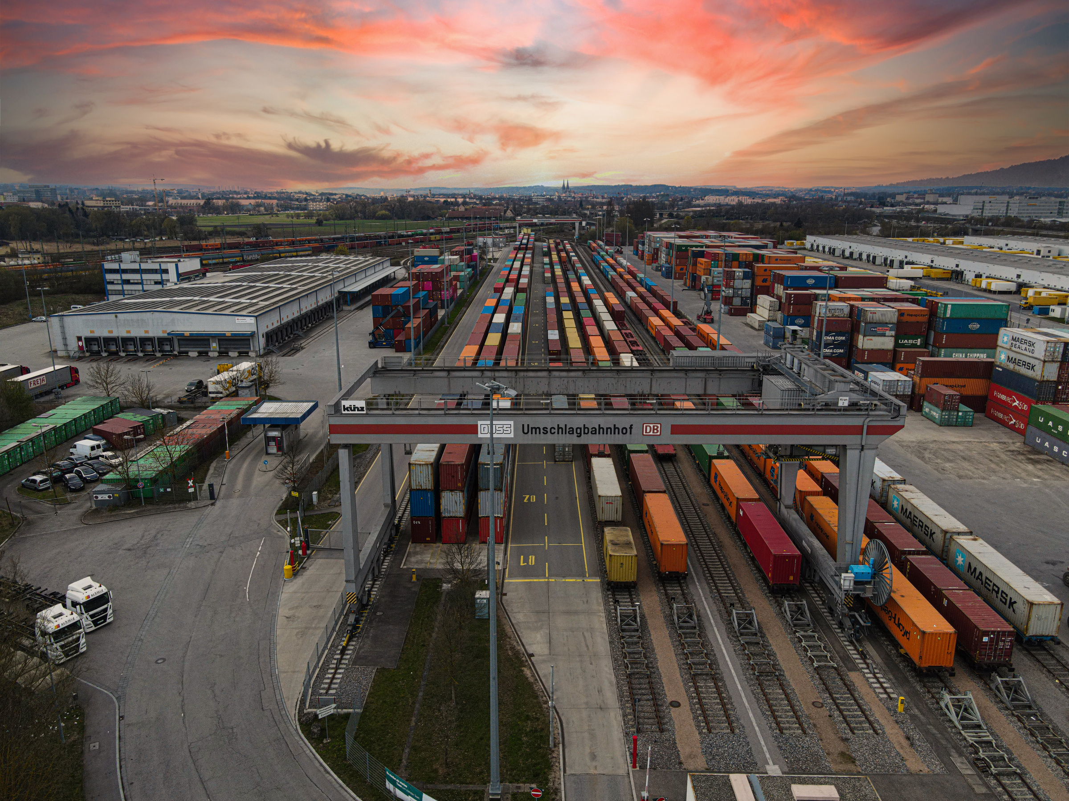



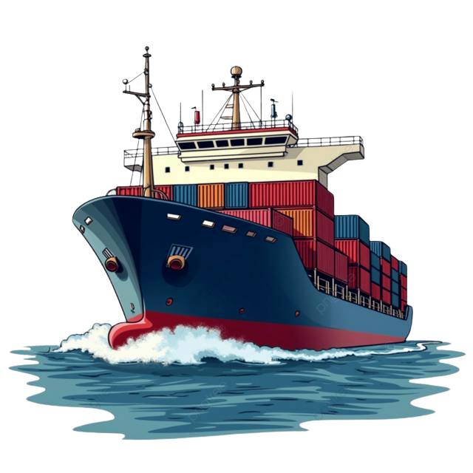


SHIPMENT INFORMATION TRACKING SYSTEM
SITS
Product Overview
www.infologia.in

Slide 2









PRODUCT OVERVIEW
SITS (Shipment Information Tracking System) is Infologia’s next generation track-and-trace platform built for freight forwarders, logistics providers and enterprises. It delivers real time visibility across multimodal shipments air, ocean, rail, road that enables businesses to monitor, predict and control their cargo movement with confidence.
Global Coverage
Real-time Visibility
Multimodal Tracking
Proactive Alerts
Advanced Analytics
Sustainability Metrics
200+
Global Carrier Integrations
20+
Enterprise Clients
32%
Reduction in Transit Time

Slide 3












WHY SITS MATTERS
SITS transforms shipment tracking into a strategic advantage by improving efficiency, reliability and trust across the supply chain.
Problem
Core Competiences
Solutions
Visibility Gaps
Multimodal Tracking
End-to-End Visibility
Manual Processes
Document Repository
Process Automation
Supply Chain Disruptions
Advanced Analytics
Proactive Alerts
Fragmented Technology
Exception Management
Seamless Integration
AI-Powered ETA
Customizable Milestone Setup

Slide 4










MULTIMODAL COVERAGE & INTEGRATION STATS
END-TO-END VISIBILITY ACROSS ALL TRANSPORTATION MODES
Air
100+ Airlines
Ocean
105+ Ocean Lines
Rail
Major Rail Networks
Road
100+ Road Carriers
Coverage across major trade lanes and logistics hubs worldwide
95%
Operational Visibility
API Integration
Fast onboarding with minimal IT investment
Sustainability Gains
Track and optimize CO₂ emissions across your supply chain. Average 15% emissions reduction after first year of implementation.
32%
Reduction in Transit Time
Data Standardization
Near real-time processing across carriers
20+
Different Stakeholders
TMS Compatibility
Seamless connection with your logistics systems

Slide 5
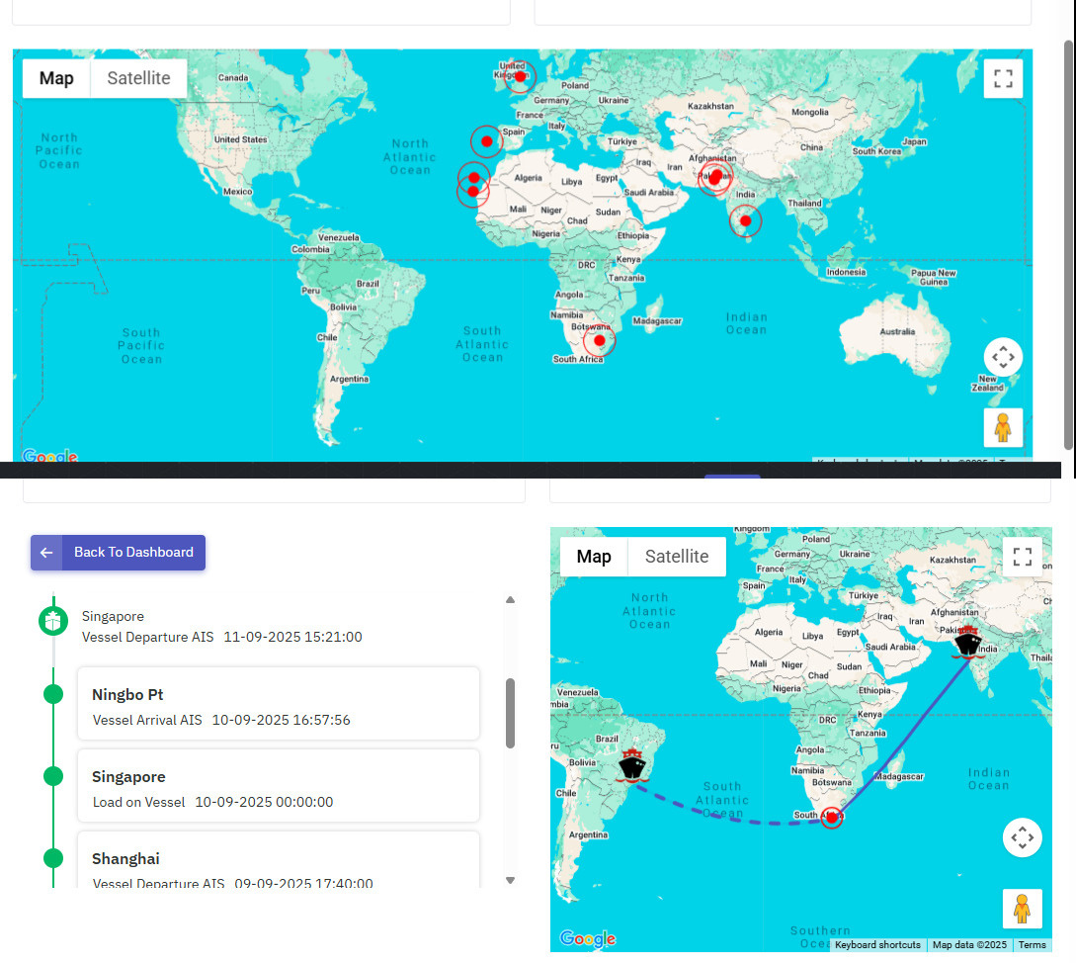
REAL TIME VISIBILITY DASHBOARD
Real-time Updates
Live tracking data with instant milestone notifications
Exception Alerts
Proactive notifications for delays and disruptions
Customizable Views
Personalized dashboards for different user roles
Predictive ETAs & ETDs
AI-powered arrival predictions with 95% accuracy

Slide 6
INTEGRATION & COLLABORATION
Seamless Connectivity
SITS is built to integrate effortlessly with global Transportation Management Systems (TMS), empowering logistics providers, freight forwarders and enterprises with real time shipment visibility. By connecting with platforms like:
Oracle OTM
CargoWise
SAP TM
Logisys
Manhattan
Magaya
MercuryGate
Descartes
Infor Nexus
SITS enriches existing workflows with:
Unified Shipment Data
Faster Decisions
Predictive Insights
Scalable & Flexible
Multimodal Coverage
Seamless Integration

Slide 7




PRICING MODAL
At SITS, we believe in transparent pricing that scales with your business needs. Our pricing is designed to deliver immediate ROI while providing the flexibility to grow with your supply chain operations.
Silver
Basic
Standard
Pro
Upto 100 Containers/Per Month
Upto 300 Containers/Per Month
Upto 500 Containers/Per Month
2.5
2
1.5
Per Container
Per Container
Per Container
API Services
API Services
API Services
If more than 500 containers contact sales team for more details

Slide 8
PRICING MODAL TWO
At SITS, we believe in transparent pricing that scales with your business needs. Our pricing is designed to deliver immediate ROI while providing the flexibility to grow with your supply chain operations.
Gold
Basic
Standard
Pro
Upto 100 Containers/Per Month
Upto 300 Containers/Per Month
Upto 500 Containers/Per Month
4
3.5
3
Per Container
Per Container
Per Container
Application
Dashboard
Reports
Email Support
2 Client Logins
API Services
Dashboard
Reports
Milestone Integration
5 Client Logins
Ticketing Priority
API Services
Access To All Features
10 Client Logins
Priority Support
API Services
If more than 500 containers contact sales team for more details

Slide 9
PRICING MODAL TWO
At SITS, we believe in transparent pricing that scales with your business needs. Our pricing is designed to deliver immediate ROI while providing the flexibility to grow with your supply chain operations.
Platinum
Basic
Standard
Pro
Upto 100 Containers/Per Month
Upto 300 Containers/Per Month
Upto 500 Containers/Per Month
6
5.5
5
Per Container
Per Container
Per Container
Application
Dashboard
Reports
Email Support
2 Client Logins
API Services
Cargowise integration
Dashboard
Reports
Milestone Integration
5 Client Logins
Ticketing Priority
API Services
Cargowise integration
Access To All Features
10 Client Logins
Priority Support
API Services
Cargowise integration
If more than 500 containers contact sales team for more details

Slide 10

Restaurant Comparison
Pizza Restaurants
PLAN STRUCTURE
PRICE
TASTE
AMBIENCE
PARKING
SERVICE
Cheese Please
Pizza Joint
Mario's Pizzeria
5M Pizza
Celia's Pizza Stop

Slide 11







Question And Answer Session
Thank You For Your Attention
www.infologia.in
Naresh Arumugam
Director of Sales
+91 4435558065
+91 9585777728 / 9962677728
info@infologia.in
naresh@infologia.in

