Slide 1










Infologia Technologies Pvt Ltd
INVESTOR PROPOSAL
DEVELOPMENT OF A NEXT-GENERATION CONSOLIDATED LOGISTICS MANAGEMENT SOFTWARE
www.infologia.in

Slide 2










ABSTRACT
Company Overview
Milestone & Partnership
Meet My Team
Infologia is building a next-generation Transport Management System (TMS) to overcome the limitations of legacy platforms. With a focused customer acquisition strategy, we aim to establish a strong global presence and position Infologia as a trusted leader in logistics technology, driving innovation and sustainable growth.
Executive Abstract
TMS Overview
Cargossoft TMS
SITS
Integration ( Cargossoft + SITS)
Enhancement of Cargossoft
New Module Enhancement in Cargossoft
AI Driven Enhancement
Segmentation
Market Opportunity TMS Scope
Competitor Analysis
Competitor Comparison Matrix
Company Financial Analysis & Revenue Potential
Investment Utilization Plan For Cargossoft
Our Clients
Terms & Condition
Conclusion

Slide 3





COMPANY OVERVIEW
Company Name: Infologia Technologies Pvt Ltd
Founded: 2017
Headquarters: Chennai
Employees: 25+
Website: www.infologia.in
About Us:
Infologia Technologies, established in 2017, is a Chennai-based IT services company delivering innovative solutions globally. Specializing in custom software, web and mobile applications, enterprise solutions, and logistics automation, Infologia has completed 89+ projects across industries like logistics, e-governance, CRM, and ERP. As a certified CargoWise Service Partner (2022), DP World Business Partner (2024), and Magaya Service Partner (2025), we excel in cloud automation, IT-enabled solutions. Our mission is to drive digital transformation with scalable, client-centric technology solutions.
Core Expertise:
CargoWise Service Partner since 2022
DP world Business Partner since 2024
Softlink Global Service Partner since 2025

Slide 4













MILESTONE & PARTNERSHIP
Infologia’s journey reflects steady growth and innovation – from IT services to global logistics solutions. Each milestone marks a strategic leap, strengthening our expertise and global presence. Partnerships with CargoWise, DP World and Magaya showcase our industry recognition. Our roadmap proves a clear vision: “Shaping the future of digital logistics with purpose”.
2017
2019
2020
2021
2022
2024
2025
Early Stage IT/Web development Beginnings
Collaboration Developed TNPSC Portal with Vishala Designs
Diversification Customized ERP For EhamGroups Saudi
Expansion ERP & CRM Solutions has Bought Global Reach
Strategic Shift Service partnered with CargoWise
Breakthrough Business Partnered with DP World
Growth Service Partnership with Magaya

Slide 5







MEET OUR FOUNDER & DIRECTOR
At Infologia, leadership is hands-on. Our CEO and Directors directly engage with clients and projects, ensuring strategic alignment with execution. With deep logistics domain expertise and a strong focus on customer success, we bridge real-world operational challenges with technology adoption. This direct involvement guarantees that every deployment of Cargossoft + SITS delivers measurable impact and long-term value for SMEs.
DHANARUBAN VELUSAMY
RAFEEQ RAJA
Founder & CEO
Director

Slide 6







EXECUTIVE ABSTRACT
AFFORDABLE, SCALABLE, GAME-CHANGING LOGISTICS MANAGEMENT SYSTEM
We are building a next-generation logistics management software designed to streamline global supply chain operations. Unlike fragmented systems in the market today, our platform offers a comprehensive, affordable and scalable solution that directly addresses inefficiencies faced by logistics companies.
Vision & Mission - Positioning
Our vision is to develop a single integrated product that can handle end-to-end logistics functionality—from Booking to entire transport management, financial reconciliation and compliance. By bridging the current gaps left by leading players, we aim to become the most cost-effective and performance-driven solution provider in the logistics technology sector.

Slide 7






TMS - OVERVIEW
A Transport Management System (TMS) is a specialized software solution designed to plan, execute and optimize the physical movement of goods. It is widely used by logistics companies, shippers, freight forwarders and supply chain managers to streamline transportation operations, reduce costs, improve visibility and ensure timely deliveries.TMS helps in automating key transportation processes such as carrier selection, route planning, freight auditing, shipment tracking and compliance.
Core Modules
Order Management
Carrier Management
Route Planning & Optimization
Load Planning & Consolidation
Shipment Execution
Freight Audit & Billing
Tracking & Visibility
Customer And Vendor Portal
Analytics & Reporting
Compliance & Documentation

Slide 8





CARGOSSOFT - INFOLOGIA’S TMS
Our current TMS (CARGOSSOFT) includes essential functionalities such as Order Management, Shipment Execution, Billing, Tracking & Visibility, and Analytics & Reporting, Customer & Vendor Portal effectively supporting core transportation workflows. However, to further enhance operational efficiency, user experience, and scalability, the system requires additional key modules. These include:
Carrier Management
Route Planning & Optimization
By integrating these modules into its existing booking and shipment solutions, Infologia can offer an end-to-end TMS that rivals global platforms like CargoWise, while still being agile, cost-effective, and customizable for customers. This positions Infologia not just as an IT service provider, but as a technology partner shaping the future of digital logistics.
Load Planning & Consolidation
Customer & Vendor Portals
Compliance & Documentation

Slide 9



SITS - INFOLOGIA’S TRACK & TRACE APPLICATION
SITS (Shipment Information Tracking System) by Infologia Technologies is a robust supply chain visibility platform offering real-time tracking across sea, air, road and rail. It consolidates shipment data from ocean carriers, airlines, and third-party solutions into a user-friendly dashboard, enabling logistics providers and cargo owners to monitor shipments without navigating multiple carrier sites. Designed for flexibility, SITS integrates seamlessly with existing Transport Management Systems (TMS), enhancing workflows without disruption. Trusted by clients, SITS boosts operational visibility, efficiency and customer satisfaction.
Centralized Dashboard
Live Map Integration
API Integration
Sustainability Tools
Milestone Tracking

Slide 10


CARGOSSOFT & SITS INTEGRATION
Infologia’s vision is not only to build a Transport Management System but also to enhance it with real-time visibility and intelligence through seamless integration with SITS (Shipment Information Tracking System). This integration transforms Cargossoft from a process-driven TMS into a data-driven logistics command center.
Business Functional Integration - Non Technical
Automation: Cargossoft users see shipments created in the TMS while SITS automatically pulls live updates from carriers, customers and partner system. Client can enable or disable the tracking system based on the needs.
Automated Updates: Any milestone update (departure, arrival, customs clearance, POD, etc.) from SITS syncs to the shipment in Cargossoft.
Customer Access: Customers don’t need to log into multiple carrier portals—through Cargossoft’s customer portal, they see SITS-powered real-time visibility.
End-to-End Flow: Book → Execute → Track → Bill → Report → Analyze (all inside one system).

Slide 11




ENHANCEMENT OF CARGOSSOFT
Our current Cargossoft TMS includes essential functionalities such as Order Management, Shipment Execution, Billing, Tracking & Visibility, Analytics & Reporting and Customer & Vendor Portals, which effectively support core transportation workflows. To keep pace with industry demands and deliver a more intelligent, scalable logistics solution, we are embarking on a strategic enhancement of Cargossoft, covering system upgrades, new module integrations and AI-driven innovations. The existing modules will be enhanced into the following modules.
Booking Interface Enhancements
Carrier Management
Advanced Freight Billing
Shipment Execution Optimization
Real-Time Analytics

Slide 12





NEW MODULE ENHANCEMENT IN CARGOSSOFT
CargosSoft is evolving into a robust TMS with new modules: Carrier Management, Route Planning & Optimization, Load Planning & Consolidation, and Compliance & Documentation. These streamline logistics and boost efficiency. Integrated AI enhancements, including predictive ETAs, smart load optimization, and automated exception handling, enable proactive decisions, reduce manual work and enhance accuracy. These upgrades make CargosSoft a scalable, future-ready transportation platform.
By focusing on these modules, we ensure these following features
Expanded Functional Coverage
Upgraded Core Modules
AI-Driven Intelligence
Stronger Collaboration Tools
Scalability & Competitive Edge
Improved User Experience
Real-Time Visibility & Alerts
Optimized Resource Utilization
Automated Compliance & Documentation
Future-Ready Architecture & Integrations
Carrier Management
Route Planning & Optimization
Load Planning & Consolidation
Compliance & Documentation

Slide 13





AI DRIVEN ENHANCEMENT
CargosSoft is becoming a smarter TMS by integrating advanced AI, powered by logistics-specific Small Language Models (SLMs). These enhancements enable predictive insights, automated task handling, and optimized decision-making. Using machine learning, CargosSoft anticipates delays, optimizes loads and delivers real-time intelligence, reducing errors, boosting efficiency and enhancing customer satisfaction. This makes CargosSoft a future-ready, intelligent platform tailored to the logistics sector.
Predictive ETA & Delay Management
Smart Load Optimization
Intelligent Exception Handling
AI Virtual Assistant
AI Enabled OCR

Slide 14




SEGMENTATION
Infologia targets mid-sized logistics operators, underserved by costly solutions, in growing global markets with rising demand for affordable, scalable tech. Our modular platform ensures seamless integration with existing systems, enabling rapid adoption and scalability. This positions Infologia as a long-term technology partner for clients’ success.
By focusing on these segments, we ensure
For our consolidated logistics management platform, the ideal target market lies in these segments
Faster product adoption due to immediate need.
Strong competitive positioning by filling the gaps left by existing players.
Sustainable recurring revenue through subscription and integration services.
Long-term customer loyalty, as our platform grows alongside their business.
Mid-sized Operators & Modular Enterprises
Emerging Markets
Faster Adoption
Sustainable Growth

Slide 15







MARKET OPPORTUNITY - TMS SCOPE
Target Capture @ 1% - 0.19 Billion USD will the turnover
The global logistics software market size was valued at USD 17.73 Billion in 2024 and is projected to grow from USD 19.39 Billion in 2025 to reach USD 39.66 Billion by 2033, growing at a CAGR of 9.36% during the forecast period (2025-2033).
Low End - 0.96 Billion USD - @ 5% NP
High End - 2.90 Billion USD - @ 15% NP
By focusing on niche specialization, global delivery and outcome-driven services, the company has the opportunity to establish itself as a leading logistics technology enabler, carving out a meaningful share of a market projected to more than double in less than a decade.

Slide 16

COMPETITOR ANALYSIS
CargoWise holds 45% of the global TMS market but is costly and rigid, while Softlink and Magaya offer limited scalability and innovation. Infologia provides a 50–70% cost advantage, 70% faster deployment, and modular flexibility, cutting integration costs by 30%. With enterprise-grade scalability and SME-friendly pricing, we aim to capture 1% of the $30B TMS market, a $300M opportunity.
HOW DO WE DIFFERENTIATE US!!!
Market Entry Strategy: Target 1% of $30B TMS market ($300M / ₹2,400 Cr opportunity).
Cost Advantage: 50–70% lower pricing than CargoWise, outpacing Magaya with deeper features.
Deployment: 60-day implementation, 70% faster than CargoWise/Magaya.
Customization: Fully modular, cutting client integration costs by 50–70%.
Support Model: India-based delivery, 50% cheaper than global competitors.
Revenue Projection: 25 high-value clients ($180K–$240K / ₹1.5–2 Cr each) yield $2.27M ARR early on.

Slide 17
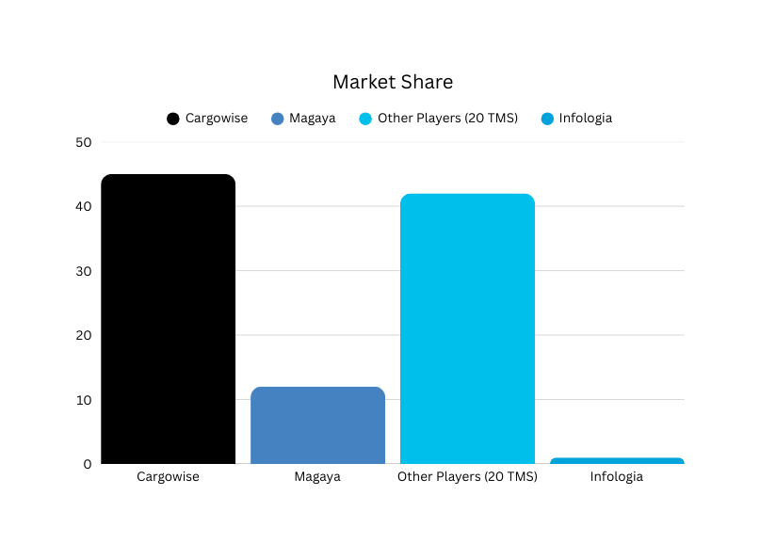

COMPETITOR COMPARISION MATRIX
Players | Client Base | Avg. Annual Cost / per Client(Avg 20 Users) | Deployment Speed | Scalability | Customization | Global Reach
CargoWise | 18K Clients | $170K – $341K | 12–18 months | High | Low | Global
Magaya | 6.5K Clients | $17K – $45K | 3–6 months | Low | Low | Regional
Infologia | Target 25 Clients - Per Year | $10K - $30K | 2 months | High | High | Expanding Global
CargoWise, with 35–45% market share, charges $170K–$341K annually (avg 25 users), offers high scalability but limited customization, and takes 12–18 months to deploy, suiting large global enterprises. Magaya, holding 10–12% share in the Americas, provides a budget-friendly $17K–$45K annually with 3–6 month deployment but lacks scalability and global reach, targeting SMEs. Infologia, aiming for 1% market capture ($300M), offers mid-range pricing ($10K–$30K annually), 2-month deployment, high scalability, and customization, positioning it as a competitive option for growing and established logistics players globally.

Slide 18
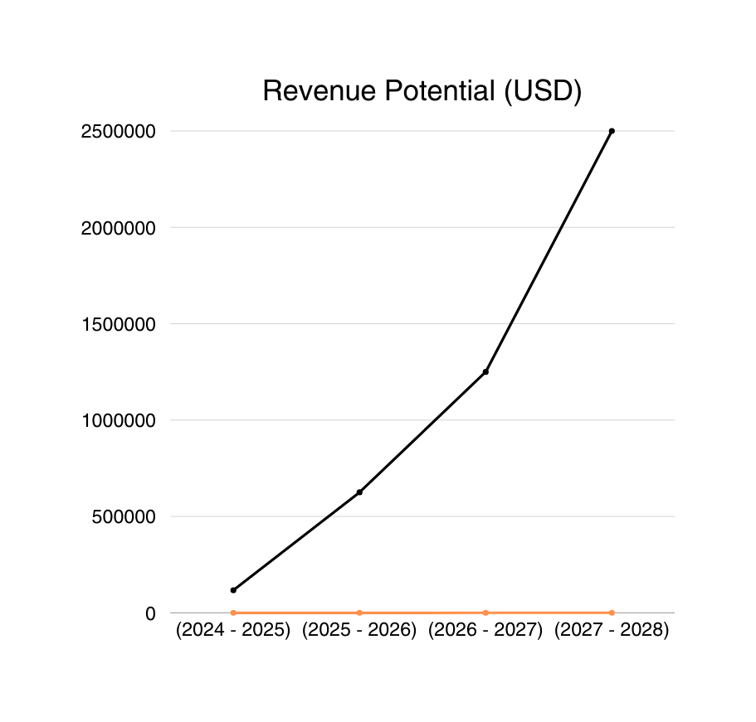


COMPANY FINANCIAL ANALYSIS & REVENUE POTENTIAL
Infologia’s revenue trajectory demonstrates a clear path of exponential growth, scaling from ₹97.2 Lakhs in 2023–24 to an estimated ₹13.05 Cr by 2027–28. This reflects a CAGR of ~ 145.1%, supported by strong demand for digital logistics and our TMS deployment strategy.
Such growth is fueled by our product-first approach (TMS + SITS integration), enabling early adoption by mid-to-large forwarders and 3PLs, followed by enterprise-level contracts. The steep upward curve signals that even a small market share in the global logistics technology market converts into high-margin, recurring revenues.

Slide 19
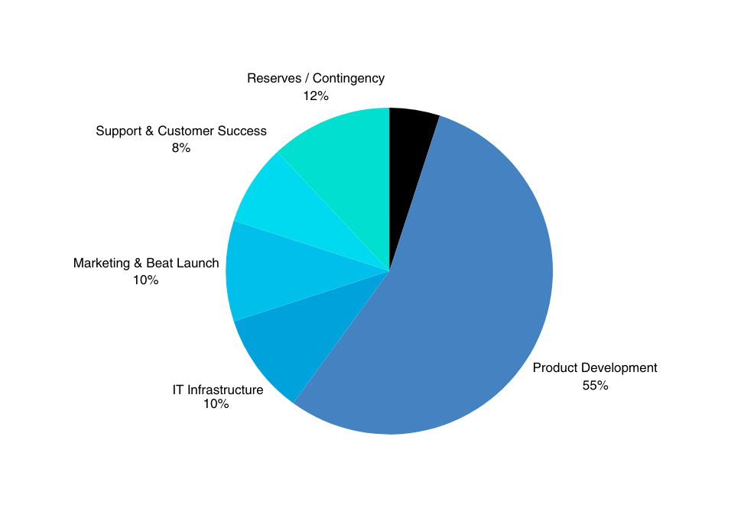
INVESTMENT UTILIZATION PLAN FOR CARGOSSOFT
AREA | ALLOCATION(USD) | RATE(%)
Discovery & Planning | $29,762 | 5%
Product Development | $3,27,381 | 55%
IT Infrastructure | $59,524 | 10%
Marketing & Beta Launch | $59,524 | 10%
Support & Customer Success | $47,619 | 8%
Contingency / Reserve | $71,429 | 12%
TOTAL | $5,95,238 | 100%
The ₹5Crs ($602K) fund is strategically distributed across manpower, IT infrastructure, salaries, licensing, marketing and product development, ensuring rapid TMS deployment, sustained operations and strong market acquisition while maintaining long-term scalability and repayment capacity for next 6 months.

Slide 20




SWOT ANALYSIS
STRENGTHS | WEAKNESSES | OPPORTUNITIES | THREATS
CargoWise Platinum expertise drives 70% faster TMS deployments. SITS/CargosSoft deliver AI-powered, affordable-cost ($10K–$30K) logistics solutions. Agile operations cut integration costs by 30% for clients. Diverse IT portfolio (300+ clients) ensures revenue stability. | Small team limits large-scale project capacity. CargoWise dependency risks operational constraints. Weak brand visibility lacks client trust signals. Early CargosSoft may face initial scalability issues. | Capture $300M in $30B TMS market for mid-sized firms. AI/SLM features align with 25% smart TMS growth. Leverage e-commerce boom for 20% YoY expansion. Meet compliance needs, saving 15% client costs. | CargoWise/Magaya competition pressures pricing edge. Economic volatility threatens logistics IT budgets. Cybersecurity risks (30% hack rise) endanger data. Talent shortages and AI advancements challenge innovation.
S
O
T
W

Slide 21









OUR CLIENTS

Slide 22



TERMS & CONDITIONS
Term | Details
Principal Amount | ₹5 Crores (approx. USD 600K) – exclusively for IT & logistics product deployment
Instrument Type | Non-Convertible Debenture (NCD)
Interest Rate | 10–14% p.a. (fixed)
Tenure | 3–5 years
Repayment | Bullet repayment at maturity
Security/Collateral | Unsecured
Covenants | Maintain minimum debt-to-equity ratio; restrict diversion of funds; mandatory quarterly reporting
Exit / Prepayment | Option for company to prepay after lock-in (with/without small penalty); investor can call back debt upon default
Conversion Option | Not applicable (no equity dilution)
Governing Law | Indian Contract Act, Arbitration for dispute resolution

Slide 23



CONCLUSION
AND RECOMMENDATIONS
Partner with Infologia to capture 1% of this multi-billion-dollar opportunity, generating predictable SaaS revenues and delivering sustainable, recurring returns for investors.
The $39.6B logistics software market is growing fast, yet SMEs remain underserved by rigid, costly platforms. Infologia’s Cargossoft + SITS delivers a flexible, affordable alternative, backed by proven expertise and leadership commitment. With a ₹5Crs investment focused on IT and logistics deployment, we target profitability by 3 Years and sustainable margins of 20–25%. The opportunity is clear—partner with us to capture market share and drive lasting value.

Slide 24






INFOLOGIA TECHNOLOGIES PVT LTD
THANK YOU
FOR YOUR ATTENTION AND PARTICIPATION
CONTACT INFORMATION:
044-3555 8065
info@infologia.in
www.infologia.in
No 15, 3rd Floor, Sarayu Park, 2rd
Main Road, New Colony, Chromepet Chennai - 44

