Slide 1










TRUCK
MANAGEMENT
SYSTEM
A smart system that simplifies and automates truck transportation operations across cities and states.
Live Tracking
Real Time Analytics
Global Coverage

Slide 2








EXECUTIVE SUMMARY
Our Truck Management System (TMS) is a comprehensive digital platform designed to streamline, automate and enhance truck transportation operations across countries. It centralizes critical operational flows into a single robust solution.
Centralized Operations
Unifies trip creation, milestone tracking, document management and vendor coordination, replacing fragmented manual processes.
Reduce Manual Work
Automate repetitive tasks and digitize paperwork to free staff for higher-value activities
Enhance Transparency
Real-Time Visibility
Ensures transparency with live updates from booking to delivery, enabling confident scaling for logistics businesses.
Gain complete visibility over shipments with real-time tracking and milestone updates
Optimize Operations
Streamline booking, tracking, and communication with centralized management
Integrated Finance
Seamlessly manages Accounts Receivable (AR) & Payable (AP) alongside operational workflows for complete financial control.
Empower Decision Making
Access critical data instantly to make informed decisions and respond quickly

Slide 3




KEY FEATURES
This system offers multi-level role-based access, real-time milestone tracking, vendor mobile integration, digital document management and complete AR/AP financial control to simplify and streamline every stage of truck transport operations.
Core Infrastructure & Tracking
Role-Based Login Structure
Secure, hierarchical access control for all stakeholders including Owner, Company, Branch, Sub Admin, Users and Master Data handlers. Ensures data integrity and operational security.
Branch-Based Operations
Enables scalable state-wise expansion with dedicated branch creation. Supports accurate GST-based rate calculations and localized operational management.
Milestone Tracking
Provides real-time visibility into every trip with departure, arrival and location-based updates. Eliminates manual follow-ups and enhances client trust.

Slide 4



KEY FEATURES
Operational Management & Documentation
Vendor Mobile Application
Empowers drivers to update trip status, share live tracking details and upload shipment documents directly from the road, enhancing connectivity.
Branch-Based Operations
Streamlines the booking lifecycle where users create entries and sub-admins validate, approve and manage milestone updates for total control.
Master Data Management
Provides a centralized and robust setup for managing critical client information, vendor lists and location details to ensure data accuracy.
Document Repository
Centralizes storage for LR copies, shipment-related docs and consigner/consignee files, all easily accessible via unique booking numbers.

Slide 5




KEY FEATURES
Assets, Finance & Admin Control
Vehicle Management
Comprehensive registry to register, store and track all vehicle and truck details. Maintains a digital history of fleet assets for better utilization and maintenance planning.
Accounts Receivable (AR) & Payable (AP)
Integrated financial modules to manage client invoicing and payments (AR) alongside vendor and truck owner settlements (AP), ensuring seamless financial reconciliation in one place.
Subscription Monitoring (Owner View)
Strategic dashboard for product owners providing deep insights on client subscriptions, active platform usage, lost accounts and key performance ratios to drive business decisions.

Slide 6



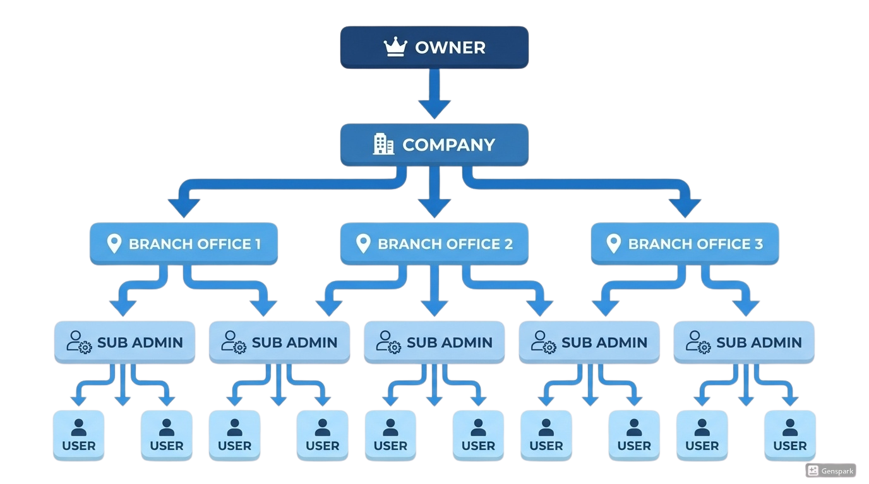




HOW THE PRODUCT WORKS
Organization Setup
Owner defines the organizational structure, assigns menus and maintains visibility over all subscriptions.
Branch Creation
Company creates state wise Branches to ensure accurate tax compliance and regional rate calculations.
Operational Management
Sub Admins manage day-to-day operations, validate bookings and oversee master data records.
Execution & Tracking
Users create bookings, drivers use the Vendor App for real-time updates and document uploads.
Visual representation of the multi-layered organizational and operational flow
Financial Reconciliation
Completed trips sync to AR/AP for seamless client invoicing and vendor payout processing.

Slide 7

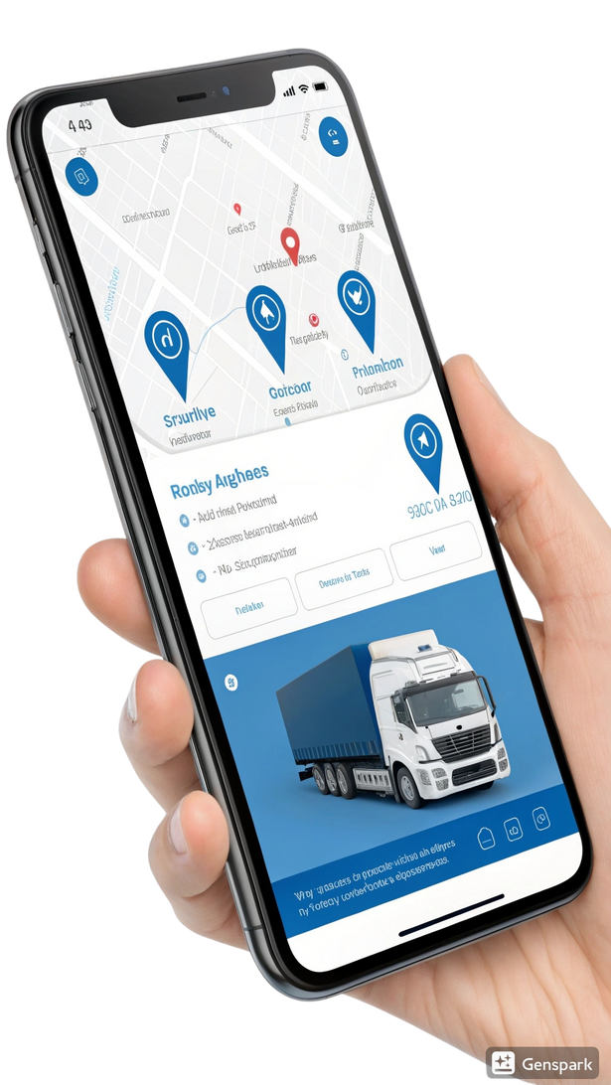




VENDOR MOBILE APP INTEGRATION
Empower drivers and truck owners with a seamless mobile interface for real-time updates and paperless operations.
Real-Time Tracking & GPS
Live location updates, journey progress monitoring and instant ETA sharing with clients and branches.
Digital Document Upload
Drivers can instantly capture and upload LR, CRO and shipment documents directly from the field.
Smart Milestone Triggers
Automated departure and arrival notifications keep all stakeholders informed without manual calls.
Offline Sync & Security
Works in low-network areas with auto-sync capabilities, ensuring data integrity and complete audit logs.

Slide 8






WHO IT BENEFITS
The Truck Management System is built to support every major participant within the trucking and logistics ecosystem
Logistics Companies
Branch Managers
Operational Staff
Gain centralized operational control across all states and branches, ensuring consistent standards and scalability.
Effortlessly manage daily operations, validate bookings and oversee milestone updates with role-specific tools.
Create and manage bookings easily through a digital interface, eliminating manual paperwork and reducing data errors.
Vendors & Truck Owners
Clients
Product Owners
Access transparent trip details, upload documents instantly and track payouts via the dedicated mobile application.
Experience improved service reliability with real-time milestone alerts and direct visibility into shipment documents.
Maintain complete strategic oversight on system subscriptions, user activity levels and overall platform engagement.

Slide 9








PROBLEM ADDRESSED
The Truck Management System solves several longstanding operational challenges in the trucking and logistics industry
Lack of transparency in trip progress and real-time milestone tracking.
Manual document handling leading to processing delays and operational errors.
Inconsistent state-wise rate calculations due to complex GST variations.
Inefficient communication silos between companies, branches and vendors.
Poor visibility of financial transactions (Client AR & Vendor AP).
Difficulty in monitoring system usage patterns and client subscriptions.
Fragmented storage of vehicle records and vendor master data.

Slide 10










EXPECTED USER OUTCOMES
Users gain faster, more accurate and fully transparent transport operations, with real-time updates, reduced manual effort and improved financial clarity for smoother end-to-end workflow management.
Operational Accuracy
Improved Transparency
Milestone Tracking
Reduced Errors
Achieve precision through automated booking validation and real-time updates.
Clients gain full visibility with milestone alerts and instant document access.
Accelerate operations via live tracking and centralized coordination.
Minimize manual mistakes through digital document uploads and master data.
Better Financial Control
Higher Productivity
Vendor Reliability
Strategic Insights
Manage cash flow effectively with fully integrated AR and AP modules.
Centralizes client, vendor and location data for accuracy.
Empower drivers with the mobile app for verification and seamless comms.
Product owners gain oversight through deep subscription and usage analytics.

Slide 11


COMMERCIALS
At TMS, we believe in transparent pricing that scales with your business needs. Our pricing is designed to deliver immediate ROI while providing the flexibility to grow with your Inland operations.
Silver
Gold
Platinum
200
300
400
INR
INR
INR
Per Shipment
Per Shipment
Per Shipment
Live truck tracking
All Silver features
All Gold features
Trip start & end status
Trip history & playback
Fuel efficiency insights
Basic route visibility
Driver performance tracking
Advanced analytics dashboard
Mobile app access
Standard support
Delay & stoppage alerts
Custom reports
Downloadable operational reports
Multi-branch / multi-fleet management
Minimum 5 trucks per account

Slide 12






THE ROAD AHEAD
TRANSFORM YOUR
LOGISTICS OPERATIONS
READY FOR DIGITAL TRANSFORMATION?
The Truck Management System is a powerful end-to-end solution built to modernize truck transportation with unmatched accuracy, efficiency and visibility.
Ensure every movement from booking to delivery is controlled, tracked and optimized.
Schedule A Live Demo
Structured Roles
Real-time Tracking
Automated Docs
Integrated AR/AP
Equip your logistics business to operate with reliability and scale without operational bottlenecks.

Slide 13







THANK YOU
Ensure every movement from booking to delivery is controlled, tracked and optimized.
www.infologia.in
Naresh Arumugam, Director of Sales
+91 4435558065
+91 9962677728
info@infologia.in
naresh@infologia.in
www.infologia.in

