Slide 1


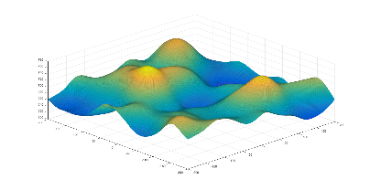
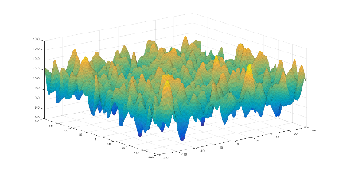
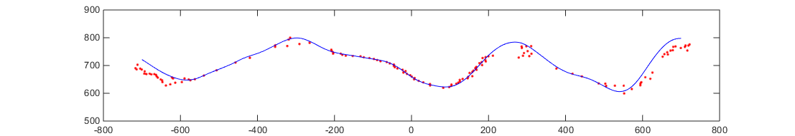
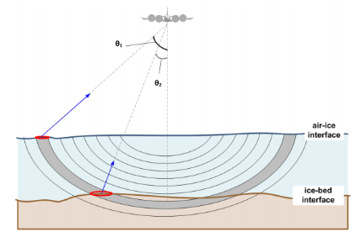
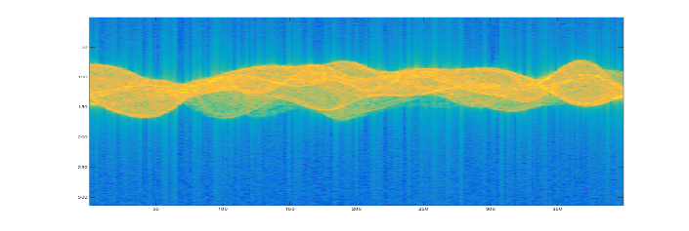
Wideband Radar Simulator for Evaluation of Direction-of-Arrival Processing Sean M. Holloway Center for the Remote Sensing of Ice Sheets, University of Kansas, Lawrence, KS 66045
Introduction
The purpose of this project was to create a radar ice-bed simulator used in assessing the performance of several array processing algorithms for direction of arrival and power estimation.
The Center for the Remote Sensing of Ice Sheets (CReSIS) at the University of Kansas uses several wideband radar imaging systems to collect glacial topography data. Signal processing algorithms are applied to extract information regarding ice sheet thickness and basal characteristics.
Development of this radar simulator allows for the evaluation of the algorithms on simulated data using either imported or randomly generated surfaces. These simulations can be used to quantify the accuracy of each algorithm. We are specifically interested in how optimizers can be used to help the algorithms track layers in three dimensional space. Since this is an NP-hard problem because it is N-dimensional where N is the number of pixels in the surface, the optimizers need to efficiently search the space and this simulator will be used to help test this in a quantitative way.
The simulation process is divided into three main tasks:
Stochastic Surface Generation: generates a surface for testing
Array Response Simulation: simulates radar scattering from the surface
Array Processing: uses the simulated array data to estimate the surface
Methodology
Stochastic Surface Generation
The surface generator creates a two-dimensional Gaussian matrix with mean and variance given by the mean elevation and RMS surface height respectively. This matrix is then smoothed with a 2nd-order Butterworth low-pass filter, to adjust the correlation length of the surface’s autocorrelation function as specified.
Array Response Simulator
Given an imported or generated surface, a set of targets is sampled and passed to a function which returns the complex amplitude response of each element of the array. Magnitude is calculated from the Friis transmission equation, and phase is determined by the round trip time-delayed exponential.
The system allows for the following parameters to be adjusted:
Methodology
Array Processing
Pictured: Single image slice showing the generated surface (blue) and the MLE-estimated target locations (red).
Array processing is applied to the simulated data to estimate the locations of scattering features from the surface. Eventually these scattering locations will be used to form an estimated surface in 3-D. The figure shows a single slice from a 3-D image. The array processing program allows for the adjustment of parameters for signal processing, and applies various algorithms from the CReSIS signal processing toolbox. Thus far the program has successfully implemented the MLE, MVDR, and MUSIC methods for target range and direction of arrival.
Future Direction
It is intended that the simulator will be developed further by future CReSIS students. Possible further utilities include:
Multi-layer surface generation, to model air-ice and ice-rock boundaries.
Implementation of more processing methods, including wideband array methods.
Acknowledgements
The author owes much gratitude to the faculty and students at the Center for the Remote Sensing of Ice Sheets, with special distinction to the assistance given by Dr. John Paden.
Environmental Parameters:
Radar Cross Section
Surface Topography
Noise Power/Temperature
Signal-to-Noise Ratio
System Parameters:
Array Size/Arrangement
Transmit Power
Antenna Pattern
Waveform/Bandwidth

