Slide 1
Guidelines for Homework 6

Slide 2
Getting Started
Homework 6 requires that you complete Homework 5.
  All of HW5 must run on the GridFarm.
  HW6 may run elsewhere (like your desktop).
  Write a simple Java program to invoke the Simpson code and verify it works.
  Install Tomcat 5.0.28 on one of the GridFarm machines.
    Make sure you change the port numbers
  Install Axis 1.1 into Tomcat.
  Convert your java program into a service
    Rename SimpsonWrapper.java to SimpsonWrapper.jws
    Copy the file to the Axis directory

Slide 3
Next, Write the Client
Following the April 25th lectures
  Install Tomcat 5.0.28 again, on a different host
    Can be a local PC
  Install Axis 1.1 as before
  Download the WSDL file for your service
    URL is something like this: http://gfX.ucs.indiana.edu/axis/services/SimpsonWrapper?wsdl
    Save it onto your PC
  Generate client stubs on your PC from this WSDL and compile these java programs.
    See http://www.grid2004.org/spring2004/examples/webservices/HelpwithHowework6.ppt for complete details.
  Use your client stubs to write a JSP page
    See also the URL above

Slide 4
A Picture
Tomcat + Axis
On JSU PC
Stubs
Tomcat + Axis
On IU Linux
SOAP
Service
The Client
The Server

Slide 5
If You Make It This Far…
Note if you follow the SimponWrapper code example, the 2D String array value returned by execLocalCommand returns standard output and standard error.
  You can print this out in your JSP page.
Send me a screen shot to verify that you were able to do this.
Make zips of your client and service to verify that it works.
  Don’t email! Put it on a web server and send me the URL.

Slide 6
Next Steps
We will come back to your JSP client in a second.
First, we will see how to convert a generic JSP into a portlet.
We will use uPortal as our portlet container.

Slide 7
Next Steps
All of the following steps should be done on your PC
  Use the same Tomcat server from the GridFarm, just copy it over to your desktop.
You will need to download the following stuff onto your PC
  Apache Ant: http://ant.apache.org/bindownload.cgi
  uPortal 2.4.2: http://www.uportal.org/download.html
  Be sure to get the “uPortal-only” version.
  HSQLDB, a lightweight java DB: http://sourceforge.net/project/showfiles.php?group_id=23316
    Get hsqldb_1_7_3_3.zip

Slide 8
Install uPortal
Unpack Apache Ant, HSQLDB, and uPortal on your PC.
  Add bin/ant to your path.
Start HSQDB
  In the hsqldb folder, run this command:
  java -cp lib/hsqldb.jar org.hsqldb.Server -database uPortal -port 8887
In the uPortal directory, edit build.properties
  You will need to change server.home to point to your Tomcat server on your PC.
  All other properties should be OK.
Install uPortal with ant
  From the uPortal_rel-2-4-2 folder, run the command “ant initportal”
  If ant is not in your PATH, just use the entire path

Slide 9
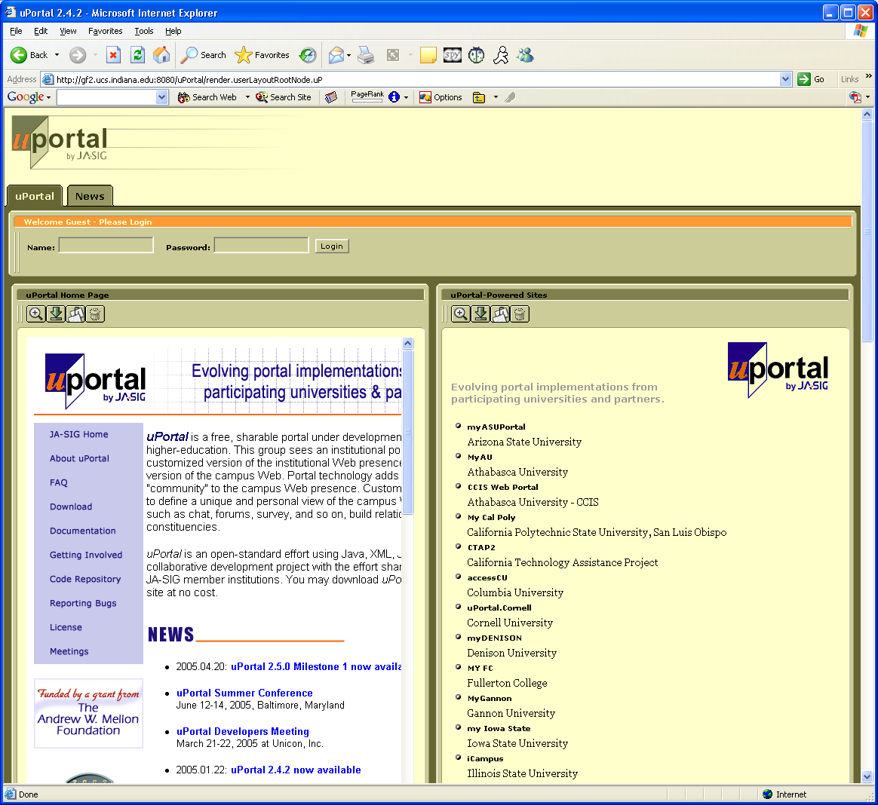
If You Made It This Far…
Fire up Tomcat on your PC
Point your browser to http://localhost:8080/uPortal
You should see uPortal.
Send me a screen shot.

Slide 10
Doing Stuff with uPortal
First you will notice that you can log into uPortal and do all sorts of things, like customizing the user interface and adding “channels” or portlets.
See http://www.collab-ogce.org/nmi/ogce2-docs/uportal_info.html for examples.

Slide 11
Now Some Portlets
uPortal’s various channels are actually portlets, as we discussed in the March 30th lecture.
You can add your own portlets.
I have some sample portlets that you should install first.
  Get them here:http://www.servogrid.org/slide/GEM/NMI/OGCE2TutorialMaterial/OGCESamplePortlet.tar.gz.
  Read the README file to see how to install into uPortal.
  After you have done this, log into uPortal and make the test portlet available
  Detailed instructions are here: http://www.collab-ogce.org/nmi/ogce2-docs/uPortal_portlets.html.
When you are done, you will have a portlet application in your Tomcat’s webapp directory.
  It will be called OGCESamplePortlet

Slide 12
Now at Last
If you have made it this far, you are now ready to convert your Simpson’s Rule Web Service client into a portlet.
But how do you do this?
Well, you already have an installed portlet from the previous step. I recommend replacing my test portlet’s JSP page with your JSP page.
But there’s more
  You will need to copy over the jars and classes from your axis client to the OGCESamplePortlet directory.
    Jars go in OGCESamplePortlet/WEB-INF/lib.
    Classes go in OGCESamplePortlet/WEB-INF/classes
Shutdown tomcat while you do this. Restart and your SimpsonWrapper portlet should be available.

Slide 13
Doing It the Right Way
The previous slide provides a short cut for getting your JSP+axis stuff into a portlet.
Actually, the full way of doing this is to do the following:
  Develop the portlet code for loading your JSP, as described in the March 30th lectures.
  Compile this (along with the stub code) and create a war file.
    Use the command “jar -cf MyClient.war *” at the top level of your webapp.
  Deploy your WAR file into uPortal, as described here: http://www.uportal.org/implementors/portlets/workingWithPortlets.html.
  Add your portlet to your portal display as described here: http://www.collab-ogce.org/nmi/ogce2-docs/uPortal_portlets.html

Slide 14
How to Turn in HW5
Homework 5
  Send me URLs of your running services on the GridFarm.
  Send me a screen shot of your JSP client that shows it working
    Should be able to display the Simpson run results.
  Zip up your client code, put it on your web server, and send me the URL so that I can download it.

Slide 15
How to Turn in Homework 6
Send me a screen shot of your uPortal installation.
  You should do this for partial credit, before attempting the portlet installation.
Send me a screen shot that shows me that you have installed the sample portlets.
  Do this for partial credit.
Send me a screen shot that shows you have converted your SimpsonWrapper client JSP page from homework #5 into a portlet.

