Slide 1

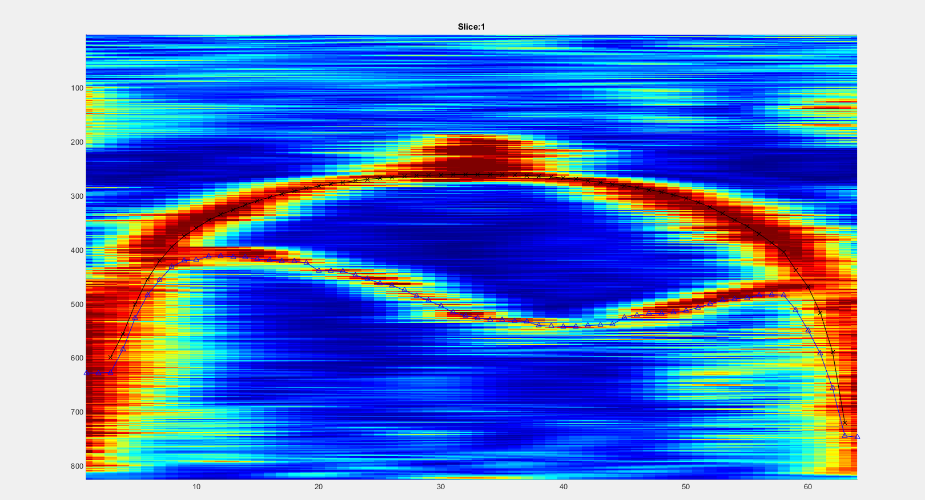
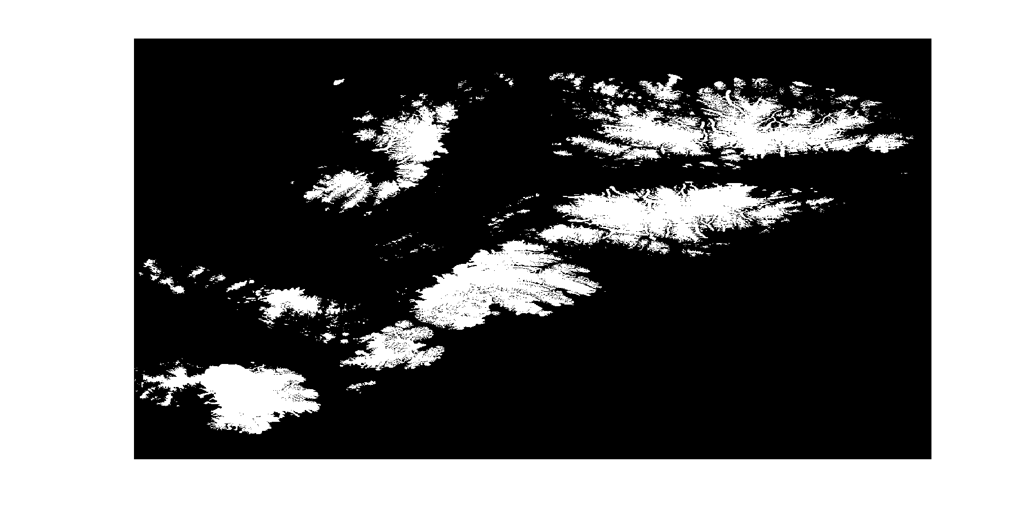
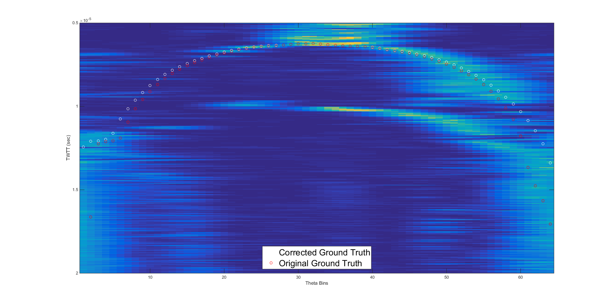
3D Radar Imaging of Canadian Archipelago Glaciers
Jordan Sprick, John Paden, Sravya Athinarapu, Mingze Xu
Jordan Sprick
The University of Kansas, Lawrence, Kansas
Introduction:
A CReSIS echogram data is collected in three spatial dimensions: nadir (below aircraft), along-track (along flight path), and across-track (perpendicular to flight path). The tradition CReSIS layer tracker places points in the along-track dimension, but now, in order to improve layer results, across-track dimension layer tracking is desired. Significant steps have already been made in developing an automatic layer tracker in this dimension. My work will help to improve these results by creating an ice mask and correcting estimated direction of arrival (DOA) error used to model a ground truth.
The ice mask is a file containing data on whether a surface has or does not have visible ice. This information can be applied so that merging of the surface layer and ice layer in the tracker becomes more likely when the ice mask presumes the presence of ice on the surface.
The predicted DOA of signals received by the radar is important in the creation of a ground truth which is used by the tracker as a reference when tracking the surface layer. Using GPS data collected from the flight and referencing the surface elevation data of the digital elevation model (DEM) collected by satellite, the surface location of the radar returns could be estimated by projecting lines from the location of the plane at given DOA angles and finding the point at which the line intersects the DEM. Any inaccuracies in the predicted DOA angles will cause inaccuracies in the intersection on the DEM and, subsequently, the derived surface location being referenced by the tracker.
To perform this file conversion, Matlab tools were used to create flat projections of both the DEM file and the ice mask shape file. A Matlab function was then applied to each pixel of the DEM, determining whether said pixel laid within a polygon of the ice mask. A value was assigned to each pixel according to whether or not it laid within a polygon.
DIRECTION OF ARRIVAL CORRECTION:
Because of non-idealities and environmental disturbances such as the aircraft carrying the radar, the estimated DOA of incoming signals was inaccurate. Because of this inaccuracy, calibration of the DOA values was required in order to create an acceptable model of the ground truth, derived from the DEM.
To correct for this error, the surface elevation collected from the DEM using the predicted DOAs was compared against the radar returns. Here it is assumed that surface elevations from the DEM would match the radar returns given that the correct DOAs were used when deriving the DEM surface elevations. The DOA error was estimated using a single data frame containing 3332 slices (along track bins). For data points in the DOA dimension in each slice, the distance in angle between the DEM estimated surface and the radar estimated surface (estimated by the nearest point of maximum intensity) were collected. The error for each DOA estimation was averaged through every frame. This mean error was then removed from each DOA estimation.
In both pre-corrected data sets, the error is the greatest at angles furthest from nadir and settles at smaller angles. After DOA correction, it appears that the majority of angular error far from nadir has been compensated for.
A positive error bias appears to be present in each data set both before and after DOA correction. The positive bias is prominent because of the method used to find the angular error. Because, in pre-corrected data sets, the DOA error always appeared to be predominantly in the increasing DOA amplitude direction, intensity maximums were only sought in the increasing DOA amplitude direction. Therefore no error was found in the negative direction and any error found would be additive.
Visually, when applied to slices of data. The ground truth appears to follow the radar’s ground measurement significantly better. The ground truth resulting from the DOA compensation is plotted below along with the original ground truth values.
Results and Discussion:
ICE MASK:
An ice mask raster file was successfully created and can be seen below where the white and black pixels correspond to surface ice and no surface ice, respectively. The ice mask has yet to be integrated into the automatic layer tracker.
Auto-tracked echogram slice seen from slice browser.
Objectives:
ICE MASK:
Produce an ice mask file that can easily be integrated into pre-existing functions
Apply the ice mask data to radar data.
DIRECTION OF ARRIVAL CORRECTION:
Remove angular error from the DOA estimation.
Ensure that DOA correction produces acceptable ground truth data to be referenced by the tracker.
Ice mask raster
DIRECTION OF ARRIVAL CORRECTION:
The DOA corrections made seem to have adjusted the ground truth data favorably. After finding the mean DOA error and making the DOA corrections, the corrected DOA values were used to find new ground truth values. In order to ensure that these new, DOA compensated ground truth values were an improvement, they were run through the same DOA error detection processes as the original ground truth values. The mean DOA errors for before and after calibration for two different frames of data are shown below.
Methods:
ICE MASK:
The ice mask file was derived from a shape file. The polygons of the shape file represented areas of the Canadian Archipelagos with surface ice. In order to streamline this portion of processing, the ice mask was to be used in conjunction with a DEM which is referred to when seeking surface elevation data. Because of this, the desired format of the ice mask was a raster file suited to the DEM file rather than a shape file.
Shows pre and post-DOA compensated ground truths
References and Acknowledgments:
[Arendt, A., T. Bolch, J.G. Cogley, A. Gardner, J.-O. Hagen, R. Hock, G. Kaser, W.T. Pfeffer, G. Moholdt, F. Paul, V. Radic, L. Andreassen, S. Bajracharya, M. Beedle, E. Berthier, R. Bhambri, A. Bliss, I. Brown, E. Burgess, D. Burgess, F. Cawkwell, T. Chinn, L. Copland, B. Davies, H. De Angelis, E. Dolgova, K. Filbert, R. Forester, A. Fountain, H. Frey, List all. 2012, Randolph Glacier Inventory [v2.0]: A Dataset of Global Glacier Outlines. Global Land Ice Measurements from Space, Boulder Colorado, USA. Digital Media.

