Slide 1
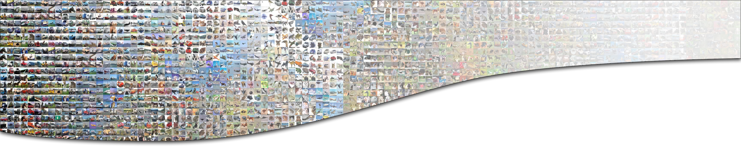

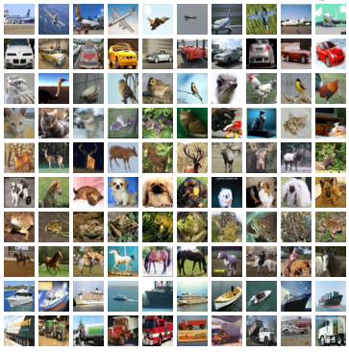
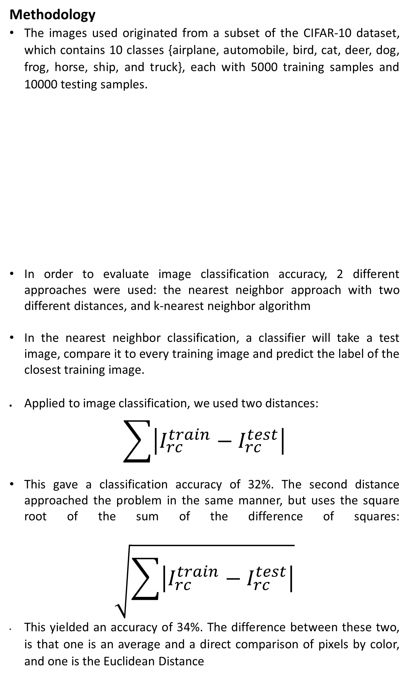
Evaluating Techniques for
Image Classification
Richmond Adjei¹, Jerome E. Mitchell², and Geoffrey Fox²
¹Indiana University – Purdue University Indianapolis and ²Indiana University
K-Nearest Neighbor
Another algorithm that we chose to use is the K nearest neighbor algorithm. This is a machine learning algorithm that detects the k nearest images
-- for our algorithm we chose to examine the following k: 1, 5, 7, 11, 15, 30, and 50 with the euclidean distance equation
The accuracy of the KNN classifier depends on the k value, and the distance algorithm.
Figure 1: k-Nearest Neighbor accuracy with varying number of k
In order to tune the parameters of the model, we used a validation set, which is a split of our training set. For example, using our CIFAR-10, we could allow 49,000 for training and 1,000 for validation
Conclusion
Image classification is a challenging problem in computer vision and has wide applicability in object detection and segmentation
We used a subset of the CIFAR-10 dataset, which consist of 10 classes with training and testing examples
We evaluated 2 classifiers, namely nearest neighbor, and k-nearest neighbor. K-nearest neighbor performed significantly better when k > 1.
Abstract
Image classification describes the problem of allowing a computer to recognize objects from an image, and although it has become a challenging problem, considerable work has been done to improve its accuracy
We present a comparative evaluation of 2 classifiers, namely Nearest Neighbor (with two different distance equations) and k-nearest neighbor, for determining accuracy from a CIFAR-10 dataset, where each image has one of ten distinct classes composed mostly of objects and animals
Our results suggest the k-nearest neighbor classifier performed better than the nearest neighbor when k > 1
Introduction and Challenges
The image classification problem is a major problem in computer vision and has a large variety of practical applications, such as object detection and segmentation.
The Image Classification Process:
1. Input:. The input consists of a set of N images, each labeled with K distinct classes -- training set
2. Learning: Process uses training set to learn the classes -- training a classifier
3. Evaluation:. Determine the quality of the classifier by predicting labels for a new, unseen set of images and compare it with labeled images (ground truth)
The task of recognizing an image is effortless for a human to perform but can be difficult for a computer vision algorithm because of the following associated challenges:
1. Varying Viewpoints: an object in an image can be oriented in many ways with respect to a camera
2. Background Clutter: the objects in an image may blend into their environment, allowing it difficult to identify
Methodology
The images used originated from a subset of the CIFAR-10 dataset, which contains 10 classes {airplane, automobile, bird, cat, deer, dog, frog, horse, ship, and truck}, each with 5000 training samples and 10000 testing samples.
In order to evaluate image classification accuracy, 2 different approaches were used: the nearest neighbor approach with two different distances, and k-nearest neighbor algorithm
In the nearest neighbor classification, a classifier will take a test image, compare it to every training image and predict the label of the closest training image.
Applied to image classification, we used two distances:
$$\sum{\left|I_{rc}^{train}−I_{rc}^{test}\right|}$$
This gave a classification accuracy of 32%. The second distance approached the problem in the same manner, but uses the square root of the sum of the difference of squares:
$$\sqrt{\sum{\left|I_{rc}^{train}−I_{rc}^{test}\right|}}$$
This yielded an accuracy of 34%. The difference between these two, is that one is an average and a direct comparison of pixels by color, and one is the Euclidean Distance
k | 1 | 5 | 7 | 11 | 15 | 30 | 60
accuracy | 34.7% | 34.9% | 35% | 33.7% | 33.2% | 33.2% | 30.6%
Acknowledgment
We like to express our gratitude to Dr. Geoffrey Fox for giving us the opportunity to work in his lab this summer. We also would like to thank the School of Informatics at Indiana University Bloomington and the IU-SROC Director Dr. Lamara Warren

