Slide 1
Developing Grid Portals Using Portlets
Marlon Pierce
Community Grids Lab
Indiana University

Slide 2
Today
Geoffrey will be back next week and will return to the MPI lectures.
In my previous lectures, I discussed Web Services and how they may be used to convert MPI programs into remote applications.
Today, I am going to cover briefly several topics.
  Modern portal architectures (homework)
  Portlet standards (homework)
  Simplifying portal builds with Maven (free advice)
  Testing portals with HttpUnit and JMeter (free advice)

Slide 3
The Big Picture, Again
Browser
HTTP
Tomcat + Web Portal
Homework 5b
Portlet
Portlet
WS Client
WS Client
SOAP+HTTP
Homework 5a
Tomcat+Axis
MPI Web Service
Homework 4
MPI Code

Slide 4
What is A Web Portal?
It is a collection of dynamic web pages that
  Provide personalized Web content
  Provide access to specific resources like RSS news feeds.
  Remember your preferences (via permanent Cookies or login).
You can build portals yourself from scratch using Java, Perl, Python, etc.
However, Web Portals are complicated and typically built from portal building toolkits.
  WebSphere from IBM, for example.
  uPortal, Jetspeed, eXoPortal, Gridsphere are all open source examples.
  Zope is a Python example

Slide 5
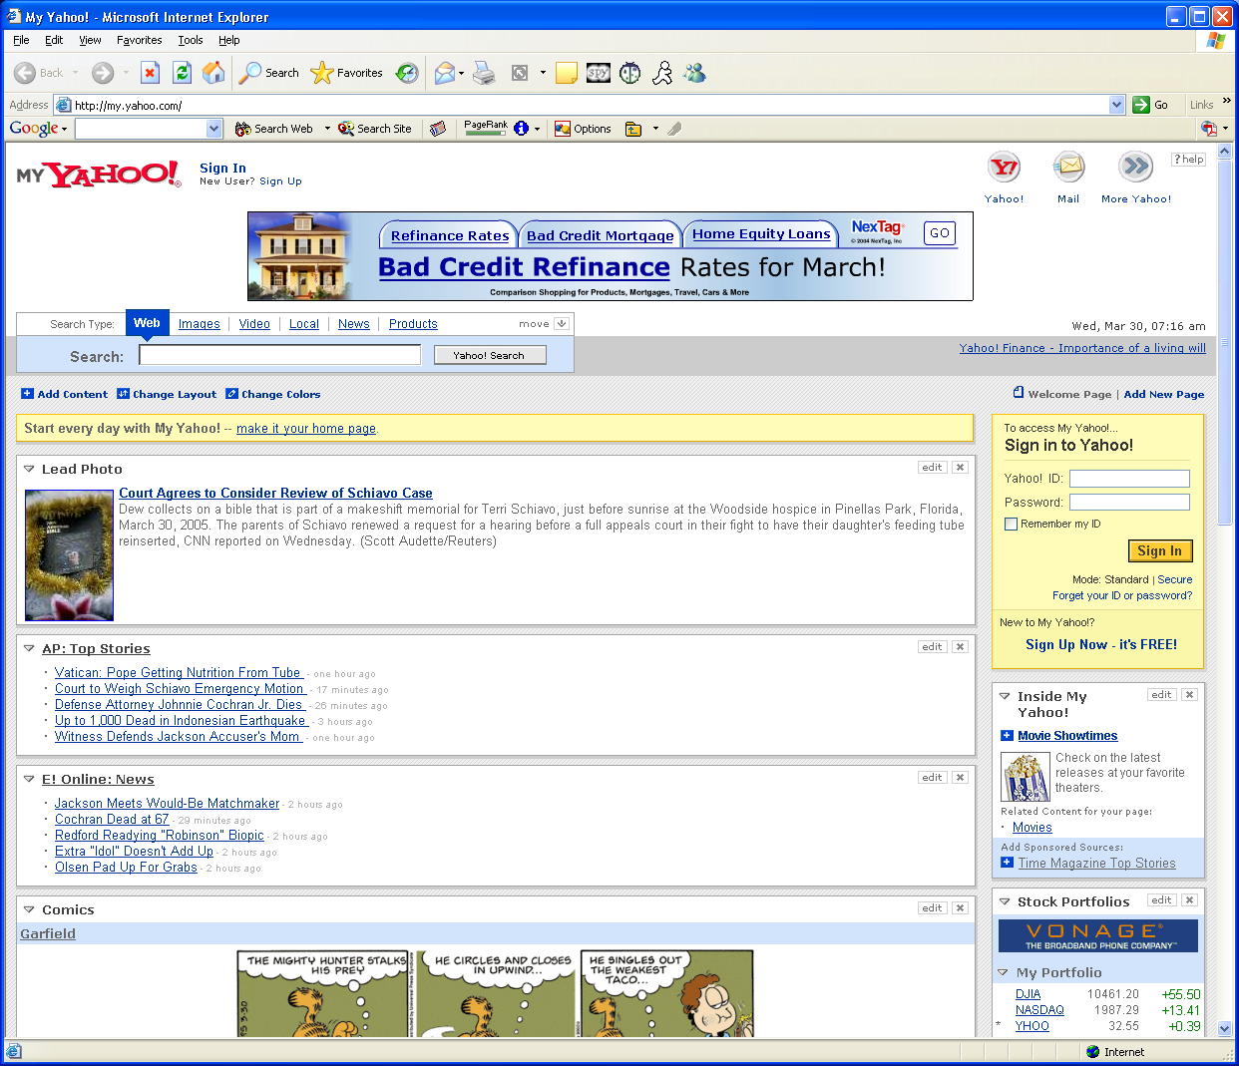
A Famous Portal

Slide 6
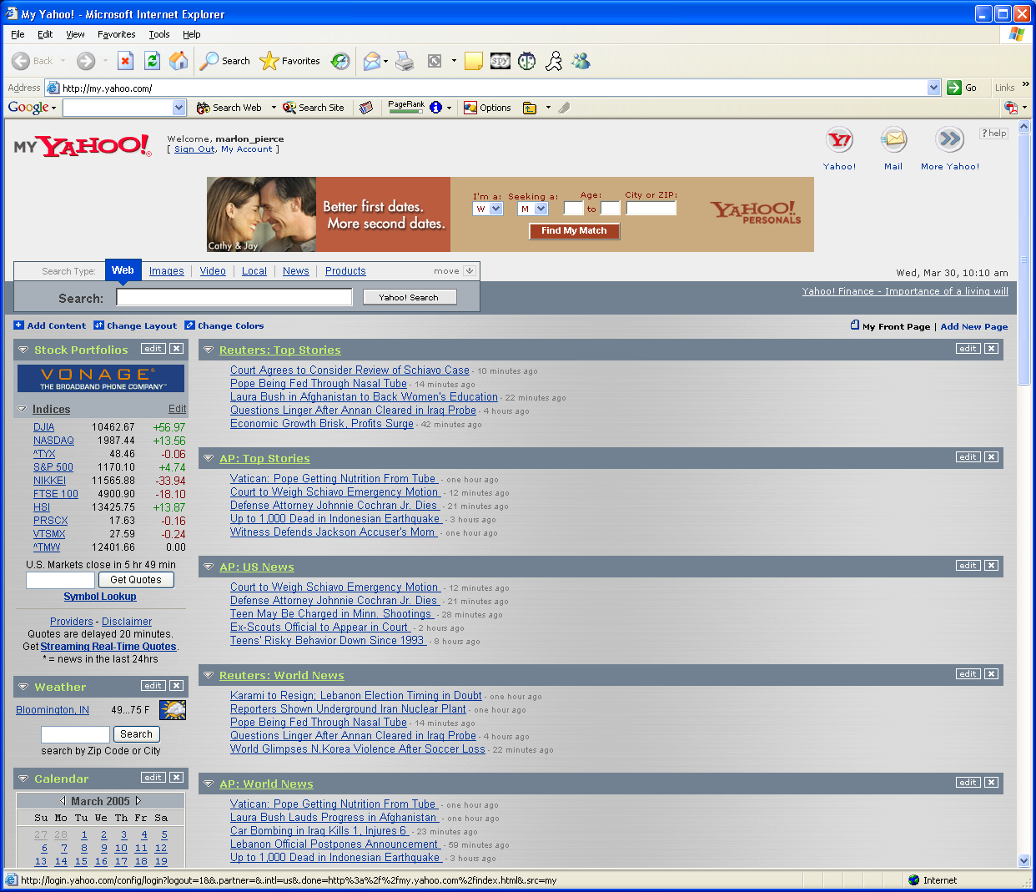
A Famous Portal, After Login

Slide 7
What to Notice
After logging in, my colors, layouts, and content all changed.
  I get my stock list, my Bloomington weather, my news stories, etc.
  I got rid of “Garfield”
As we will see later, each of these content fragments (encircled) is managed by a thing called a portlet…
  … I don’t guarantee that this is true for Yahoo’s web site but it is true for a large class of enterprise Java portal systems.

Slide 8
What Is a Grid Computing Portal?
Yahoo is an example of an information portal.
  Data driven.
Grid Computing Portals have similarities and differences.
  The basic portal capabilities (login, customization, personalization) are the same.
  But they are driven by science applications and scientific data instead of news feeds.
Browser based user interface for accessing grid and other services
  “Live” dynamic pages available to authenticated, authorized users.
  Use(d) Java/Perl/Python COGs
  Manage credentials, launch jobs, manage files, etc.
  Hide Grid complexities like batch job submission with RSL
  Can run from anywhere
  Unlike user desktop clients, connections go through portal server, so overcome firewall/NAT issues
Combine “Science Grid” with traditional web portal capabilities
  Get web pages for news feeds
  Post and share documents
  Search engine interfaces, calendars, etc.
  Enabled by portlets, as we will see.
Customizable interfaces and user roles/views

Slide 9
What a Grid Portal Is/Is Not
It is
  A tool for aggregating and managing web content
  A user customizable view of these Web content pieces.
    You see what you want/can see.
    But you must log in.
  Implemented on top of standard services
    Like login, authorization, customization.
    May include collaboration, etc, that depend on login.
  A way to accomplish Grid tasks through browsers:
    Launch, monitor jobs
    Move files
    Run science applications based on these services.
  Compatible with emerging standards and best practices (such as portlets, JSR 168 and WSRP).
It is not (just)
  A web page
  A collection of links
  An applet
That is, it involves at least as much coding as HTML authoriing.

Slide 10
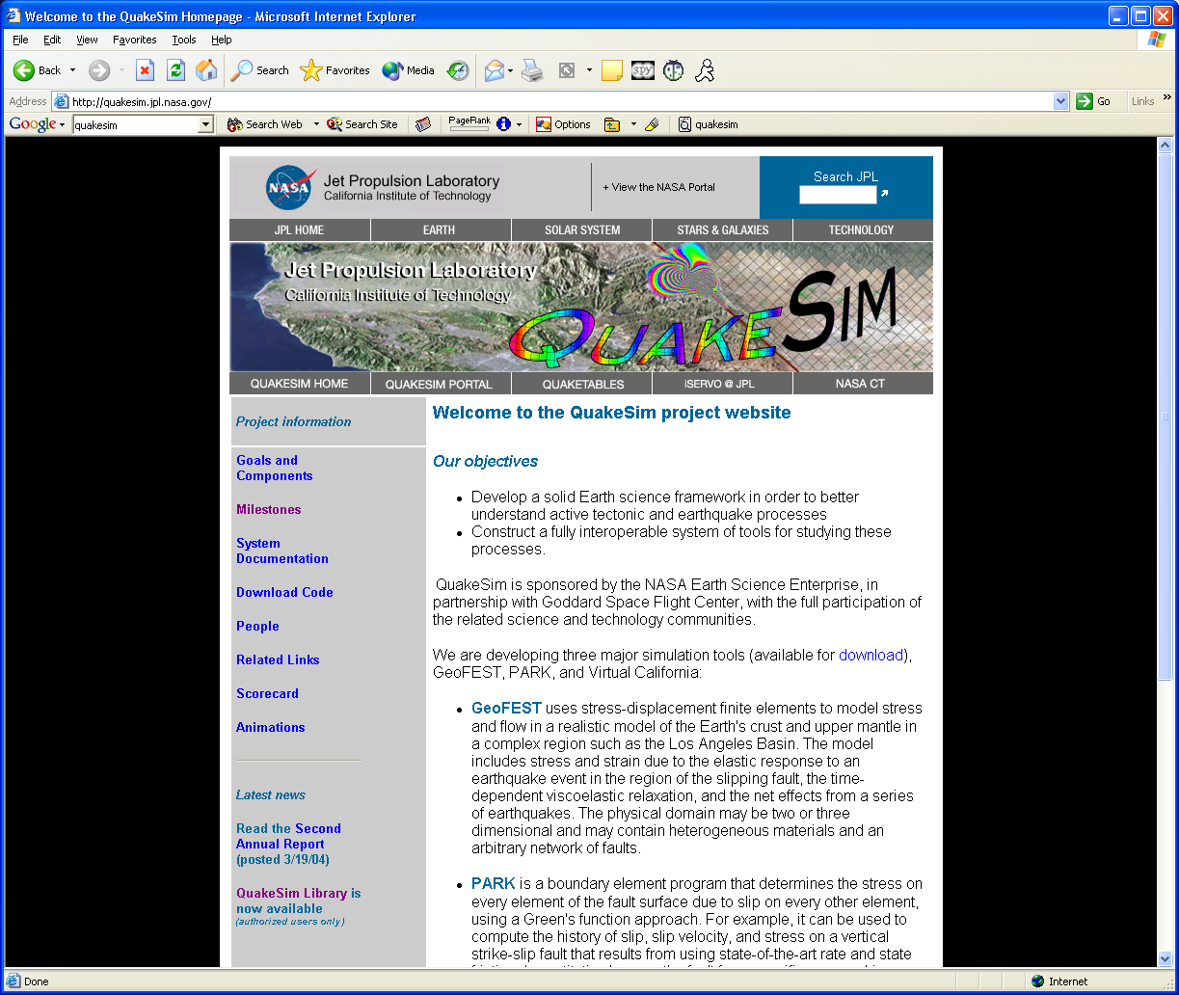
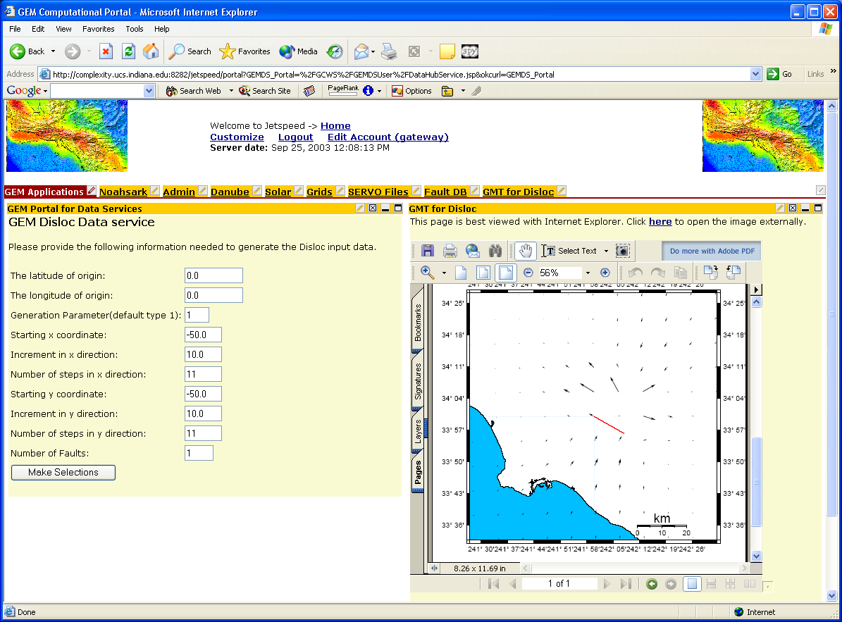
Which Is the Portal?

Slide 11
Which Is the Computing Portal?
In fairness, the screenshots are not large enough to see, but you have to log in to the one on the right.
  Point is that they are superficially similar to browser users, but have many differences under the hood.
The screen shot on the left is of the NASA JPL QuakeSim project page.
  http://quakesim.jpl.nasa.gov/
The screen shot on the right is the NASA JPL QuakeSim portal.
  http://www.complexity.ucs.indiana.edu:8282
  Go here to run QuakeSim earthquake simulation codes, access earthquake databases, etc.

Slide 12
Let 10,000 Flowers Bloom
Many portal projects have been launched since late ’90s.
  HotPage from SDSC, NCSA efforts, DOD, DOE Portals, NASA IPG
  2002 Special Issue of Concurrency and Computation: Practice and Experience.
Continue to be important component of many large projects
  NEESGrid, DOE SciDAC projects, NASA, NSF, many international efforts
Global Grid Forum’s Grid Computing Environments (GCE) Research Group
  Community forum

Slide 13
Three-Tiered Architecture
Grid and
Web
Protocols
JDBC,
Local, or
Remote
Connection
Portal User Interface
Portal
Client
Stub
Database
Service
Database
Portal
Client
Stub
Grid Resource
Broker Service
HPC
or
Compute Cluster
Portal
Client
Stub
Information
and
Data Services
Grid Information
Services, SRB
Three-tiered architecture is accepted standard for accessing Grid and other services
Notes:
This three-tiered architecture is depicted above. The figure greatly simplifies most portal systems described in [33] but serves as a conceptual illustration. The portal interface consists of Web interfaces that work with remote services through the service tier. The portal (presentation) layer not only must manage user information but also maintains “client stubs” that interact with a usually remote service tier. In the figure, the top-most horizontal thread illustrates a typical three-tiered scenario from e-business, in which the portal contacts the remote database through a client-server system. The server in turn contacts the database. The middle thread indicates a second user portal scenario in which a “portal client stub” accesses a Grid service through a standard Grid protocol. This service (such as a resource broker accessed through GRAM) in turn spawns a job on a High Performance Computer (HPC) system. The final thread illustrates portal access to Grid specific data and information services such as the Storage Resource Broker (SRB) [44] [45].
This architecture has been widely adopted, and from this we conclude that computing portal architectures are well established, with a range of standard services for accessing the Grid through such systems as the Java [46] and Perl [47] CoG kits.

Slide 14
Problem with Portals
GCE revealed two things
  Everyone was doing the same thing
    Not quite, but significant
    Everyone builds secure logins, remote file manipulation, command execution, access to info servers.
    Everyone would at least like support for multiple user roles (administrators, users) and customization
  No one could share components with other groups
    No well defined way of sharing UI components or making services interoperate.
    No well defined interfaces to portal services.
A research opportunity!
  Two levels of integration: user interfaces and services
Our challenges
  Stop reinventing things and provide ways for groups to reuse components.
  Provide a portal marketplace for competing (advanced) services.
  Provide APIs for service integration

Slide 15
A Solution Based on Components
A software component is object defined by
  A precise public interface
  A semantics that includes a set of “standard” behaviors.
A Software component architecture is:
  A a set of rules for component behavior &
  A framework in which components can be easily installed and interoperate.
The component architecture of choice for the Portal community is the one based on portlets
We have now many, many components.
  So don’t start from scratch.

Slide 16
Portlets as Components

Slide 17
Portals and Portlets
Previously we described the reusability/interoperability problem of portals.
  If I build a weather forecast application, how do I share it with you?
  Remember, the weather component is customized to my preferences.
    I want Bloomington, you may want Piney Woods
The answer is to build portals out of pluggable components, called “portlets”.

Slide 18
Portlet History
I first learned about portlets in early 2002 from Jetspeed.
  Apache Open Source project
IBM WebSphere, BEA WebLogic had their own implementations.
uPortal (for universities) had a similar concept they called “channels”.
It soon became apparent that these implementations needed to be replaced by a common solution.
JSR 168, from the Java Community Process, provides the standard.
  Pluto (from Apache Jakarta but implemented by IBM) is the reference implementation.

Slide 19
But What Is a Portlet?
A portlet is a piece of Java code that manages the content of one section of a web portal’s HTML.
It can do anything else that a Java web application can do.
  You can connect a portlet to a database, invoke a web service, download an RSS feed, etc.
It lives in a Web Portlet engine, which creates, manages, and destroys all the portlets of the portal.
JSR 168 standardizes two main things:
  How the portlet container manages portlet lifecycles
  How the portlets are programmed.

Slide 20
JSR 168 Tutorial
A General Review of JSR 168 with uPortal Examples

Slide 21
What is JSR 168?
From the portlet development point of view, it is really very simple:
  You write a java class that extends GenericPortlet.
  You override/implement several methods inherited from GenericPortlet.
  You use some supporting classes/interfaces
    Many are analogous to their servlet equivalents
    Some (portletsession) actually seem to be trivial wrappers around servlet equivalents in Pluto.

Slide 22
Some Terminology
Term | Definition
Portlet | Java code that manages a piece of web content and which may invoke services.
Portlet Container | Manages the lifecycle of the portlets (inits, invokes,destroys).
Portal | Displays the portal content provided by the container. The portal is responsible for the actual layout.
Portlet Application | A webapp containing a group of related portlets, content, supporting jars, etc.

Slide 23
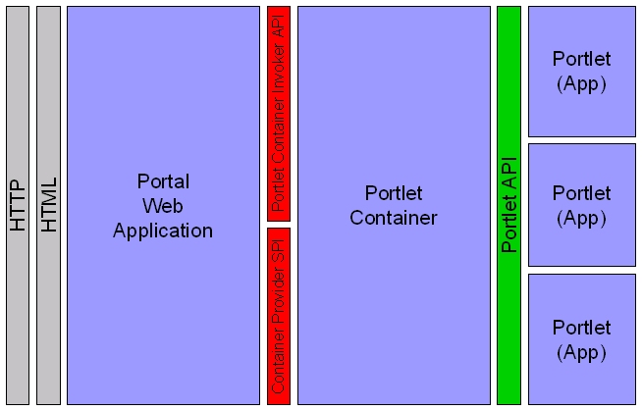
The Big Picture
As a portlet developer, the previous set of classes are all you normally touch.
The portlet container (Pluto) is responsible for running your portlets.
  Init, invoke methods, destroy.
Portlets have a very limited way of interacting with the container.
  The API is basically one-way.
  Portlets can’t learn much or interact with their container.

Slide 24
Some Generic Portlet Methods
Method | Description
Init | Called when the portlet is created. Override if you need to set initial params.
doView | Controls what happens immediately before the portlet is displayed in view mode. Normally you override this.
doHelp, doEdit | Other portlet display modes
processAction | Place for handling any <form> actions before turning over to the display mode method (like doView). You should override this for web forms.

Slide 25
Some Supporting Classes/Interfaces
Class | Description
PortletContext | Similar to servlet context; get context info and the RequestDispatcher from here.
PortletSession | Stores attribute information for a single portlet application across multiple requests.
RenderRequest, RenderResponse | The request and response objects available to the doView() method. Similar to the normal servlet request
ActionRequest,ActionResponse | The request and response objects available to the processAction() method. Similar to the servlet request and response objects.
PortletURL | Use this to create URLs that reference the portal.
PortletRequestDispatcher | Use this to include/forward to a JSP or servlet in the same portlet app.
WindowState | See if you are in minimized, maximized, normal state.

Slide 26
So How Do You Write a Portlet?
First, you need to download a portlet-based portal system.
  Your portlet will run in here.
  GridSphere and uPortal are two open source examples.
Next, write a portlet application.
  Consists of Java code, Portlet.xml, web.xml files.
  We will look at this next.
Usually you couple your portlet application to a set of JSP pages or similar.
  Use JSP to generate the HTML
  Use portlets to handle form actions and link clicks.
Finally, deploy the portlet in your portal container.
  Varies between containers.

Slide 27
In Action: Get started.
public class JunkPortlet extends GenericPortlet {
public void init(){
//Do any initialization.
}
//Rest of the methods on following slides go here.
…
}

Slide 28
Override doView()
protected void doView( RenderRequest req, RenderResponse res)
throws PortletException, IOException {
//Include the desired JSP or HTML page.
//We could also use out to write directly to the response.
WindowState state=req.getWindowState();
if(!state.equals(WindowState.MINIMIZED)) {
res.setContentType("text/html");
PortletRequestDispatcher rd=
getPortletContext().getRequestDispatcher(“MyJSP.jsp”);
rd.include(req,res);
}
}

Slide 29
The JSP Page
<portlet:defineObjects/>
<%
PortletSession portletSession=renderRequest.getPortletSession();
portletSession.setAttribute("localattname","localattval");
PortletURL url=renderResponse.createActionURL();
String theActionString=url.toString();
%>
HTML Content is here.
A form is below.
<form method=post action="<%=theActionString%>">
<input type=…>
</form>

Slide 30
Some Notes
Include the <%portlet:definedObjects/%> tag, which will instantiate renderRequest, renderResponse, and portletConfig objects.
  You can then just use them, as with request, response, and other JSP implicit objects.
The renderRequest gives you access to the PortletSession, if you want to store session variables.
  One of the trouble points.
The renderResponse gives you access to the PortletURL object.
Use the PortletURL to generate a URL for the <form action>
  So that it points to portlet container and gets handled by the processAction() method, rather than going of into space.
  Handle href URLs similarly.
  This is one of the sticking points.

Slide 31
Lastly, Override processAction()
When you invoke the form on the previous JSP, the portlet container will pass the action handling to the processAction method.
The ActionRequest can be used to get any of the <input> parameters in a way similar to the usual HttpServletRequest.
When the processAction method returns, the container then invokes the appropriate do method (usually doView).
If you need to pass <form> parameters on to doView, add them to the ActionResponse.
  This will give them to the RenderRequest.
  The example shows how to add ALL parameters.
public void processAction (ActionRequest request, ActionResponse actionResponse) throws PortletException, java.io.IOException {
//Process request parameters
…
//Add any other request params
// to the renderRequest
actionResponse.setRenderParameters(request.getParameterMap());
}

Slide 32
A Final Comment on Portlet Coding
The above example makes some important and dubious assumptions
  Developers want to write a GenericPortlet extension for every single portlet they develop.
    And write really complicated processAction() and doView() methods.
  Developers will like the specific JSR 168 portlet-style MVC that it forces on them.
  Developers will gladly ignore other development methodologies/frameworks like Velocity, Struts, and JSF.
Fortunately, we can develop bridges that allow you to develop with other tools and avoid writing lots of specialized portlet code.
  We (OGCE) have developed support for Velocity, yet another Apache Jakarta project for web application development.
  Java Server Faces will probably be the preferred way in the future.
  Jakarta Struts plans to support portlet developments
    http://struts.apache.org/status.html

Slide 33
Deploying Portlet Applications
The portlet container (i.e. uPortal) runs as a distinct web application.
  That is, it has its own directory in tomcat.
  Moreover, it runs as a separate context, with its own classloader, session management, etc.
Portlet applications are deployed as distinct war files/web applications.
  You go through the container webapp to get to the portlet webapp.
  Portlets in the same application share jars, classes, and runtime stuff like request and session variables.
  Portlets in different portlet apps do not share anything.
JSR 168 containers vary in the specifics of their deployment procedures.

Slide 34
Web.xml
Web.xml is the standard place to put webapp configuration for servlets/jsp.
JSR 168 containers need a special servlet that can handle cross-webapp communication.
  This is typically configured in each portlet app’s web.xml file.
  This is portal vendor-specific.
For uPortal installation, you don’t have to worry about these details.
  uPortal has a tool to read the web.xml you give it and add in the additional required XML tags.
  You can examine the changes in the OGCESamplePortlets webapp.

Slide 35
A Homework Pre-Assignment
I have a simple portlet example available from http://www.servogrid.org/slide/GEM/NMI/OGCE2TutorialMaterial/OGCESamplePortlet.tar.gz.
You will need to also install Tomcat, Maven, and uPortal to play with it.
See also later slide for more resources.

Slide 36
Simplifying Portlet Deployment with Maven
Some advice on making your life simpler.

Slide 37
The Maven Way
Maven is a very powerful build/deploy tool.
Compared to Apache Ant, it has many more built-in functions (“goals”)
  Essentially, you avoid writing a lot of Ant build.xml boilerplate for common tasks like compiling code, making javadocs, and creating wars.
  Also helps you manage jar dependencies.
  Just use a common directory structure.
If you need to do custom things, create Maven scripts that just call Ant or Jelly.

Slide 38
Using Maven in Portlet Development
First, create a standard directory structure.
  See right
Project.xml is a maven file that defines your project.
Put all your application under src.
Put all java code under src/java.
  Use package dir structure
Images, HTML, JSP, etc. go under the webapp directory.
Put unit tests under the tests directory.
MyProject/project.xml
MyProject/src/java/
MyProject/src/webapp/jsp
MyProject/src/webapp/WEB-INF/web.xml
MyProject/src/webapp/WEB-INF/portlet.xml
MyProject/tests

Slide 39
Maven War
If you use the previous structure, all you need to do to compile everything and create a war file is type “maven war” in the MyProject directory.
This will also run any unit tests that you have placed in MyProject/tests.
The resulting war file is placed in MyProject/target/

Slide 40
project.xml, project.properties, and maven.xml
project.xml allows you to specify jar dependencies and build characteristics.
project.properties defines any variables that you want to set in project.xml.
  It also defines maven properties like the maven remote repository values.
You can also script maven using maven.xml.
  You can also beef maven goals up with Ant and/or Jelly scripts.
  Not used in the example but used extensively in the OGCE download.

Slide 41
Portlet Resources

Slide 42
Portlet Resources
uPortal is a free, Java-based, JSR 168 compliant portal geared toward universities.
  http://www.uportal.org
GridSphere is a similar, but less domain specific.
  http://www.gridsphere.org
Other free JSR 168 portals
  eXo, LifeRay, Jetspeed2 (still in cvs)
OGCE is an open source portlet developers’ consortium.
  We make portlets for uPortal and GridSphere containers.
  http://www.collab-ogce.org

Slide 43
Portal Testing with HTTPUnit
Marcus Christie and Marlon Pierce

Slide 44
Types of Unit Testing
JUnit is a great way for testing code functionality.
But how do you test portals and portlets?
  Portal interfaces need to be tested by simulated users.
    Button clicks, link clicks, form interactions, etc.
For the NMI OGCE project, we have adopted HttpUnit for this.
  http://httpunit.sourceforge.net/

Slide 45
Unique Challenges for Testing Grid Portals
Fluid GUI
Much setup required for Grid Portal
  Portal account
  Grid Software, accounts
  Reliance on external services
Broken HTML
Infinite set of user operations
  Use Cases + Simple Error Handling

Slide 46
HTTPUnit Features
Extension of Junit
  Integrates easily with Ant <junit> task
Fairly high level API
Browser emulation (cookies, JavaScript, etc.)
Includes a sloppy/quirky HTML parser (NekoHTML)

Slide 47
Setting Up Your Test
The code on the right shows the boilerplate to put at the start of your test.
We will fill in the rest of the test in the following slides.
package xportlets.tests;
import com.meterware.httpunit.*;
import junit.framework.*;
public class XPortletTestCase extends TestCase {
....
public void setUp() throws Exception {
super.setUp();
}
//Rest of the test
}

Slide 48
Testing a Login Form
The code shows how to actually write a simple form test.
Create a WebConversation object.
Use WebResponse to work programmatically with the HTML.
Use WebForm to invoke HTML <forms>
Assertions are used to test the content of the returned page.
public WebConversation xPortletAuth() throws Exception {
WebConversation wc = new
WebConversation();
WebResponse resp =
wc.getResponse(url);
WebForm form = resp.getForms()[0];
form.setParameter("username", username);
form.setParameter("password", password);
form.submit();
WebResponse resp2 =
wc.getCurrentPage();
String page = resp2.getText();
assertTrue("Failed to log in", page.indexOf("Welcome to
your workspace") != -1);
return wc;
}

Slide 49
Simulating Button Clicks
Create SubmitButton objects to simulate button clicks.
  “myButton” is the name of the submit button in the HTML <form>
Calling click() causes the form action to take place.
Get the new page from the WebConversation object.
public void testSimplePing() throws Exception {
WebConversation wc =
xPortletAuthProxy();
WebResponse resp = wc.getCurrentPage();
WebForm form = resp.getForms()[3];
form.setParameter("service", "rainier.extreme.indiana.edu");
SubmitButton addServiceBtn = form.getSubmitButton(“myButton");
assertNotNull(“myButton",
addServiceBtn);
addServiceBtn.click();
WebResponse resp2 =
wc.getCurrentPage();
WebForm form2 = resp2.getForms()[3];
}

Slide 50
Running HttpUnit with Ant
After you have developed a suite of tests, you can automate your portal tests using Ant’s optional JUnit task.
Even better, you can combine this with the <junitreport> task that will generate nice HTML report forms.
First, you will need to put these jars in ant’s lib directory.
  httpunit.jar
  junit.jar

Slide 51
An Example Unit Test Target
Let’s say all of your tests fit the pattern Test*.class.
Then run a <batchtest> to run all of them at once.
  Will run all tests
  Won’t exit on failed test.
Use errorProperty and failureProperty to catch these states.
Specify an XML formatter for pretty output (next).
<junit printsummary="true”
errorProperty="test.failed" failureProperty="test.failed">
<formatter type="xml"/>
<batchtest
todir="${report.dir}">
<fileset dir="classes"
includes="**/Test*.class"/>
</batchtest>
</junit>

Slide 52
Generating HTML dashboards
The <junitreport> target can be used to convert the report outputs from <junit>.
Use <report> to generate HTML.
Finally the <fail> message checks if any tests failed.
  See previous target.
<junitreport todir="${report.dir}">
<fileset dir="${report.dir}">
<include name="TEST*.xml"/>
</fileset>
<report format="frames" todir="${html.report.dir}"/>
</junitreport>
<fail message=“Tests failed." if="test.failed"/>

Slide 53
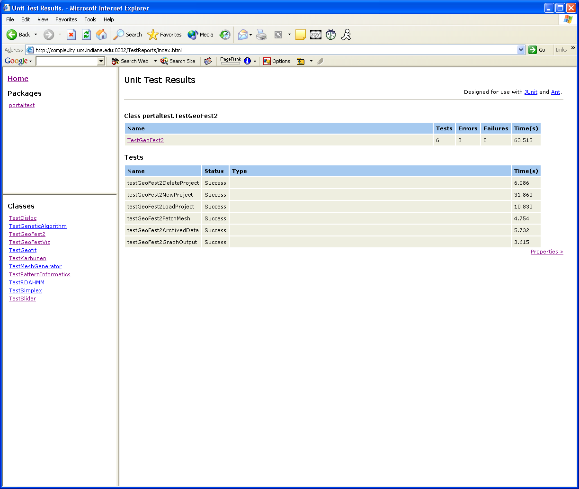
Example Report Dashboard
List of
Test Classes
Test Results for One
Of the Test Cases

Slide 54
Some Drawbacks to HTTPUnit
Tests are tied to page structures.
  If you change your page (say, reordering links or forms), you will break your tests.
Test assertions typically depend on the content of the page.
  If content changes, tests may break.
  Checking content is not completely sufficient for testing Grid portals.

Slide 55
Testing with JMeter

Slide 56
JMeter vs. HttpUnit
HttpUnit is a package for building programming tests.
  Static tests
  You have to recompile
HttpUnit has a rich assertion API.
  But you really just verify that HTML is correct.
HttpUnit tests are one-time tests.
  Does it work or not?
JMeter allows you to express tests in XML.
  Dynamic, easily changed only the fly
JMeter assertions are simpler, but in practice just as effective
  Verify returned HTML is correct.
JMeter can be used to set up stress tests
  Simulate 100 users making 5 requests per second, see when things break.

Slide 57
Setting Up and Running JMeter
Just download the binary from Jakarta
  http://jakarta.apache.org/jmeter/
  It’s in Java, so will run on Windows, Linux, Mac
  You need Java, of course.
Unpack the zip or tar.gz and type ./bin/jmeter in the jakarta-jmeter directory at the command prompt.
You will see the following…

Slide 58
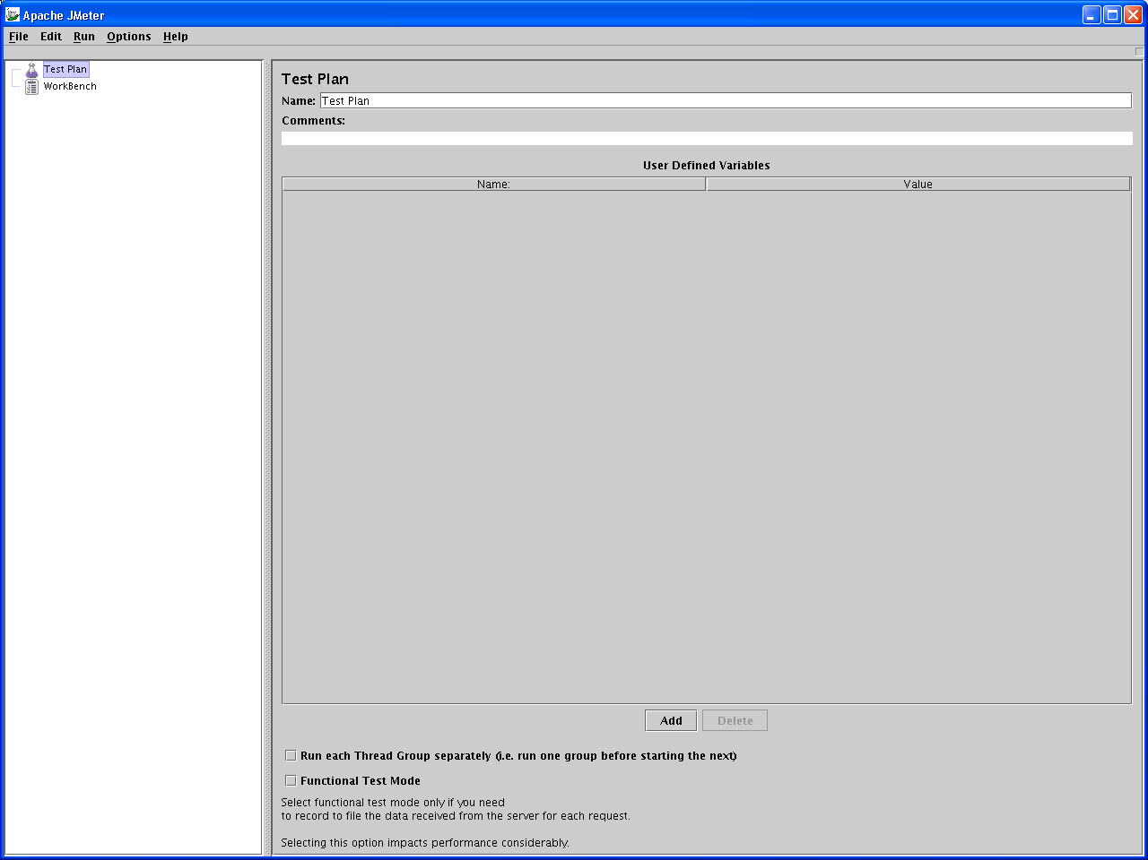
Exciting JMeter Control Panel Screen Shot

Slide 59
What Can You Do With It?
JMeter lets you set up test plans that simulate logging into a web site, filling out forms, clicking buttons, links, etc.
You can simulate the number of users doing this, the rate that they do it, and so on.
This is obviously a great way to stress-test your Web portal.
  Or you can stress test Amazon.com if you prefer.

Slide 60
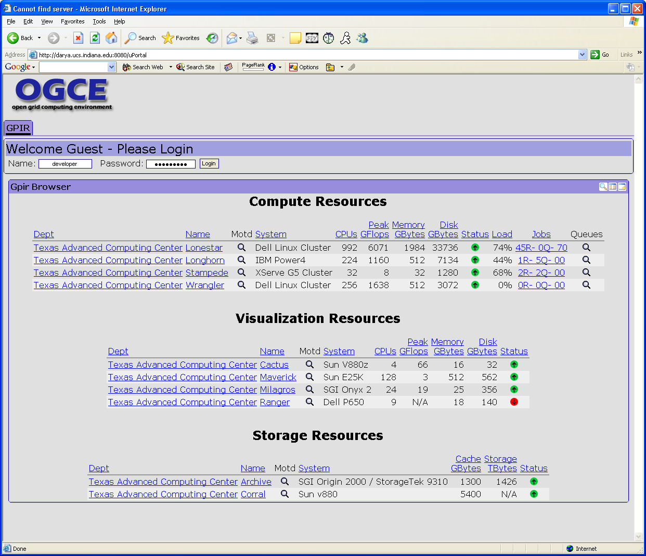
Sample Web Portal To Test
We are going to uese JMeter to simulate logging into the portal on the right and filling out some simple forms.
We can do this once to make sure that it works, then set up stress tests.

Slide 61
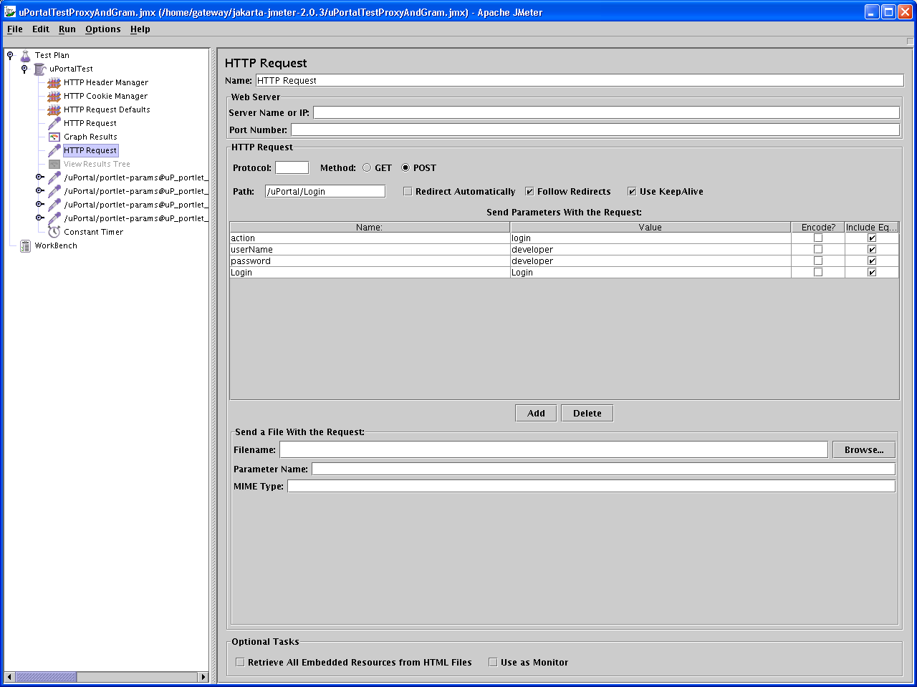
Some Test Parameters
Our test plan
Login Parameters

Slide 62
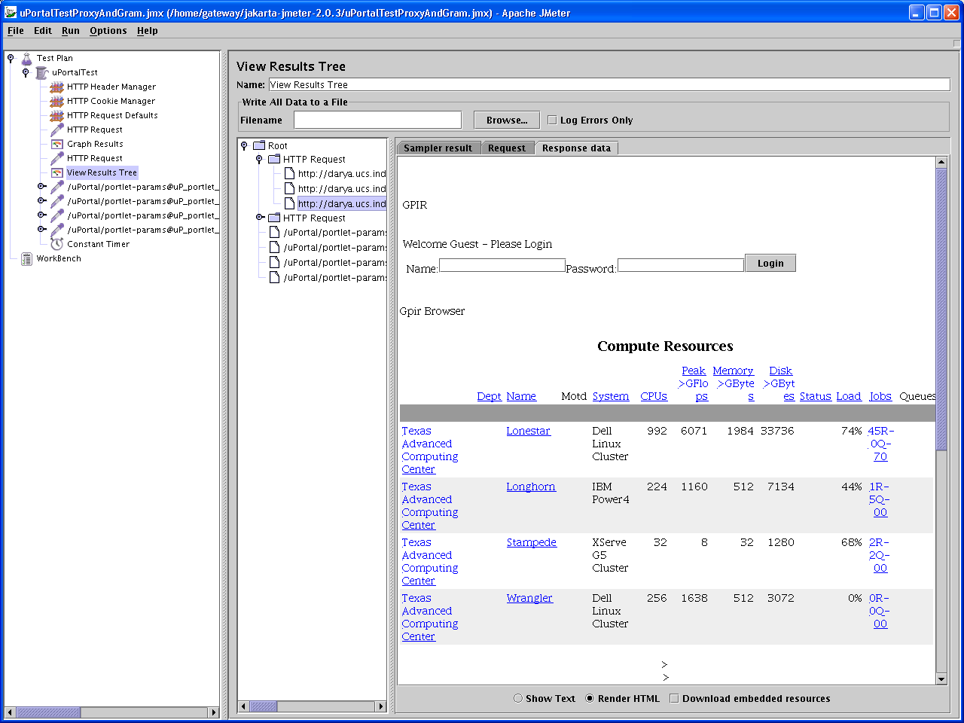
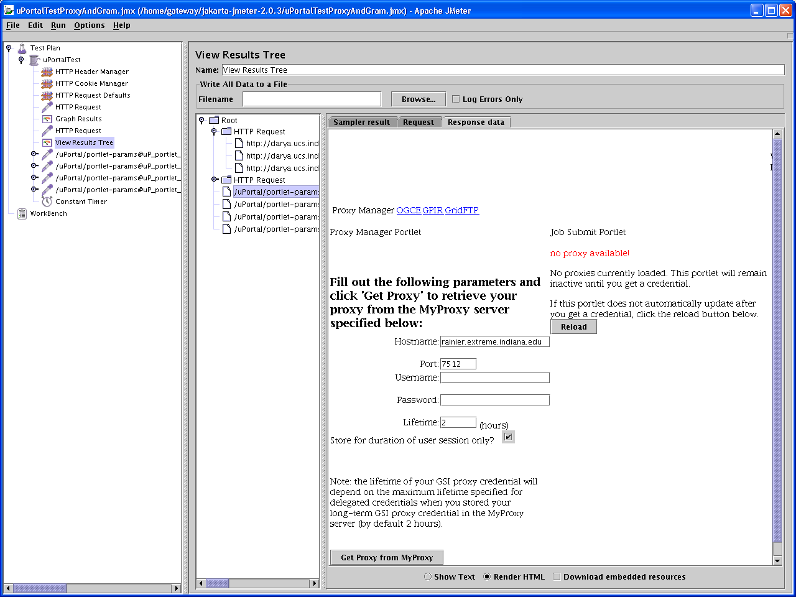
View the Results

Slide 63
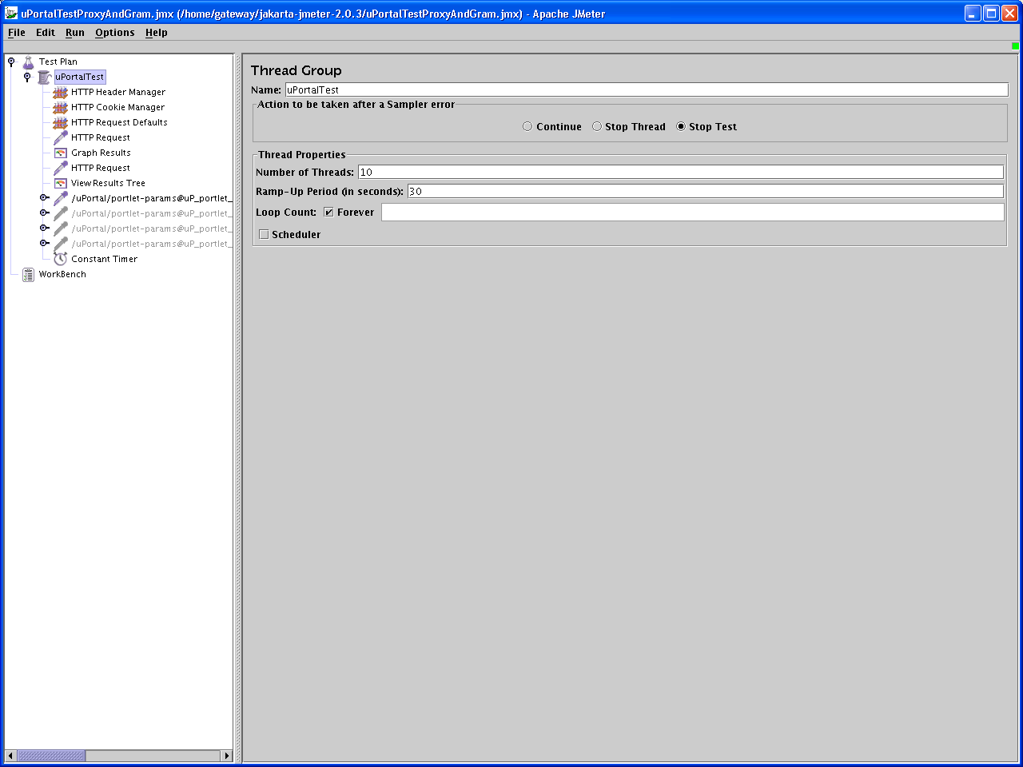
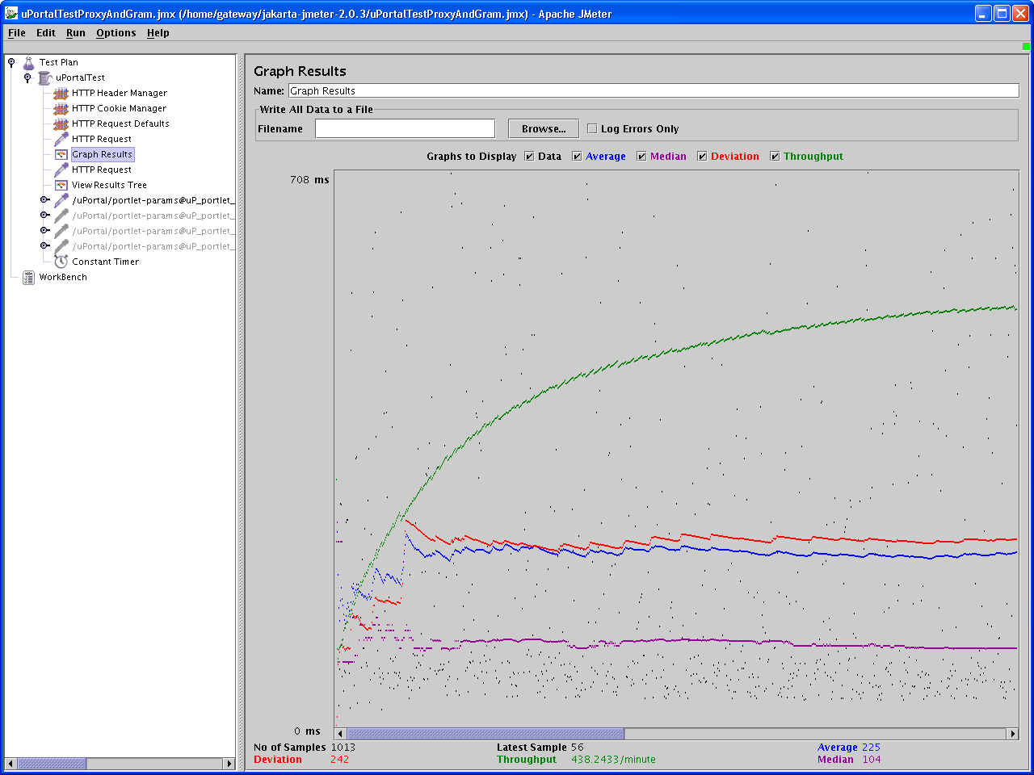
Everything’s OK, So Stress It

Slide 64
Conclusions
JMeter and HttpUnit can be used to develop tests of your web portals.
  HttpUnit tests are programs that you write, good for one-time, pass-through tests.
  JMeter tests are XML files bound dynamically to Java classes that are edited through a Swing GUI; can be used for stress testing.
JMeter can also be used for testing Web Services
  Under development.
Homework: use JMeter to launch a denial of service attack against your favorite web site.

Slide 65
OGCE: Open Grid Computing Environments
Marlon Pierce
Indiana University

Slide 66
NSF NMI Project for Reusable Portal Components: Who We Are
University of Chicago
  Gregor von Laszewski
Indiana University
  Marlon Pierce, Dennis Gannon, Geoffrey Fox, and Beth Plale
University of Michigan
  Charles Severance, Joseph Hardin
NCSA/UIUC
  Jay Alameda, Joe Futrelle
Texas Advanced Computing Center/San Diego State University
  Mary Thomas

Slide 67
Portlets and Containers
Just to emphasize this point again….
Portals are (typically)
  Web sites that support login, user and administrator customization, roles and access controls, etc.
  Modern Java portals are built out of portlet components.
Portlets are really quite simple, and mostly are used to load and manage templates based on other technologies.
  JSP, Velocity, JSF, and possibly others.
So the main ideas are
  Don’t invent your own container when many sophisticated ones exist.
  Instead, develop portlets that you can plug in to nice portal containers, reuse in your own projects, share with others.
  Reuse other people’s portlets where you can.
  But it only works if everyone works with the standards

Slide 68
OGCE Release 2
Portlets for basic Grid tasks
  Getting credentials, running jobs, moving files around, monitoring machine loads.
JSR 168 Compatibility
  This allows our new portlets to run in various containers, as long as they are 168-compliant.
  uPortal, GridSphere, plus a host of commercial products.
  Jetspeed2 someday, eXoportal, ….
Velocity support
  This is how must pre-JSR168 portlets were written.
  So we implemented this as a migration for our first portlet release.
Inter-portlet communication
  This overcomes one of the major omissions (from our point of view) of the 168 standard.
  Works independently of the container.

Slide 69
What Is OGCE’s Release 1
The OGCE Portal release is based on CHEF/Jetspeed 1.4
Available for download and installation from http://www.collab-ogce.org.
It comes with many pre-configured capabilities if you want a grid portal “out of the box”.
  Except for the mysql jar.
  You must still set up Grid services (MyProxy servers, Globus, etc).
  Globus version compatibility through the Java CoG.
Apache Ant-based installation procedure:
  Edit one properties file, run ant, and away you go.

Slide 70
User Portlets
Portal Capabilities | Description
Grid Proxy Certificate Manager | Get MyProxy certs after logging in.
Schedule | Interactive individual and group calendars
Discussion | Persistent topic-based discussion for groups
Chat | Live chat services and interfaces
Document managers | WEBDav based document system for group file sharing
MDS/LDAP Browsers | Basic Globus MDS browsing and navigating
GridContext Portlets | Access context services for managing metadata
GRAM Job Submission | Run simple executables on remote hosts
GridFTP | Upload, download, crossload remote files.
GPIR Portlets | View, interact with HPC status, job, etc information.
Anabas | Access to Anabas shared display applets
Newsgroups and citation portlets | Post topics to newsgroup, manage group references and citations with access controls

Slide 71
More User Portlets and Services
Portal Capabilities | Description
CoG Workflow demonstration portlet | Set up and run task graphs using the Java CoG
Job Scheduling and Sequencing | Schedule sequences of jobs on several hosts using Community Scheduling Framework.
Condor Portlets | Interact with Condor through browser.
Application Management | Combine GridFTP and GRAM into application wizard forms.
Newsgroup Services | Download and install server side of the OGCE newsgroup system.
OGRE Job Management Services | Manage complicated grid tasks through an extensible, Apache Ant like task list.
XDirectory Services | The backend for the Grid Context portlet

