Slide 1
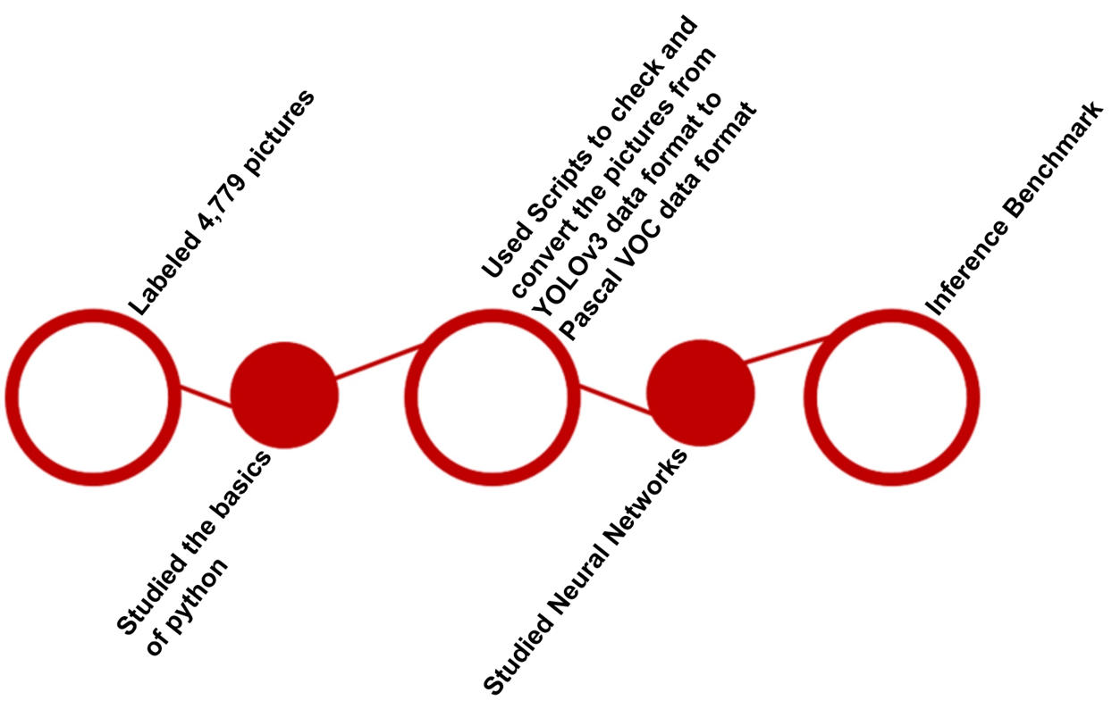
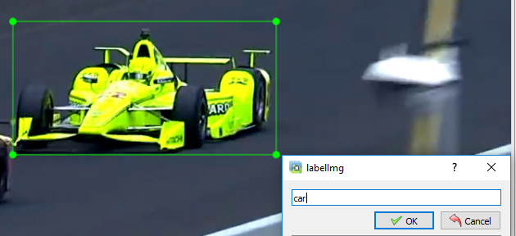
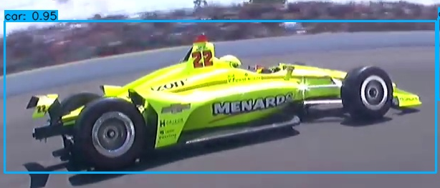




Real Time Object Detection and Data Preparation for Indy 500
La'Andrea Gates and TaJuan Beckworth
Advisor Judy Qiu
Abstract
Methodology
Conclusion
One of the biggest audience attractions is sports racing. Discovering new information, predicting insights in the future, and the ability to make control decisions from applying machine learning and Artificial Intelligence (AI) is a very important process. This helps the team managers, engineers, organizers, announcers, drivers, and the fans. The biggest problem to solve is detecting anomalies accurately. We will work with part of a bigger project for the IndyCar 500. The focus is mostly towards data preparation to help the current team working on this project.
The current program was created to advance the racing experience for the Indianapolis 500. This program shows all the tools and procedures that come together to enhance anomaly detection in racing. The more we train our system with continuous up to date data, the better the system will be at detecting real time anomalies. The system seems to learn much more when being trained with various data sets. The initial results compared to the currents results have improved tremendously with the increased number of data input. After using YOLOv3 to label the data, the results that followed showed outstanding growth in our systems object detection results. We work as a team to develop a program that will ease the minds of the racers, so they have more focus in the race. We use real time object detection and data preparation to ensure the best results for the racers.
Introduction
Results
The IndyCar series is the leading level of open-wheel racing in North America. The racing cars reach speeds up to 235 miles per hour at the Indianapolis Motor Speedway. They need a system to support real-time data analysis. Some of it would detect anomalies on the timing and scoring data, although it is challenging. We will prepare the data and train data to aid the original group working on this assignment. There are three main states in the project, labelling images, training data, and inference. We primarily worked on labelling. There is a demo that identifies cars from the IndyCar 500 as all sorts of objects such as boats, trucks, trees, etc. The system needs to constantly be trained for more accuracy.
Related Work
Figure 1.1 Yolo labelling tool
Figure 1.2 Inferred image
The cars in the images were previously labelled as all sorts of objects other than a car. The cars now are labelled as cars as the system is being trained that these are cars. The probability of a racecar being detected as a car increases as the system is continuously trained.
Acknowledgements
We would like to thank our advisor Judy Qiu and the video analytics team (Selahattin Akkas, Sumeet Mishra, and Sahaj Maini) and the National Science Foundation.

