Slide 1
Web Services
Overview
Marlon Pierce
Indiana University
mpierce@cs.indiana.edu
March 7, 2005

Slide 2
March Lectures
Prof. Fox will be traveling the rest of this month.
  He will be able to give the March 15th lecture.
I will be filling in
  When is JSU’s Spring Break?
My lectures will have a different focus
  Web services, portals.
  These will be based on lectures from last Spring
    Additional material to cover portlets.

Slide 3
Assignments
Homework 3 and 3.5
  Prof. Fox will email you
Homework 4
  Will be posted 9 am Tuesday (tomorrow) morning.
Homework 5
  TBD

Slide 4
This Lecture…
This lecture is intended to introduce the main concepts of Web Services.
We will also look at some things (SOAP, WSDL) in detail…
But the primary purpose is to introduce topics that will all be covered in greater detail in future lectures.

Slide 5
What Are Web Services?
Web services framework is an XML-based distributed object/service/component system.
  SOAP, WSDL, UDDI
  Intended to support machine-to-machine interactions over the network.
Basic ideas is to build a platform and programming language-independent distributed invocation system out of existing Web standards.
  Most standards defined by W3C, Oasis (IP considerations)
  Interoperability really works, as long as you can map XML message to a programming language type, structure, class, etc.
Very loosely defined, when compared to CORBA, etc.
Inherit both good and bad of the web
  Scalable, simple, distributed
  But no centralized management, system is inefficient, must be tolerant of failures.

Slide 6
Web Services Compared to MPI
WSDL is a API definition language
  Your programs have been using the MPI API
  Your codes on the Grid Farm machines have been using the LAM-MPI implementation of MPI.
    Prof. Andrew Lumsdaine, Indiana U and the Open Systems Lab
SOAP is an envelope for transferring messages.
  You can build messaging systems (“MOMs”) with SOAP.
For the most part, WS and MPI apply to very different domains.
  Web Services are loosely coupled
    Use HTTP to carry messages.
  No shared memory
  Millisecond (or longer) message communication speeds instead of microsecond.
    They are not for use for calculating the Pi using the Simpson’s rule.
    Or more generally, you do not use them for the applications Geoffrey described last week.
  But Web Services, done correctly, scale
    Use and couple services from all over the world.
    We are trying hard to convince people to do this for Earthquake science

Slide 7
Web Services and Portals to Parallel Applications
As Geoffrey described last week, parallel programming field is very mature
  Computational fluid dynamics, for example
  Long standing software development projects
  So contributing here is very hard
But making these codes easy to use is also important.
Web Services can be used to wrap MPI codes
  Provide airplane modeling codes as a Web accessible application.
  Build user interfaces (portals, GUIs) to simplify access to these codes and the queuing systems that run them.
  We will have an exercise/homework assignment on this.

Slide 8
Basic Architectures:
Servlets/CGI and Web Services
Browser
Browser
GUI
Client
Web
Server
HTTP GET/POST
WSDL
SOAP
Web
Server
WSDL
Web
Server
WSDL
WSDL
SOAP
JDBC
JDBC
DB
or MPI
Appl.
DB
or MPI
Appl.

Slide 9
Explanation of Previous Slide
The diagram on the left represents a standard web application.
  Browsers converse with web servers using HTTP GET/POST methods.
  Servlets or CGI scripts process the parameters and take action, like connect to a DB.
  Examples: Google, Amazon
On the right, we have a Web services system.
  Interactions may be either through the browser or through a desktop client (Java Swing, Python, Windows, etc.)
  I will explain how to do this in several more lectures.
  Examples: Google, Amazon

Slide 10
Some Terminology
The diagram on the left is called a client/server system.
The diagram on the right is called a multi-tiered architecture.
SOAP: Simple Object Access Protocol
  XML Message format between client and service.
WSDL: Web Service Description Language.
  Describes how the service is to be used
  Compare (for example) to Java Interface.
  Guideline for constructing SOAP messages.
  WSDL is an XML language for writing Application Programmer Interfaces (APIs).

Slide 11
Amazon and Google Experiment with Web Services
Both Google and Amazon have conducted open experiments with Web services.
Why? To allow partners to develop custom user interfaces and applications that work Google and Amazon data and services.
You can download their APIs and try them.
  http://www.google.com/apis/
  http://www.amazon.com/webservices

Slide 12
Why Use Web Services?
Web services provide a clean separation between a capability and its user interface.
This allows a company (Google) with a sophisticated capability and huge amounts of data to make that capability available to its partners.
  “Don’t worry about how PageRank works or web robots or data storage. We will do that. You just use this WSDL API to build your client application to use our search engine.”

Slide 13
A Google Aside
Google’s PageRank system was developed by two Stanford grad students.
Open algorithm published in scholarly journals, conferences.
  Previous (and lousy) search engines were all proprietary.
See for example http://www7.scu.edu.au/programme/fullpapers/1921/com1921.htm

Slide 14
When To Use Web Services?
Applications do not have severe restrictions on reliability and speed.
Two or more organizations need to cooperate
  One needs to write an application that uses another’s service.
Services can be upgraded independently of clients.
  Google can improve PageRank implemenation without telling me.
  Just don’t change the WSDL.
Services can be easily expressed with simple request/response semantics and simple state.
  HTTP and Cookies, for example.

Slide 15
More Examples of Web Services
Geographical Information Systems are perfect candidates for WS
  The Open Geospatial Consortium defines several relevant standards
    Geographic Markup Language (GML) exchanges info.
    Web Feature Service works with abstract GML feature data.
    Web Map Service creates maps (images)
XMethods
  Lots and lots of contributed examples, live demos
  Try them
    http://www.xmethods.com/

Slide 16
XML Overview
Dr. Bryan Carpenter prepared some very nice, extensive notes on XML for last Spring.
  See http://www.grid2004.org/spring2004/
XML is a language for building languages.
Basic rules: be well formed and be valid
Particular XML “dialects” are defined by XML Schemas.
  XML itself is defined by its own schema.
XML is extensible via namespaces
Many non-Web services dialects
  RDF, SVG,GML, XForms, XHTML
Many basic tools available: parsers, XPath and XQuery for searching/querying, etc.

Slide 17
XML and Web services
XML provides a natural substrate for distributed computing:
  Its just a data description.
  Platform, programming language independent.
So let’s describe the pieces.
Web Services Description Language (WSDL)
  Describes how to invoke a service (compare with CORBA IDL).
  Can bind to SOAP, other protocols for actual invocation.
Simple Object Access Protocol (SOAP)
  Wire protocol extension for conveying RPC calls.
  Can be carried over HTTP, SMTP.

Slide 18
Web Service Architectures
The following examples illustrate how Web services interact with clients.
For us, a client is typically a JSP, servlet, or portlet that a user accesses through browser.
You can also build other clients
  Web service interoperability means that clients and services can be in different programming languages (C/C++, python, java, etc).

Slide 19
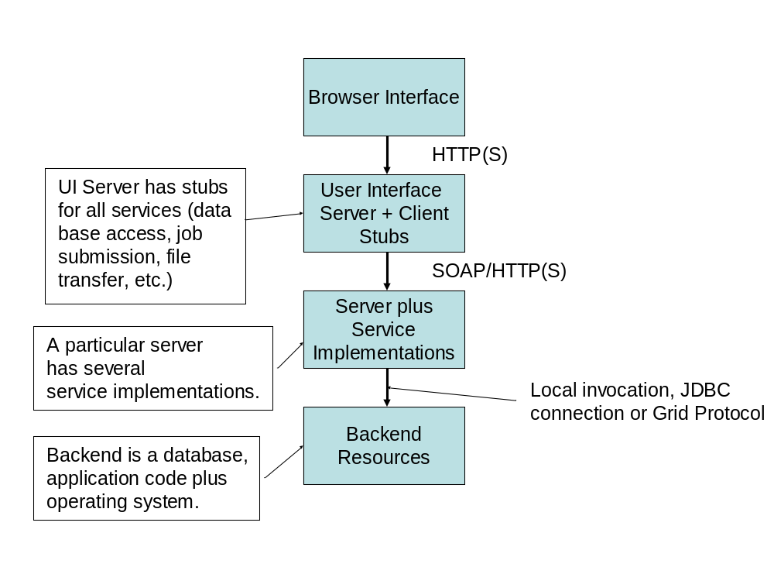

Slide 20
User Interface
User Interface Server
DB Service 1
Job Sub/Mon
And File
Services
DB Service 2
JDBC
JDBC
DB
Operating and
Queuing
Systems
DB
Host 1
Host 2
Host 3

Slide 21
Before Going On…
In the next several slides we’ll go into the details of WSDL and SOAP.
But in practice, you don’t need to work directly with either.
  Most tools that I’m familiar with generate the WSDL for you from your class.
  SOAP messages are constructed by classes.
  Generated client stubs will even hide SOAP classes behind a local “façade” that looks like a local class but actually constructs SOAP calls to the remote server.
I am just showing you these slides to test your eyesight.

Slide 22
Web Services Description Language
Defines what your service does and how it is invoked.

Slide 23
WSDL Overview
WSDL is an XML-based Interface Definition Language.
  You can define the APIs for all of your services in WSDL.
WSDL docs are broken into five major parts:
  Data definitions (in XML) for custom types
  Abstract message definitions (request, response)
  Organization of messages into “ports” and “operations” (→classes and methods).
  Protocol bindings (to SOAP, for example)
  Service point locations (URLs)
Some interesting features
  A single WSDL document can describe several versions of an interface.
  A single WSDL doc can describe several related services.

Slide 24
A Very Simple, Very Dangerous Service
The next two slides show a very simple Java program that use the operating system to run executables.
  You normally want to wrap this service to control access to the operating system.
You can use this to execute your MPI programs.
This is not a Web Service. It is just a Java program that you compile and run at a shell prompt.

Slide 25
The Java Code
public String[] execLocalCommand(String command) {
Runtime rt = Runtime.getRuntime();
String stdout="",stderr="";
try {
Process p = rt.exec(command);
BufferedReader in=
new BufferedReader(new InputStreamReader(p.getInputStream()));
BufferedReader err=
new BufferedReader(new InputStreamReader(p.getErrorStream()));

Slide 26
Java Code Continued
String line;
while((line=in.readLine())!= null) {stdout+=line+"\n";}
in.close();
while ((line=err.readLine())!=null) {stderr+=line+"\n";}
err.close();
}//End of try{}
catch (Exception eio) {…}
String[] retstring=new String[2];
retstring[0]=stdout;
retstring[1]=stderr;
return retstring;
} //End of method

Slide 27
WSDL Example: Job Submission
The proceeding Java program will serve as the core of our simple service.
  It can execute local (to the server) commands.
The service implementation (in Java) has a single method
  ExecLocal takes a single string argument (the command to exec)
  Returns a 2D string array (standard out and error).
The WSDL maps to a Java interface in this case.

Slide 28
The Full WSDL
The following slide contains the WSDL definition for the Job Submit service.
  I omitted some data definitions to get into one page with a decent font.
As you can see, WSDL is very verbose
  Typically, you don’t write WSDL
  This file was actually generated from my Java class by Apache Axis.
We will go through the parts of the doc in some detail.

Slide 29
<?xml version="1.0" encoding="UTF-8"?>
<wsdl:definitions>
<wsdl:message name="execLocalCommandResponse">
<wsdl:message name="execLocalCommandRequest">
<wsdl:portType name="SJwsImp">
<wsdl:operation name="execLocalCommand" parameterOrder="in0">
<wsdl:input message="impl:execLocalCommandRequest" name="execLocalCommandRequest"/>
<wsdl:output message="impl:execLocalCommandResponse" name="execLocalCommandResponse"/>
</wsdl:operation>
</wsdl:portType>
<wsdl:binding name="SubmitjobSoapBinding" type="impl:SJwsImp">
<wsdlsoap:binding style="rpc" transport="http://schemas.xmlsoap.org/soap/http"/>
<wsdl:operation name="execLocalCommand">
<wsdlsoap:operation soapAction=""/>
<wsdl:input name="execLocalCommandRequest">
<wsdl:output name="execLocalCommandResponse">
</wsdl:operation>
</wsdl:binding>
<wsdl:service name="SJwsImpService">
<wsdl:port binding="impl:SubmitjobSoapBinding" name="Submitjob">
</wsdl:service>
</wsdl:definitions>

Slide 30
WSDL Elements I
Types: describes custom XML data types (optional) used in messages.
  For OO languages, types are a limited object serialization.
  We’ll see an example for defining arrays.
Message: abstractly defines the messages that need to be exchanged.
  Conventionally messages are used to group requests and responses.
  Each method/function in the interface contains 0-1 request and 0-1 response messages.
  Consists of part elements. Usually you need one part for each variable sent or received. Parts can either be XML primitive types or custom complex types.

Slide 31
Types for Job Submission
Recall that the job submission service sends a string (the command) and returns a 2D array.
Strings are XML Schema primitive types, so we don’t need a special definition in our WSDL.
Arrays are not primitive types. They are defined in the SOAP schema, so we will import that definition.
  In other words, SOAP has rules for array encoding; vanilla XML does not.

Slide 32
Example: WSDL types for Custom Data Definition
<wsdl:types>
<schema targetNamespace="http://.../GCWS/services/Submitjob"
xmlns:impl="http://.../GCWS/services/Submitjob"
xmlns="http://www.w3.org/2001/XMLSchema">
<import namespace="http://schemas.xmlsoap.org/soap/encoding/" />
<complexType name="ArrayOf_xsd_string">
<complexContent>
<restriction base="soapenc:Array">
<attribute ref="soapenc:arrayType"
wsdl:arrayType="xsd:string[]" />
</restriction>
</complexContent>
</complexType>
<element name="ArrayOf_xsd_string" nillable="true"
type="impl:ArrayOf_xsd_string" />
</schema>
</wsdl:types>

Slide 33
What Does It Mean?
We start with some useful namespace definitions.
We next import the SOAP schema
  It has the array definitions we need.
Finally, we define our own local XML complex type, ArrayOf_xsd_string.
  This extends the SOAP array type
  We restrict this to String arrays.

Slide 34
Message Elements for Job Submission Service
Our service implementation has one method of the form (in Java)
  public String[] execLocalCommand(String cmd)
This will require one “request” message and one “response” message.
Each message has one part:
  Request message must send the String cmd.
  Response must get back the String[] array (defined previously as a custom type).
If we had to pass two input variables, our “request” message would need two part elements.
Note the name attributes of messages are important!

Slide 35
Message Examples for Job Submission Service
<wsdl:message name="execLocalCommandResponse">
<wsdl:part
name="execLocalCommandReturn"
type="impl:ArrayOf_xsd_string" />
</wsdl:message>
<wsdl:message name="execLocalCommandRequest">
<wsdl:part name="in0" type="xsd:string" />
</wsdl:message>

Slide 36
portTypes
portType elements map messages to operations.
You can think of portType==class, operation==class methods.
Operations can contain input, output, and/or fault bindings for messages.
An operation may support of the following message styles:
  One-way: request only
  Two-way: request/response
  Solicit-response: server “push” and client response
  Notification: one-way server push

Slide 37
portType for JobSubmit
We previously defined the messages and types needed. Now we bind them into the portType structure.
PortType names are important
  Will be referenced by binding element.
Note names of previously defined messages are used as references in the operations.

Slide 38
Example WSDL Nugget
<wsdl:portType name="SJwsImp">
<wsdl:operation name="execLocalCommand"
parameterOrder="in0">
<wsdl:input message="impl:execLocalCommandRequest"
name="execLocalCommandRequest" />
<wsdl:output message="impl:execLocalCommandResponse"
name="execLocalCommandResponse" />
</wsdl:operation>
</wsdl:portType>

Slide 39
Some Notes on the PortType Definition
PortTypes refer to messages by name
  The message attribute in <input> and <output> elements of <operation> refer to the name attributes of the previously defined messages.
  The operation and portType names will similarly be used for reference in forthcoming tags.
Also note “parameterOrder” does what you would expect. For the current example, there is only one input parameter.

Slide 40
PortType Bindings
portTypes are abstract interface definitions.
  Don’t say anything about how to invoke a remote method.
Remote invocations are defined in binding elements.
Binding elements are really just place holders that are extended for specific protocols
  WSDL spec provides SOAP, HTTP GET/POST, and MIME extension schema examples.

Slide 41
SOAP Overview

Slide 42
SOAP Bindings for JobSubmit Service
Note that the binding element contains a mixture of tags from different namespaces (wsdl and wsdlsoap).
WSDL child elements for binding element are operation, input, and output.
WSDLSOAP elements are from a different XML schema (a new one, neither WSDL nor SOAP).
  This is how you extend WSDL bindings: define a new schema that gives mapping instructions from WSDL to the protocol of choice.
The binding element name is important, will be used as a reference by the final port binding.

Slide 43
<wsdl:binding
name="SubmitjobSoapBinding" type="impl:SJwsImp">
<wsdlsoap:binding style="rpc"
transport="http://schemas.xmlsoap.org/soap/http" />
<wsdl:operation name="execLocalCommand">
<wsdlsoap:operation soapAction="" />
<wsdl:input name="execLocalCommandRequest">
<wsdlsoap:body
encodingStyle=http://schemas.xmlsoap.org/soap/encoding/
namespace="http://.../GCWS/services/Submitjob"
use="encoded" />
</wsdl:input>
<wsdl:output name="execLocalCommandResponse">
<wsdlsoap:body
encodingStyle=http://schemas.xmlsoap.org/soap/encoding/
namespace=http://.../GCWS/services/Submitjob
use="encoded" />
</wsdl:output>
</wsdl:operation>
</wsdl:binding>

Slide 44
A Closer Look at SOAP Binding
<wsdlsoap:body encodingStyle=http://schemas.xmlsoap.org/soap/encoding/ namespace=http://.../GCWS/services/Submitjob use="encoded" />
All this really means is “encode the message by the rules in encodingStyle and put it in the SOAP body.”
The bindings are just instructions that must be implemented by the SOAP message generator.

Slide 45
Service and Port Definitions
So far, we have defined the class method interfaces (portTypes) and the rules for binding to a particular protocol.
Port elements define how the bindings (and thus the portTypes) are associated with a particular server.
The service element collects ports.

Slide 46
Service and Port Elements for the Job Submission Service
<wsdl:service name="SJwsImpService">
<wsdl:port
binding="impl:SubmitjobSoapBinding"
  name="Submitjob">
<wsdlsoap:address
location="http://.../GCWS/services/Submitjob" />
</wsdl:port>
</wsdl:service>

Slide 47
Explanation
Note the port element’s binding attribute points to the appropriate binding element by name.
The only purpose of the port element is to point to a service location (a URL). This is done by extension (SOAP in this case.)
Ports are child elements of the service element. A service can contain one or more ports.
  Note the value of multiple ports: a single portType may correspond to several ports, each with a different protocol binding and service point.

Slide 48
WSDL Trivia
The schema rules allow all of the elements we have discussed to appear zero or more times.
A single WSDL file may contain many portTypes (although this is not usual).
  You may want to do this to support multiple interface definitions of a service for backward compatibility.
Multiple ports may also be used to provide different views of a service
  One portType defines the interface.
  Another provides access to metadata about the service.
  Yet another may define how the service interacts with other services via notification/event systems.

Slide 49
Simple Object Access Protocol
A message format for exchanging structured, typed information

Slide 50
SOAP Basics
SOAP is often thought of as a protocol extension for doing RPC over HTTP.
This is not completely accurate: SOAP is an XML message format for exchanging structured, typed data.
It may be used for RPC in client-server applications but is also suitable for messaging systems (like JMS) that follow one-to-many (or publish-subscribe) models.
SOAP is not a transport protocol. You must attach your message to a transport mechanism like HTTP.

Slide 51
SOAP Structure
A SOAP message is contained in an envelop.
The envelop element in turn contain (in order)
  An optional header with one or more child entries.
  A body element that can contain one or more child entries. These child entries may contain arbitrary XML data.

Slide 52
SOAP Headers
Headers are really just extension points where you can include elements from other namespaces.
  i.e., headers can contain arbitrary XML.
Header entries may optionally have a “mustUnderstand” attribute.
  mustUnderstand=1 means the message recipient must process the header element.
  If mustUnderstand=0 or is missing, the header element is optional.

Slide 53
SOAP Body
Body entries are really just placeholders for arbitrary XML from some other namespace.
The body contains the XML message that you are transmitting.
The message format is not specified by SOAP.
  The <Body></Body> tag pairs are just a way to notify the recipient that the actual XML message is contained therein.
  The recipient decides what to do with the message.

Slide 54
Example Messages
Recall the WSDL interface for “SubmitJob”
  Sends one string command
  Returns array of strings for standard out and error.
The envelop is decorated with a few useful namespaces:
  soapenv defines the version
  xsd is the Schema definition itself
  xsi defines some useful constants.
The body is just an arbitrary XML fragment.
  Assumes the recipient knows what this means.
  Recipient must looks up the ExecLocalCommand operation in the JobSubmit service and passes it one string argument.
  The ns1 namespace tells the recipient the WSDL namespace that defines the service.
  xsi:type lets the recipient know that the arbitrary XML element in0 is in fact a string, as defined by the XML Schema.

Slide 55
SOAP Request
<soapenv:Envelope
xmlns:soapenv="http://schemas.xmlsoap.org/soap/envelope/"
xmlns:xsd=http://www.w3.org/2001/XMLSchema
xmlns:xsi="http://www.w3.org/2001/XMLSchema-instance">
<soapenv:Body>
<ns1:execLocalCommand
soapenv:encodingStyle
="http://schemas.xmlsoap.org/soap/encoding/"
xmlns:ns1
="http://.../GCWS/services/Submitjob/GCWS/services/Submitjob">
<in0 xsi:type="xsd:string">/usr/bin/csh /tmp/job.script</in0>
</ns1:execLocalCommand>
</soapenv:Body>
</soapenv:Envelope>

Slide 56
Example Response
The structure is the same as the request.
The interesting thing here is that the request returns a 2-element array of two strings.
  Arrays not defined by XML schema
  SOAP encoding does define arrays, so use xsi:type to point to this definition.
  <item></item> surrounds each array element.
Note that arbitrary XML returns can likewise be encoded this way.
  Use xsi:type to point to a schema.

Slide 57
SOAP Response
<soapenv:Envelope
xmlns:soapenv=http://schemas.xmlsoap.org/soap/envelope/
xmlns:xsd=http://www.w3.org/2001/XMLSchema
xmlns:xsi="http://www.w3.org/2001/XMLSchema-instance">
<soapenv:Body>
<ns1:execLocalCommandResponse
soapenv:encodingStyle=
http://schemas.xmlsoap.org/soap/encoding/ xmlns:ns1="http://../services/Submitjob">
<execLocalCommandReturn xsi:type="soapenc:Array“
soapenc:arrayType="xsd:string[2]"
xmlns:soapenc="http://schemas.xmlsoap.org/soap/encoding/">
<item></item> <item></item>
</execLocalCommandReturn>
</ns1:execLocalCommandResponse>
</soapenv:Body>
</soapenv:Envelope>

Slide 58
Developing Web Services
Using Apache Axis to develop Java implementations of Web services.

Slide 59
Web Service Development Tools
Web service toolkits exist for various programming languages:
  C++, Python, Perl, various Microsoft .NET kits.
We’ll concentrate on building Java Web services with Apache Axis.
Language and implementation interoperability is addressed through WS-I.
  http://www.ws-i.org/

Slide 60
Apache Axis Overview
Apache Axis is a toolkit for converting Java applications into Web services.
Axis service deployment tools allow you to publish your service in a particular application server (Tomcat).
Axis client tools allow you to convert WSDL into client stubs.
Axis runtime tools accept incoming SOAP requests and redirect them to the appropriate service.

Slide 61
Developing and Deploying a Service
Download and install Tomcat and Axis.
Write a Java implementation
  Our SubmitJob is a simple example but services can get quite complicated.
  Compile it into Tomcat’s classpath.
Write a deployment descriptor (WSDD) for your service.
  Will be used by Axis runtime to direct SOAP calls.
Use Axis’s AdminClient tool to install your WSDD file.
  The tells the axis servlet to load your class and direct SOAP requests to it.
That’s it.
  Axis will automatically generate the WSDL for your service.

Slide 62
Sample WSDD
<deployment name="Submitjob"
xmlns="http://xml.apache.org/axis/wsdd/"
xmlns:java="http://xml.apache.org/axis/wsdd/providers/java">
<service name="Submitjob" provider="java:RPC">
<parameter name="scope" value="request"/>
<parameter name="className"
value="WebFlowSoap.SJwsImp"/>
<parameter name="allowedMethods"
value="execLocalCommand"/>
</service>
</deployment>

Slide 63
Explanation
Use Axis’s command-line AdminClient tool to deploy this to the server.
Axis will create a service called
  http://your.server/services/SubmitJob
WSDL for service is available from
  http://your.server/services/SubmitJob?wsdl
A list of all services is available from
  http://your.server/services

Slide 64
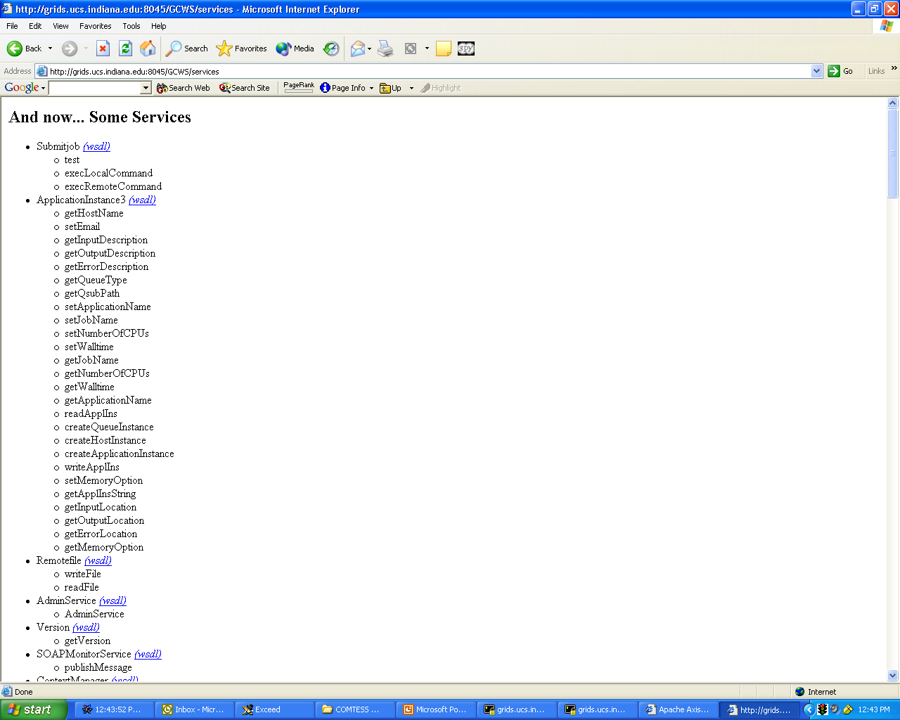
Check your Tomcat Server
for a list of deployed
services.

Slide 65
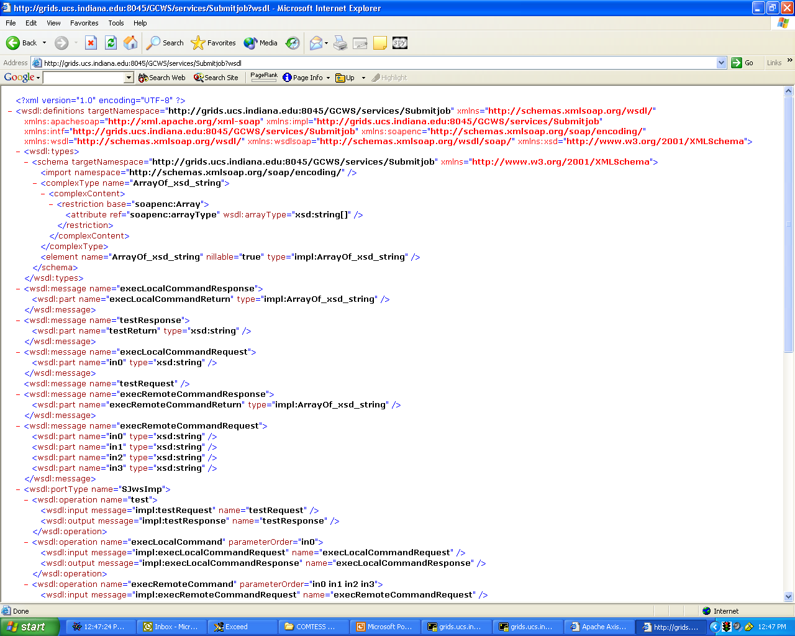
WSDL generated by
inspecting the Java
implementation. Can be
download from the
server.
(XML was shown in
earlier slides)

Slide 66
Building a Client with Axis
Obtain the WSDL file.
Generate client stubs
  Stubs look like local objects but really convert method invocations into SOAP calls.
Write a client application with the stubs
  Can be a Java GUI, a JSP page, etc.
Compile everything and run.

Slide 67
Sample Java Client Code
/**Create SubmitJob client object and point to the service you want to use */
SubmiJob sjws = new
SubmitJobServiceLocator().getSubmitjob(new
URL(http://your.server/services/SubmitJob));
/** Invoke the method as if local. */
String[] messages =
sjws.execLocalCommand(command);

Slide 68
Two Notes On Client Stubs
Axis stubs convert method calls into SOAP requests but WSDL does not require the use of SOAP.
  Web Service Invocation Framework (WSIF) from IBM allows flexibility of protocols. (Alek Slominski, IU)
Client stubs introduce versioning problems.
  We are developing dynamic (stubless) clients that construct SOAP messages by inspecting WSDL at runtime.

Slide 69
Web Service URLs
Java
  http://xml.apache.org/axis/
XSOAP: C++ and Java toolkits for WS
  http://www.extreme.indiana.edu/xgws/xsoap/
gSOAP: C++ SOAP toolkit
  http://www.cs.fsu.edu/~engelen/soap.html
Python Web Services:
  http://pywebsvcs.sourceforge.net/
Perl:
  http://www.soaplite.com/

