Slide 1
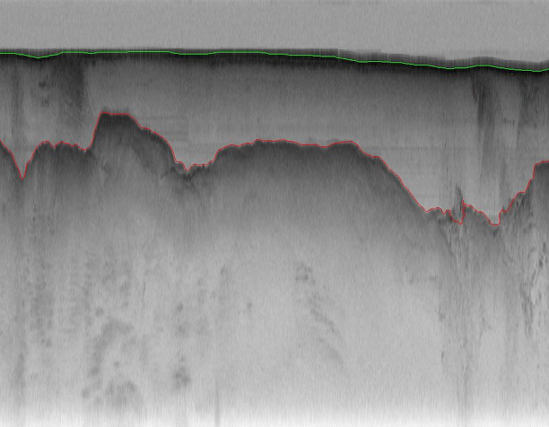
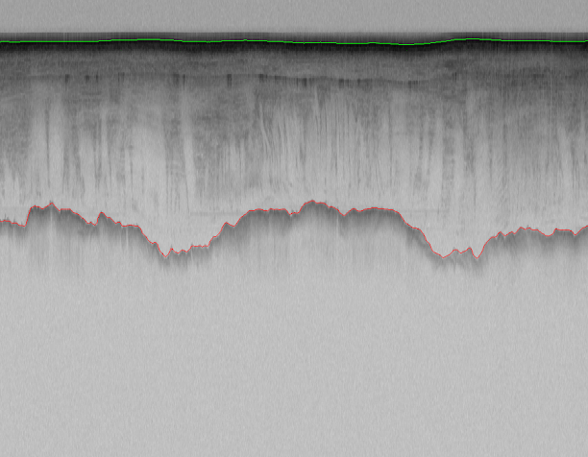
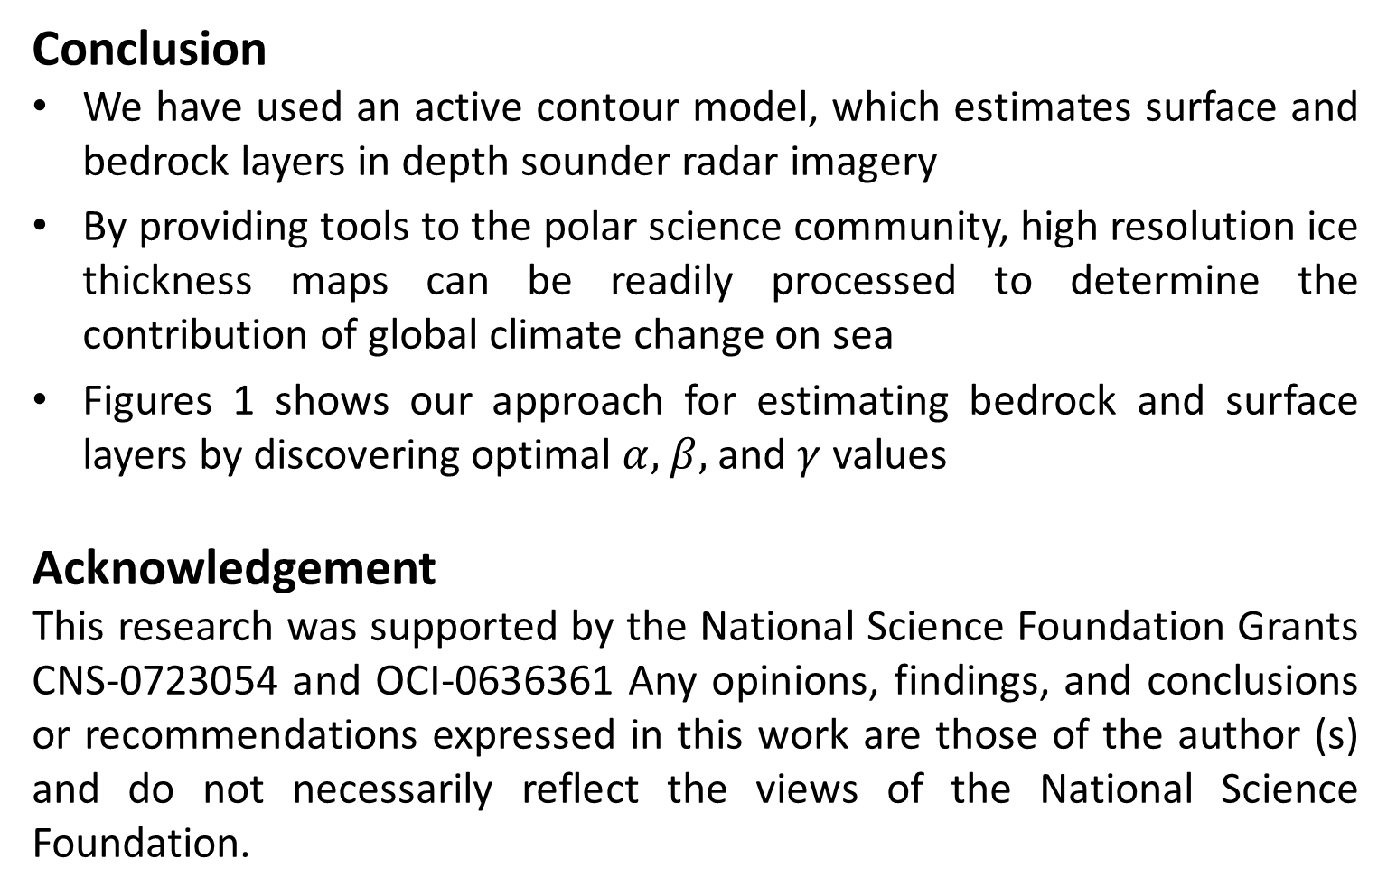
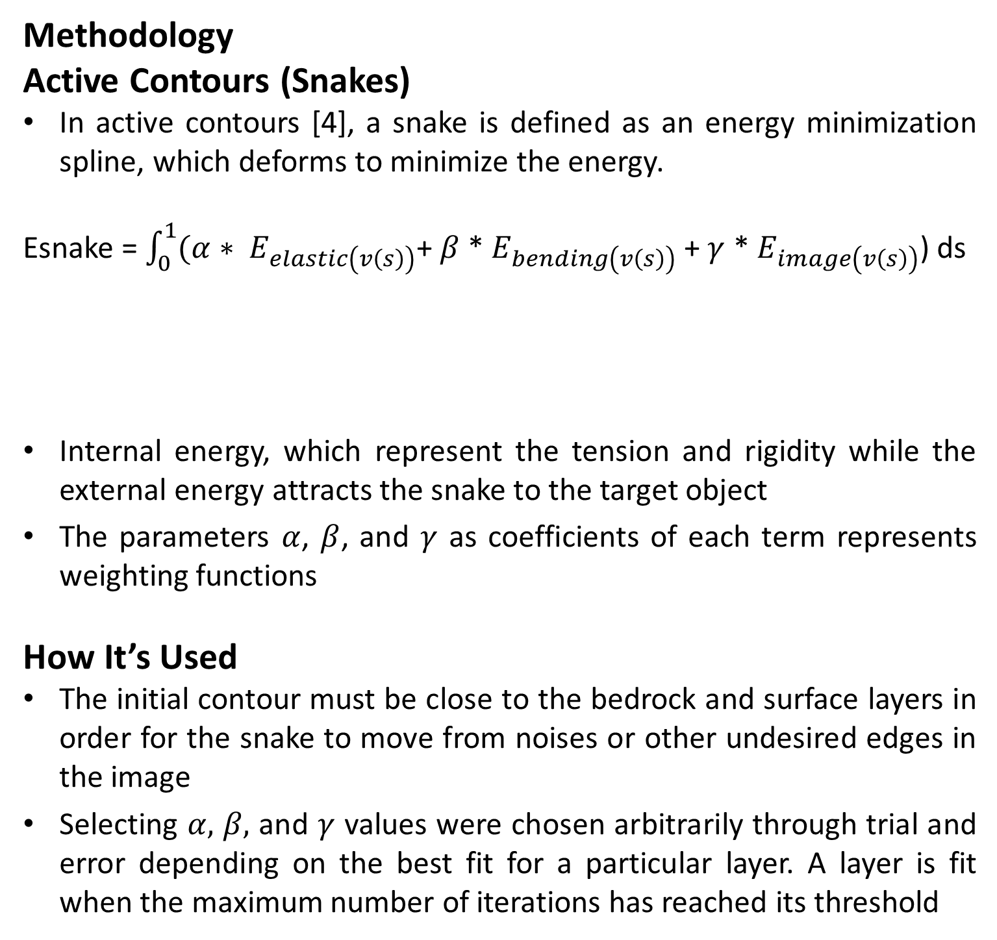
Exploring Learning Algorithms for Layer Identification from Polar Radar Imagery
Tori Wilborn (Elizabeth City State University), Omar Owens (Winston Salam University), Jerome Mitchell, and Geoffrey Fox (Indiana University)
Abstract
The rise of the planet’s temperature has a very negative impact on the subsurface dynamics of Earth’s Polar Regions
Analyzing the polar subsurface is typically performed manually by examining echograms acquired by radar sounder instruments operated in Greenland and Antarctica. It is necessary to develop data analysis techniques for automatically identifying and tracing bedrock and surface layers
To address this problem, we have identified a set of values for α, β, and γ, which are important parameters for controlling an active contour towards the surface and bedrock layers
Introduction
Understanding the ice flow dynamics in Greenland and Antarctica poses a significant climate problem. A modest change in ice sheet volume could strongly affect future sea level and freshwater flux to the oceans
This uncertainty could be substantially reduced by more and better observations of the polar ice sheets’ subsurface structure
The Center for Remote Sensing of Ice Sheets (CReSIS) has developed a Multichannel Coherent Radar Depth Sounder (MCoRDS) radar in order to image surface and bedrock layers for producing high-resolution ice thickness map
Identifying bedrock and surface layers require significant resources to complete a single radar data file consisting of thousands of measurements
Given the volume of radar data acquired in the past and its growth each year, automating this task is necessary for providing results to the scientific community
Methodology
Active Contours (Snakes)
In active contours [4], a snake is defined as an energy minimization spline, which deforms to minimize the energy.
Esnake = $\int_{0}^{1}{(α∗ E_{elastic\left(v\left(s\right)\right)}}$+$β$ * $E_{bending\left(v\left(s\right)\right)}$ + $γ$ * $E_{image\left(v\left(s\right)\right)}$) ds
Internal energy, which represent the tension and rigidity while the external energy attracts the snake to the target object
The parameters $α$, $β$, and $γ$ as coefficients of each term represents weighting functions
How It’s Used
The initial contour must be close to the bedrock and surface layers in order for the snake to move from noises or other undesired edges in the image
Selecting $α,$ $β,$ and $γ$ values were chosen arbitrarily through trial and error depending on the best fit for a particular layer. A layer is fit when the maximum number of iterations has reached its threshold
Internal Energy
External Energy
Conclusion
We have used an active contour model, which estimates surface and bedrock layers in depth sounder radar imagery
By providing tools to the polar science community, high resolution ice thickness maps can be readily processed to determine the contribution of global climate change on sea
Figures 1 shows our approach for estimating bedrock and surface layers by discovering optimal $α,$ $β,$ and $γ$ values
Acknowledgement
This research was supported by the National Science Foundation Grants CNS-0723054 and OCI-0636361 Any opinions, findings, and conclusions or recommendations expressed in this work are those of the author (s) and do not necessarily reflect the views of the National Science Foundation.
Challenges Associated with Processing Radar Imagery
Automated processing and extraction of information from radar imagery is challenging.
Radar inherently records noise, which is electromagnetic interference (EMI) from other electronics, such as components near the sensing equipment in the frequency band of focus.
Analog-to-digital convertors, which convert the received energy signals for digital storage can introduce artifacts.
Vertical and horizontal intensity variations across an image introduce additional difficulties for identifying and tracing near surface layers
Figure 1: Detected surface (green) and bedrock (red) layers
References
[1] A. Turk, K. Hocaoglu, and A. Vertily. Subsurface Sensing. Wiley, 2011.
[2] H. Frigui, K. Ho, and P. Gader. Real-time landmine detection with ground-penetrating radar using discriminative hidden markov models. J. Appl. Sig. Proc., 2005.
[3] A. Ferro and L. Bruzzone. A novel approach to the automatic detection of subsurface features in planetary radar sounder signals. In IEEE Geo&Rem Sens. Symp., 2011.
[4] M. Kass, A. Witkin, and D. Terzopoulos. Snakes: Active contour models. IJCV, 1(4):321–331, 1988.
[5] MA Reid, Christopher M Gifford, Michael Jefferson, Eric L Akers, Gladys Finyom, and Arvin Agah, “Automated polar ice thickness estimation from radar imagery,” in Geoscience and Remote Sensing Symposium (IGARSS), 2010 IEEE International. IEEE, 2010, pp. 2406–2409.

