Slide 1
Course Business
This week:
  Today we will go over getting Web Service installation stuff.
  Wednesday we will look at UDDI, a way for finding and binding to Web Services.
When is the last day of classes?
We have one more homework/final assignment
  I will post today.
  This requires the successful completion of Homework 5.
When are final grades due?

Slide 2
Installing and Configuring Tomcat
A quick guide to getting things set up on Windows

Slide 3
Setup Environment
I will assume everyone will be using Windows.
  Installing on Linux is similar.
  Just use the .sh instead of the .bat files and set appropriate environment variables with the BASH shell.
Also make sure you have the Java SDK installed on your PC.
  The SDK includes the java compiler and some other tools as well as the runtime environment.
  You need the compiler to run tomcat.
  See the RUNNING.txt file that comes with the release.

Slide 4
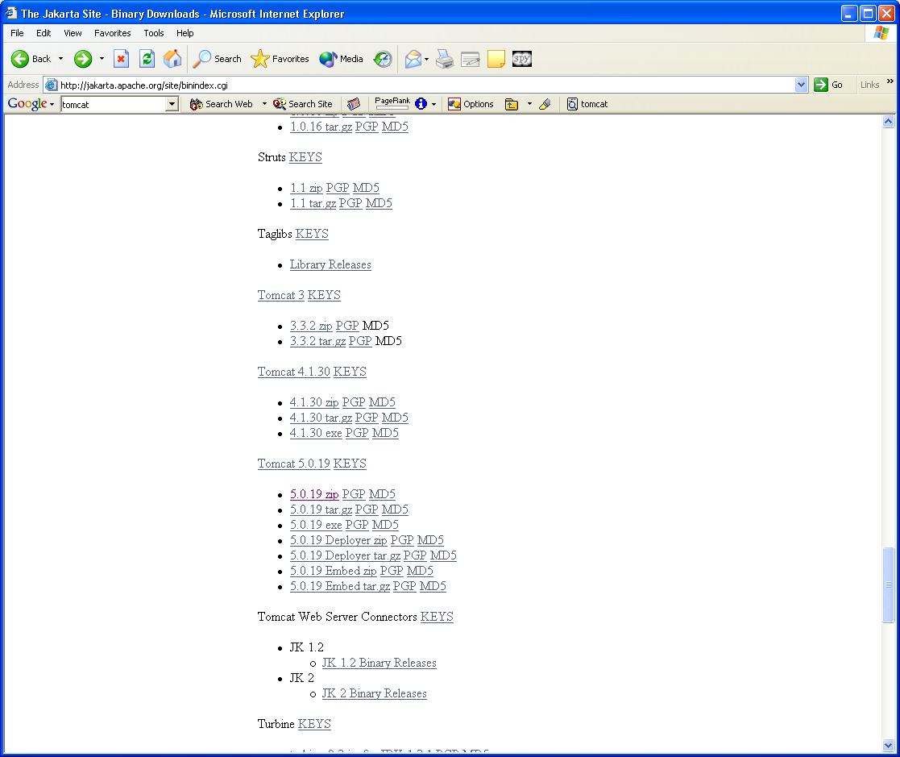
Installing Tomcat
Go to the Jakarta binaries web site:
  http://jakarta.apache.org/site/downloads/downloads_tomcat-5.cgi
Get the latest 5.0.x release ZIP or tar.gz file.
  Right click and save to your desktop
  Either 5.0.28 or 5.0.30 are OK.
  Don’t use 5.0.19: it is obsolete.
Note Tomcat 5.5 works with JSDK 1.5, and I have not extensively tested Axis in this container, so I advise not using it for this assignment.

Slide 5
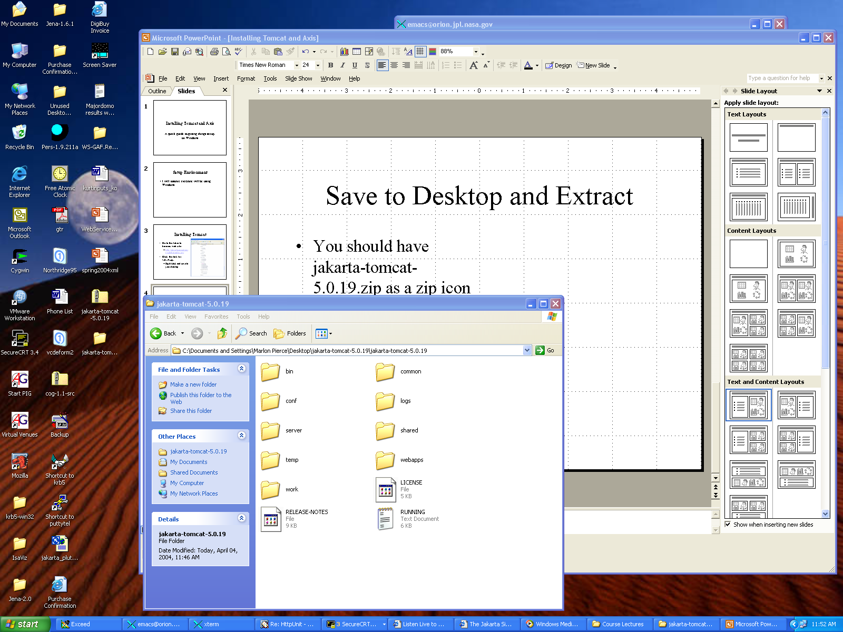
Save to Desktop and Extract
You should have jakarta-tomcat-5.0.x.zip as a zip icon on your desktop.
Right click and choose
“Extract All”.
This will create a jakarta-tomcat-5.0.x folder also on your desktop.

Slide 6
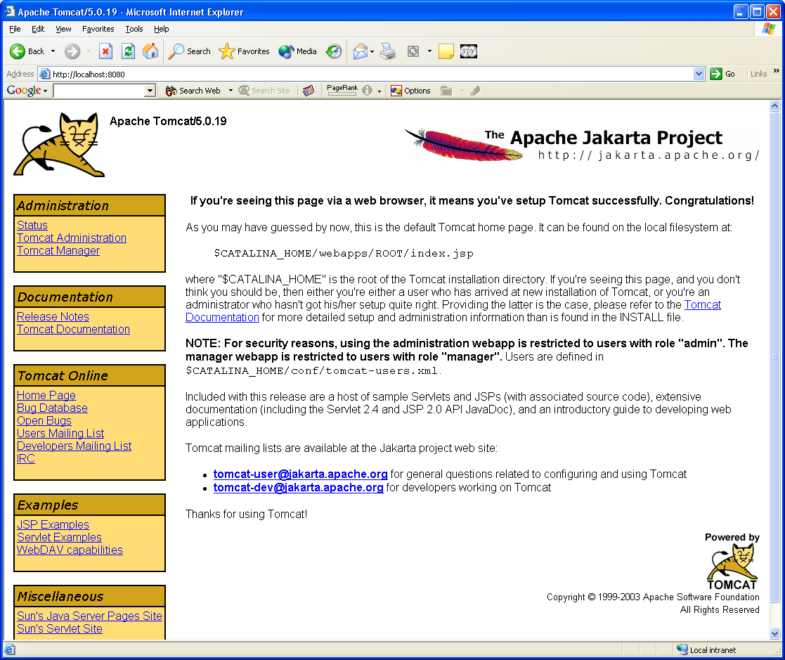
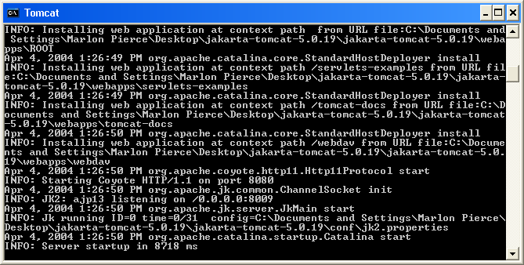
Running Tomcat
In the Tomcat folder, open the bin folder.
Click the startup.bat icon.
You should see a black and white Java command window.
  You should not see any obvious java error messages.
Open your browser and point to http://localhost:8080.
  You should see the Tomcat welcome page.
Note startup.bat actually calls other scripts in the same directory (catalina.bat, particularly).
The .sh files are for running Tomcat on Linux/Unix
  Maybe Mac also.

Slide 7
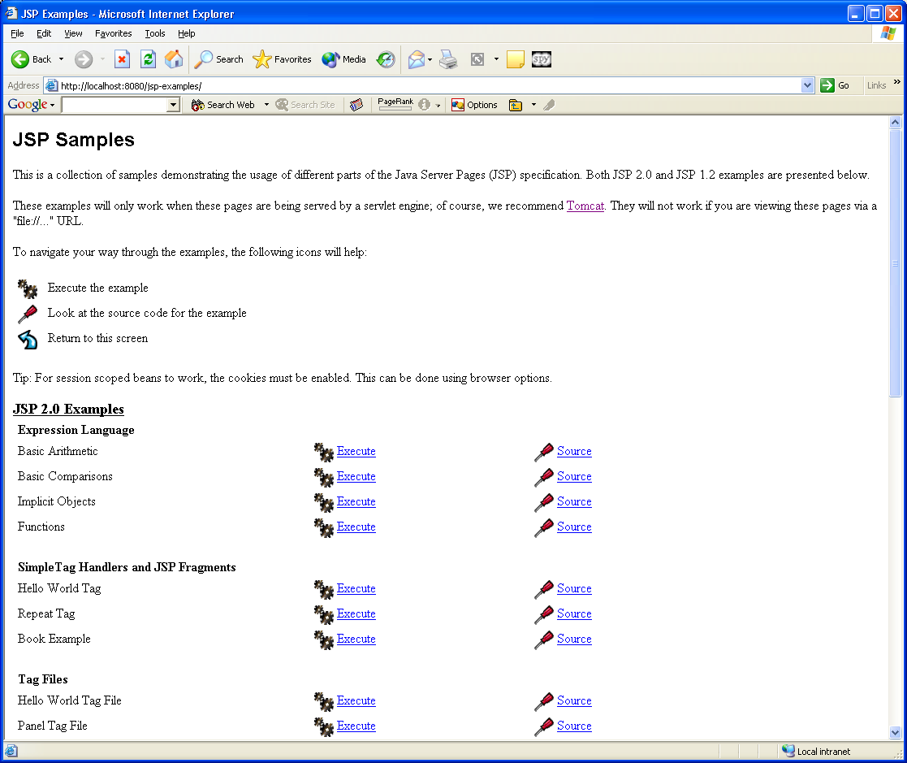
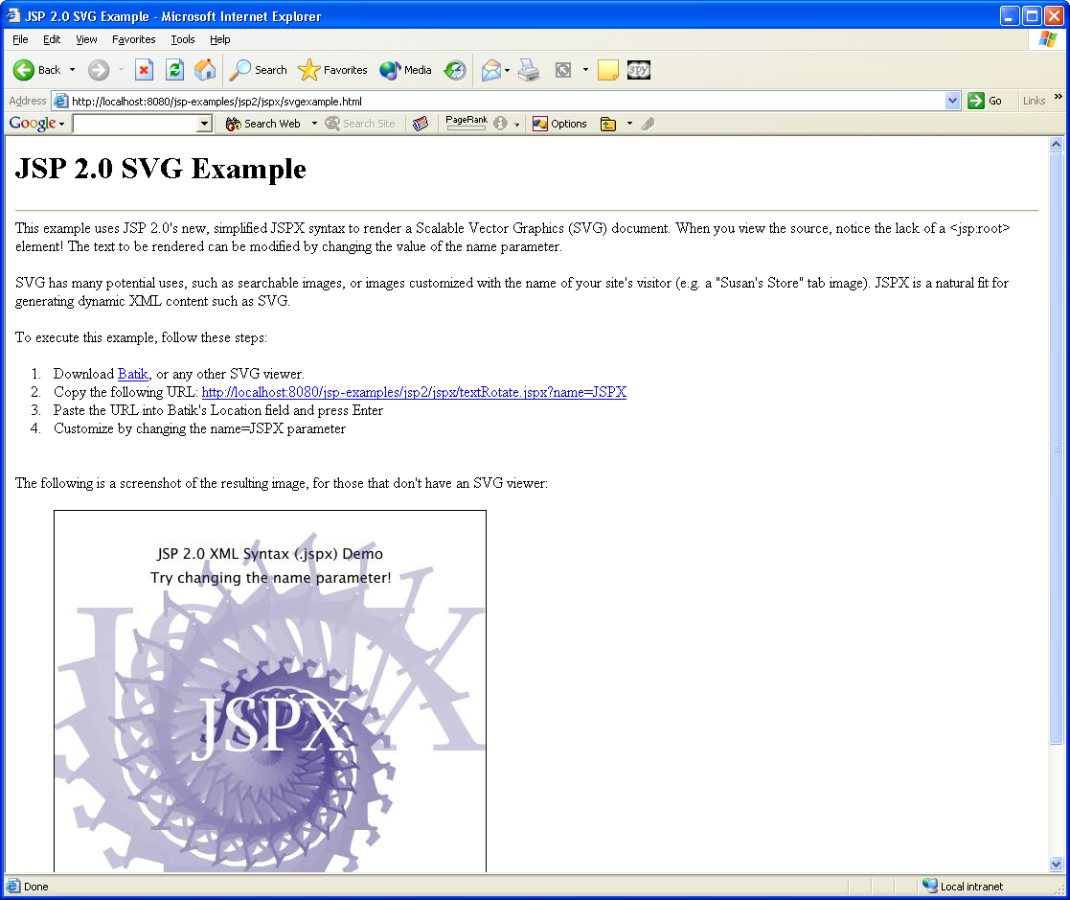
Run Some Examples
From Tomcat’s welcome page, click the examples link and run some examples to make sure everything is OK.

Slide 8
Problems
Tomcat fails to start correctly if
  you either do not have the Java SDK installed, or
  your JAVA_HOME environment variable is set incorrectly.
You must have the Java SDK installed, since you need javac.

Slide 9
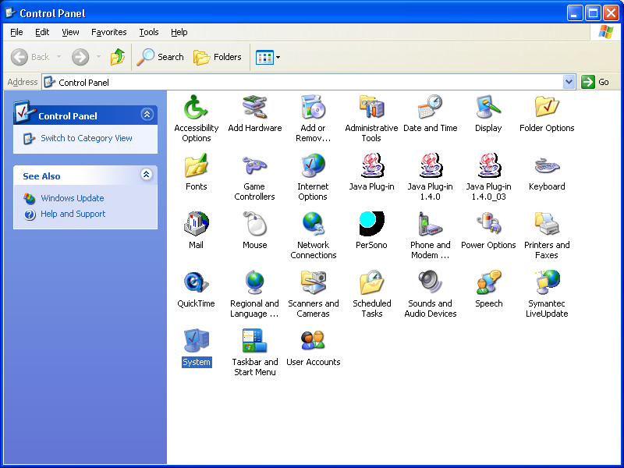
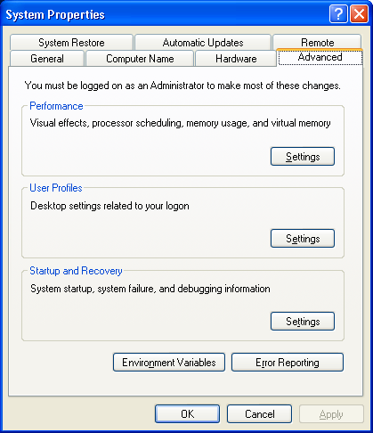
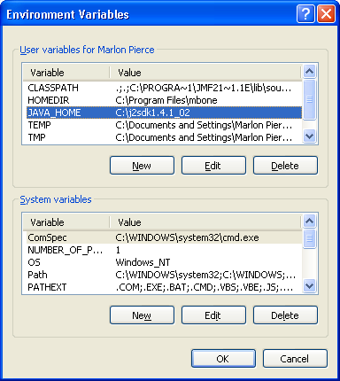
Setting JAVA_HOME on Windows XP
From “Start” at the bottom left of your screen, open the control panel.
Select “System” to edit System properties and choose the “Advanced” tab.
Click the “Environment Variables” Button.
Edit or add the JAVA_HOME variable
  It should point to the top folder of your Java installation.
  C:\j2sdk1.4.1_02, for example.
  Check “My Computer” to get the actual name.

Slide 10
Setting JAVA_HOME with Linux
Assuming you use the BASH shell (the default), do this:
[yourname@gridfarm004 ]$ export JAVA_HOME=/usr/java/j2sdk1.4.2_03/
(This is all typed on one line)
echo $JAVA_HOME
ls –l $JAVA_HOME

Slide 11
Shutting Down Tomcat
You can do this in at least two ways:
  By closing the black and white java command window.
  By executing shutdown.bat in Tomcat’s bin directory
    Same place as startup.bat.
Running shutdown.sh is probably best.

Slide 12
Running Two Tomcat Servers
Web services often are applied to allow two Tomcat (or other) servers communicate
  One does display, the other runs commands.
So to really test things out and to understand what is going on, you should set up and run two web servers.
  Preferably on two different machines.
Installing a second server on the same host follows all of the same steps as before, with one additional step.
  You must modify server.xml

Slide 13
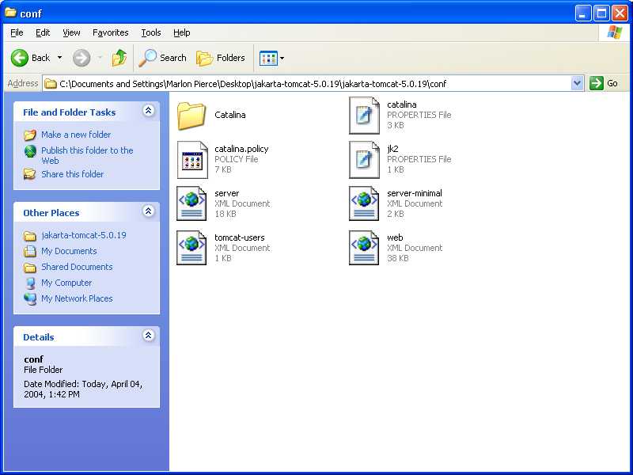
Finding server.xml
The file server.xml has all of the server configuration information.
This is located in the folder jakarta-tomcat-5.0.x/conf.
You only need to edit it in three places.
  See next slide
Double click it to open it with your favorite text editor.
Make a backup copy of server.xml before you change things.

Slide 14
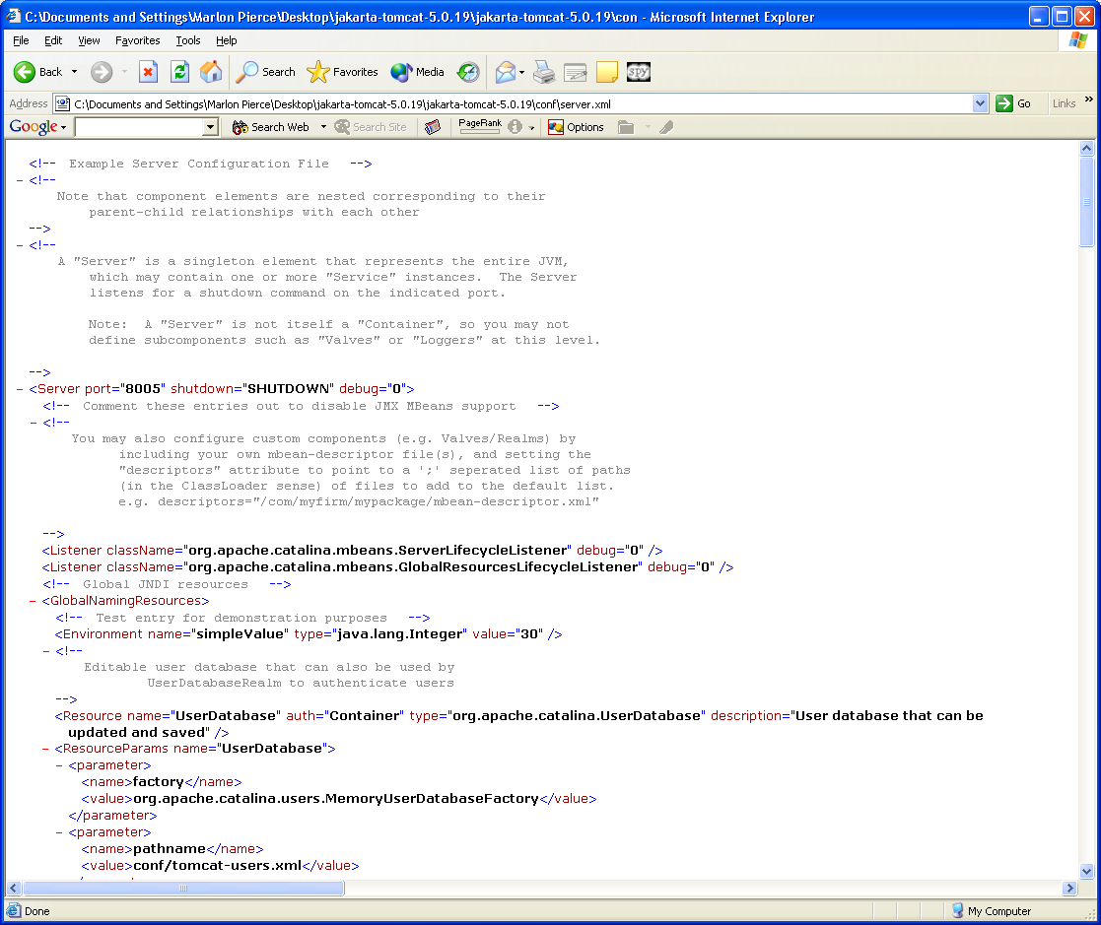
Tomcat Ports
Tomcat 5’s default settings listen to three ports: 8080, 8005, 8009.
  8080 is the http port number.
  8005 is the shutdown port.
    You can contact this to shutdown Tomcat from another process.
  8009 is the AJP port for running Tomcat behind an Apache server.
    Not needed here, but port opened
Tomcat can use other ports
  8443 for SSL connections
    Commented out by default.
    Requires some additional configuration
  8082 is for proxy connections
    Redirecting HTTP to other servers.
    Commented out by default.
  You don’t have to edit these.
For reference, use 9090, 9005, and 9009.

Slide 15
Changing Ports
Only one server at a time can accept connections on ports 8080, 8005, and 8009.
If you want run a second Tomcat server, you must change the values of these ports for the second server.
Just edit server.xml to change these ports.
  Shutdown the server first.
  Values don’t matter
  For Linux/Unix, values <1024 are owned by root processes so you normally can’t use these values.
Now restart the server. Point your browser at the new port number to check.
  http://localhost:9090 for example.

Slide 16
Editing server.xml
The following slides show the config settings that you need to change the shutdown, http, and ajp ports.
You can freely change other parameters if you want, with two restrictions.
You can’t use ports <1024 on Linux unless you are the superuser.
You can’t use a port # if someone else is using it.
  telnet host.name 8080 to see if port 8080 is open.
So don’t use 8080/8005/8009 or 9090/9005/9009 on gridfarm, since someone will beat you to it.
  Use some more obscure number.
  Test with telnet

Slide 17
Shutdown port
<!-- A "Server" is a singleton element that represents the entire JVM,
which may contain one or more "Service" instances. The Server
listens for a shutdown command on the indicated port.
Note: A "Server" is not itself a "Container", so you may not
define subcomponents such as "Valves" or "Loggers" at this level.
-->
<Server port="9005" shutdown="SHUTDOWN" debug="0">

Slide 18
HTTP Connector
<!-- Define a non-SSL Coyote HTTP/1.1 Connector on port 8080 -->
<Connector port="9090"
maxThreads="150" minSpareThreads="25" maxSpareThreads="75"
enableLookups="false" redirectPort="8443" acceptCount="100"
debug="0" connectionTimeout="20000"
disableUploadTimeout="true" />
<!-- Note : To disable connection timeouts, set connectionTimeout value to 0 -->

Slide 19
AJP Port
<!-- Define a Coyote/JK2 AJP 1.3 Connector on port 8009 -->
<Connector port="9009"
enableLookups="false"
redirectPort="8443" debug="0"
protocol="AJP/1.3" />

Slide 20
Installing Apache Axis
Setting up your Tomcat server to use Web Services.

Slide 21
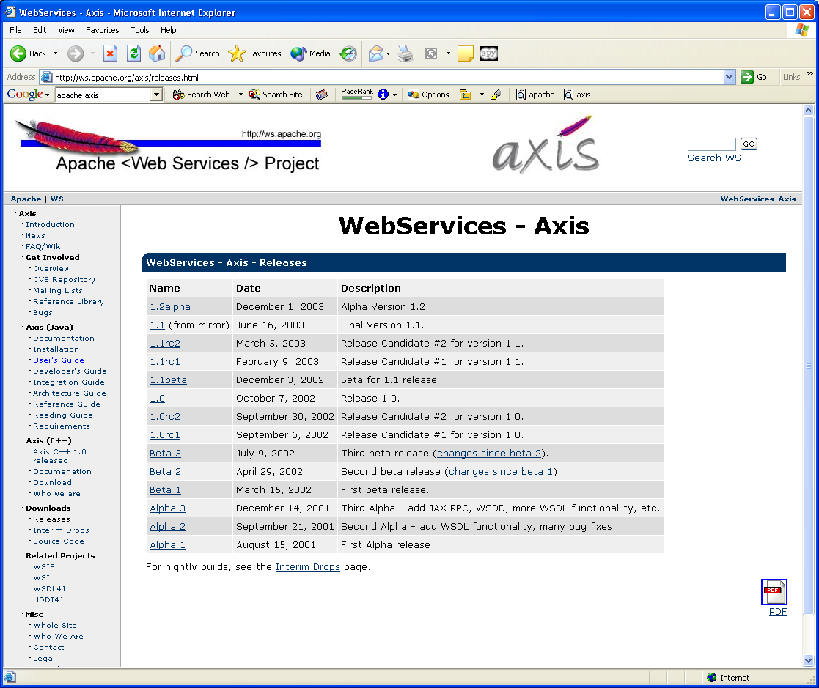
Get the Code
Axis Web site: http://ws.apache.org/axis/
Select downloads.
Get release 1.1
  1.2 is beta
  1.1rcx are older release candidates.
From the mirror site, download the .zip.
  Right click to save to desktop.
  .tar.gz is for the Unix/Linux tar utility.
Right click the axis-1_1 zip folder icon to extract the files.

Slide 22
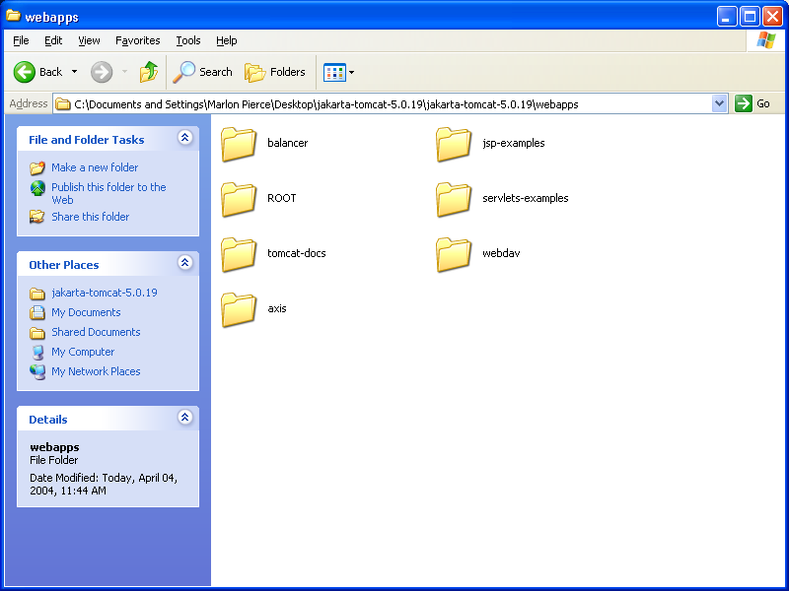
Install the Code
Shutdown Tomcat if it is running.
Open the new axis folder.
  All of the documentation is in the docs subfolder.
Copy the axis_1.1/webapps/axis folder into the jakarta-tomcat-5.0.x webapps folder.
The webapps folder should resemble the image.

Slide 23
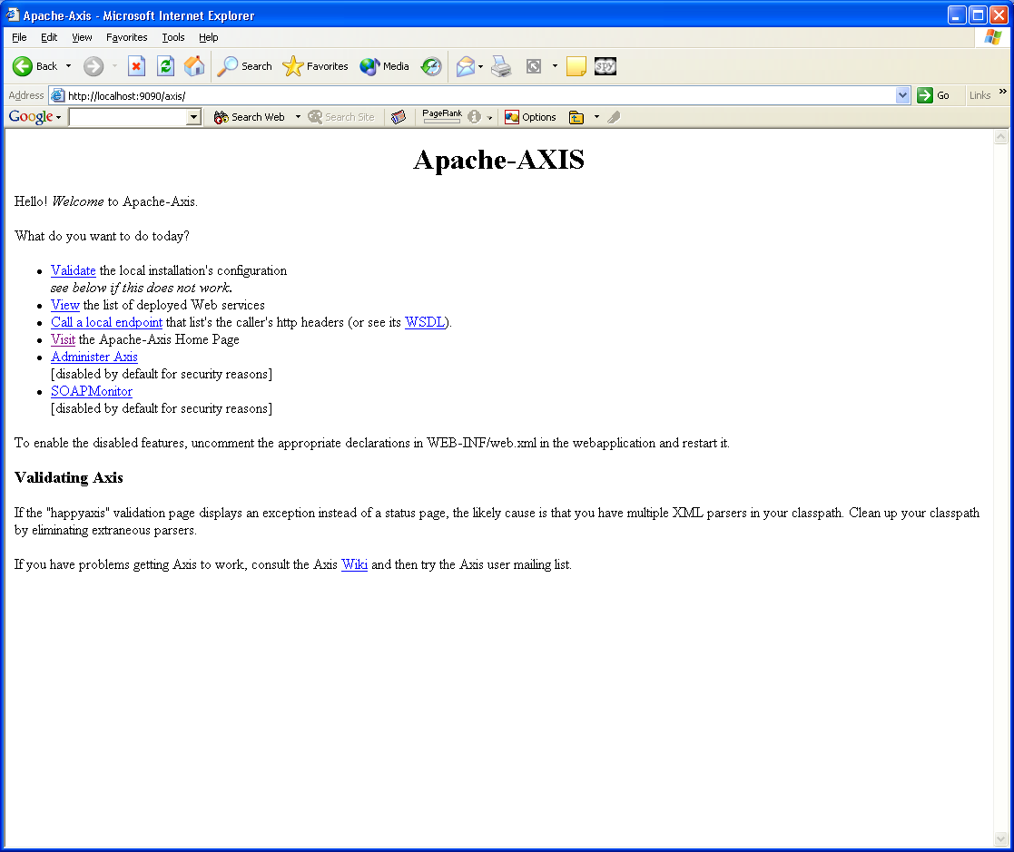
Verify the Installation
Restart Tomcat.
Point your browser at http://localhost:9090/axis.
  Assuming you changed server.xml to use 9090.
You should see the page on the right.

Slide 24
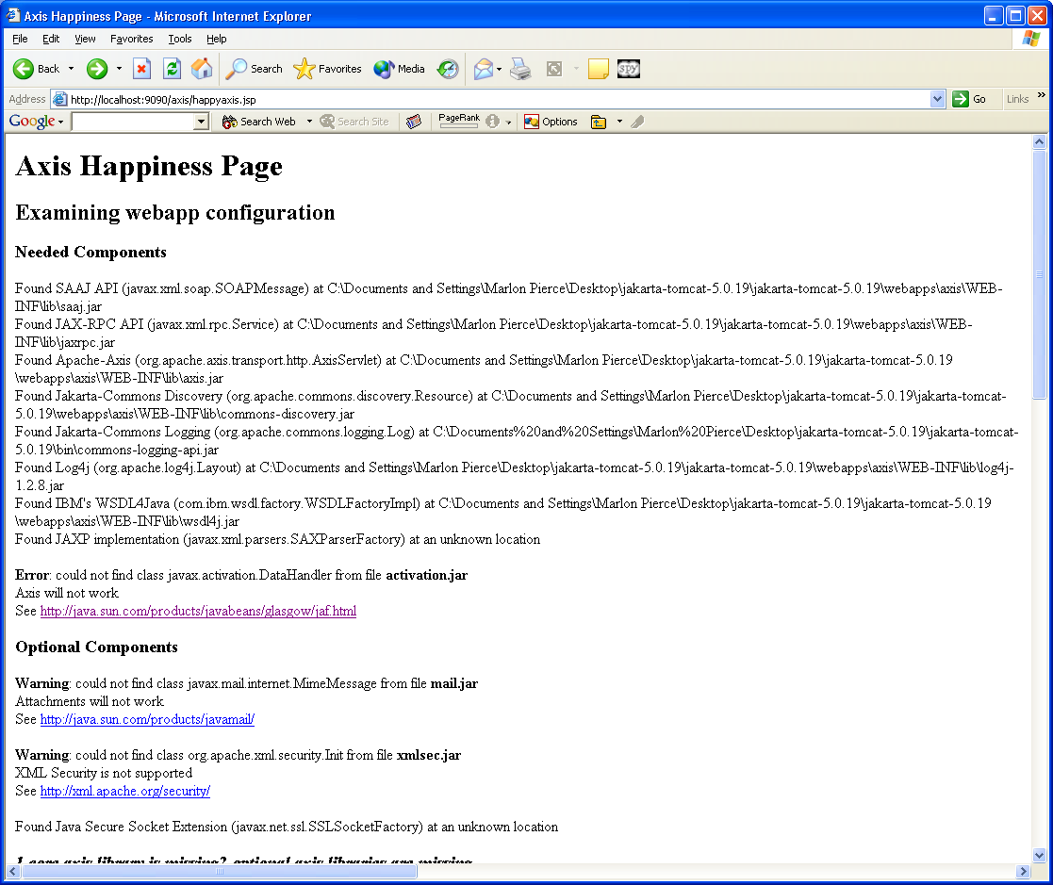
Happy Axis
Click the Happy Axis validation link (first on the page).
Read this page for any errors.
  I got one core error: activation.jar was missing.
  Get it from the link provided.
Correct any errors by getting the appropriate jar files.
  Put them in axis/WEB-INF/lib and restart tomcat.
Reload the Happy Axis page until joy.

Slide 25
Writing an Axis Application
public class echoService {
public String echo(String msg) {
return msg;
}
}
The code on the left is can be converted to an extremely simple service.
Just copy it into a file called echoService.jws in the jakarta-tomcat-5.0.19/webapps/axis directory.
  Make sure Windows does not append .txt to your .jws file name.
  In general, write and compile this as a .java file to check for errors.
  The file will not work if you do.
You’re done. Axis will deploy all .jws files for you.
Point your browser to http://localhost:9090/axis/echo.jws to view the wsdl.

Slide 26
Wrapping the Simpson’s Rule Service

Slide 27
A Very Simple, Very Dangerous Service
The next two slides show a very simple Java program that use the operating system to run executables.
  You normally want to wrap this service to control access to the operating system.
You can use this to execute your MPI programs.
This is not a Web Service. It is just part of a Java program that you compile and run at a shell prompt.

Slide 28
The Java Code
public class SimpsonWrapper {
public String[] execLocalCommand(String command) {
Runtime rt = Runtime.getRuntime();
String stdout="",stderr="";
try {
Process p = rt.exec(command);
BufferedReader in=
new BufferedReader(new InputStreamReader(p.getInputStream()));
BufferedReader err=
new BufferedReader(new InputStreamReader(p.getErrorStream()));

Slide 29
Java Code Continued
String line;
while((line=in.readLine())!= null) {stdout+=line+"\n";}
in.close();
while ((line=err.readLine())!=null) {stderr+=line+"\n";}
err.close();
}//End of try{}
catch (Exception eio) {…}
String[] retstring=new String[2];
retstring[0]=stdout;
retstring[1]=stderr;
return retstring;
} //End of method
}//End of SimpsonWrapper class.

Slide 30
Some Comments
Put this code in a file called SimpsonWrapper.java
Note that “command” string in the execLocalCommand method should be the name of an executable.
  String[] execLocalCommand(String command)
Use here the name of your compiled Simpson’s rule executable.
  Use the full path name for the value.
  Something like /usr/local/bin/mpirun –np 4 ~/JSUClass/a.out
  You can also test this with other Unix commands.

Slide 31
Working With Apache Axis

Slide 32
Axis Information
See http://ws.apache.org/axis/java/user-guide.html for the basic user guide.
Note the WSDD description.
  “Custom Deployment—Introducing WSDD”
Note the WSDD file is not a Web Service standard.
  Not universal, like SOAP or WSDL
  Axis specific.

Slide 33
Developing and Deploying a Service
Write a Java implementation
  Compile it into Axis’s classpath.
    Jakarta-tomcat-5.0.28/webapps/axis/WEB-INF/classes/
Write a deployment descriptor (WSDD) for your service.
  Will be used by Axis runtime to direct SOAP calls.
  Typical use is to specify the Java methods you actually want to expose as a service.
Use Axis’s AdminClient tool to install your WSDD file.
  The tells the axis servlet to load your class and direct SOAP requests to it.
That’s it.
  Axis will automatically generate the WSDL for your service.

Slide 34
Sample WSDD
<deployment name="Submitjob"
xmlns="http://xml.apache.org/axis/wsdd/"
xmlns:java="http://xml.apache.org/axis/wsdd/providers/java">
<service name="Submitjob" provider="java:RPC">
<parameter name="scope" value="request"/>
<parameter name="className"
value="WebFlowSoap.SJwsImp"/>
<parameter name="allowedMethods"
value="execLocalCommand"/>
</service>
</deployment>

Slide 35
Explanation
Use Axis’s command-line AdminClient tool to deploy this to the server.
  java org.apache.axis.client.AdminClient deploy.wsdd
  You must have axis.jar in the classpath.
Axis will create a service called
  http://your.server/axis/services/SubmitJob
WSDL for service is available from
  http://your.server/axis/services/SubmitJob?wsdl
A list of all services is available from
  http://your.server/services

Slide 36
Writing a SOAP Client
Assume you have a deployed service.
You now want to develop a client to invoke the service.
You can do this by directly programming to Axis’s SOAP API.
The following example shows how to do this.
These java classes are responsible for generating the SOAP message we saw earlier.
Put this code in your client application.

Slide 37
Axis SOAP Programming Example
Service service = new Service();
Call call = (Call) service.createCall();
//Set the target service host and service location,
call.setTargetEndpointAddress( new URL(“http://localhost:8080/axis/services) );
//Invoke the operation.
call.setOperationName(new QName(“EchoService",“echo"));
call.addParameter( “in0", XMLType.XSD_STRING,
ParameterMode.IN );
call.setReturnType(XMLType.XSD_STRING);
Object ret = call.invoke(new Object[] {in0});
//The object ret will either be a String is successful or a
//RemoteException on failure.

Slide 38
Avoiding the SOAP Call API
Programming the above works well enough a few times.
But you quickly learn it is tedious and repetitive.
Axis has a tool that will generate the above code for you directly from the WSDL.

Slide 39
Using WSDL2Java
First, make sure your classpath is set correctly.
Obtain a WSDL file for your service.
  Use http://localhost:8080/axis/services/Echo?wsdl,for example.
Use the following command:
  java org.apache.axis.wsdl.WSDL2Java Echo.wsdl
Note you need Axis jars in your classpath to run the above command.

Slide 40
What Do You Get From WSDL2Java?
Four client files get generated.
For the Echo Service example from Spring 2004, these are
  Echo.java
  EchoService.java
  EchoServiceLocator.java
  EchoSoapBindingStub.java: Wraps the SOAP Call method used previously.
You can then write a java program using these client stubs.

Slide 41
Example Stubs
/**Create Echo client object and point to the service you want to use */
Echo myEcho = new
EchoServiceLocator().getEcho(new
URL(http://your.server/axis/services/Echo));
/** Invoke the method as if local. */
String backTalk =
myEcho.echo(“Hello World”);

Slide 42
Using Stubs
You can use the above client snippet in any Java code to invoke the remotely running service.
  Swing GUIs, command line clients, JSPs.
You MUST get the classpath correct for this to work.
  Axis jars needed by both the client and service.
So if you develop a client, you must distribute not only the client code but the Axis jars.
If you use a client Tomcat server, axis must be located in the classpath of that server.
  Jakarta-tomcat-5.0.x/webapps/myapp/WEB-INF/lib

Slide 43
Steps for Completing Homework
I assume you have two Tomcat servers running.
  Tomcat A=server
  Tomcat B=client
I also assume your service has been deployed as a web service.
  Either use the JWS or the WSDD approach for axis.
  This is deployed on Tomcat A.
You should copy the Axis folder into both Tomcat webapp directories for simplicity.

Slide 44
First, Get the WSDL File
Should be something like http://localhost:9090/axis/EchoService.jws?wsdl
Save this to a file in Tomcat B’s folder.
Inspect the file to make sure it is properly formatted WSDL.
Use WSDL2Java to create client stub programs.
  Use something like the following line.
    java –classpath C:\{tomcat_folder}\webapp\axis\WEB-INF\lib\axis.jar org.apache.axis.wsdl.WSDL2Java Echo.wsdl
  You can set the classpath in many other ways.

Slide 45
Now Compile the Stubs
You must now compile the client stubs that you generated and place them in the classpath of Tomcat B.
Tomcat’s classpath is automatically set when you load it.
  It looks in axis/WEB-INF/classes and WEB-INF/lib for each webapp.
  So you need to compile your Axis stubs into axis/WEB-INF/classes and restart tomcat.

Slide 46
Lastly, Write the Application
Lastly, you need to write your JSP application and place it in Tomcat B’s axis webapp.
  A file such as jakarta-tomcat-5.0.x/webapps/axis/MyClient.jsp.
This should remotely invoke the service deployed on Tomcat A.

Slide 47
Another Tutorial
I found the small tutorial link below, which looks reasonable.
  2 minutes of Google can save you hours of frustration.
http://www.ammai.com/modules.php?op=modload&name=Sections&file=index&req=viewarticle&artid=4&page=1

Slide 48
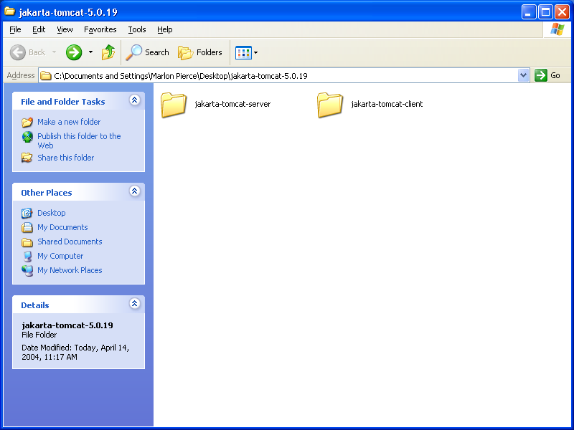
Setting Up
First, install tomcat and axis as described elsewhere.
Then copy Tomcat into a second folder.
  I’ve named mine jakarta-tomcat-server and jakarta-tomcat-client.
  I’ll refer to these as the “Client” and the “Server” folders afterwards.
Edit the Client’s conf/server.xml to use the ports 9005, 9090, and 9009.

Slide 49


Starting Servers
Go into both the Client’s and the Server’s bin folder and start both servers.
I will assume the Client runs on 9090 and the server runs on 8080.
Open 2 browsers and point one at localhost:8080 and the other at localhost:9090. You should see Tomcat splash screens in both cases.

Slide 50
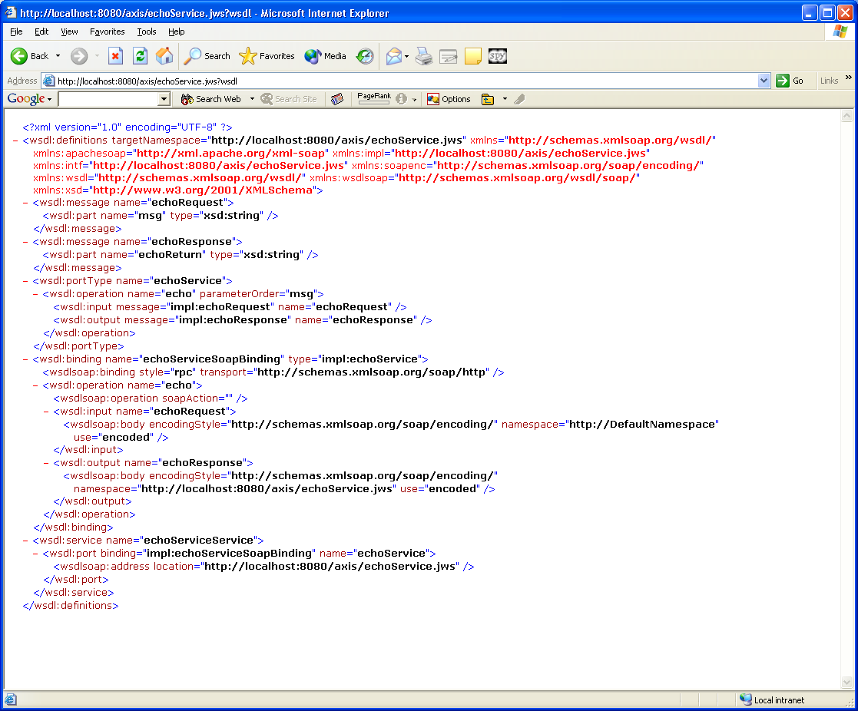
Deploy Service
Deploy your web service onto the Server.
Verify that it works.
I’m using the Echo Service as an example, so it is deployed as a JWS on http://localhost:8080/.
I have a file called echoService.jws, and I can view the wsdl at
  http://localhost:8080/axis/echoService.jws?wsdl

Slide 51
Save WSDL
After viewing the WSDL file from your browser, save it into your Client folder.
  Not required to be in this folder, but a convenient place to put it.
Open the WSDL file with WordPad and make sure that it is correct
  That is, you saved it as WSDL, not HTML
You may also have to rename the file to get the extension correct.
  Mine saved as echoService.jws, so I renamed it to echoService.wsdl.

Slide 52
Compile Client Stubs
As with all java programs, you MUST get the classpath correct.
  This is almost always the cause of any compilation errors.
The simplest thing to do is put all of the axis/WEB-INF/lib jars into your classpath.
If you work in the jakarta-tomcat-client folder, you can use the following command
  C:\Documents and Settings\Marlon Pierce\Desktop\jakarta-tomcat-5.0.19\jakarta-to
  mcat-client>java -classpath .\webapps\axis\WEB-INF\lib\axis.jar;.\webapps\axis\W
  EB-INF\lib\log4j-1.2.8.jar;.\webapps\axis\WEB-INF\lib\commons-discovery.jar;.\we
  bapps\axis\WEB-INF\lib\commons-logging.jar;.\webapps\axis\WEBINF\lib\wsdl4j.jar
  ;.\webapps\axis\WEB-INF\lib\activation.jar;.\webapps\axis\WEB-INF\lib\saaj.jar;.
  \webapps\axis\WEB-INF\lib\axis-ant.jar;.\webapps\axis\WEB-INF\lib\jaxrpc.jar org
  .apache.axis.wsdl.WSDL2Java echoService.wsdl

Slide 53
Some Common Errors
If you mistype WSDL2Java, you will get
  Exception in thread “main” java.lang.NoClassDefFoundError: org.apache.axis.WSDL.WSDL2java
  Or similar.
If you have a typo in your classpath, you will get
  Java.lang.NoClassDefFoundError: {some class}
Both of these can be corrected by checking the classpath and the command.

Slide 54
Success
If you have successfully created your stubs, they will be located in the folder
  Jakarta-tomcat-client/localhost/axis/echoService_jws
  You should see four files there.
  WSDL2Java has options that can change this default location.

Slide 55
Now Compile the Java Stubs
First, look at the generated code.
  You will notice the 4 stub classes all have package name that matches its directory.
You need to compile the stub classes into Client’s WEB-INF/classes directory.
You need to use the same classpath as before (all the jars in WEB-INF/lib).
But also you need WEB-INF/classes in your classpath now, too.
  Some of the stubs depend upon other stubs.

Slide 56
The Full Javac Command
C:> javac -d webapps\axis\WEB-INF\classes -classpath webapps\axis\WEB-INF\classes;.\webapps\axis\WEB-INF\lib\axis.jar;.\webapps\axis\WEB-INF\lib\log4j-1.2.8.jar;.\webapps\axis\WEB-INF\lib\commons-discovery.jar;.\webapps\axis\WEB-INF\lib\commons-logging.jar;.\webapps\axis\WEB-INF\lib\wsdl4j.jar;.\webapps\axis\WEB-INF\lib\activation.jar;.\webapps\axis\WEB-INF\lib\saaj.jar;.\webapps\axis\WEB-INF\lib\axis-ant.jar;
.\webapps\axis\WEB-INF\lib\jaxrpc.jar localhost/axis/echoService_jws/*.java

Slide 57
Note the -d option
This tells the compiler where to put your classes.
I’ve specified the classes directory.
The classes will be created in
  axis/WEB-INF/classes/localhost/axis/echoService_jws/
Check the above folder in the Client tomcat to verify.
  You must verify this before proceeding.

Slide 58
Designing the JSP
First, shutdown and restart the Client tomcat host.
  Easiest way to force it to load your new classes.
Next, create a new file, MyClient.jsp
  Name doesn’t matter, but should have .jsp extension
MUST put this in jakarta-tomcat-client’s webapp/axis directory.
  It may also be in any subfolder of axis except WEB-INF.
  It must be in the axis folder so that it can access all of the axis jars and the stub classes you just compiled.

Slide 59
MyClient.jsp
<%@ page import="localhost.axis.echoService_jws.*"%>
<%@ page import="java.net.URL"%>
<%
String host="http://localhost:8080/axis/echoService.jws";
EchoService myEcho=new EchoServiceServiceLocator().getechoService(new URL(host));
String message=myEcho.echo("Hello World");
%>
<html><body>
The echo message is <%=message%>
</body></html>

Slide 60
Notes
We had to import the packages of the client stubs that we created.
We also needed java.net.URL.
The client side steps are
  First, create a locator instance for your service (EchoServiceServiceLocator).
  Second, create the local proxy class instance of EchoService, myEcho.
  Now use myEcho as if it were local. It has all the methods (wsdl operations) of your service.

Slide 61
Final Comments
Why did we go to so much trouble?
Now you can run the service independently from the client.
To test, zip up your client and give it to someone else.
Have them invoke your service.
  You must run your Server tomcat.
  Your victim should modify localhost:8080 to your.real.machine.name:8080.

