Slide 1
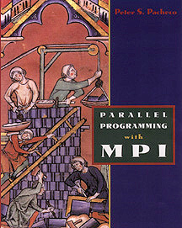
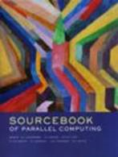
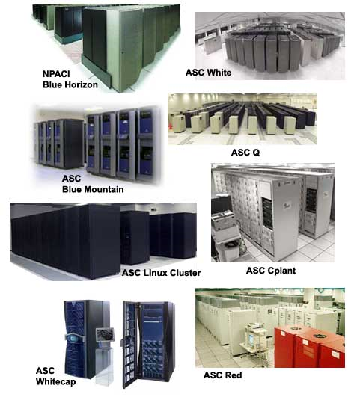
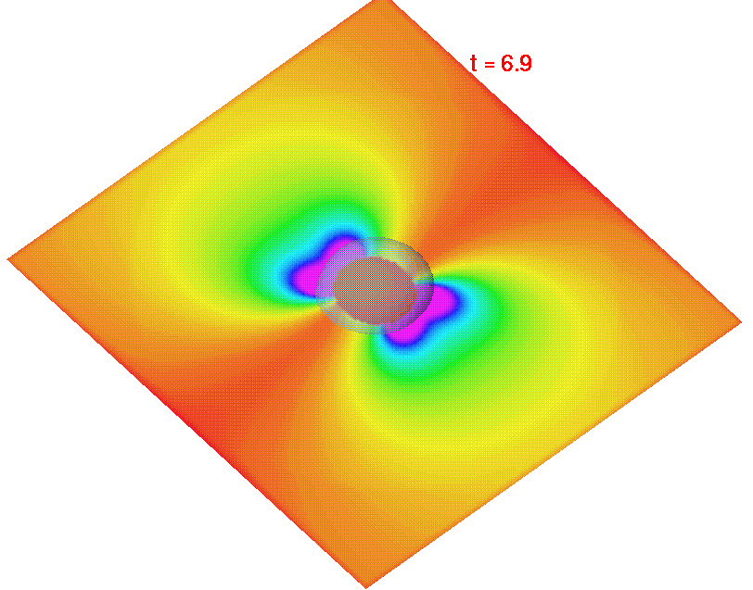
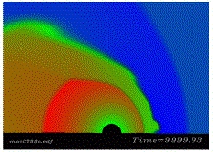
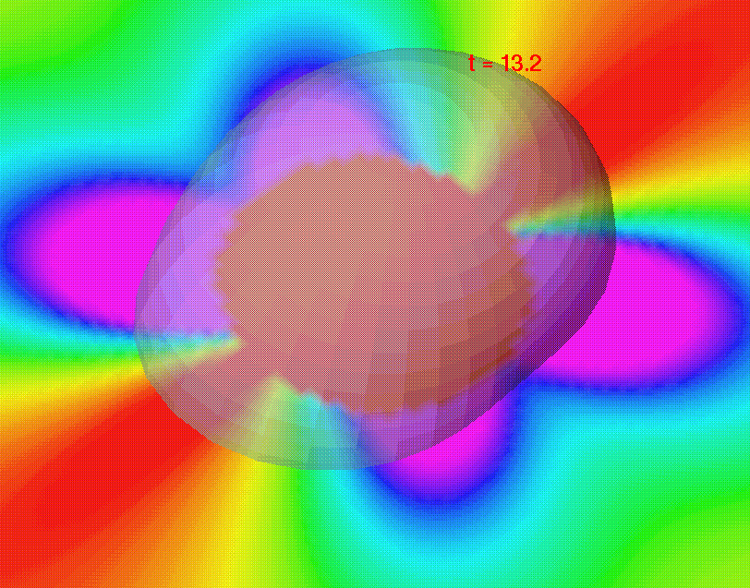

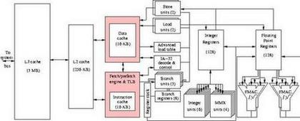
High Performance Computing How to use Recommended Books
Spring Semester 2005
Geoffrey Fox
Community
Grids Laboratory
Indiana University
505 N Morton
Suite 224
Bloomington IN
gcf@indiana.edu

Slide 2
Books For Course
The Sourcebook of Parallel Computing, Edited by Jack Dongarra, Ian Foster, Geoffrey Fox, William Gropp, Ken Kennedy, Linda Torczon, Andy White, October 2002, 760 pages, ISBN 1-55860-871-0, Morgan Kaufmann Publishers. http://www.mkp.com/books_catalog/catalog.asp?ISBN=1-55860-871-0
Parallel Programming with MPI, Peter S. Pacheco, Morgan Kaufmann, 1997. Book web page: http://fawlty.cs.usfca.edu/mpi/

Slide 3
The MPI Book I
This book is important as MPI is the parallel programming technology used in this course
Chapters 1 and 2 form a useful introduction to parallel programming
Chapter 3 and 4 represent basic introduction to MPI and its application in simplest example of numerical integration
Chapters 9-12 discuss operation uses of MPI and performance issues
  We will discuss performance at this level

Slide 4
The MPI Book II
Chapters 5 and 6 discuss “collective communication” (called multicast on the Internet) which we will cover but not stress
Chapter 7 describes parallel matrix multiplication which we will also cover
Chapter 8 (I/O), 13 and 15 are advanced
Chapter 14 has parallel tree-like algorithms; we will do a different one – the Fast Fourier Transform
Chapter 16 is conclusions while appendices are useful compendia of MPI commands

Slide 5
The Sourcebook I
The core material is chapters 1,2,3,4,10.1,16,20.1 and 20.2
Chapters 1-4 are similar to introductory material in this course and more advanced than chapters 1 and 2 of MPI book
Chapter 10.1 of the Sourcebook is MPI but you can substitute chapter 3 or 3-7 of MPI book
Chapter 16 is solution of the Poisson equation used in chapter 4 of Sourcebook and this class
Chapters 20.1 and 20.2 are parallel linear algebra (cf. Chapter 7 of MPI book)

Slide 6
The Sourcebook II
There are a set of useful chapters building on the core material and still broadly applicable: chapters 8, 9, 14, 15 and 21
Chapter 8 is a short description of several parallel applications; a good place to go to get a hint as to how to parallelize a new application that might be thrown at you
Chapter 9 describes the different ways you can develop parallel codes and the trade-offs between them
Chapter 15 (cf. Chapter 9 of MPI book) tells you about tools you can use to find bugs and improve performance of parallel code

Slide 7
The Sourcebook III
Chapter 14 describes Problem Solving Environments and how one uses Web Interfaces to access parallel codes
  The Grid is also briefly discussed
  This is important but don’t worry about detail as this area is advancing rapidly
Chapter 21 describes sophisticated but important ways of supporting parallel solution of partial differential equations
  Many scientific simulations use this
  It describes the excellent PETSc library

Slide 8
The Sourcebook IV
More detailed material can be found in chapters 5, 6, 7, 10.2, 11, 12, 13, 17-19, 20.3-20.8, 22 and 23
Chapters 5, 6, 7, 20.3-20.8 are essentially advanced examples (applications)
Chapters 10.2, 11, 12, 13, 17 advanced parallel software techniques
Chapter 18 has state of the art approach to load balancing; a topic we will discuss simplistically
We will mention importance of mesh generation in solution of partial differential equations; chapter 19 describes the important problem in detail
Chapter 22 and 23 describes tools for optimization and analytic continuation

Slide 9
Students in class
Andre Johnson andre38732@yahoo.com
Georgvell Christian georgvell1@yahoo.com
Harold Griffin big_heazie@hotmail.com
Michael Williams authur27@yahoo.com
Edward Mims Dwardo321@aol.com
Kylie Nash kylie.r.nash@ccaix.jsums.edu
Malcolm Thompson methompson82@hotmail.com
Godwin Adu-Boateng godwin.adu-boateng@ccaix.jsums.edu
Fareedah Sabree f_sabree@excite.com
Tolulola Oyeleye oyeleyetolulola@yahoo.com
Sharintae Matthews sharintae.m.matthews@ccaix.jsums.edu

