Slide 1


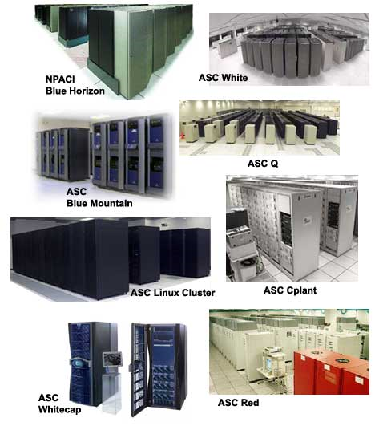
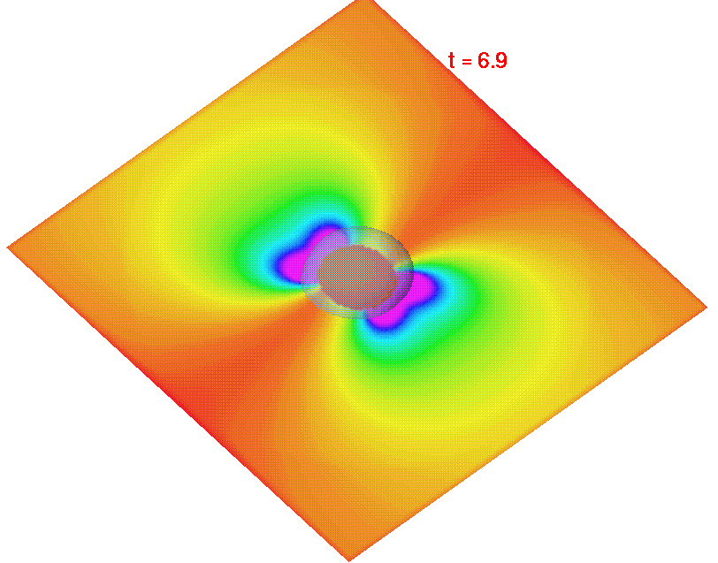
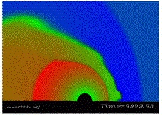
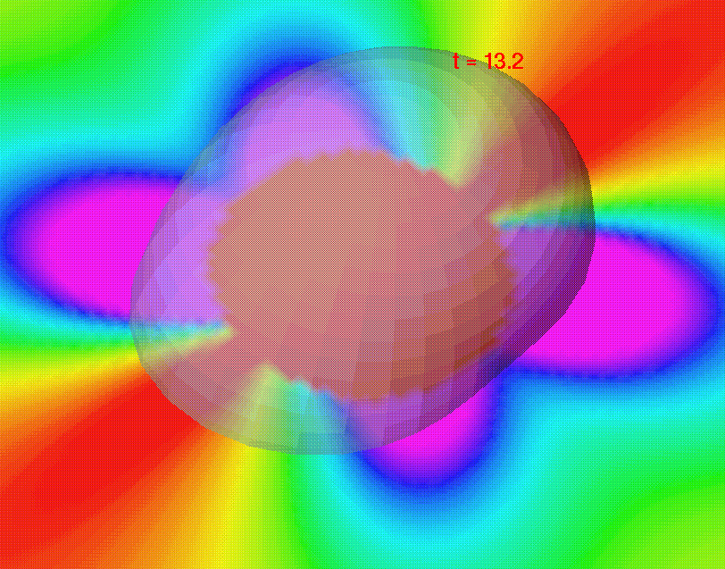

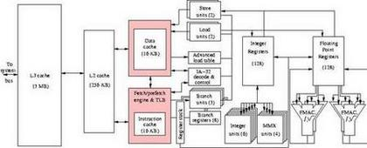
High Performance Computing Discussion of Student Applications
Spring Semester 2005
Geoffrey Fox
Community
Grids Laboratory
Indiana University
505 N Morton
Suite 224
Bloomington IN
gcf@indiana.edu

Slide 2
Weather and Climate Simulations I
Parallel Computing works very well in this area which varies from
  Weather: predict next few hours to days
  Climate: predict next 100 years
One gets parallelism from dividing atmosphere up into 3D sub-regions by vertical or horizontal subdivisions
Important special cases include hurricane and Tornado simulations which need high performance to meet real-time constraints
  Tornados need particularly small spatial regions (so called mesoscale) to capture rapid space variation

Slide 3
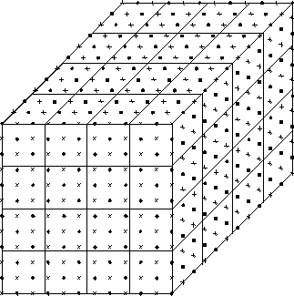
Weather and Climate Simulations II
12X12X12 mesh divided between into 64 3X3X3 sub-regions
Real Problem could be
500X500X100 on 200 50X50X50 sub-regions

Slide 4
Weather and Climate Simulations III
Simulations require a lot of input data
  Boundary values at edges of region
  Chemical make-up of atmosphere
Climate predictions involve ecology and oceanography as very sensitive to atmosphere-ocean and atmosphere-land interactions
  Ocean currents (gulf stream, El Nino) affect climate
  Forests (or not if cut down) in Amazon affect chemical composition of air
Growing number of velocity, temperature and composition sensors (including satellites)

Slide 5
Weather and Climate Simulations IV
The dependency on often unknown data suggests ensemble computations where one runs the same model with lots of different choices for defining data
One can now use “decomposition over data choices” to get additional parallelism
  running each data choice simultaneously on a different node of a parallel machine
Used in hurricane simulations to define regions better they might land better
Used in climate predictions in SETI@Home style where distribute a different data set on each home computer
  See http://www.climateprediction.net
  Note importance in 100 year global warming simulations

Slide 6
Drug Discovery
It is very important to discover if a particular compound could be a useful drug
Compounds are geometrical structures made up from atoms or molecules interacting with known forces
  Simulate compound in a media such as a collection of water molecules
One needs to study system dynamics ( evolution in time) to see shape (folding) of compound
One also looks at shape to see if naturally binds to other compounds
This can lead to a computer screening with real experiments used to verify and extend simulations for selected compounds
Parallel computing implies that one divides atoms between the different processors and calculates forces and advances dynamics simultaneously
FOLDING@Home http://folding.stanford.edu/ uses peer-to-peer computing for this and it is also has excellent introductory educational material

Slide 7
Oil Exploration
This area is discussed in Chapter 6 of Sourcebook by Mary Wheeler
There are two major classes of uses of HPC
In the first one supports the analysis of data which comes from ships or ground stations propagating sound waves in the earth and measuring the response. This can be analyzed (tomography) to map out structure of earth below the surface and discover good places to drill for oil
In the second one models existing oil fields (collections of oil wells) to see how oil and water will flow with various extraction strategies
  Water is often pumped into fields to force oil into better locations
  This allows one to get more oil more cheaply from field

Slide 8
HPC in Department of Defense
We should discuss this as the HPCMO (High Performance Computing Modernization Office) is sponsoring this class
HPCMO runs many large systems complemented by several distributed systems for focused problems
Example areas of importance include weather (discussed separately), airflow for vehicles and planes, effect of explosions, chemical spills, bioterrorism, electromagnetic signatures for stealth systems, image and signal analysis to identify “needles in haystack”, “war-games”, design of armor and tracking of projectiles hitting vehicles
DARPA (research part of DoD) has a major HPCS (High Productivity Computing Systems) initiative aimed at higher productivity i.e. easier to realize performance – current supercomputers often only realize 5-10% of advertised peak (or of TOP500 number)

Slide 9
Macintosh Clusters and Plasma Physics
Apple has recently been making computers that are very competitive with PC’s in constructing clusters
  Virginia Tech made this famous with a very large system and UCLA designed AppleSeed cluster
  http://exodus.physics.ucla.edu/appleseed/appleseed.html
  Note one can also build interesting clusters from video game controllers (Xbox, Playstation ..) as they have tremendous floating point performance needed by graphics
The UCLA group does Plasma Physics and worked in the first machines I built in 1985; I think they prefer Apple’s!
Plasma Physics is distinctive as has a mesh and particles (electrons) in the mesh and it combines the two major types of parallel applications
  Evolve a set of particles simultaneously
  Have a 3D distribution of a “field” (here electrical potential) and solve partial differential equations
One uses the usual geometrical decomposition to get parallelism

Slide 10
Parallel Computing and Grids
There are growing synergies between
  Parallel Computing
  Distributed Computing
  Internet Computing
  Peer-to-peer Computing
  The Grid which is Internet Scale Distributed Computing
Each consist of processes (computers) exchanging messages
Different trade-offs between bandwidth/latency of network and nature of application

Slide 11
Some definitions of a Grid
Supporting human decision making with a network of at least four large computers, perhaps six or eight small computers, and a great assortment of disc files and magnetic tape units - not to mention remote consoles and teletype stations - all churning away. (Licklider 1960)
Coordinated resource sharing and problem solving in dynamic multi-institutional virtual organizations
Infrastructure that will provide us with the ability to dynamically link together resources as an ensemble to support the execution of large-scale, resource-intensive, and distributed applications.
Realizing thirty year dream of science fiction writers that have spun yarns featuring worldwide networks of interconnected computers that behave as a single entity.

Slide 12
What is a High Performance Computer?
We might wish to consider three classes of multi-node computers
1) Classic MPP with microsecond latency and scalable internode bandwidth (t_{comm}/t_{calc} ~ 10 or so)
2) Classic Cluster which can vary from configurations like 1) to 3) but typically have millisecond latency and modest bandwidth
3) Classic Grid or distributed systems of computers around the network
  Latencies of inter-node communication – 100’s of milliseconds but can have good bandwidth
All have same peak CPU performance but synchronization costs increase as one goes from 1) to 3)
Cost of system (dollars per gigaflop) decreases by factors of 2 at each step from 1) to 2) to 3)
One should NOT use classic MPP if class 2) or 3) suffices unless some security or data issues dominates over cost-performance
One should not use a Grid as a true parallel computer – it can link parallel computers together for convenient access etc.

Slide 13
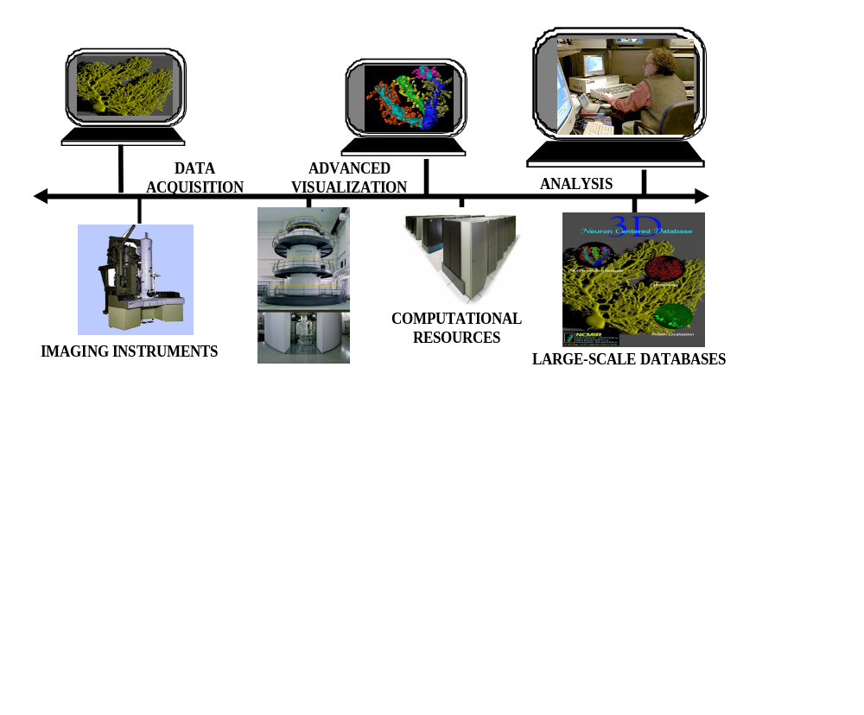
e-Science and Grid
e-Science is about global collaboration in key areas of science, and the next generation of infrastructure that will enable it. This is a major UK Program
e-Science reflects growing importance of international laboratories, satellites and sensors and their integrated analysis by distributed teams
CyberInfrastructure is the analogous US initiative
Grid Technology supports e-Science and CyberInfrastructure

Slide 14
Desktop and P2P Grids I
There are set of “desktop grid” or “peer-to-peer computing” applications which are implemented by parallel computing over the “Internet” i.e. on “idle” machines in peoples homes and business
Note power of such machines is 1000X that in best supercomputers BUT their communication bandwidth is poor between peers (machines at “edge of Internet”); it is modest to good for bandwidth between Internet peers and “servers at the center of the world”
  Only use for problems that can be broken up into independent parallel parts communicating with central systems (farm or master-worker computing paradigm)
Applied to businesses with idle workstations on a corporate intranet, one can get good peer-to-peer communication
  These are Crunch Grids used by financial and aerospace industry for “overnight” simulations

Slide 15
Desktop and P2P Grids II
Discovering if a very large number is prime (Mersenne prime search) is typical of the Internet style Desktop Grid
  Naively one sees if all lower numbers divide the large number; one can send different ranges of possible divisors to different Internet peers
Applications include:
  Ensemble model of climate prediction (different defining data on each peer)
  Analysis of SETI (extra terrestrial) data (different data sets on each peer)
  Drug discovery (different potential drugs on each peer)
  Cracking RSA Security codes (related to prime number problem)
  Becoming rich (model of different stock prices on each peer)
Features include embedding in screen savers; tolerance for flaky peers; “sandbox” need to isolate peer from downloaded code

Slide 16
Desktop and P2P Grids III
There are many software systems supporting such “embarrassingly parallel” computations; well-known commercial systems are
  Entropia
  United Devices (commercial version of SETI@Home)
  Parabon (Java)
Academic systems are SETI@Home with software BOINC (Berkeley Open Infrastructure for Network Computing) freely available
Related systems are Condor, PBS (Portable Batch Scheduler), Sun Grid Engine which do similar orchestration of multiple PC’s/workstations but emphasize “enterprise” (intranet not internet) applications

Slide 17
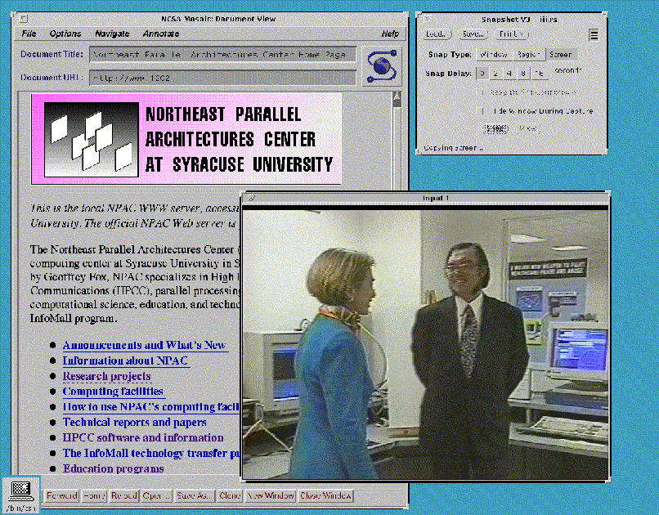
Telemedicine
Telemedicine involves linking patients and care providers at a distance and some of technology is related to that used in distance education
I once presented possibly first ever web-based telemedicine system to Hillary Clinton in April 1994
Today one would use Grid technology with audio/video technology linking people
Instruments can get data from patients and display it remotely in doctors office
Important for rural medicine where nearest major hospital hundreds of miles away
Military and prison also important applications

Slide 18
Medical Instruments
Several medical instruments can be helped by parallel computing
Some take images in two or three dimensions
These need to be analyzed to identify cancers and other anomalies
Image analysis (e.g. find large blob in sketch below) has been studied extensively on parallel machines; you divide the region up geometrically as illustrated by green lines; load balancing is nontrivial
Another class of instrument needs planning so as for example direct a proton beam past vital organs to a tumor; getting reliable reproducible answers is essential to avoid being sued!

Slide 19
Heart and Systems Biology I
Biology is a very promising new area for computational science where large scale use of simulations is only just beginning
We understand basic equations in
  physics (structure of fundamental particles – quarks and gluons)
  Engineering (cars crashing, airflow around wings)
We do not understand cell dynamics very well and so many important biological simulations not feasible at present
However systems like heart as a pump and blood flow can be treated well as details of cells not important
Compare with Bioinformatics that studies genomics or structure inside cells
  This becomes pattern matching algorithms – comparing one Gene sequence with database and is very different type of computer science

Slide 20
Heart and Systems Biology II
Compare with Bioinformatics that studies genomics or structure inside cells
  This becomes pattern matching algorithms – comparing one Gene sequence with database and is very different type of computer science
  “Graph” structure algorithms
Genes often stored in a collection of distributed computers across the world as genes discovered in many different laboratories
Parallelism is usually “just” of the embarrassing “Google” style
  Google divides Web in 30,000 parts and runs your query with one CPU doing 1/30000th of the possible web sites
So divide existing genes into say 100 parts and one CPU compares new Gene with 1/100 of existing Genes

Slide 21
Airline Scheduling
Scheduling of tasks is a very important problem that for aircraft becomes:
Assign times for plane flights and assign crew to planes subject to lots of constraints
  Desires of Passengers
  Location of crew
  Capacity of aircraft and airports …
  Maintenance and Weather!
Do this so that fuel costs minimized, passengers happiest, airline stockholders happiest etc. and do in real-time for a winter storm
Optimization occurs in many other areas such university class scheduling, getting shuttle ready to fly, identifying enemy aircraft in a cluttered radar image, deciding order of links in a Google search, finding best chess move
One important approach is linear programming which involves matrix arithmetic which can be parallelized with some difficulty; we will discuss easier linear algebra problems later in course
Other methods involve combinatorial searches over all possibilities which are very computer time intensive; this involves issues like NP completeness (can’t be done in a time polynomial in number of parameters) and heuristic (approximate) methods; parallelism is possible but often tricky

Slide 22
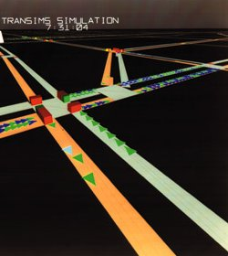
Transportation I
Modeling transportation systems is very interesting and it can hard to make parallel computers perform well
Distribution of roads on the ground is very irregular in space while vehicles vary in space and time
TRANSIMS http://www.transims.net/ is a top class system built by the department
of energy at Los Alamos
These generalize to so-called
critical infrastructure simulations
electrical/gas/water grids and
Internet, cell and wired phone
dynamics.
Couple these national
infrastructures

Slide 23
Transportation II
Activity data for people/institutions essential for detailed dynamics; get from census data and studies of people flow at various places in a city
This tell you goals of people and where they are but not their detailed movement between places
  Use “Monte Carlo” methods to generate a possible movement model consistent with average data on business, shopping and living data
Disease and Internet virus spread and social network simulations can be built on this movement data
Parallelism comes again from geographical decomposition of people and vehicles

