Slide 1
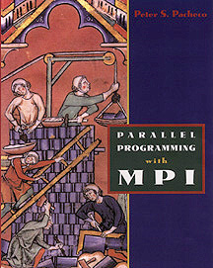

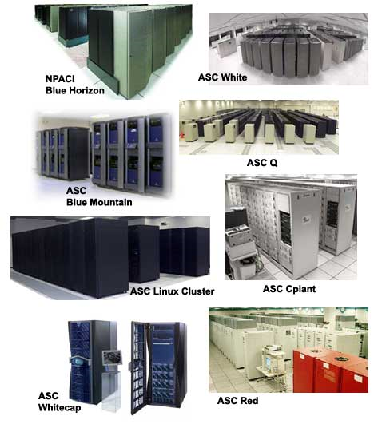
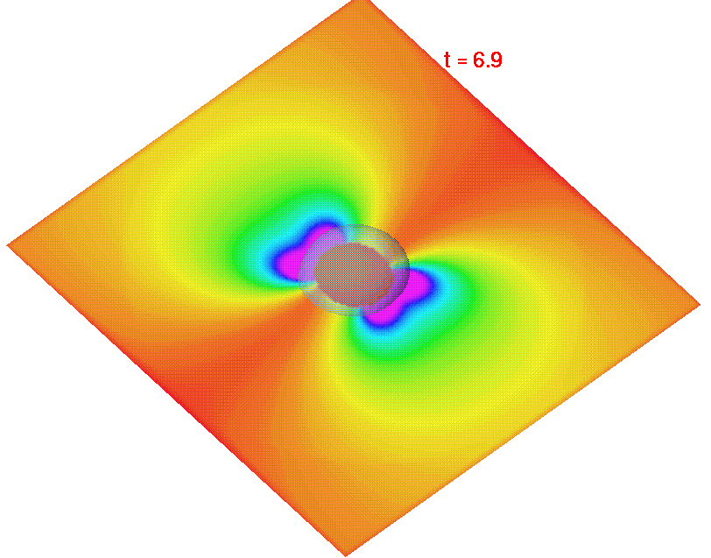
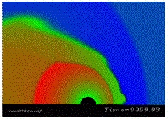
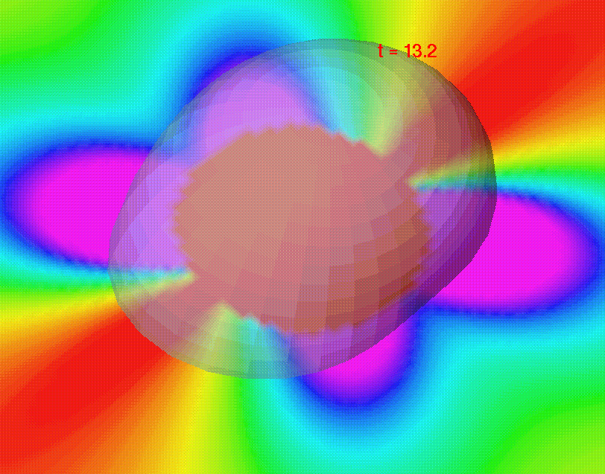

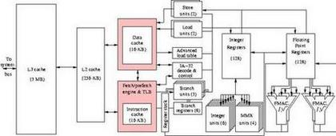
Parallel Matrix Multiplication and other Full Matrix Algorithms
Spring Semester 2005
Geoffrey Fox
Community
Grids Laboratory
Indiana University
505 N Morton
Suite 224
Bloomington IN
gcf@indiana.edu

Slide 2
Abstract of Parallel Matrix Module
This module covers basic full matrix parallel algorithms with a discussion of matrix multiplication, LU decomposition with latter covered for banded as well as true full case
Matrix multiplication covers the approach given in “Parallel Programming with MPI" by Pacheco (Section 7.1 and 7.2) as well as Cannon's algorithm.
We review those applications -- especially Computational electromagnetics and Chemistry -- where full matrices are commonly used
Note sparse matrices are used much more than full matrices!

Slide 3
Matrices and Vectors
We have vectors with components x_{i} i=1…n
x = [x₁,x₂, … x_{(n-1)}, x_{n}]
Matrices A_{ij} have n² elements
A = a₁₁ a₁₂ …a_{1n}
a₂₁ a₂₂ …a_{2n}
…………...
a_{n1} a_{n2} …a_{nn}
We can form y = Ax and y is a vector with components like
y₁ = a₁₁x₁ + a₁₂ x₂ + .. + a_{1n}x_{n} .........
y_{n} = a_{n1}x₁ + a1₂ x₂ + .. + a_{nn}x_{n}

Slide 4
More on Matrices and Vectors
Much effort is spent on solving equations like Ax=b for x
x =A⁻¹b
We will discuss matrix multiplication C=AB where C A and B are matrices
Other major activities involve finding eigenvalues λ and eigenvectors x of matrix A
Ax = λx
Many if not the majority of scientific problems can be written in matrix notation but the structure of A is very different in each case
In writing Laplace’s equation in matrix form, in two dimensions (N by N grid) one finds N² by N² matrices with at most 5 nonzero elements in each row and column
  Such matrices are sparse – nearly all elements are zero
IN some scientific fields (using “quantum theory”) one writes A_{ij} as <i|A|j> with a bra <| and ket |> notation

Slide 5
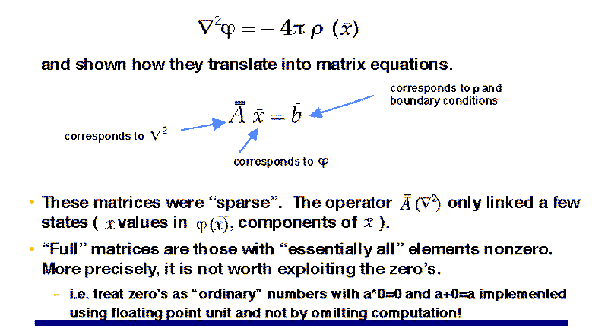
Review of Matrices seen in PDE's
Partial differential equations are written as given below for Poisson’s equation
  Laplace’s equation is ρ = 0
  ∇² Φ= ∂²Φ/∂x² + ∂²Φ/∂y² in two dimensions

Slide 6
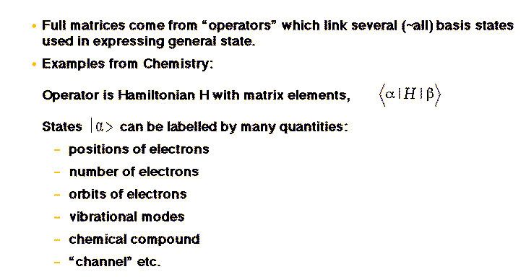
Examples of Full Matrices in Chemistry

Slide 7
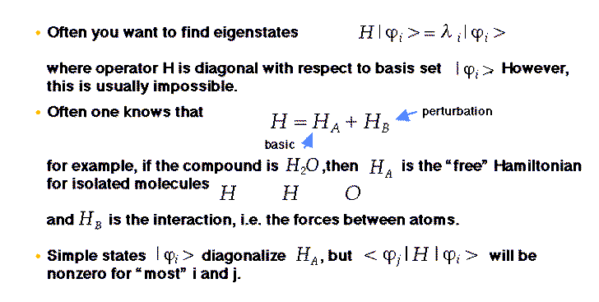
Operations used with Hamiltonian operator

Slide 8
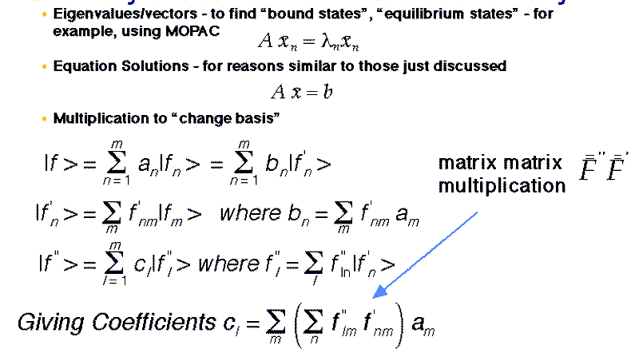
Examples of Full Matrices in Chemistry

Slide 9
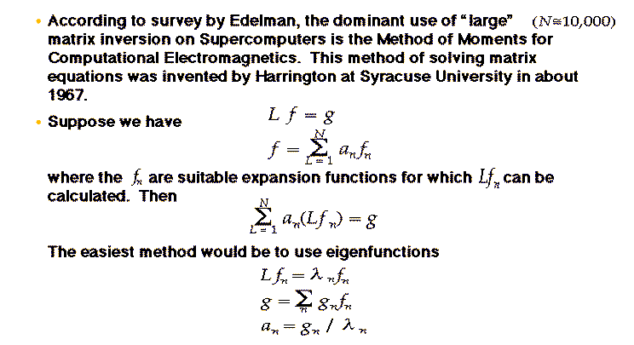
Examples of Full Matrices in Electromagnetics

Slide 10
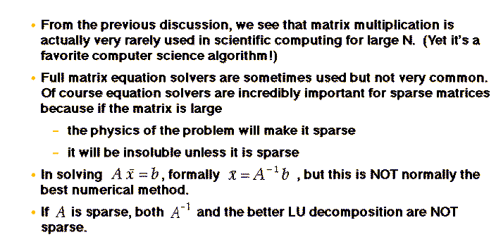
Notes on the use of full matrices

Slide 11
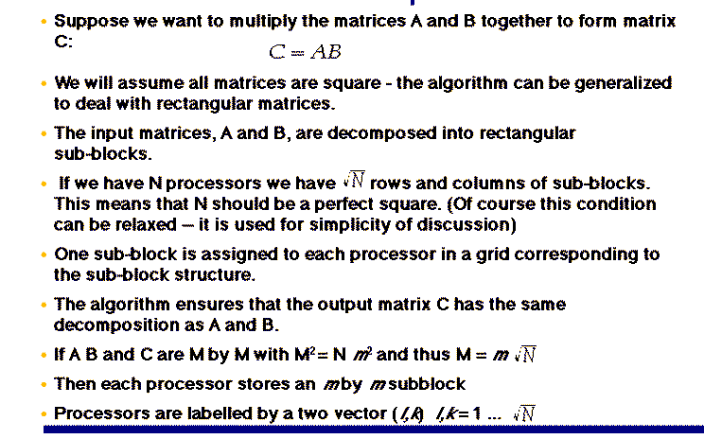
Introduction: Full Matrix Multiplication

Slide 12
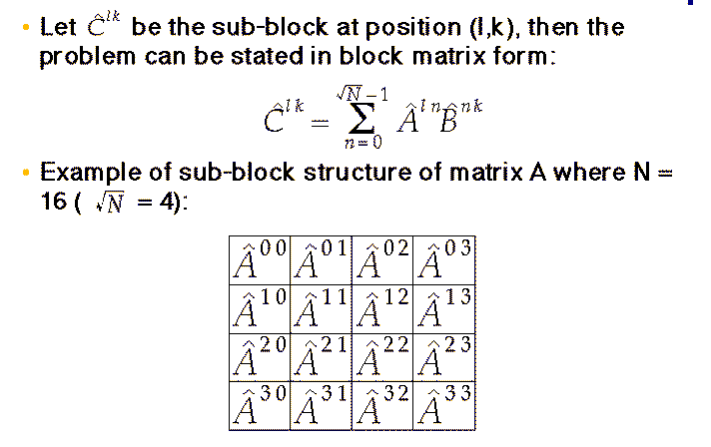
Sub-block definition of Matrix Multiply
Note indices start at
0 for rows and columns of matrices
They start at 1 for rows and columns of processors

Slide 13
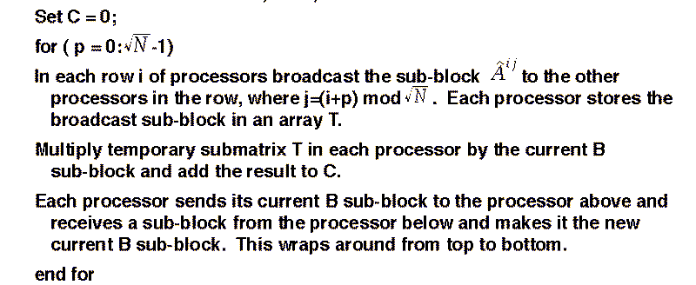
The First (“Fox’s” in Pacheco) Algorithm
(Broadcast, Multiply, and Roll)

Slide 14
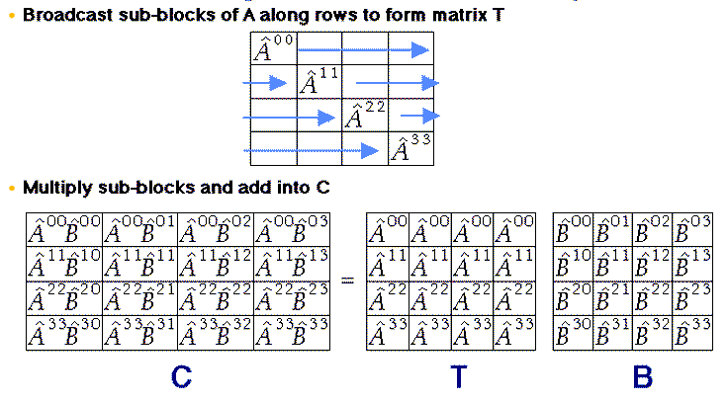
The first stage -- index n=0 in sub-block sum -- of the algorithm on N=16 example

Slide 15
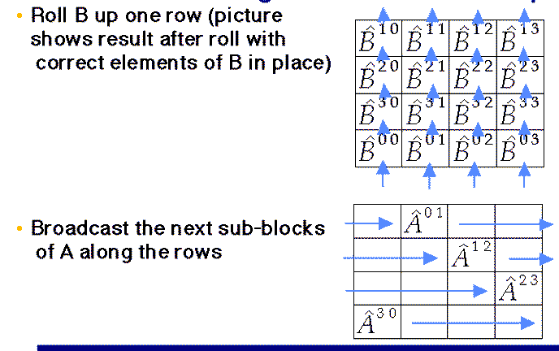
The second stage -- n=1 in sum over subblock indices -- of the algorithm on N=16 example

Slide 16
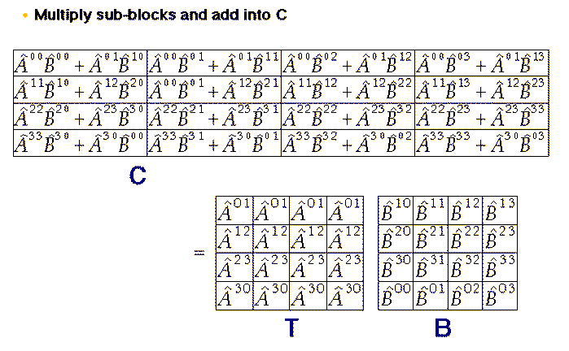
Second stage, continued

Slide 17
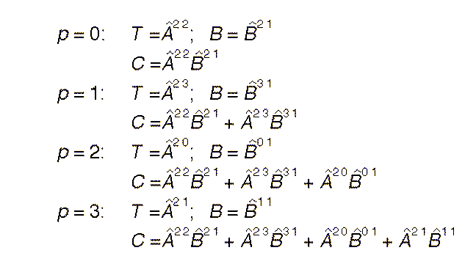
Look at the whole algorithm on one element

Slide 18
MPI: Processor Groups and Collective Communication
We need “partial broadcasts” along rows
And rolls (shifts by 1) in columns
Both of these are collective communication
“Row Broadcasts” are broadcasts in special subgroups of processors
Rolls are done as variant of MPI_SENDRECV with “wrapped” boundary conditions
There are also special MPI routines to define the two dimensional mesh of processors

Slide 19
Broadcast in the Full Matrix Case
Matrix Multiplication makes extensive use of broadcast operations as its communication primitives
We can use this application to discuss three approaches to broadcast
  Naive
  Logarithmic given in Laplace discussion
  Pipe
Which have different performance depending on message sizes and hardware architecture

Slide 20
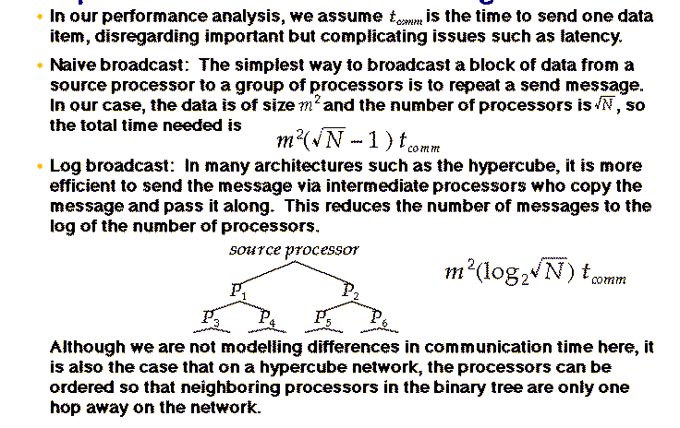
Implementation of Naive and Log Broadcast

Slide 21
The Pipe Broadcast Operation
In the case that the size of the message is large, other implementation optimizations are possible, since it will be necessary for the broadcast message to be broken into a sequence of smaller messages.
The broadcast can set up a path (or paths) from the source processor that visits every processor in the group.
The message is sent from the source along the path in a pipeline, where each processor receives a block of the message from its predecessor and sends it to its successor.
The performance of this broadcast is then the time to send the message to the processor on the end of the path plus the overhead of starting and finishing the pipeline.
  Time = (Message Size + Packet Size (√N – 2))t_{comm}
For sufficiently large grain size the pipe broadcast is better than the log broadcast
Message latency hurts Pipeline algorithm

Slide 22
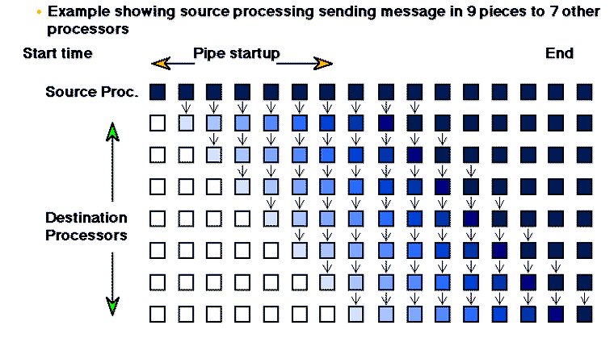
Schematic of Pipe Broadcast Operation

Slide 23
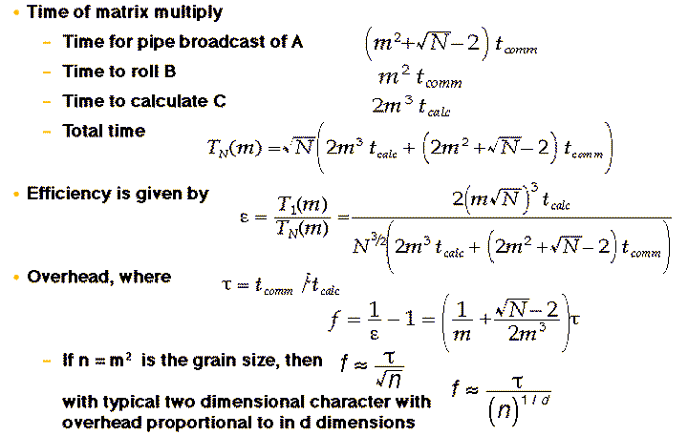
Performance Analysis of Matrix Multiplication

Slide 24
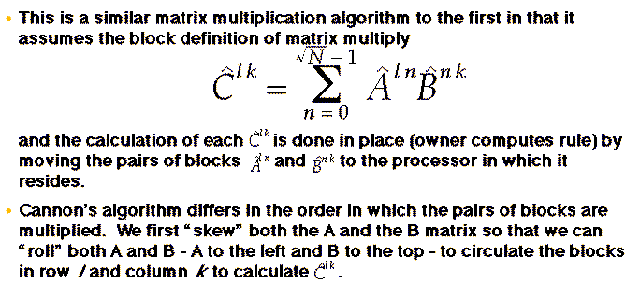
Cannon's Algorithm for Matrix Multiplication

Slide 25
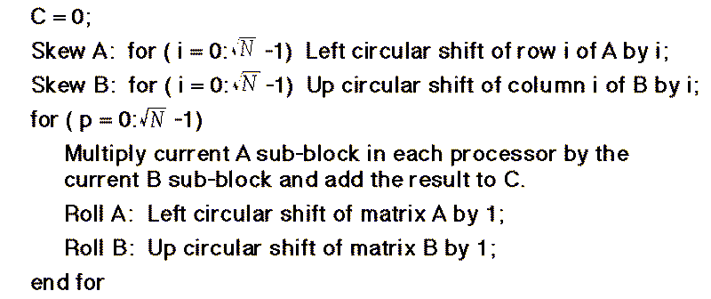
Cannon's Algorithm

Slide 26
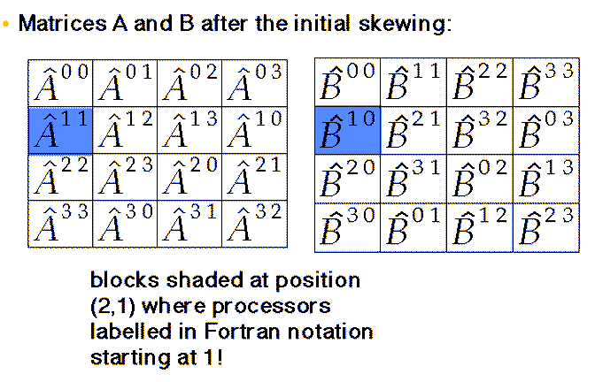
The Set-up Stage of Cannon’s Algorithm

Slide 27
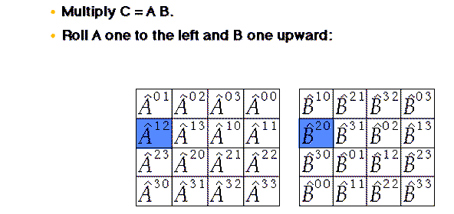
The first iteration of Cannon’s algorithm

Slide 28
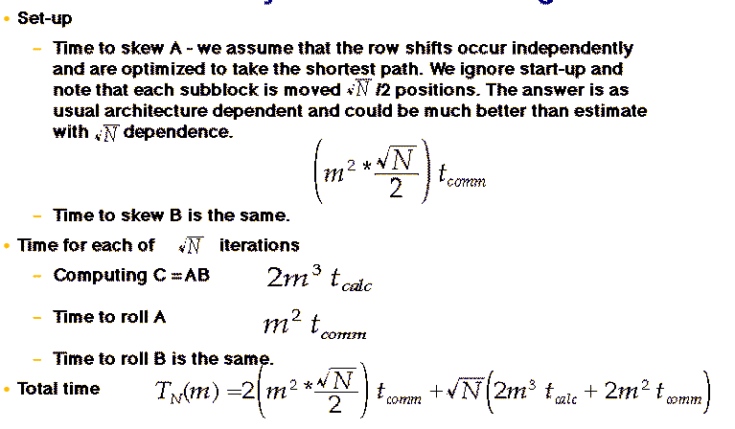
Performance Analysis of Cannon's Algorithm

