Slide 1


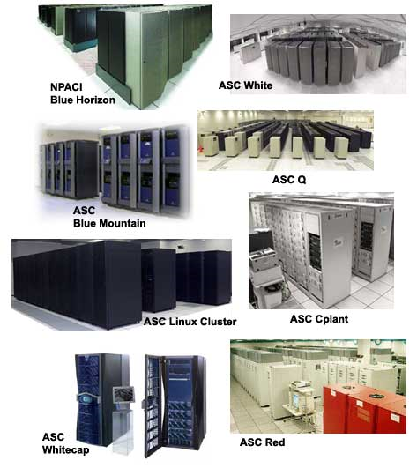
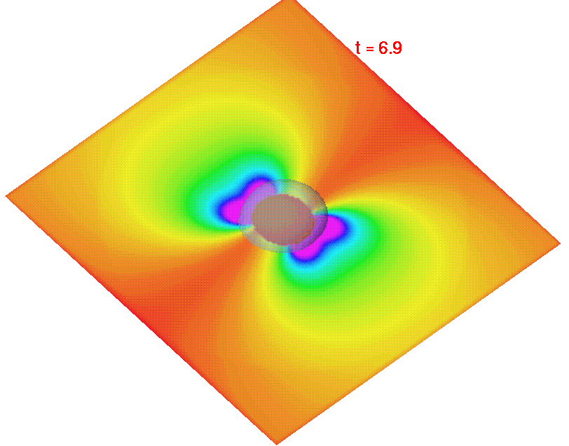
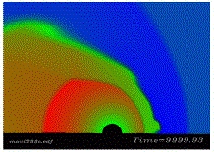
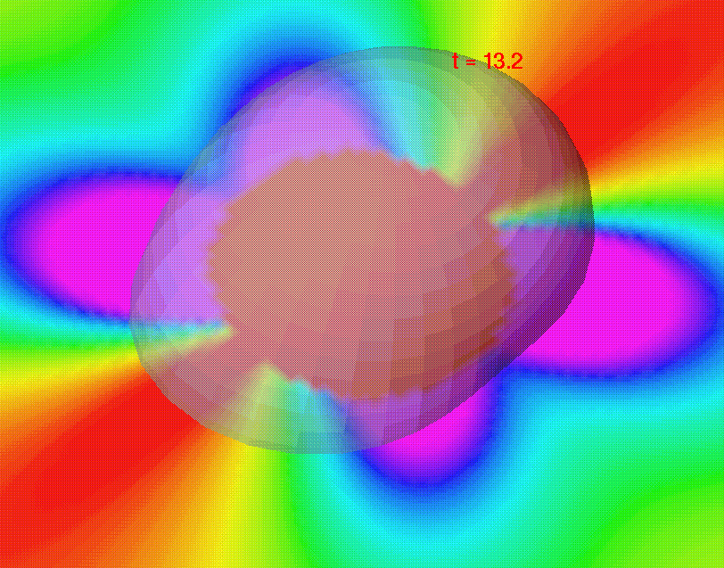

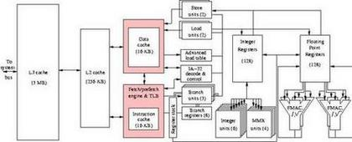
Parallel Programming for Laplace’s Equation
Spring Semester 2005
Geoffrey Fox
Community
Grids Laboratory
Indiana University
505 N Morton
Suite 224
Bloomington IN
gcf@indiana.edu

Slide 2
Abstract of Parallel Programming for Laplace’s Equation
This takes Jacobi Iteration for Laplace's Equation in a 2D square and uses this to illustrate:
Programming in both Data Parallel (HPF) and Message Passing (MPI and a simplified Syntax)
SPMD -- Single Program Multiple Data -- Programming Model
Stencil dependence of Parallel Program and use of Guard Rings
Collective Communication
Basic Speed Up, Efficiency and Performance Analysis with edge over area dependence and consideration of load imbalance and communication overhead effect

Slide 3
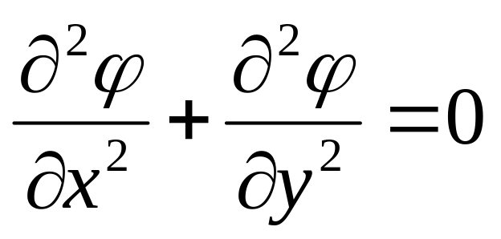
Potential in a Vacuum Filled Rectangular Box
So imagine the world’s simplest PDE problem
Find the electrostatic potential inside a box whose sides are at a given potential
Set up a 16 by 16 Grid on which potential defined and which must satisfy Laplace’s Equation

Slide 4
Basic Sequential Algorithm
φ_{Up}
φ_{New}
Initialize the internal 14 by 14 grid to anything you like and then apply for ever!
φ_{Right}
φ_{Left}
φ_{Down}
φ _{New} = (φ _{Left} + φ _{Right} + φ _{Up} + φ _{Down} ) / 4

Slide 5
Update on the Grid
14 by 14
Internal
Grid

Slide 6
Parallelism is Straightforward
If one has 16 processors, then decompose geometrical area into 16 equal parts
Each Processor updates 9 12 or 16 grid points independently

Slide 7
Communication is Needed
Updating edge points in any processor requires communication of values from neighboring processor
For instance, the processor holding green points requires red points

Slide 8
Red points on edge are known values of φ from boundary values
Red points in
circles are
communicated
by neighboring
processor
In update of a processor points, communicated and boundary value points act similarly

Slide 9
Sequential Programming for Laplace I
We give the Fortran version of this
C versions are available on our Web Site (go to area associated with “2 volume CD-ROM”)
  We will put this type of material on the class Wiki
If you are not familiar with Fortran
  AMAX1 calculates the maximum value of its arguments
  Do n starts a for loop ended with statement labeled n
  Rest is obvious from “English” implication of Fortran command
We start with one dimensional Laplace equation
  d²Φ/d²x = 0 for a ≤ x ≤ b with known values of Φ at end-points x=a and x=b
  But also give the sequential two dimensional version

Slide 10
Sequential Programming for Laplace II
We only discuss detailed parallel code for the one dimensional case; the online resource has three versions of the two dimensional case
  The second version using MPI_SENDRECV is most similar to discussion here
This particular ordering of updates given in this code is called Jacobi’s method; we will discuss different orderings later
In one dimension we apply
Φ_{new}(x) = 0.5*(Φ_{old}(x-left) + Φ_{old}(x-right))
for all grid points x and
Then replace Φ_{old}(x) by Φ_{new}(x)

Slide 11
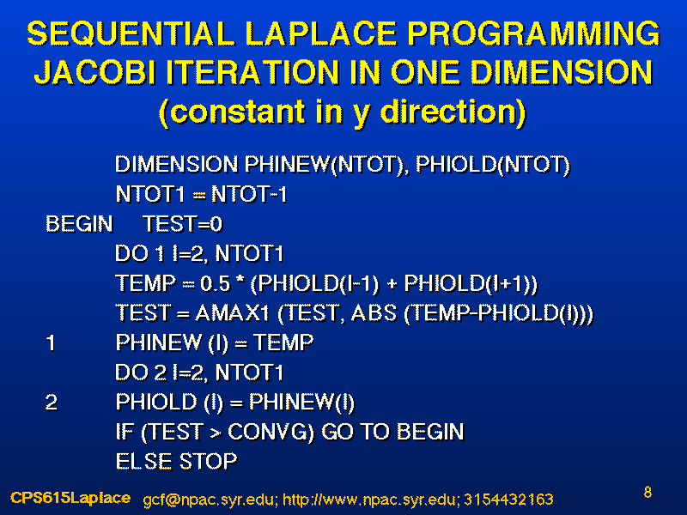
One Dimensional Laplace’s Equation
Left neighbor Typical Grid Point x Right Neighbor
1
2
NTOT

Slide 12
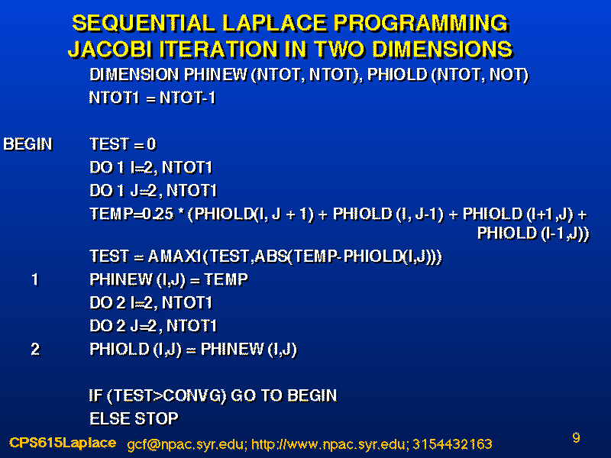

Slide 13
Sequential Programming with Guard Rings
The concept of guard rings/points/”halos” is well known in sequential case where one has for a trivial example in one dimension (shown above) 16 points.
The end points are fixed boundary values
One could save space and dimension PHI(14) and use boundary values by statements for I=1,14 like
  IF( I.EQ.1) Valueonleft = BOUNDARYLEFT
  ELSE Valueonleft = PHI(I-1) etc.
But this is slower and clumsy to program due to conditionals INSIDE Loop and one dimensions instead PHI(16) storing boundary values in PHI(1) and PHI(16)
  Updates are performed as DO I =2,15
  and without any test Valueonleft = PHI(I-1)

Slide 14

Sequential Guard Rings in Two Dimensions
In analogous 2D sequential case, one could dimension array PHI(φ) to PHI(14,14) to hold updated points only. However then points on the edge would need special treatment so that one uses boundary values in update
Rather dimension PHI(16,16) to include internal and boundary points
  Run loops over x(I) and y(J) from 2 to 15 to only cover internal points
  Preload boundary values in PHI(1, . ), PHI( . , 16), PHI(.,1), PHI( . ,16)
This is easier and faster as no conditionals (IF statements) in inner loops

Slide 15
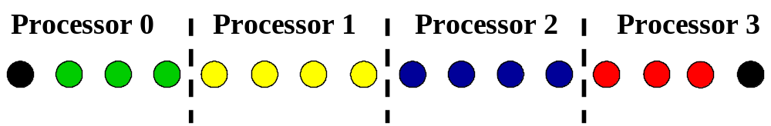
Parallel Guard Rings in One Dimension
Now we decompose our 16 points (trivial example) into four groups and put 4 points in each processor
Instead of dimensioning PHI(4) in each processor, one dimensions PHI(6) and runs loops from 2 to 5 with either boundary values or communication setting values of end-points
Sequential:
Parallel:
PHI(6) for Processor 1

Slide 16
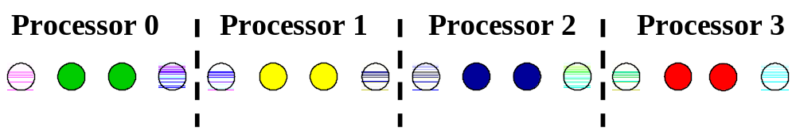
Summary of Parallel Guard Rings in One Dimension
In bi-color points, upper color is “owning processor” and bottom color is that of processor that needs value for updating neighboring point
Owned by Yellow -- needed by Green
Owned by Green -- needed by Yellow

Slide 17




Setup of Parallel Jacobi in One Dimension
Processor 0
Processor 1
Processor 2
Processor 3
1 2(I1)
NLOC1+1
NLOC1
NLOC1+1
NLOC1
1 2(I1)
Boundary
Boundary

Slide 18
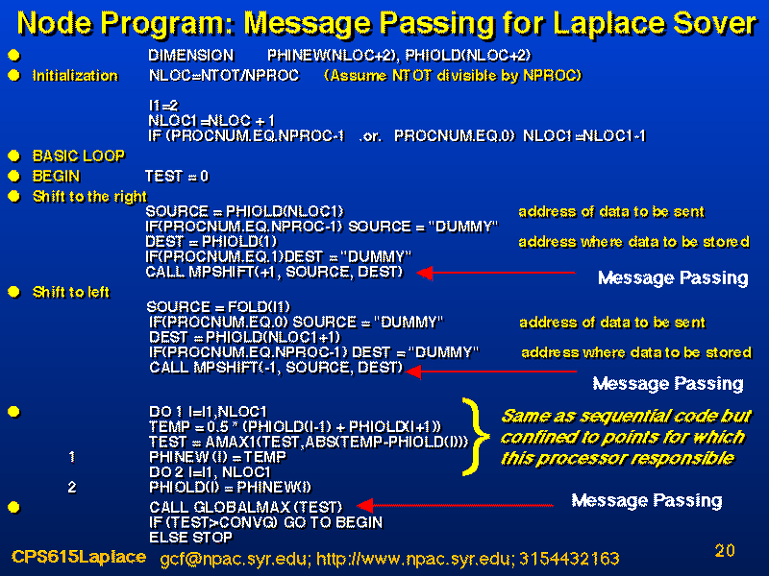

Slide 19
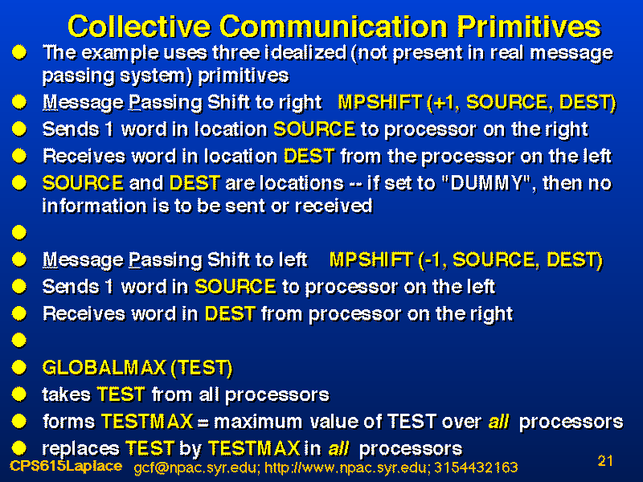

Slide 20
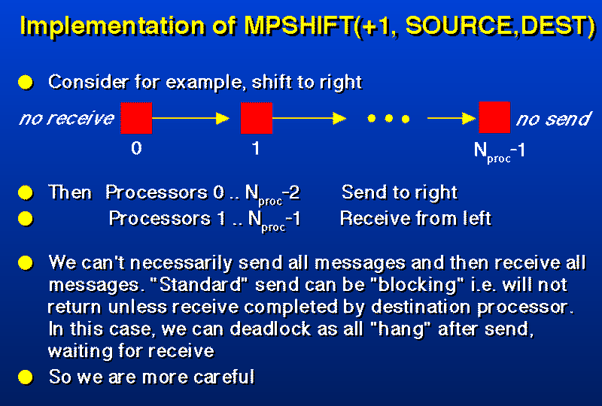
“Dummy”
“Dummy”

Slide 21
Blocking SEND Problems I
0
1
2
NPROC-2
NPROC-1
SEND
SEND
SEND
BAD!!
SEND
Followed by:
0
1
2
NPROC-2
NPROC-1
RECV
RECV
RECV
RECV
This is bad as 1 cannot call RECV until its SEND completes but 2 will only call RECV (and complete SEND from 1) when its SEND completes and so on
  A “race” condition which is inefficient and often hangs

Slide 22
Blocking SEND Problems II
0
1
2
NPROC-2
NPROC-1
SEND
RECV
SEND
GOOD!!
SEND
RECV
Followed by:
0
1
2
NPROC-2
NPROC-1
SEND
RECV
RECV
This is good whatever implementation of SEND and so is a safe and recommended way to program
If SEND returns when a buffer in receiving node accepts message, then naïve version works
  Buffered messaging is safer but costs performance as there is more copying of data

Slide 23
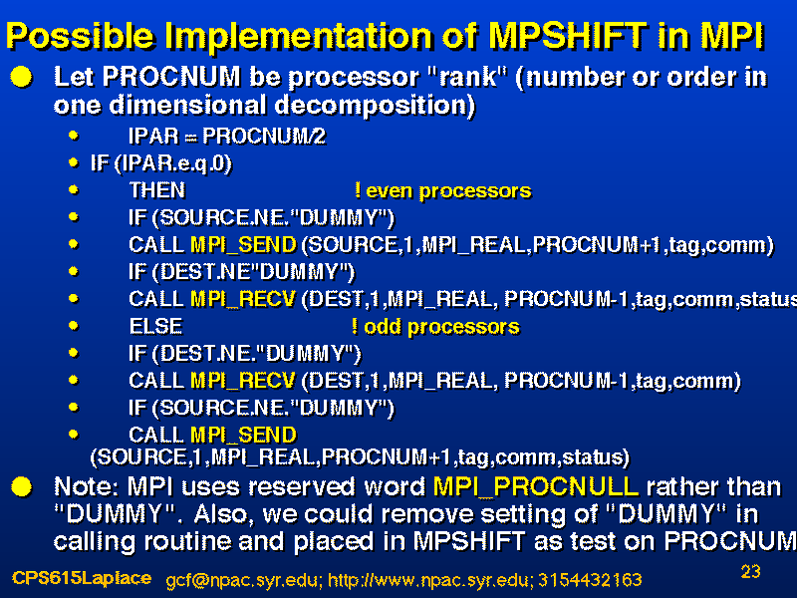

Slide 24
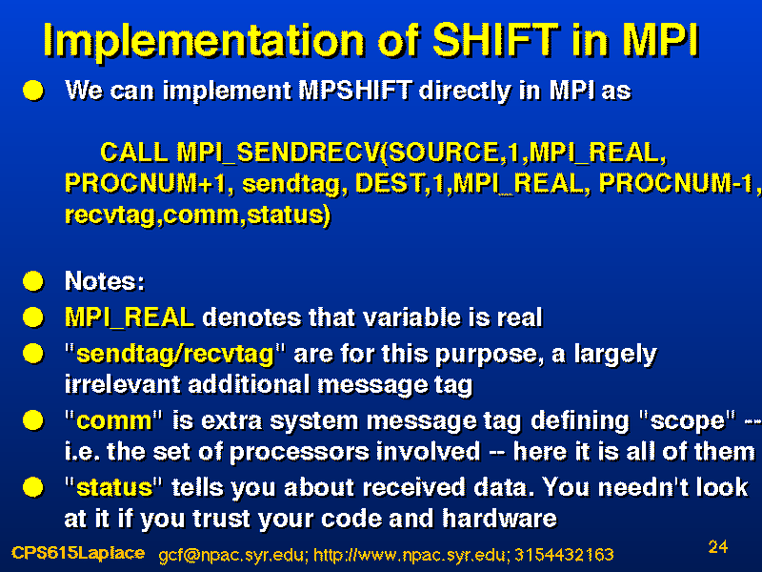
Built in Implementation of MPSHIFT in MPI

Slide 25
How not to Find Maximum
One could calculate the global maximum by:
Each processor calculates maximum inside its node
  Processor 1 Sends its maximum to node 0
  Processor 2 Sends its maximum to node 0
  ……………….
  Processor NPROC-2 Sends its maximum to node 0
  Processor NPROC-1 Sends its maximum to node 0
The RECV’s on processor 0 are sequential
Processor 0 calculates maximum of its number and the NPROC-1 received numbers
  Processor 0 Sends its maximum to node 1
  Processor 0 Sends its maximum to node 2
  ……………….
  Processor 0 Sends its maximum to node NPROC-2
  Processor 0 Sends its maximum to node NPROC-1
This is correct but total time is proportional to NPROC and does NOT scale

Slide 26
How to Find Maximum Better
One can better calculate the global maximum by:
Each processor calculates maximum inside its node
Divide processors into a logical tree and in parallel
  Processor 1 Sends its maximum to node 0
  Processor 3 Sends its maximum to node 2 ……….
  Processor NTOT-1 Sends its maximum to node NPROC-2
Processors 0 2 4 … NPROC-2 find resultant maximums in their nodes
  Processor 2 Sends its maximum to node 0
  Processor 6 Sends its maximum to node 4 ……….
  Processor NPROC-2 Sends its maximum to node NPROC-4
Repeat this log₂(NPROC) times
This is still correct but total time is proportional to log₂(NPROC) and scales much better

Slide 27
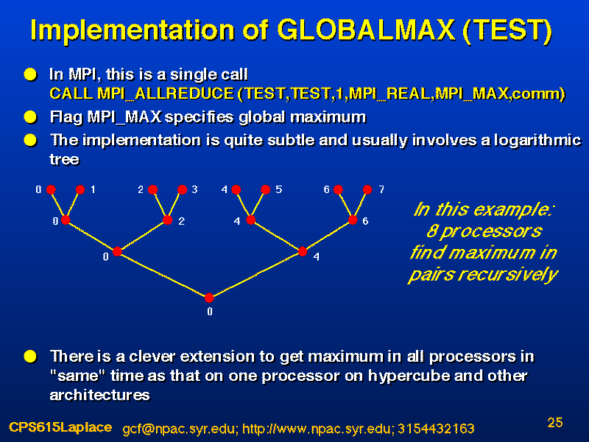

Slide 28
Comments on “Nifty Maximum Algorithm”
There is a very large computer science literature on this type of algorithm for finding global quantities optimized for different inter-node communication architectures
One uses these for swapping information, broadcasting, global sums as well as maxima
Often one does not have the “best” algorithm in installed MPI
Note in real world this type of algorithm is used
  If University Presidents wants average student grade, she does not ask each student to send their grade and add it up; rather she asks the schools/colleges who ask the departments who ask the courses who do it by the student ….
  Similarly in voting you do by voter, polling station, by county and then by state!

Slide 29
Structure of Laplace Example
We use this example to illustrate some very important general features of parallel programming
  Load Imbalance
  Communication Cost
  SPMD
  Guard Rings
  Speed up
  Ratio of communication and computation time

Slide 30
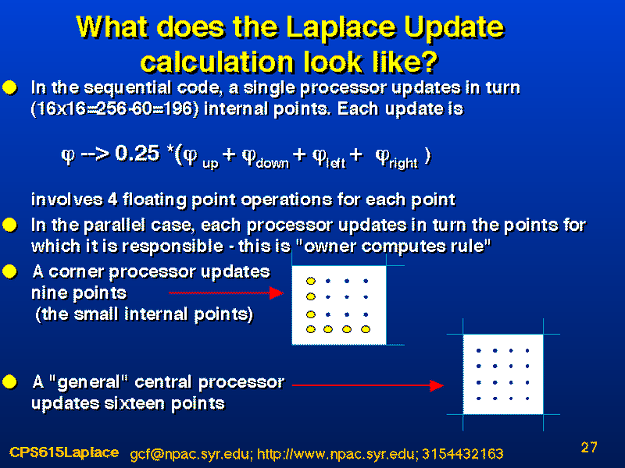

Slide 31
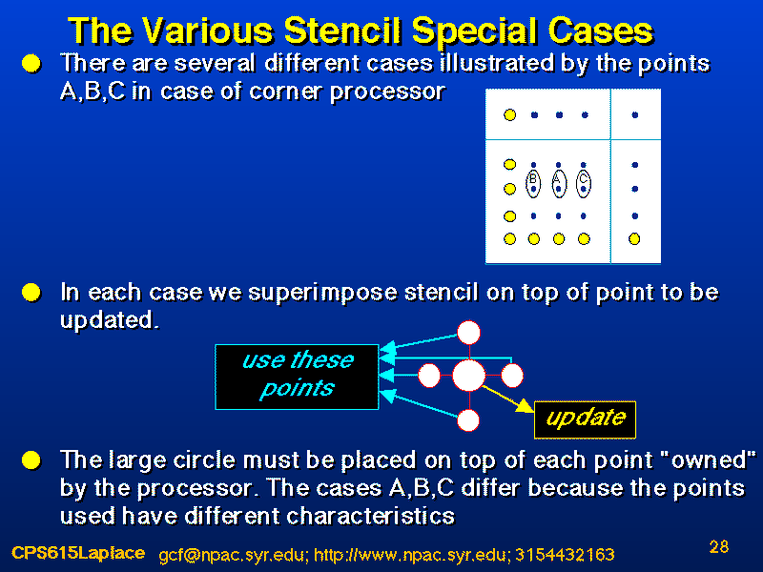

Slide 32
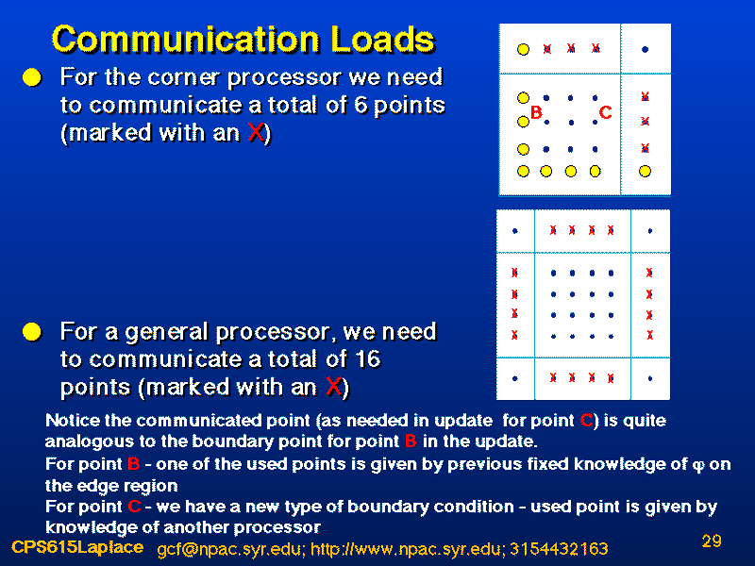

Slide 33
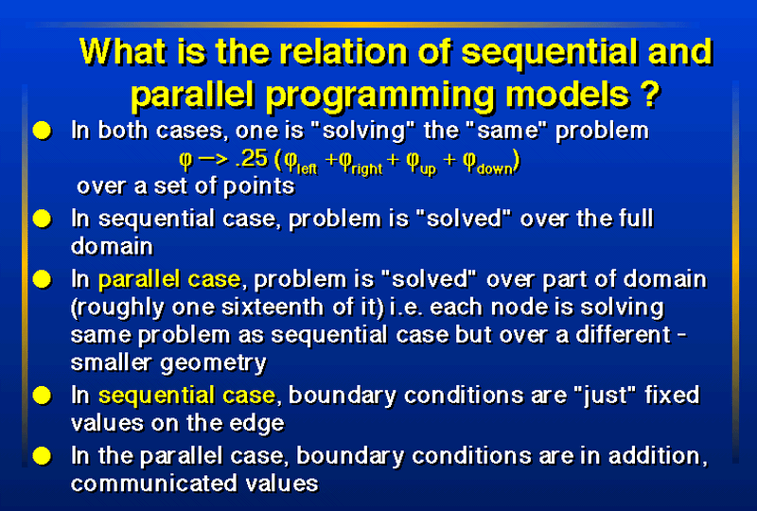

Slide 34
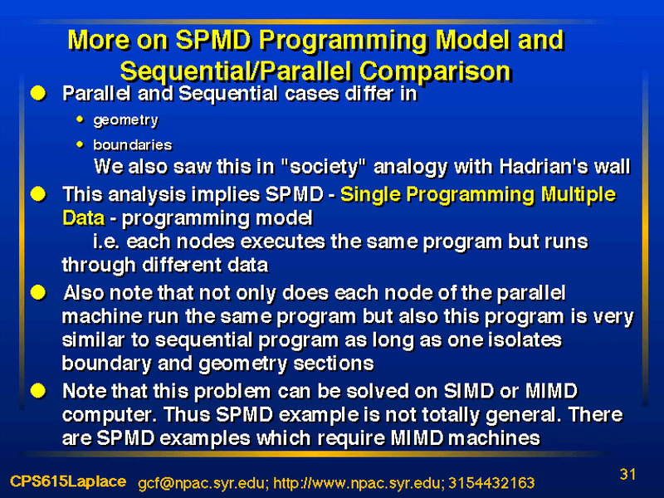

Slide 35
Sequential Guard Rings in Two Dimensions
In analogous 2D sequential case, one could dimension array PHI(φ) to PHI(14,14) to hold updated points only. However then points on the edge would need special treatment so that one uses boundary values in update
Rather dimension PHI(16,16) to include internal and boundary points
  Run loops over x(I) and y(J) from 2 to 15 to only cover internal points
  Preload boundary values in PHI(1, . ), PHI( . , 16), PHI(.,1), PHI( . ,16)
This is easier and faster as no conditionals (IF statements) in inner loops

Slide 36
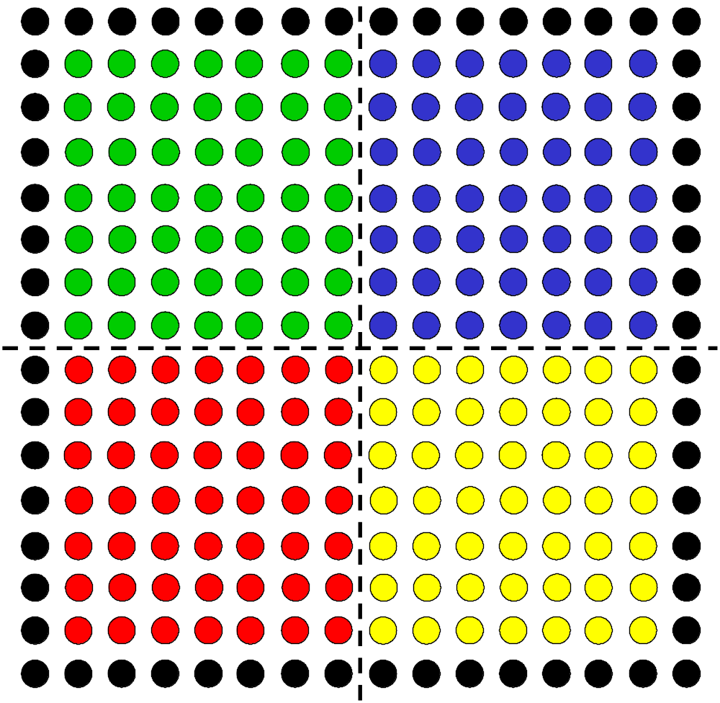
Parallel Guard Rings in Two Dimensions I
This is just like one dimensional case
First we decompose problem as we have seen
Four Processors are shown

Slide 37
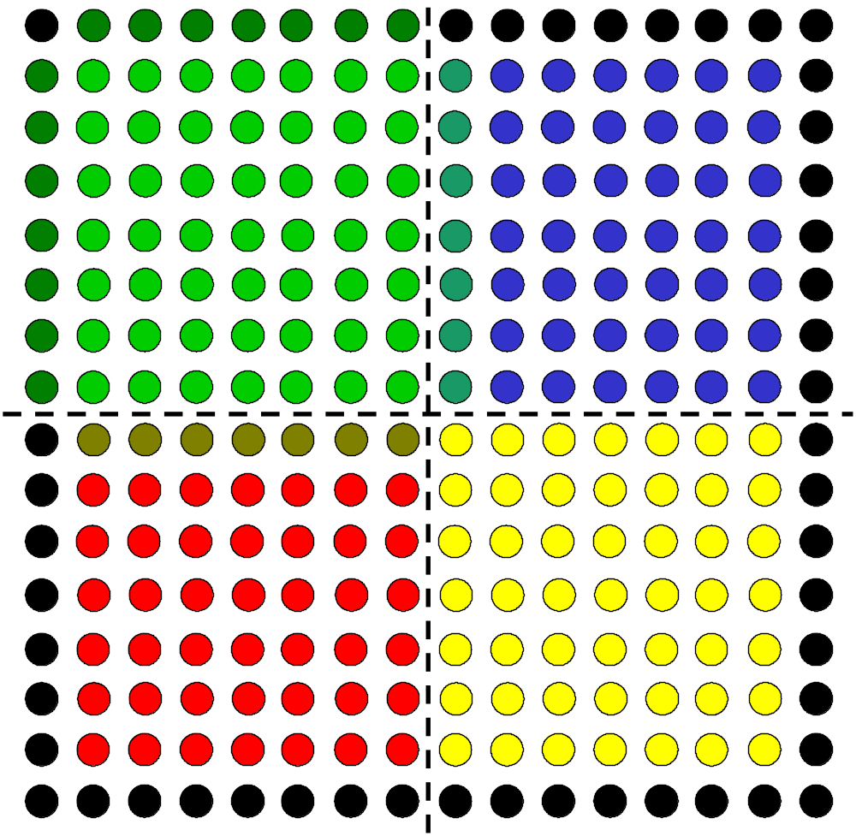
Parallel Guard Rings in Two Dimensions II
Now look at processor in top left
It needs real boundary values for updates shown as black and green
Then it needs points from neighboring processors shown hatched with green and other processor color

Slide 38
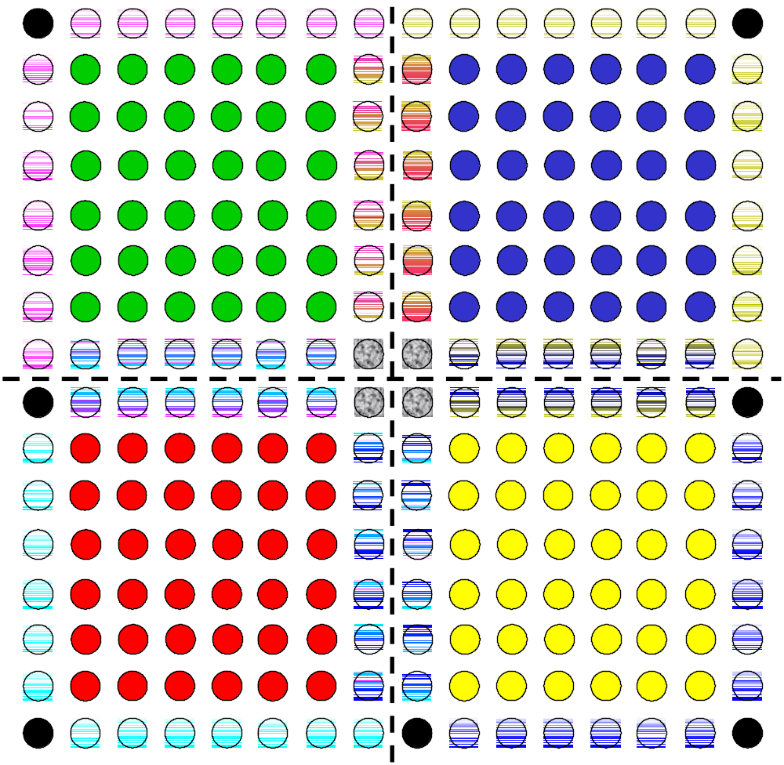
Parallel Guard Rings in Two Dimensions III
Now we see the effect of all guards with four points at center needed by 3 processors and other shaded points by 2
One dimensions overlapping grids PHI(10,10) here and arranges communication order properly

Slide 39
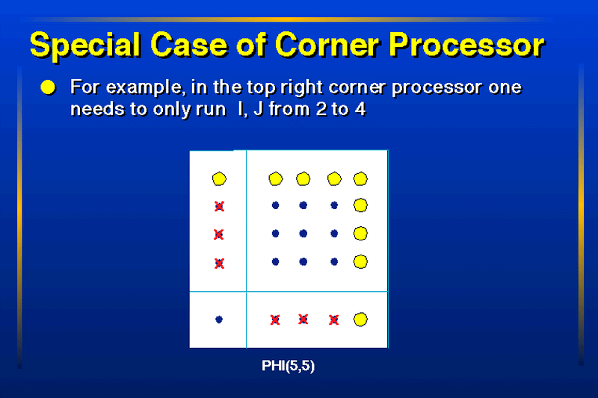

Slide 40


Slide 41
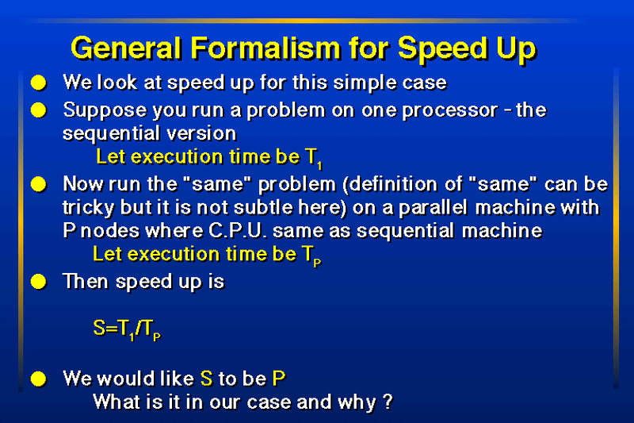

Slide 42
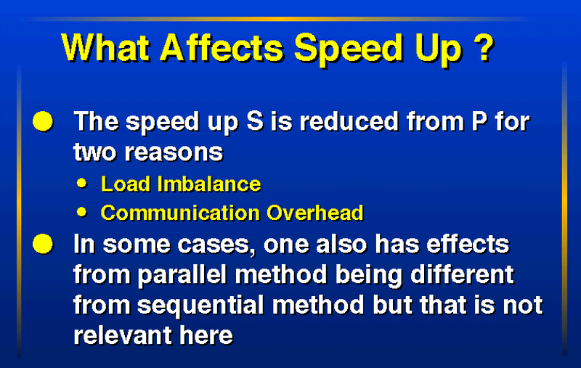

Slide 43
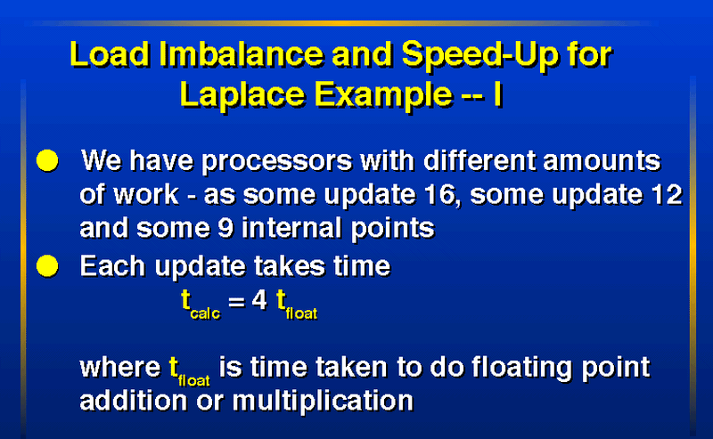

Slide 44
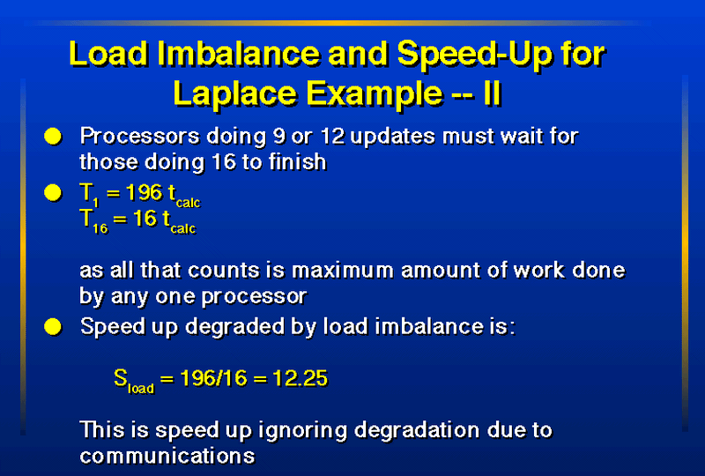

Slide 45
Performance Analysis Parameters
This will only depend on 3 parameters
n which is grain size -- amount of problem stored on each processor (bounded by local memory)
t_{float} which is typical time to do one calculation on one node
t_{comm} which is typical time to communicate one word between two nodes
Most importance omission here is communication latency
Time to communicate = t_{latency}+ (Num Words)t_{comm}
Memory n
Memory n
Node A
Node B
t_{comm}
CPU t_{float}
CPU t_{float}

Slide 46
Analytical analysis of Load Imbalance
Consider N by N array of grid points on P Processors where √P is an integer and they are arranged in a √P by √P topology
Suppose N is exactly divisible by √P and a general processor has a grain size n = N²/P grid points
Sequential time T₁ = (N-2)² t_{calc}
Parallel Time T_{P} = n t_{calc}
Speedup S = T₁/T_{P} = P (1 - 2/N)² = P(1 - 2/√(nP) )²
S tends to P as N gets large at fixed P
This expresses analytically intuitive idea that load imbalance due to boundary effects and will go away for large N

Slide 47
Example of Communication Overhead
Largest communication load is communicating 16 words to be compared to calculating 16 updates -- each taking time t_{calc}
Each communication is one value of φ probably stored in a 4 byte word and takes time t_{comm}
Then on 16 processors,
T₁₆ = 16t_{calc} + 16t_{comm}
Speedup
S = T₁/T₁₆ = 12.25 / (1 + t_{comm}/t_{calc})
or S = 12.25 / (1 + 0.25 t_{comm}/t_{float})
or S ≈ 12.25 * (1 - 0.25 t_{comm}/t_{float})

Slide 48
Communication Must be Reduced
4 by 4 regions in each processor
  16 Green (Compute) and 16 Red (Communicate) Points
8 by 8 regions in each processor
  64 Green and “just” 32 Red Points
Communication is an edge effect
Give each processor plenty of memory and increase region in each machine
Large Problems Parallelize Best

Slide 49
General Analytical Form of Communication Overhead for Jacobi
Consider N grid points in P processors with grain size n = N²/P
Sequential Time T₁ = 4N² t_{float}
Parallel Time T_{P} = 4 n t_{float} + 4 √n t_{comm}
Speed up S = P (1 - 2/N)² / (1 + t_{comm}/(√n t_{float}) )
Both overheads decrease like 1/√n as n increases
This ignores communication latency but is otherwise accurate
Speed up is reduced from P by both overheads
Load Imbalance Communication Overhead

Slide 50
General Speed Up and Efficiency Analysis I
Efficiency ε = Speed Up S / P (Number of Processors)
Overhead f_{comm} = (P T_{P} - T₁) / T₁ = 1/ ε - 1
As f_{comm} linear in T_{P}, overhead effects tend to be additive
In 2D Jacobi example
f_{comm} = t_{comm}/(√n t_{float})
While efficiency takes approximate form
ε ≈ 1 - t_{comm}/(√n t_{float}) valid when overhead is small
As expected efficiency is < 1 corresponding to speedup being < P

Slide 51
General Speed Up and Efficiency Analysis II
In many problems there is an elegant formula
f_{comm} = constant . t_{comm}/(n^{1/d} t_{float})
d is system information dimension which is equal to geometric dimension in problems like Jacobi where communication is a surface and calculation a volume effect
  We will see soon case where d is NOT geometric dimension
d=1 for Hadrian’s wall and d=2 for Hadrian’s Palace floor while for Jacobi in 1 2 or 3 dimensions, d =1 2 or 3
Note formula only depend on local node and communication parameters and this implies that parallel computing does scale to large P if you build fast enough networks (t_{comm}/t_{float}) and have a large enough problem (big n)

Slide 52
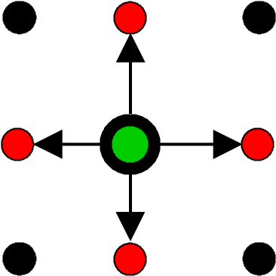
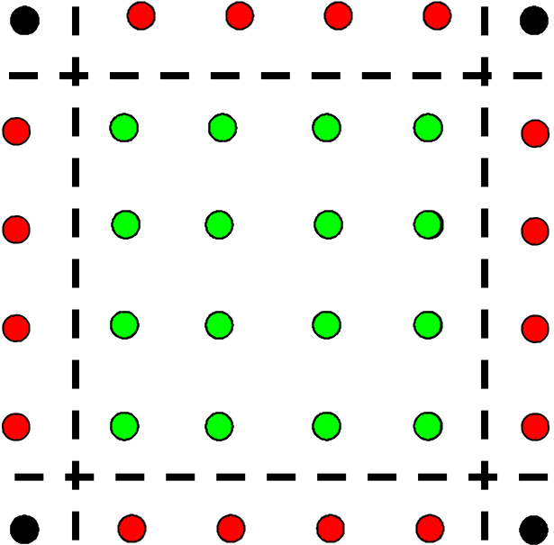
Communication to Calculation Ratio as a function of template I
For Jacobi, we have
Calculation 4 n t_{float}
Communication 4 √n t_{comm}
Communication Overhead
f_{comm} = t_{comm}/(√n t_{float})
“Smallest” Communication
but NOT smallest overhead
Update
Stencil
Communicated
Updated
Processor Boundaries

Slide 53
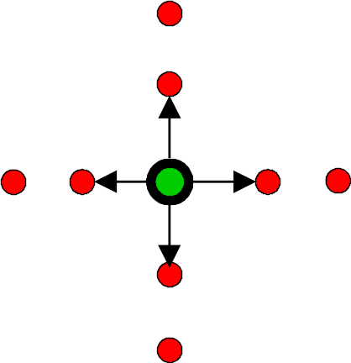
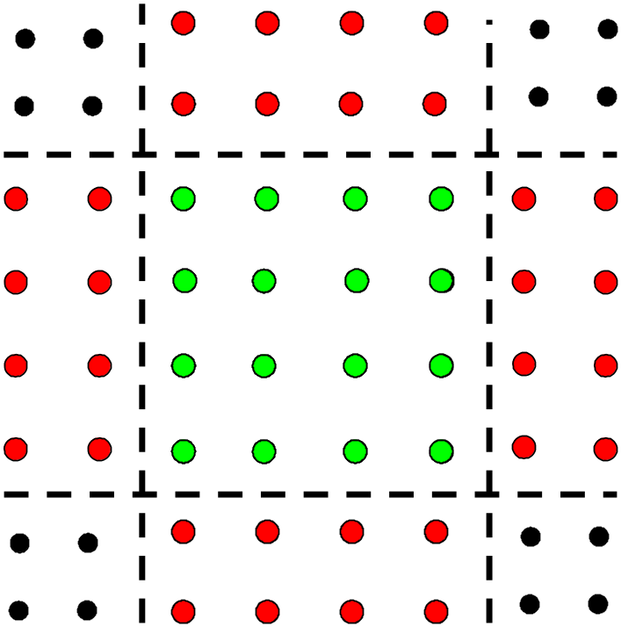
Communication to Calculation Ratio as a function of template II
For Jacobi with fourth order
differencing, we have
Calculation 9 n t_{float}
Communication 8 √n t_{comm}
Communication Overhead
f_{comm} = 0.89 t_{comm}/(√n t_{float})
A little bit smaller as
communication and computation
both doubled
Update
Stencil
Communicated
Updated
Processor Boundaries

Slide 54
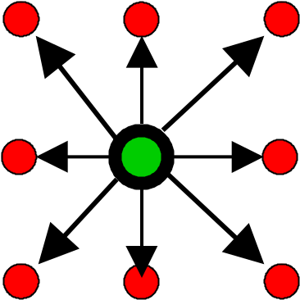
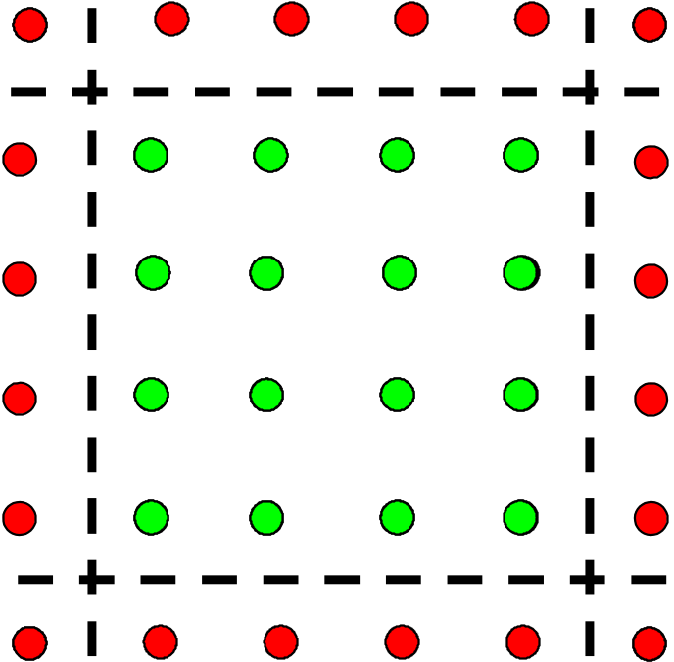
Communication to Calculation Ratio as a function of template III
For Jacobi with diagonal
neighbors, we have
Calculation 9 n t_{float}
Communication 4(√n + 1 ) t_{comm}
Communication Overhead
f_{comm} = 0.5 t_{comm}/(√n t_{float})
Quite a bit smaller
Update
Stencil
Communicated
Updated
Processor Boundaries

Slide 55
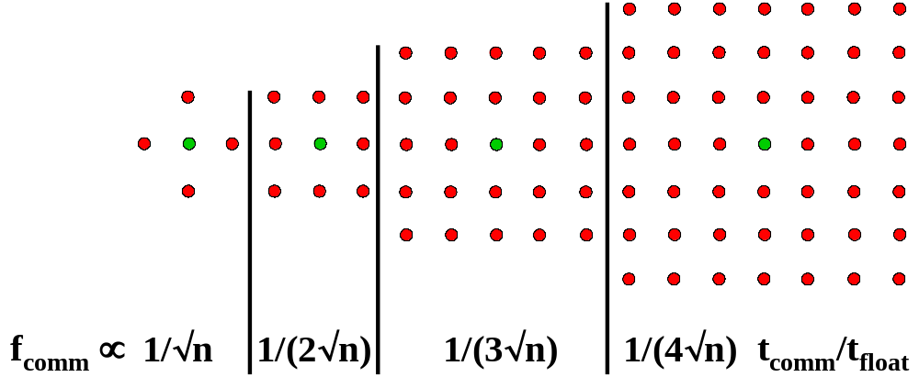
Communication to Calculation IV
Now systematically increase size of stencil. You get this in particle dynamics problems as you increase range of force
Calculation per point increases but communication increases faster and f_{comm} decreases systematically
Must re-use communicated values for this to work!
Update Stencils
of increasing range

Slide 56
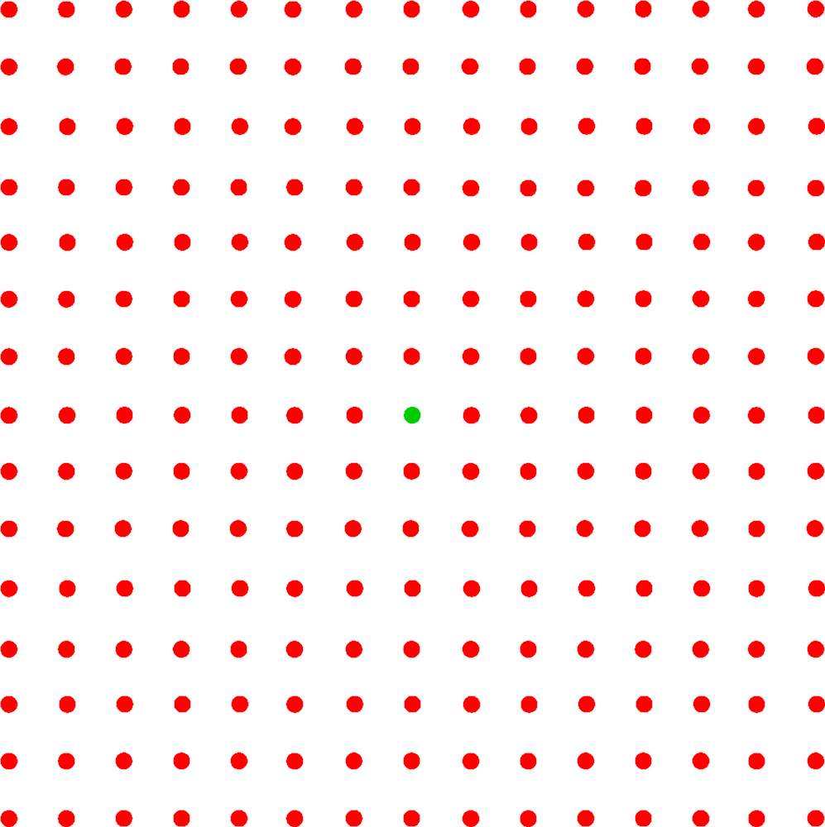
Communication to Calculation V
Now make range cover full domain as in long range force problems
f_{comm} ∝
t_{comm}/(n t_{float})
This is a case with geometric dimension 1 2 or 3 (depending on space particles in) but information dimension always 1

Slide 57
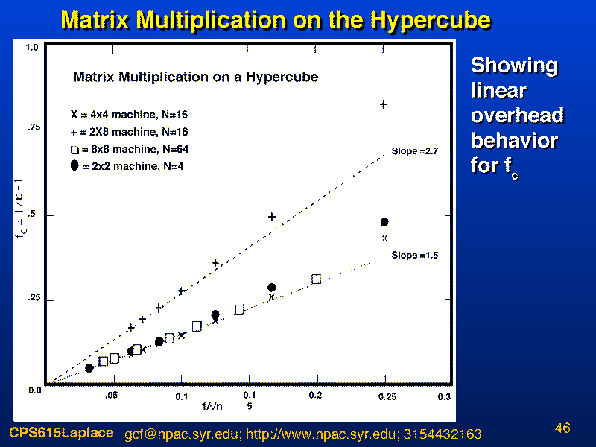

Slide 58
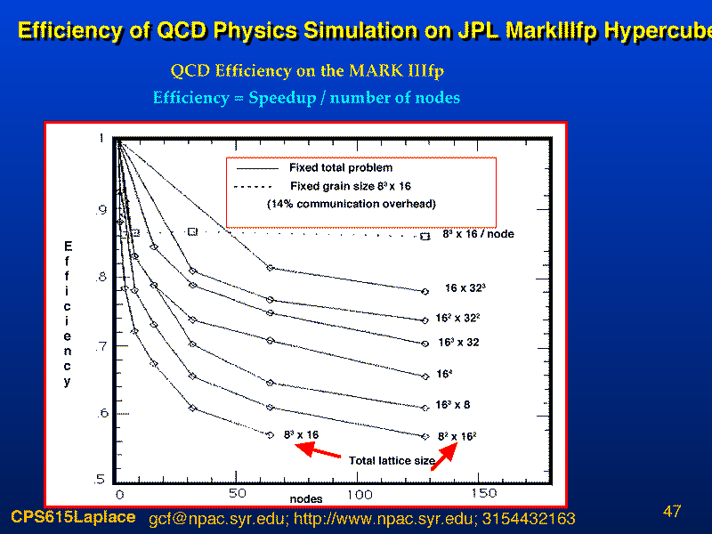

Slide 59
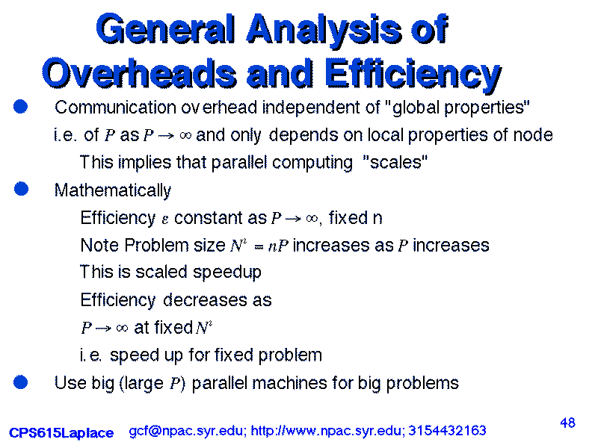

Slide 60
