Slide 1
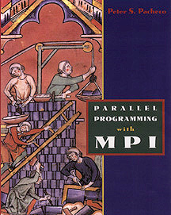


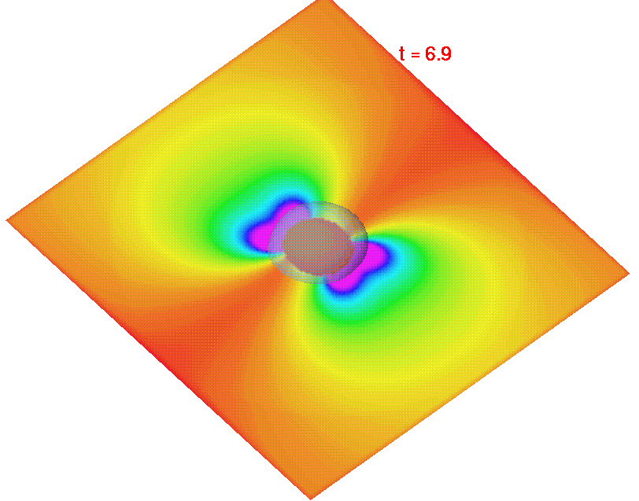
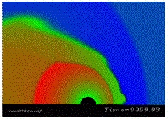
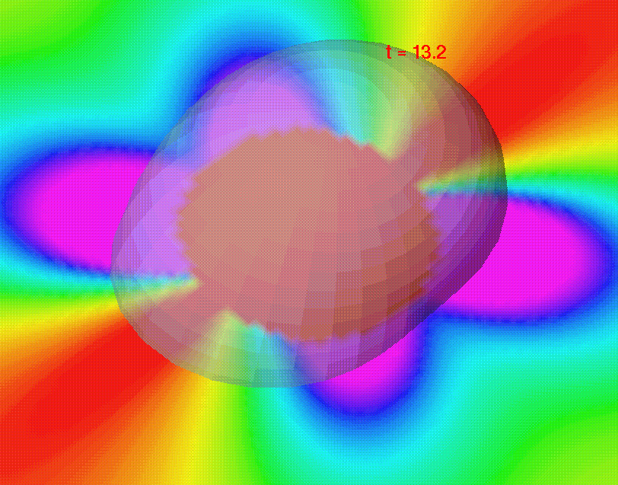

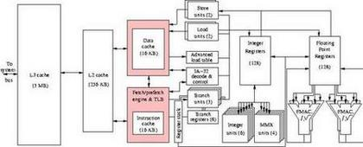
Parallel Numerical Integration
Spring Semester 2005
Geoffrey Fox
Community
Grids Laboratory
Indiana University
505 N Morton
Suite 224
Bloomington IN
gcf@indiana.edu

Slide 2
Links
See Chapter 4 of Pacheco’s MPI Book
See http://www.old-npac.org/users/gcf/slitex/CPS615NI95/index.html
  For a more advanced treatment which we will highlight in these lectures
See http://www.old-npac.org/projects/cps615spring00/presentations-html/cps615nic95/ for lectures on Romberg’s method
There is also software at http://www.old-npac.org/projects/cpsedu/summer98summary/examples/mpi-c/mpi-c.html (Examples 1 and 2)

Slide 3
Problem to be Solved
Integrals can be done in many dimensions but for the methods discussed here the essential issues are seen in one dimension
  Although as advanced references describe in three and especially higher dimensions than that, Monte Carlo Methods become preferred approach
We wish to calculate the integral of a function f(x) from x=a to x=b
Implicitly we assume f(x) is relatively smooth, set up a set of “interpolation” or grid points x_{i} in region a ≤ x ≤ b and calculate the integral in term of values of f(x) at the grid points
∫
b
I = f(x) dx
a

Slide 4
Trapezoidal Rule
This makes the strong assumption that f(x) is constant
I = 0.5*(b-a)*(f(a)+f(b))
f(a)
f(b)
0
x
X=a
X=b
x

Slide 5
Simpson’s Rule
This makes the less strong assumption that f(x) is a quadratic function
I = (b-a)*(f(a)+ 4f(x_{c})+f(b))/6
f(X_{c})
f(a)
f(b)
X=a
x_{c} = (a+ b)/2
X=b
x

Slide 6
Iterated Rules
There are a set of rules (Newton-Cotes and Gaussian) which make higher and higher order polynomial approximations to f(x)
  These are hard to program conveniently and not very “robust” (they work very badly if f(x) is varying rapidly in non-polynomial fashion)
So in practice one uses iterated Simpson or Trapezoidal Rules – use an odd number of points to apply Simpson’s rule iteratively
e.g. Apply Simpson over each of 18 sub intervals delineated by arrows below
Trapezoidal iteration would involve 36 separate integrals
x₀
x₄
x₈
x₁₂
x₁₆
x₂₀
x₂₄
x₂₈
x₃₂
x₃₆

Slide 7
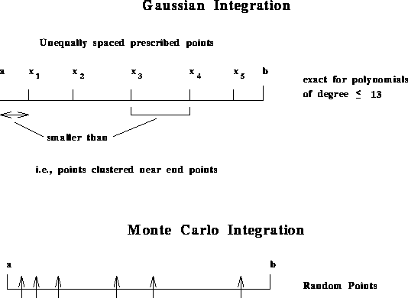
Other Choices
Gaussian ingeniously chooses the points between x=a and x=b to be exact for very high order polynomials
To avoid “tail wagging dog” the points are denser near the endpoints
  High order polynomials get large quickly as x increases; to control this “tail” put points at edge of region to be interpolated
a
b
This case is exact for
polynomials of
degree ≤ 13
Smaller Than
Gaussian

Slide 8
Monte Carlo Methods
Monte Carlo (the most important) un-ingeniously chooses the points at random
The Integral is sum of the function values f(x_{Random-i}) at the randomly chosen x values x_{Random-i} multiplied by the Interval (b-a here) divided by the number of generated points
This gives the most robust method (unbiased) that is easiest to apply for multi-dimensional integrals and integrals of badly behaved functions
Funny boundaries are easy to take care of
  Integrate over convenient region bigger than real region
  Define function to be zero outside true integration region
  Often makes function discontinuous but OK for Monte Carlo
a
b

Slide 9
Errors
For an integral with N points
Monte Carlo has error 1/N^{0.5}
Iterated Trapezoidal has error 1/N²
Iterated Simpson has error 1/N⁴
Iterated Gaussian is error 1/N^{2m} for our a basic integration scheme with m points
But in d dimensions, for all but Monte Carlo must set up a Grid of N^{1/d} points on a side; that hardly works above N=3
  Monte Carlo error still 1/N^{0.5}
  Simpson error becomes 1/N^{4/d etc.}

Slide 10
Iterated Trapezoidal and Simpson Rule
Suppose we have N points x_{i} with
I= (b-a) (f(x₀)+2f(x₁)+2f(x₂)+ ……
+2f(x_{(N-2)})+f(x_{(N-1)})/(2(N-1))
While Simpson’s Rule is
I= (b-a) (f(x₀)+4f(x₁)+2f(x₂)+ ……
+4f(x_{(N-2)})+f(x_{(N-1)})/(3(N-1))
They all add f(x_{i}) with different weights
Note trapezoidal and Simpson rule apply their approximation over a region of size (b-a)/(N-1)
(twice this for Simpson) which goes to zero as N gets large so approximation gets better as N geta larger

Slide 11
The weight Functions
One is adding up w_{i} f(x_{i}) and the different algorithms just correspond to different w_{i}
Trapezoidal for index values = 0 1 2 3 .. N-1
has characteristic pattern
w_{i} ∝ 1 2 2 … 2 2 1
Simpson for the same indices and N odd
has characteristic pattern
w_{i} ∝ 1 2 4 2 4 … 2 4 2 4 1

Slide 12
Parallel Computing
0
1
2
3
x₀
x₄
x₈
x₁₂
x₁₆
x₂₀
x₂₄
x₂₈
x₃₂
Different processors calculating independently different points in the integral and then sum results in each processor
Most natural is scenario shown in figure with each processor calculating an integral over a subregion
  x₀ to x₈ in processor 0 … x₂₄ to x₃₂ in processor 3 etc.
  Then total Integral is sum of sub-integrals calculated in each processor
However it is also possible to assign POINTS not REGIONS to processors
  x₀ x₄ x₈ .. x₃₂ in processor 0
  x₃ x₇ x₁₁ .. x₃₁ in processor 3

Slide 13
Issues in Numerical Integration for Parallel Computing
This is a classic master worker paradigm with individual processors calculating parts of the integral
They need to use MPI rank to decide which part of integration range they are responsible for
They calculate integral over this range and then we just sum their contributions over all processors
  Global sum can be done by pipeline, tree or by all workers independently sending their results to the master

Slide 14
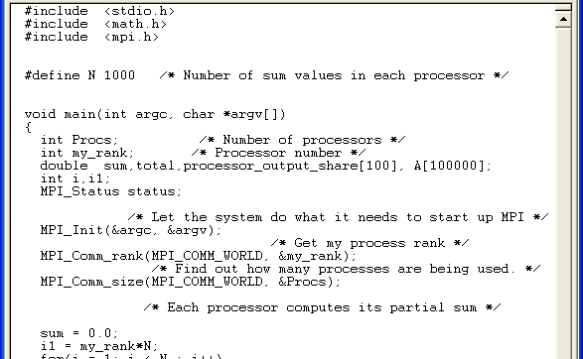
Calculating Sum I
Homework 2

Slide 15
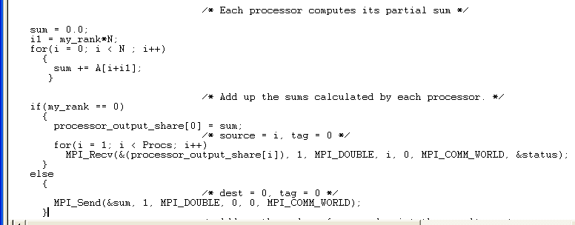
Calculating Sum II

Slide 16
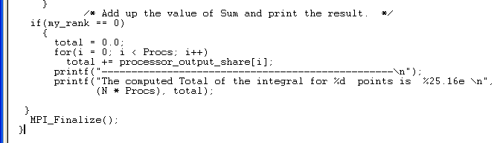
Calculating Sum III
Note distribution of A is not done properly here
This is not a problem in related parallel integration

Slide 17
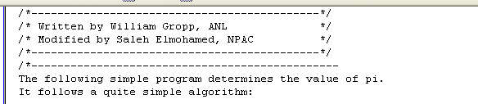
Argonne Calculation of π I
This comes from http://www.new-npac.org/projects/cdroms/cewes-1999-06-vol2/cps615course/examples/pi.c
But I think the preamble is dubious so I have changed it below; The code is correct
1
∫
We are calculating π = 4/(1+x*x) dx
0

Slide 18
Argonne Calculation of π II
The method evaluates the integral of 4/(1+x*x) between 0 and 1.
The method is simple: the integral is approximated by a sum of n intervals; the approximation to the integral in each interval is (1/n)*4/(1+x*x) where x is the midpoint of the integral (this is a variant of the trapezoidal method)
n is the total number of points; The master process (rank 0) asks the user for the number of intervals; N_{proc} is number of processors
The master should then broadcast this number to all of the other processes. Each process with a given rank then adds up every N_{proc}'th interval (x = rank/n, rank/n+N_{proc}/n, -rank/n+2N_{proc}/n...).
Finally, the sums computed by each process are added together using an MPI reduction.
Note this is a case where we assign POINTS not REGIONS to processors and points are not adjacent; note all points have the same weight function in this method

Slide 19
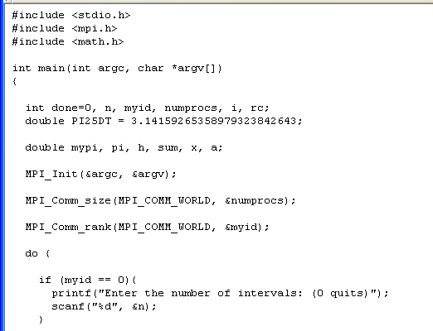
Argonne Calculation of π III

Slide 20
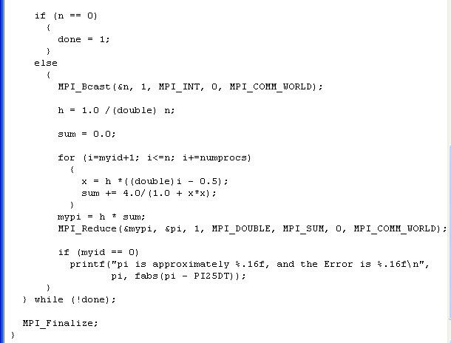
Argonne Calculation of π IV
Input n from user
Broadcast to all processors
Calculate sum in each processor
Starting at offset index myid and
increasing by numprocs
MPI_Reduce with MPI_SUM flag calculates global sum of first argument &mypi and returns to root processor

Slide 21
Simpson’s Rule I
http://www.new-npac.org/projects/cdroms/cewes-1999-06-vol1/cps615course/index.html
Brief description: Using Simpson's rule we compute the value of π. When using this approach and integrating on a multiprocessor, the logical thing to do would be to partition the interval to subintervals and make each processor run on one of these subintervals. In turn, each processor applies Simpson's rule to its own interval, again, partitioning it into subintervals of equal number to the one above it, etc. Among the processors, one takes charge of receiving and adding up the results

Slide 22
Simpson’s Rule II
1
∫
Again We are calculating π = 4/(1+x*x) dx
0
This time we assign regions to each processor
my_rank labels processors
Each processor calculates from
x1= my_rank/N_{proc} to x2= x1 + 1/N_{proc}
N is now the number of Simpson rule intervals in each processors (so we use a total of 2N-1 points in each processor with end points shared

Slide 23
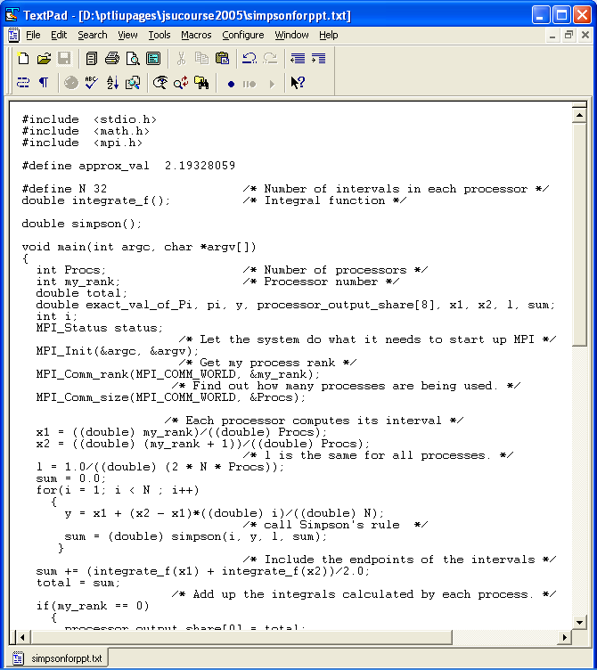
Simpson’s Rule III
Set the C and MPI Scene

Slide 24
Simpson’s Rule IV
Calculate the integral inside each processor
We divide the range x1 to x2 in each processor into N sub-integrals and each sub-integral is done by Simpson’s rule using points at each end and the one in the middle of the sub-integral

Slide 25
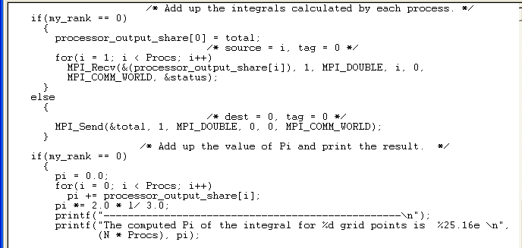
Simpson’s Rule V
Sum results over all processors using simple (non-optimal) method where all processors send to “processor 0”

Slide 26
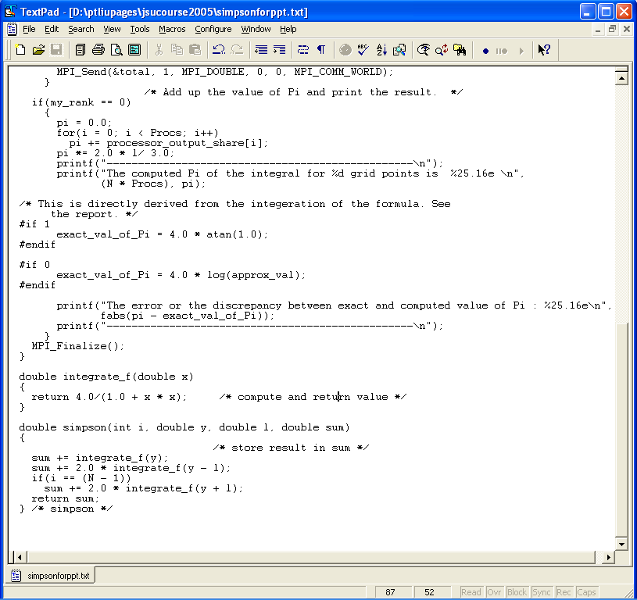
Simpson’s Rule VI
Print out exact value – unimportant for parallel computing and a bit obscure!

Slide 27
Simpson’s Rule VII
Here are the auxiliary functions
integrate_f is straightforward but the form of simpson is obscure albeit correct
There are more efficient (less arguments for simpson) and elegant formulations
Note this approach needs special test on i==(n-1) here and adding endpoints in the main body of code

