Slide 1


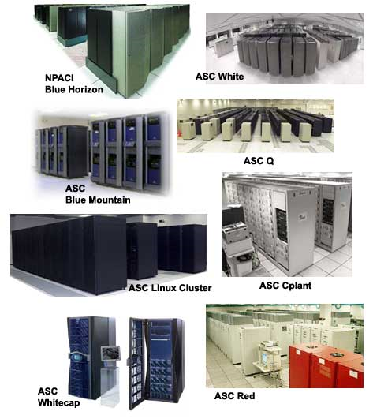
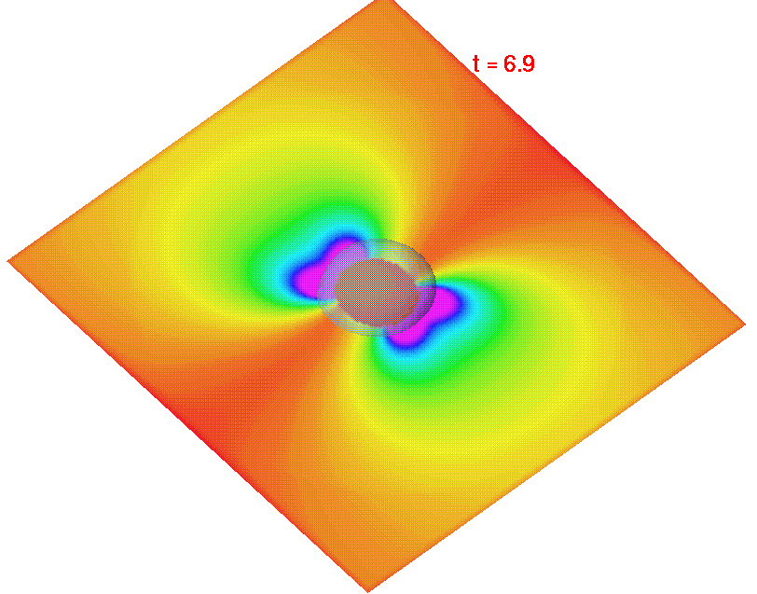
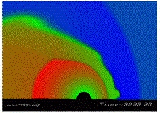
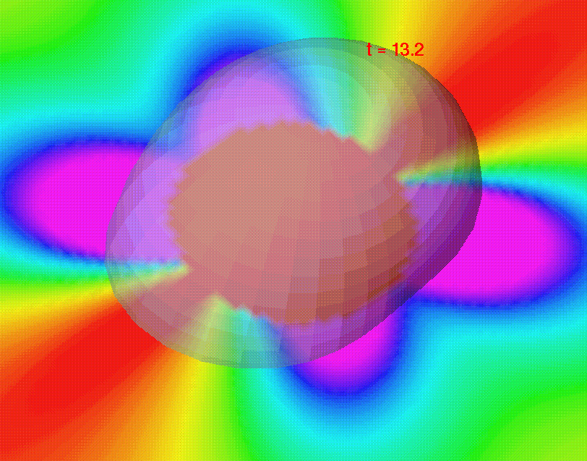

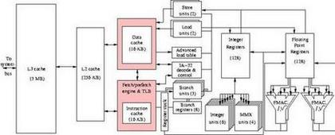
Parallel Programming for Wave Equation
Spring Semester 2005
Geoffrey Fox
Community
Grids Laboratory
Indiana University
505 N Morton
Suite 224
Bloomington IN
gcf@indiana.edu

Slide 2

Vibrating String
A Simple vibrating string is described by the wave equation which is a one dimensional version of Maxwell’s equations
∂² Φ/ ∂t² = -c² ∂² Φ / ∂x²
The parallel solution is very similar to Laplace’s equation in one dimension
Instead of an iterative formula one has an equation that steps forward in time

Slide 3
Numerical Formulation
One can write numerical approximations to the derivatives to get
(Φ(x,t+1)-2Φ(x,t)+Φ(x,t-1))/δt² =
-c² (Φ(x+1,t)-2Φ(x,t)+Φ(x-1,t))/δx²
Or
Φ(x,t+1) = 2Φ(x,t) - Φ(x,t-1)
- (Φ(x+1,t)-2Φ(x,t)+Φ(x-1,t)) (c² δt² /δx² )
Calculates Φ one time step in future from value at current time t and one time step in past

Slide 4
Time and Space
t
First two time
values and
endpoints
are fixed
Stencil same
as 2D Laplace
NOT decomposing
in time
x

Slide 5
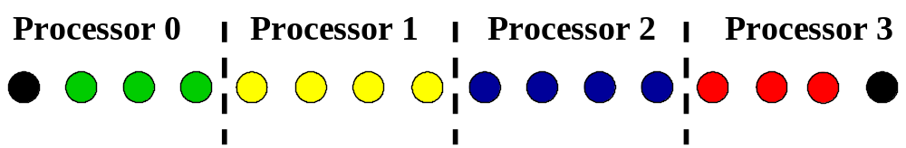
Sequential One Dimensional Wave Equation
Left neighbor Typical Grid Point x Right Neighbor
1
2
TPOINTS
Use Guard Rings in parallel
Sequential:
Parallel:
PHI(6) for Processor 1

Slide 6
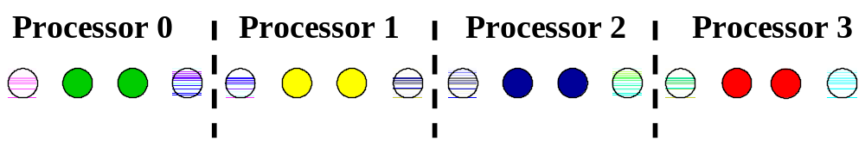
Summary of Parallel Guard Rings in One Dimension
In bi-color points, upper color is “owning processor” and bottom color is that of processor that needs value for updating neighboring point
Owned by Yellow -- needed by Green
Owned by Green -- needed by Yellow

Slide 7
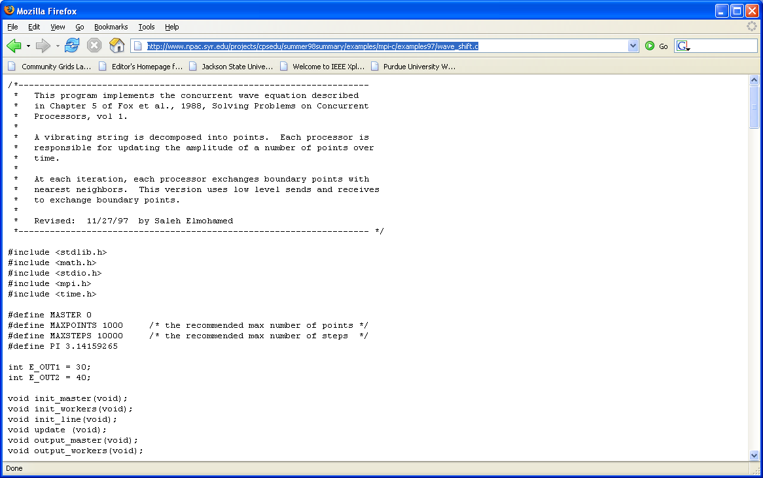
MPI for Parallel Wave Equation
Code is at:
http://www.old-npac.org/projects/cpsedu/summer98summary/examples/mpi-c/examples97/wave_shift.c
This is second example of three that use different MPI SEND and RECV primitives
This one uses MPI_Sendrecv for core communication
Not really
its MPI_Sendrecv

Slide 8
MPI Wave Equation II
Global Stuff
MAXPOINTS is total number
before decomposition
Tags
Functions Used

Slide 9
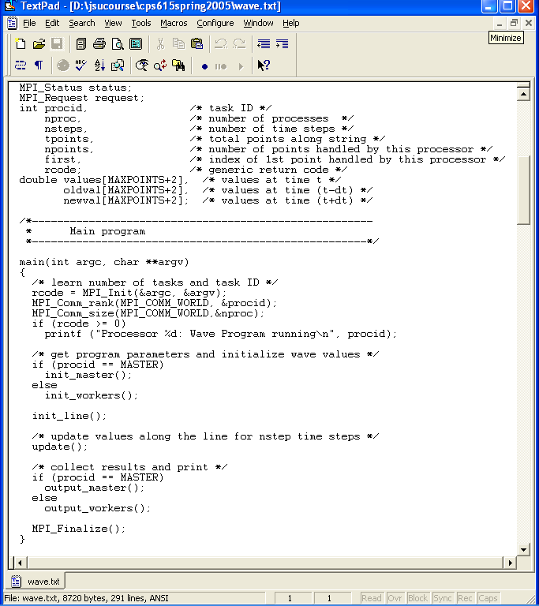
MPI Wave Equation III
Awful Programming
All nodes have enough space
for sequential problem
Usual Beginning
Initialize user parameters read by master

Slide 10
MPI Wave Equation IV
Define string size and initial values
Update in Parallel String
Displacements
Send Final Positions to Master

Slide 11
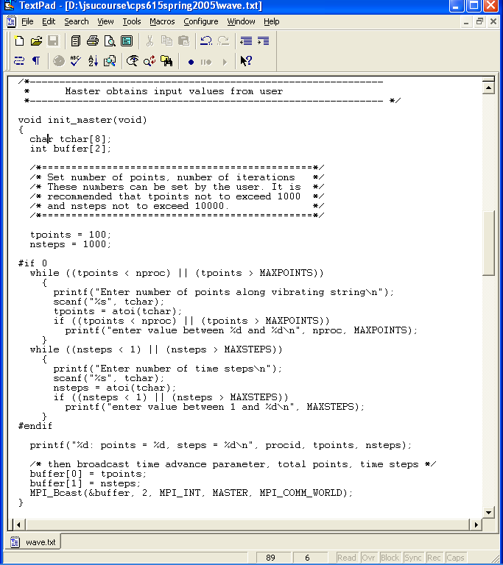
MPI Wave Equation V
Only executed in master
Read tpoints until user types an
acceptable value

Slide 12
MPI Wave Equation VI
Read nsteps – number of time steps until user types an
acceptable value
Broadcast tpoints and nsteps to all
processors in a single buffer

Slide 13
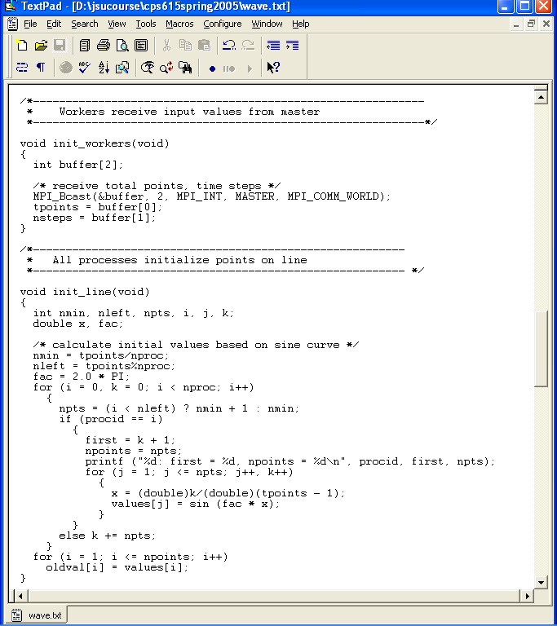
MPI Wave Equation VII
User fed tpoints and nsteps to MASTER processor
Initialize Vibrating String at first two t values

Slide 14
MPI Wave Equation VIII
First find how many points in each processor considering case where unequal as nproc doesn’t divide tpoints
Only use positions 1 to npts (plus one guard position either side) in arrays
Initial Condition is sinusoidal wave with zero velocity and one wavelength in string length

Slide 15
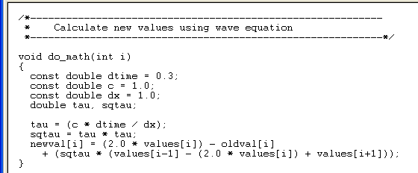
MPI Wave Equation IX
This is basic update with core template of nearest neighbors in x an t and called from loop in update()
Time Step
Wave Equation Constant – Speed
Position Grid size
newval is t+1; values is t; oldval is t-1

Slide 16
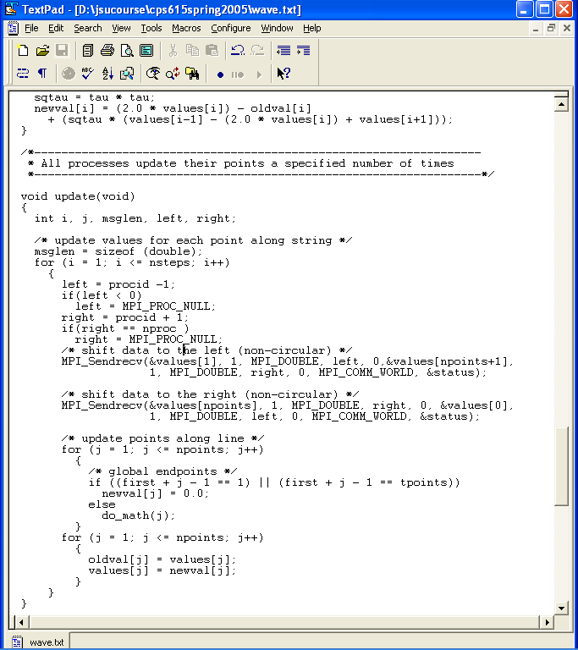
MPI Wave Equation X
MPI_PROC_NULL for missing neighbors of first and last processors
SHIFT DATA Left Safely

Slide 17
MPI Wave Equation XI
SHIFT DATA Right Safely
Set Boundary values at x= start and finish as zero
Call core update routine
Move values up in time

Slide 18
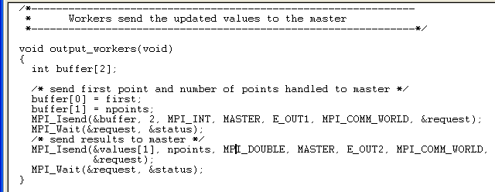
MPI Wave Equation XII
Workers send first which tells MASTER where they are and how many points transmitted
Then points themselves using MPI_Isend and MPI_Wait

Slide 19
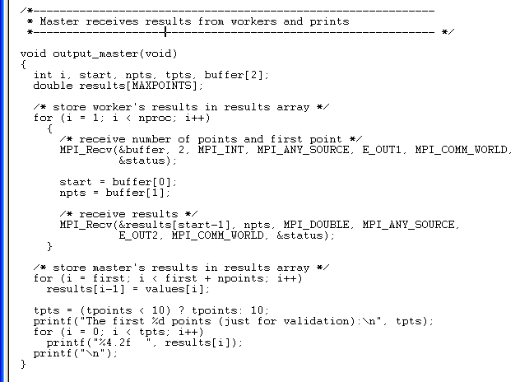
MPI Wave Equation XIII
Note MASTER uses ordinary MPI_Recv
MASTER stores final string positions
Print out first few points

