Slide 1



Welcome to
User ID
Password
Log In
Forgot your Username or Password?
Content Management Portal
Register
If you don't have an account, create one so that you can begin using all of the customization features of this site.
Register Now!

Slide 2

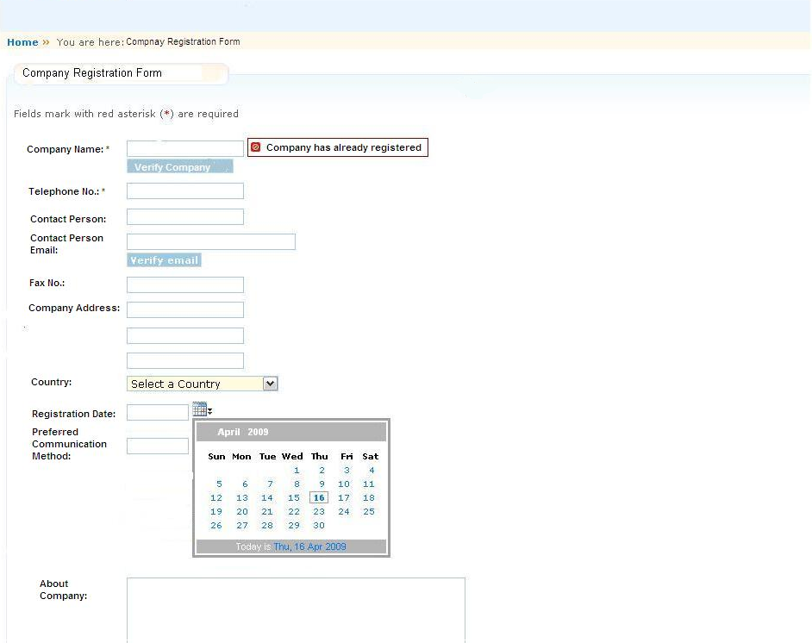
May 5, 2009
Feedback
Content Management Portal
Search Engine…
Home Page
About Us
Registration Info
Our Services
Contact Us
CM Portal Admin
User Admin
Registration Info
Content Category
Registration Info
>>Module
>>Exercise
Welcome to Content Portal Management!
Please kindly contact us for the registration details
>>Examination
>>Survey
*
Log In
*
Portal Help
Registration Procedure:
1.
2.
3.
4.
Submit
Reset

Slide 3
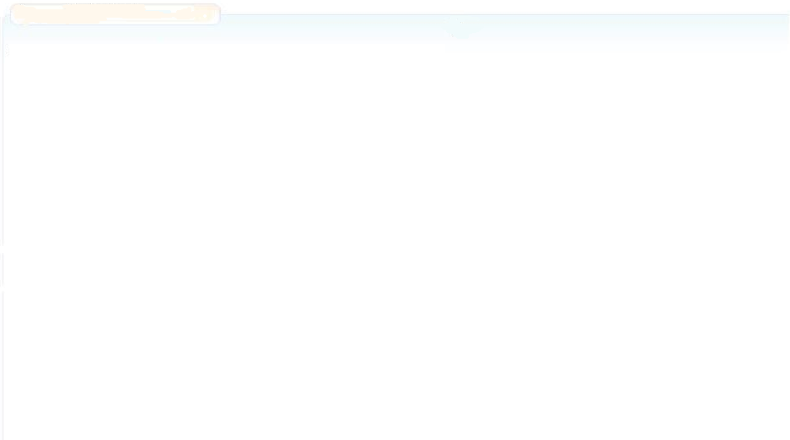
May 5, 2009
Feedback
Content Management Portal
Search Engine…
Home Page
About Us
Company Registration
Our Services
Contact Us
CM Portal Admin
User Admin
Home
>>
You are here: About Us
Content Category
About Us
>>Module
Welcome to Content Management Portal!
……
Our Vision:
To be a global recognized content management portal
Our Mission:
We are an integrated content management portal, we bring value to our customers and partners through our delivery of total, integrated quality content management solution and support.
Our Value:
……
>>Exercise
>>Examination
>>Survey
Log In
Portal Help

Slide 4
May 5, 2009
Feedback
Content Management Portal
Search Engine…
Home Page
About Us
Company Registration
Our Services
Contact Us
CM Portal Admin
User Admin
Home
>>
You are here: Our Services
Content Category
Our Services
>>Module
Services Type:
……
Services Method:
…….
>>Exercise
>>Examination
>>Survey
Log In
Portal Help

Slide 5
May 5, 2009
Feedback
Content Management Portal
Search Engine…
Home Page
About Us
Company Registration
Our Services
Contact Us
CM Portal Admin
User Admin
Home
>>
You are here: Contact Us
Content Category
Contact Us
>>Module
For general enquiries :
Tel : (65) 1234 5678
Fax : (65) 8765 4321
For registration enquiries :
Tel : (65) 1234 5678
Fax : (65) 8765 4321
Email : registration@cmp.com
Help Desk :
Tel : (65) 1234 5678
Fax : (65) 8765 4321
Email : cmpHelpDesk@cmp.com
>>Exercise
>>Examination
>>Survey
Log In
Portal Help

Slide 6
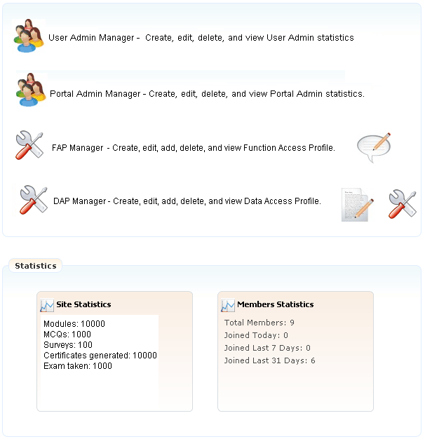
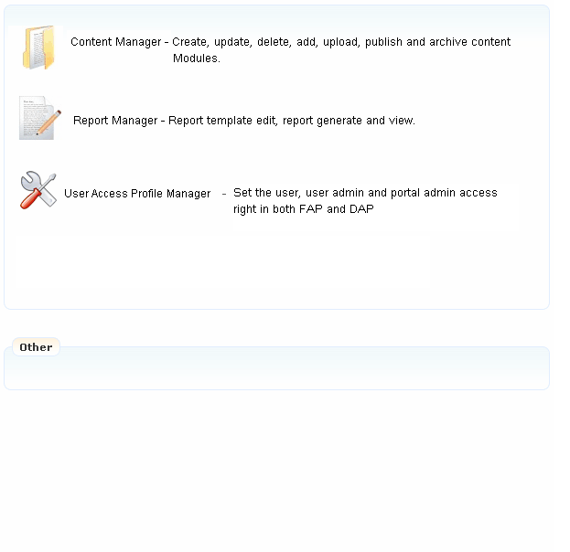

May 5, 2009
Feedback
Content Management Portal
Search Engine…
Home Page
User Admin Manager
Portal Admin Manager
FAP Manager
DAP Manager
CM Portal Admin
Content Manager
Report Manager
Role Manager
User Admin
Welcome Portal Admin: Kelly Mei
CM Portal Administration
>>
You are here: CM Portal Administration Page
Content Category
CM Portal Administration Page
>>Module
>>Exercise
>>Examination
>>Survey
Log Out
Role
Portal Help
Company Registration – Register company information before create user admin.

Slide 7
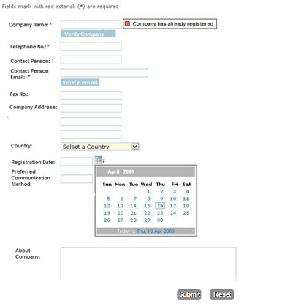
May 5, 2009
Feedback
Content Management Portal
Search Engine…
Home Page
User Admin Manager
Portal Admin Manager
FAP Manager
DAP Manager
CM Portal Admin
Content Manager
Report Manager
Role Manager
Company Registration
User Admin
Welcome Portal Admin: Kelly Mei
CM Portal Administration
>>
You are here: Company Registration
Content Category
Company Registration Form
>>Module
>>Exercise
>>Examination
>>Survey
Log Out
Portal Help
Clear
Add
Update

Slide 8
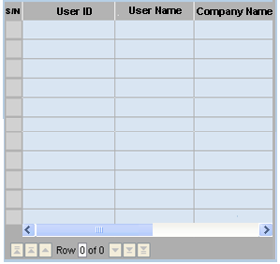
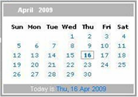
May 5, 2009
Feedback
Content Management Portal
Search Engine…
Home Page
User Admin Manager
Portal Admin Manager
FAP Manager
DAP Manager
CM Portal Admin
Content Manager
Report Manager
Role Manager
Company Registration
User Admin
Welcome Portal Admin: Kelly Mei
CM Portal Administration
>>
You are here: User Admin Manager
Content Category
User Admin Manager
>>Module
Create a new User Administrator
User Admin Lists
>>Exercise
Search by User ID
>>Examination
User ID:
User Name:
Company Name:
Email Address:
User one time password:
User Role:
Module subscribed:
License No. subscribed:
Valid period:
Find
>>Survey
Log Out
Portal Help
>>
Auto Set
>>
Select
>>
Select
100
From
To
Edit
Delete
Clear
Add
Update

Slide 9
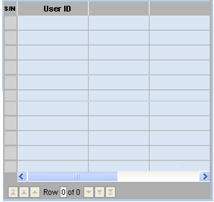
May 5, 2009
Feedback
Content Management Portal
Search Engine…
Home Page
User Admin Manager
Portal Admin Manager
FAP Manager
DAP Manager
CM Portal Admin
Content Manager
Report Manager
Role Manager
Company Registration
User Admin
Welcome Portal Admin: Kelly Mei
CM Portal Administration
>>
You are here: Portal Admin Manager
Content Category
Portal Admin Manager
>>Module
Create a new Portal Administrator
Portal Administrator List
>>Exercise
Search by User ID
>>Examination
User ID:
Employee ID:
Employee Name:
Department:
Date Joined:
Email Address:
User one time password:
Find
>>Survey
Employee ID
Department
Log Out
Portal Help
>>
Auto Set
Clear
Add
Update
Edit
Delete

Slide 10
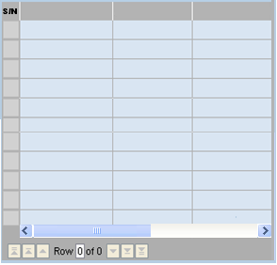
May 5, 2009
Feedback
Content Management Portal
Search Engine…
Home Page
User Admin Manager
Portal Admin Manager
FAP Manager
DAP Manager
CM Portal Admin
Content Manager
Report Manager
Role Manager
Company Registration
User Admin
Welcome Portal Admin: Kelly Mei
CM Portal Administration
>>
You are here: FAP Manager
Content Category
FAP Manager
>>Module
Create a new Functional Access Profile (FAP)
Functional Access Profile (FAP) List
>>Exercise
>>Examination
FAP ID:
Function Name:
Description:
Function List:
Search by FAP ID
>>Survey
Find
Log Out
FAP ID
Function Name
Description
Portal Help
Take Exam
Take Exercise
Print Certification
Take Survey
Clear
Add
Update
Edit
Delete

Slide 11
May 5, 2009
Feedback
Content Management Portal
Search Engine…
Home Page
User Admin Manager
Portal Admin Manager
FAP Manager
DAP Manager
CM Portal Admin
Content Manager
Report Manager
Role Manager
Company Registration
User Admin
Welcome Portal Admin: Kelly Mei
CM Portal Administration
>>
You are here: DAP Manager
Content Category
DAP Manager
>>Module
Create a new Data Access Profile (DAP)
>>Exercise
Data Access Profile (DAP) List
>>Examination
DAP ID:
Module Name:
Description:
Module Data List:
>>Survey
Search by DAP ID
Find
Log Out
Portal Help
DAP ID
Module Name
Description
Module 1
Module 2
Module 3
Module 4
Edit
Delete
Clear
Add
Update

Slide 12
May 5, 2009
Feedback
Content Management Portal
Search Engine…
Home Page
User Admin Manager
Portal Admin Manager
FAP Manager
DAP Manager
CM Portal Admin
Content Manager
Report Manager
Role Manager
Company Registration
User Admin
Welcome Portal Admin: Kelly Mei
CM Portal Administration
>>
You are here: Role Manager
Content Category
Role Manager
>>Module
Create a new Role
User Access Profile (UAP) List
>>Exercise
>>Examination
Role Name:
Description:
FAP:
DAP:
Search by Role Name
>>Survey
Find
Log Out
Role Name
FAP
DAP
Portal Help
>>
Select
>>
Select
Clear
Add
Update
Edit
Delete

Slide 13
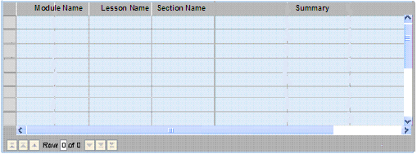
May 5, 2009
Feedback
Content Management Portal
Search Engine…
Home Page
User Admin Manager
Portal Admin Manager
FAP Manager
DAP Manager
CM Portal Admin
Content Manager
Report Manager
Role Manager
Company Registration
User Admin
Welcome Portal Admin: Kelly Mei
CM Portal Administration
>>
You are here: Content Manager
Content Category
Content Manager
>>Module
Create a Lesson
>>Exercise
Module Name:
Category:
Lesson Name:
Section Name:
Section file:
Section Summary:
>>Examination
>>
Browse
>>Survey
Select a Content Category
Select a Content Category……
Log Out
Lesson
MCQ
Portal Help
Survey
Upload
Save
Search by Module Name
Find
Edit
Delete
Publish

Slide 14

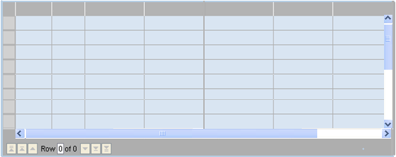
May 5, 2009
Feedback
Content Management Portal
Search Engine…
Home Page
User Admin Manager
Portal Admin Manager
FAP Manager
DAP Manager
CM Portal Admin
Content Manager
Report Manager
Role Manager
Company Registration
User Admin
Welcome Portal Admin: Kelly Mei
CM Portal Administration
>>
You are here: Content Manager
Content Category
Content Manager
>>Module
Create a Question
>>Exercise
Module Name:
Category:
Lesson Name:
Section Name:
Question Difficulty:
Set Question:
Set Answer:
>>Examination
>>Survey
Select a Content Category
Select a Content Category……
A. Enter Answer …
Log Out
Lesson
MCQ
B. Enter Answer …
Portal Help
Survey
C. Enter Answer …
D Enter Answer …
E. Enter Answer …
Hard
Middle
Easy
Upload
Save
Search by Module Name
Find
Module ID
MCQ ID
Module Name
Lesson Name
Section Name
Question
Description
Difficulty
Edit
Delete
Publish

Slide 15
May 5, 2009
Feedback
Content Management Portal
Search Engine…
Home Page
User Admin Manager
Portal Admin Manager
FAP Manager
DAP Manager
CM Portal Admin
Content Manager
Report Manager
Role Manager
Company Registration
User Admin
Welcome Portal Admin: Kelly Mei
CM Portal Administration
>>
You are here: Content Manager
Content Category
Content Manager
>>Module
Create a MCQ
>>Exercise
Pick Questions:
>>Examination
Module Name:
Certificate Name:
Certificate (Image):
Duration:
Passing Marks:
Section
>>Survey
Weight
Log Out
>>
Browse
Simple
Portal Help
Medium
Hard
Upload
Save
Search by Module Name
Find
Module Name
Certificate Name
Duration
Passing Marks
Question Distribution
Edit
Delete
Publish

Slide 16
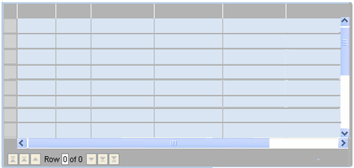
May 5, 2009
Feedback
Content Management Portal
Search Engine…
Home Page
User Admin Manager
Portal Admin Manager
FAP Manager
DAP Manager
CM Portal Admin
Content Manager
Report Manager
Role Manager
Company Registration
User Admin
Welcome Portal Admin: Kelly Mei
CM Portal Administration
>>
You are here: Content Manager
Content Category
Content Manager
>>Module
Create a Survey
>>Exercise
Module Name:
Category:
Survey
Section Name:
Set Survey Questions:
>>Examination
>>Survey
Select a Content Category
Select a Content Category……
Log Out
Lesson
MCQ
Portal Help
Survey
Upload
Save
Search by Module Name
Find
Module
ID
Survey
ID
Module Name
Section Name
Question
Description
Edit
Delete
Publish

Slide 17
May 5, 2009
Feedback
Content Management Portal
Search Engine…
Home Page
User Admin Manager
Portal Admin Manager
FAP Manager
DAP Manager
CM Portal Admin
Content Manager
Report Manager
Role Manager
Company Registration
Welcome Portal Admin: Kelly Mei
User Admin
CM Portal Administration
>>
You are here: Report Manager
Content Category
Report Manager
>>Module
Create or update a report template
>>Exercise
Report Name:
Report Type:
Template:
>>Examination
>>Survey
Select a Report Type
Log Out
>>
Browse
Portal Help
Save
Search by Report Name
Find
Report
ID
Report
Type
Template
Section Name
Question
Description
Delete
Upload
Generate

Slide 18
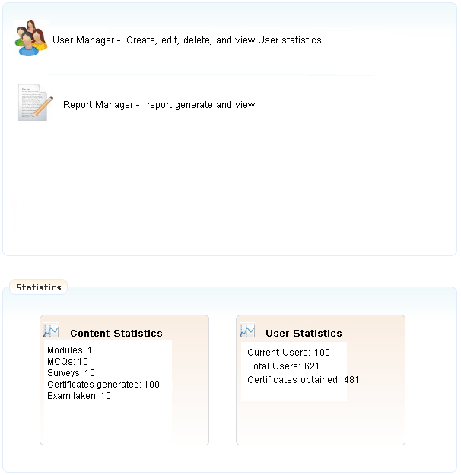
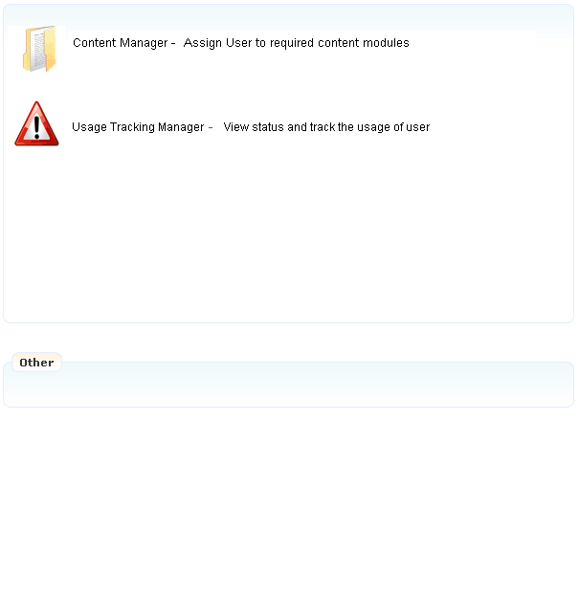
May 5, 2009
Feedback
Content Management Portal
Search Engine…
Home Page
User Manager
Report Manager
CM Portal Admin
Welcome Portal Admin: Kelly Mei
User Admin
User Administration
>>
You are here: User Administration Page
Content Category
User Administration Page
>>Module
>>Exercise
>>Examination
>>Survey
Log Out
Portal Help

Slide 19
May 5, 2009
Feedback
Content Management Portal
Search Engine…
Home Page
User Manager
Report Manager
CM Portal Admin
Welcome Portal Admin: Kelly Mei
User Admin
User Administration
>>
You are here: User Manager
Content Category
User Manager
>>Module
Create or modify a user
>>Exercise
Search by User ID
Find
>>Examination
User ID:
Employee ID:
Employee Name:
Department:
Date Joined:
Email Address:
User one time password:
User Role:
Valid period:
>>Survey
Employee ID
Department
Log Out
Portal Help
>>
Auto Set
>>
Select
From
To
Edit
Delete
Clear
Add

Slide 20
May 5, 2009
Feedback
Content Management Portal
Search Engine…
Home Page
User Manager
Report Manager
CM Portal Admin
Welcome Portal Admin: Kelly Mei
User Admin
User Administration
>>
You are here: Report Manager
Content Category
Report Manager
>>Module
Select a report type to be generated from the list
>>Exercise
Report Type:
Report Name:
>>Examination
Select a Report Type
>>Survey
Log Out
Generate
Save
Portal Help
Search by Report Name
Find
Report
S/N
Date
Type
Report Name
Report Content
Delete
Print

Slide 21

May 5, 2009
Feedback
Content Management Portal
Search Engine…
Home Page
Module
Exercise
Examination
Survey
CM Portal Admin
Welcome Portal Admin: Kelly Mei
User Admin
Content Category
>>
You are here: Module
Content Category
Module Learning
>>Module
>>Exercise
Self-Learning Management:
Save current learning progress
as next log in
Learning progress map
>>Examination
Module 1: MTech Software Project Management
>>Survey
Section 1: Project Planning
Section 2: Project Analysis
Log Out
Section 3: Project Design
Report Generator
Portal Help
Exam Results
Obtain Certification
Module 2: IT Service Management
Module 3: ERP

Slide 22
May 5, 2009
Feedback
Content Management Portal
Search Engine…
Home Page
Module
Exercise
Examination
Survey
CM Portal Admin
Welcome Portal Admin: Kelly Mei
User Admin
Content Category
>>
You are here: Exercise
Content Category
Take Exercise
>>Module
>>Exercise
Self-Learning Management:
Save current learning progress
as next log in
Learning progress map
>>Examination
Module 1: MTech Software Project Management
>>Survey
Section 1: Project Planning
Section 2: Project Analysis
Log Out
Section 3: Project Design
Report Generator
Portal Help
Exam Results
Obtain Certification
Module 2: IT Service Management
Module 3: ERP

Slide 23
May 5, 2009
Feedback
Content Management Portal
Search Engine…
Home Page
Module
Exercise
Examination
Survey
CM Portal Admin
Welcome Portal Admin: Kelly Mei
User Admin
Content Category
>>
You are here: Examination
Content Category
Take Examination
>>Module
>>Exercise
Self-Learning Management:
Save current learning progress
as next log in
Learning progress map
>>Examination
Module 1: MTech Software Project Management
>>Survey
Module 2: IT Service Management
Module 3: ERP
Log Out
Report Generator
Portal Help
Exam Results
Obtain Certification

Slide 24
May 5, 2009
Feedback
Content Management Portal
Search Engine…
Home Page
Module
Exercise
Examination
Survey
CM Portal Admin
Welcome Portal Admin: Kelly Mei
User Admin
Content Category
>>
You are here: Examination
Content Category
Take Examination
>>Module
>>Exercise
Examination: Module 1: MTech Software Project Management
Self-Learning Management:
Save current learning progress
as next log in
Learning progress map
>>Examination
>>Survey
Question 1:
A) ..
B) …
C)…
D)…
Log Out
Report Generator
Portal Help
Exam Results
Obtain Certification
Question 2:
Continue
Back
Next
Submit

Slide 25
May 5, 2009
Feedback
Content Management Portal
Search Engine…
Home Page
Module
Exercise
Examination
Survey
CM Portal Admin
Welcome Portal Admin: Kelly Mei
User Admin
Content Category
>>
You are here: Survey
Content Category
Take Survey
>>Module
>>Exercise
Select a report type to be generated from the list
Self-Learning Management:
Save current learning progress
as next log in
Learning progress map
>>Examination
>>Survey
Survey Type:
Select a Survey
Log Out
Report Generator
Portal Help
Continue
Exam Results
Obtain Certification

Slide 26
May 5, 2009
Feedback
Content Management Portal
Search Engine…
Home Page
Module
Exercise
Examination
Survey
CM Portal Admin
Welcome Portal Admin: Kelly Mei
User Admin
Content Category
>>
You are here: Survey
Content Category
Take Survey
>>Module
>>Exercise
Survey Paper Once : Survey on Module ONE
Self-Learning Management:
Save current learning progress
as next log in
Learning progress map
>>Examination
>>Survey
Question 1:
A) ..
B) …
C)…
D)…
Log Out
Portal Help
Question 2:
Continue
Back
Next
Submit

Slide 27

May 5, 2009
Feedback
Content Management Portal
Search Engine…
Home Page
Module
Exercise
Examination
Survey
CM Portal Admin
Welcome Portal Admin: Kelly Mei
User Admin
Content Category
>>
You are here: Survey
Content Category
Take Survey
>>Module
>>Exercise
Survey Paper Once : Survey Name
Self-Learning Management:
Save current learning progress
as next log in
Learning progress map
>>Examination
>>Survey
Question 1:
A) ..
B) …
C)…
D)…
Log Out
Report Generator
Portal Help
Exam Results
Are you confirmed to log out the system?
Obtain Certification
Question 2:
Continue
Back
Next
Submit

Slide 28
Welcome to
User ID
Password
Log In
Forgot your Username or Password?
Content Management Portal
Register
If you don't have an account, create one so that you can begin using all of the customization features of this site.
Register Now!

