Slide 1
Content Management Portal
Second Project Presentation
Team SE16 – 7S
20 August, 2009

Slide 2
Agenda
Project Retrospect
Technical Review
  Use Case Model Survey
  Use Case Analysis
  Transition Strategy
  Software Architecture
Project Management Update
  Project Status
  Main Challenges
  Plans for Implementation Phase
  Expected Implementation Issues
  Plan for next phase

Slide 3
Project Retrospect - Background
Sponsor: Index Info Systems Pte Ltd
Web-based Application
Provide online learning platform to subscribed members
Host training materials

Slide 4
Project Retrospect – Core Modules
Content Management System (CMS)
A platform for hosting training materials
Administration Control System (ACS)
User Management and Access Control
Multiple Choice Question (MCQ)
Generate multiple choice questions as well as surveys

Slide 5
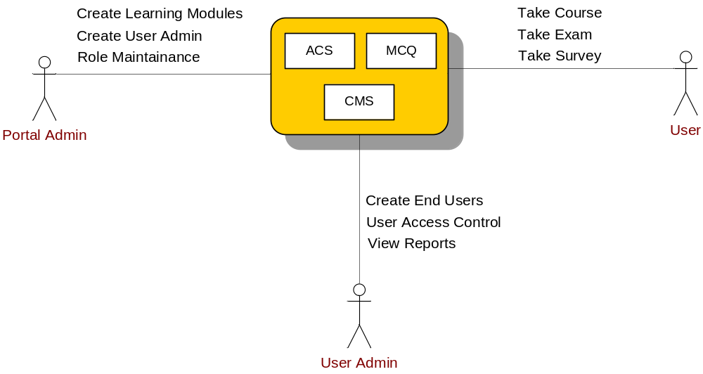
Project Retrospect – Actors
Notes:
User admin can distribute the modules among the user, and will assign the roles to user.

Slide 6
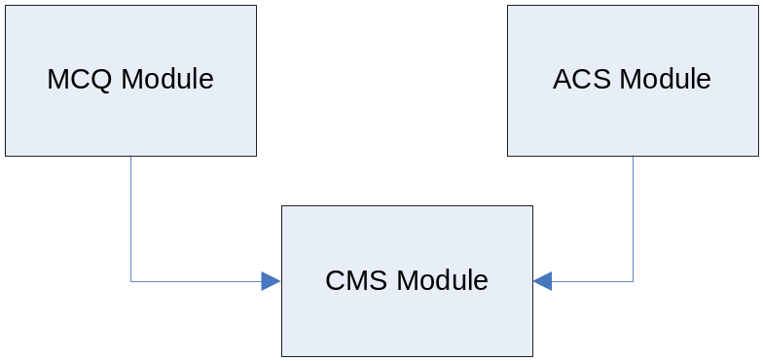
Progress Achieved from 1st Audit
Comments from Auditors:
Project scope is too big, with 3 modules to be developed.
Our progress:
Leverage on open-source CMS module (JMD CMS)
Integrate with ACS, MCQ modules
Revise Use Case Realization Reports
Re-define strategy
Notes:
Just say the project plan is big hard to achieve. We customize the open-source

Slide 7
Technical Review
Use Case Model Survey
Global View

Slide 8
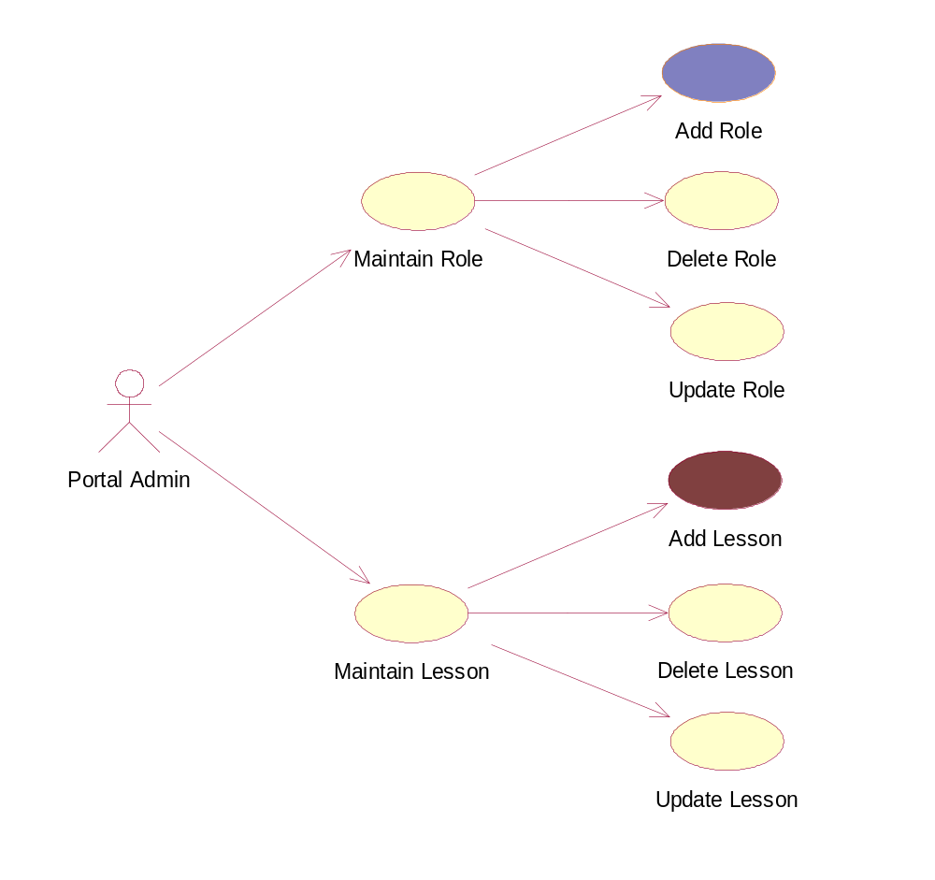
Technical Review – Use Case Analysis
Notes:
One from acs, to show how to control the system, and how to integrate.

Slide 9
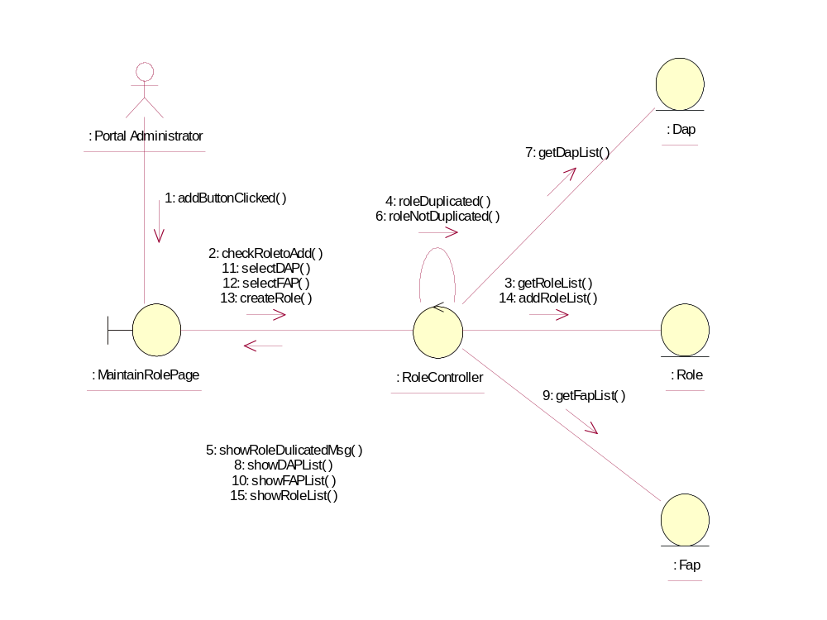
Technical Review – Use Case Analysis
Add Role

Slide 10
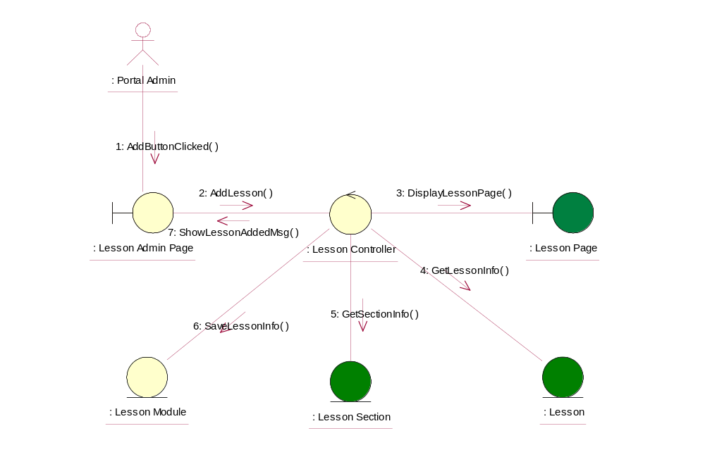
Technical Review – Use Case Analysis
Add Lesson
Notes:
Add one more slide to Open Souce.

Slide 11
JMDCMS Introduction
Introduction
A Free Open Source
Written in ASP.net and C# with SQL Server as database
Easy installation
Create & Maintain content
Create & Maintain file manager
Gaps
No functionality to upload the content, PDF, XLS, Video files
No functionality to calculate the % of content read by user

Slide 12
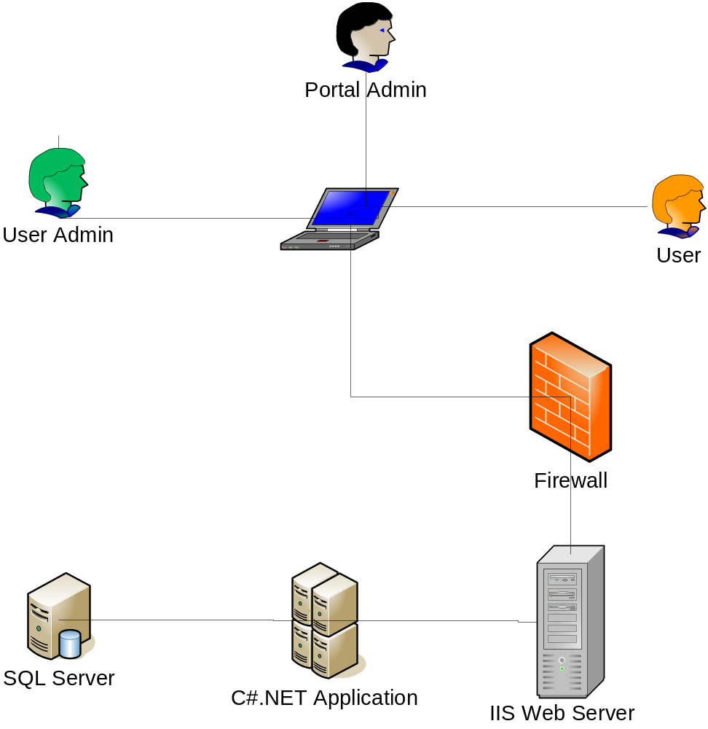
System Architecture

Slide 13
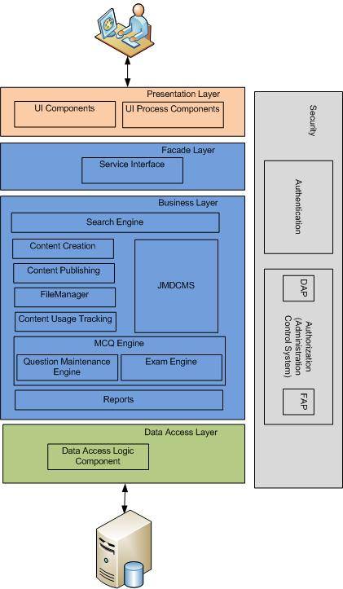
Application
Architecture

Slide 14
Prototype Study
2 sets of prototypes were developed:
Mock up prototype (UI design)
  Make sure the customer’s requirements were well understood
  Get Customer feedback.
Workable prototype (core module)
  Verify the technique feasibility
  Customer’s acknowledgement

Slide 15





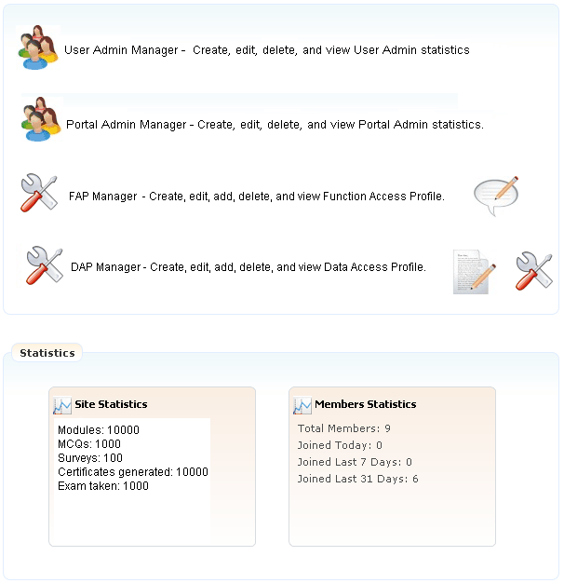
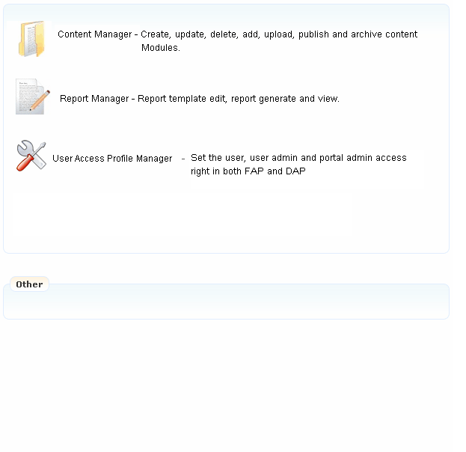

May 5, 2009
Feedback
Content Management Portal
Search Engine…
Home Page
User Admin Manager
Portal Admin Manager
FAP Manager
DAP Manager
CM Portal Admin
Content Manager
Report Manager
Role Manager
User Admin
Welcome Portal Admin: Kelly Mei
CM Portal Administration
>>
You are here: CM Portal Administration Page
Content Category
CM Portal Administration Page
>>Module
>>Exercise
>>Examination
>>Survey
Log Out
Role
Portal Help
Company Registration – Register company information before create user admin.

Slide 16
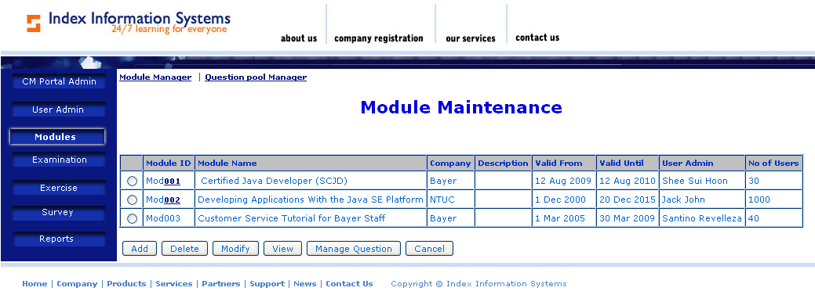
Working Prototype

Slide 17
What we learned from prototype study
Successfully incorporated and customized Open-source JMDCMS according to URS.
Performance of uploading content.
Supporting various media types.

Slide 18
Transition Strategy
Boundary Object will be converted into aspx page
Controller will become classes in Business Layer
Configurations will be stored in web.config file.
Data Objects will be converted into dataset.

Slide 19
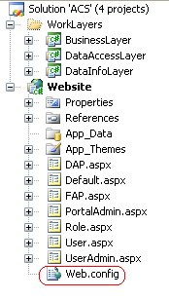
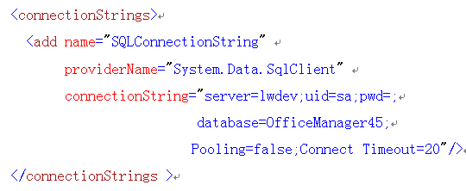
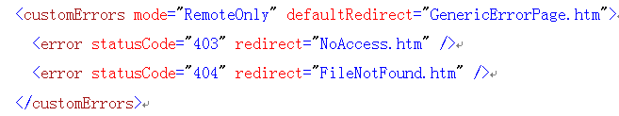
Web.config

Slide 20
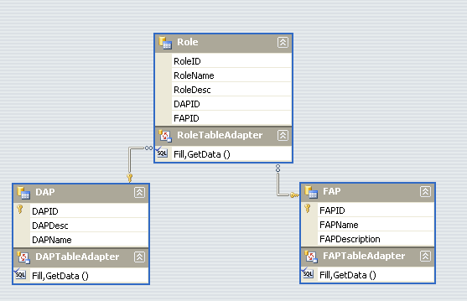
Dataset

Slide 21
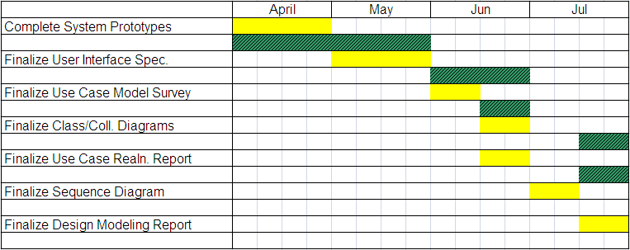
Overall Project Status
Plan
Actual
Project Deviation: 1 month
Contingency Plan
Use buffer time
Extend from 13-Dec-09 to 10-Jan-10
Notes:
Put original plan, lengend.

Slide 22
Plans for Implementation Phase
Milestone | Start Date | End Date | Deliverables
Design Modeling | 10-Aug-09 | 10-Sep-09 | Detailed Design Spec
Coding | 10-Sep-09 | 15-Nov-09 | Executable Code
Unit & Integration Testing | 20-Sep-09 | 30-Nov-09 | Test Documentation
UAT | 30-Nov-09 | 30-Dec-09 | User Guide
Sign-off | 30-Dec-09 | 10-Jan-10 | End of Project Report
Notes:
One more column as deliverables in documents.

Slide 23
Problems & Issues
Management Problems
Team member commitment
Solution:
close monitoring
teamwork and collaboration
Expected Implementation Issues
Performance
Solution:
stress testing in project plan

Slide 24


Slide 25
Updated Project Plan
 |  |  | Original | Updated
ACTIVITY 5: |  | DESIGN MODELING
5.1 | Finalize Sequence Diagrams |  | 19/07/2009 | 30/08/2009
5.2 | Finalize Design Modeling Report |  | 31/07/2009 | 10/09/2009
ACTIVITY 6: |  | SOFTWARE DEVELOPMENT
6.1 | Complete coding |  | 22/09/2009 | 30/10/2009
6.2 | Complete bug-fixing and enhancements |  | 12/10/2009 | 15/11/2009
ACTIVITY 7: |  | SYSTEM TEST
7.1 | Finalize System Test Plan |  | 14/08/2009 | 30/08/2009
7.2 | Complete System Test |  | 17/10/2009 | 30/11/2009
ACTIVITY 8 |  | USER ACCEPTANCE TEST
8.1 | Finalize UAT Plan |  | 20/10/2009 | 30/11/2009
8.2 | Complete UAT |  | 29/11/2009 | 15/12/2009
8.3 | Complete Enhancements |  | 13/12/2009 | 30/12/2009
ACTIVITY 9 |  | SIGN OFF
9.1 | Get User Sign Off |  | 13/12/2009 | 10/01/2010

Slide 26
Updated Project Plan
 |  |  | Original | Updated
ACTIVITY 5: |  | DESIGN MODELING
5.1 | Finalize Sequence Diagrams |  | 30/08/2009 | 30/08/2009
5.2 | Finalize Design Modeling Report |  | 10/09/2009 | 10/09/2009
ACTIVITY 6: |  | SOFTWARE DEVELOPMENT
6.1 | Complete coding |  | 30/10/2009 | 30/10/2009
6.2 | Complete bug-fixing and enhancements |  | 15/11/2009 | 15/11/2009
ACTIVITY 7: |  | SYSTEM TEST
7.1 | Finalize System Test Plan |  | 30/08/2009 | 30/08/2009
7.2 | Complete System Test |  | 30/11/2009 | 10/01/2010
ACTIVITY 8 |  | USER ACCEPTANCE TEST
8.1 | Finalize UAT Plan |  | 30/11/2009 | 10/01/2010
8.2 | Complete UAT |  | 15/12/2009 | 15/01/2010
8.3 | Complete Enhancements |  | 30/12/2009 | 20/01/2010
ACTIVITY 9 |  | SIGN OFF
9.1 | Get User Sign Off |  | 10/01/2010 | 30/01/2010

